Slide 1
What’s New VRG Controls
Ver 030720 - REDLINE

Slide 2
New Look – Revamped Image

Slide 3
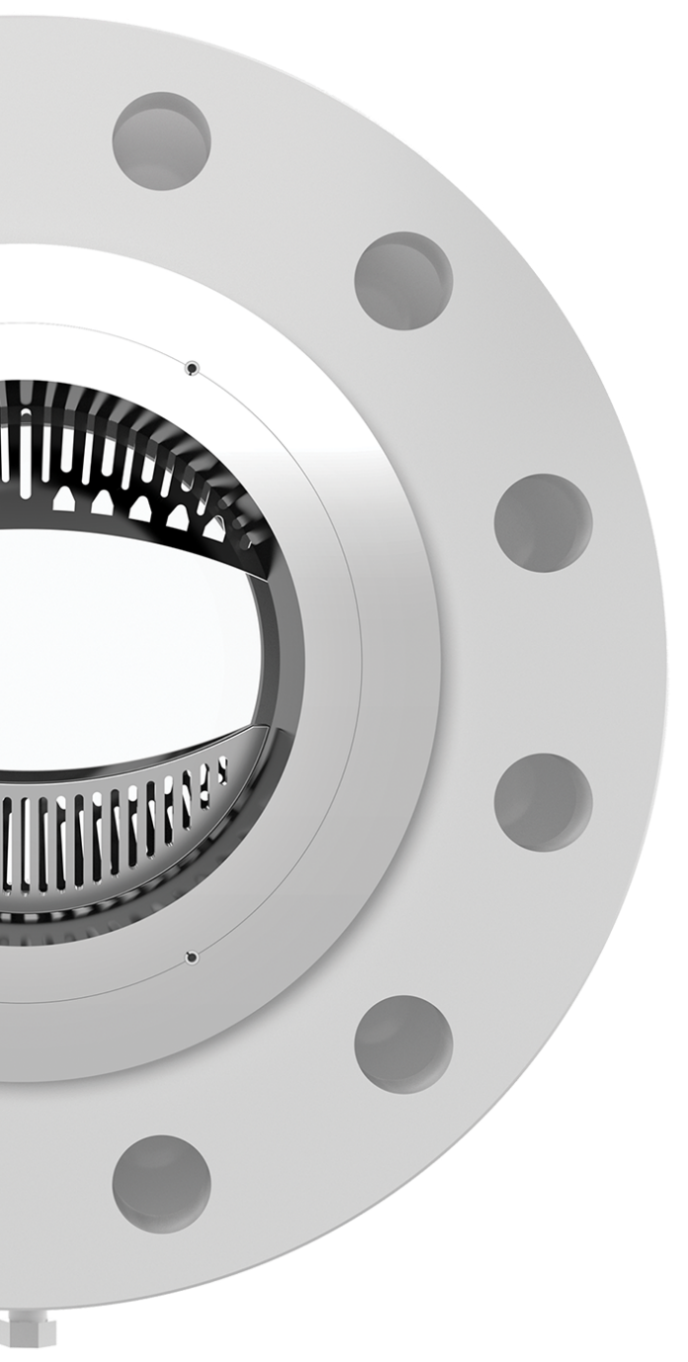
VRG Controls - A “Market Leader” in Eight Years
8
Years

Slide 4
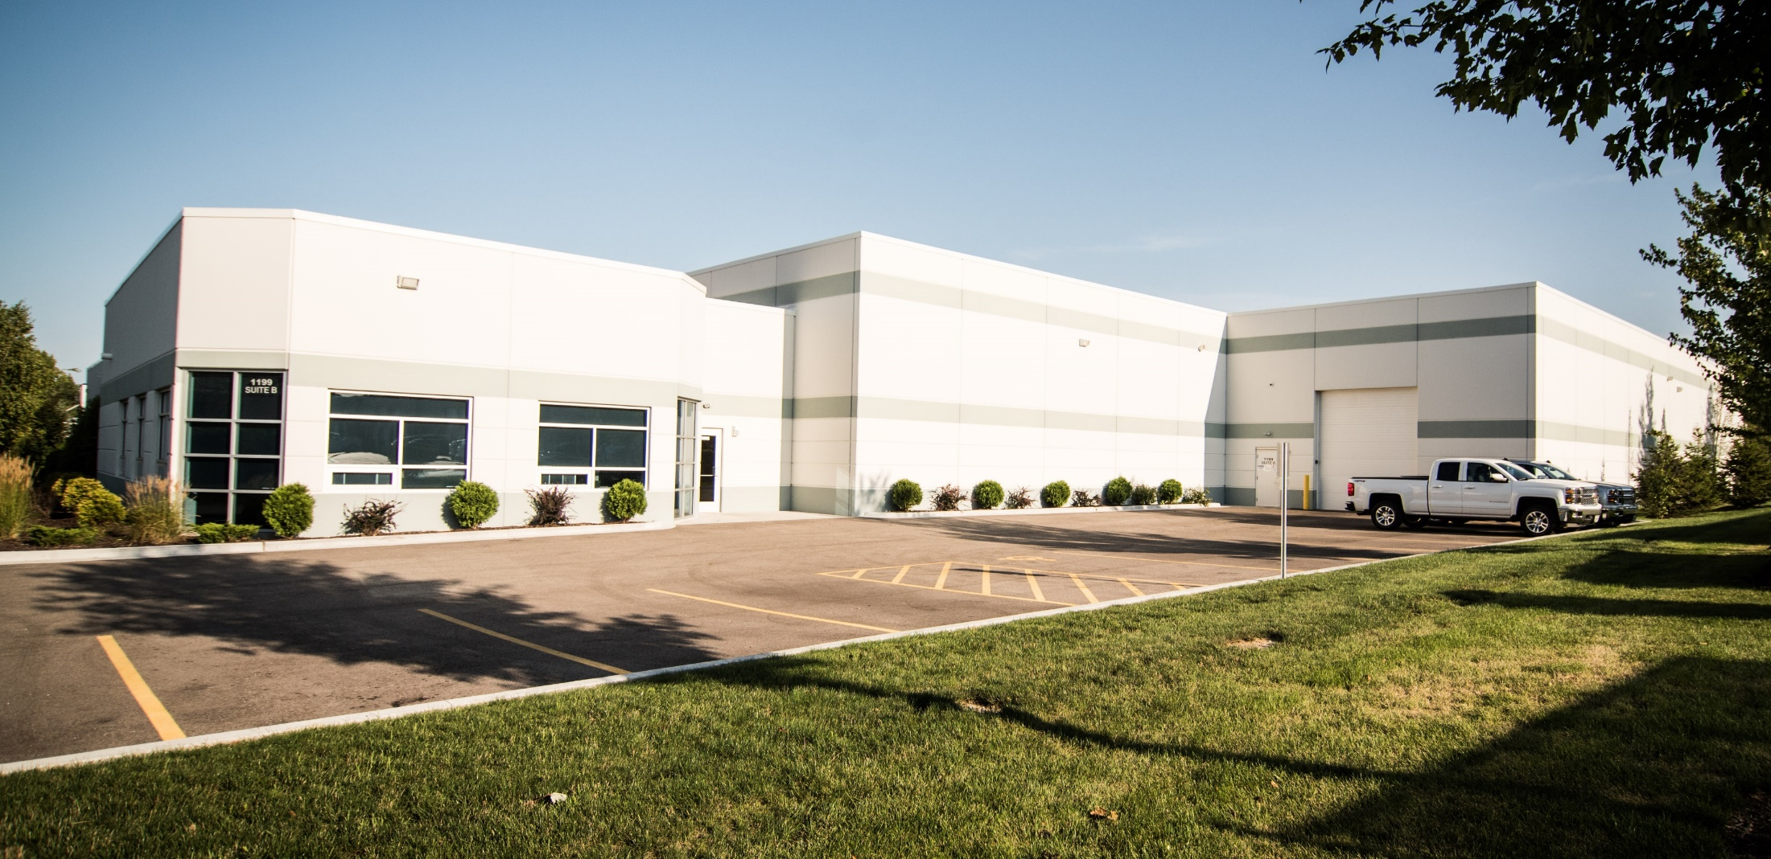
New Facilities - 28,000 ft² Manufacturing – Chicago Metro Area

Slide 5
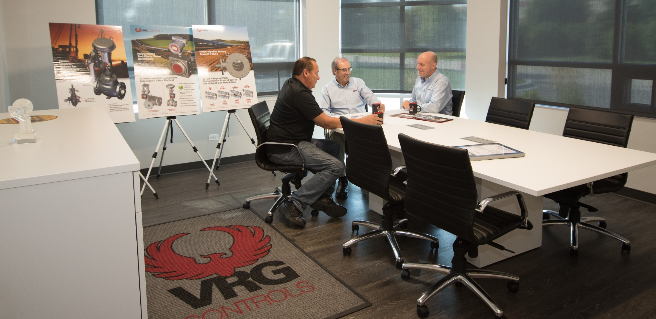
28,000 ft² Manufacturing – Chicago Metro Area
Lake Zurich, Illinois USA

Slide 6
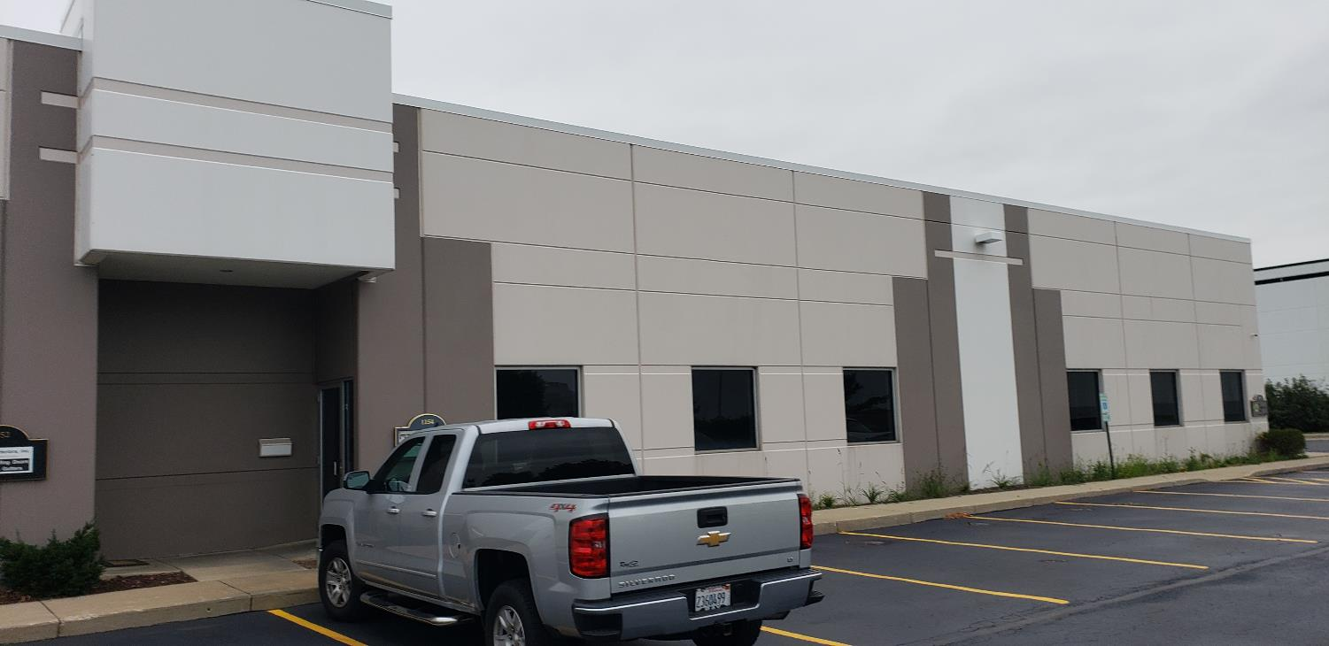
New Facilities – Inventory and Product Staging 6,000 ft²
Lake Zurich, Illinois USA

Slide 7
New Facilities – Product Training Available
Lake Zurich, Illinois USA

Slide 8
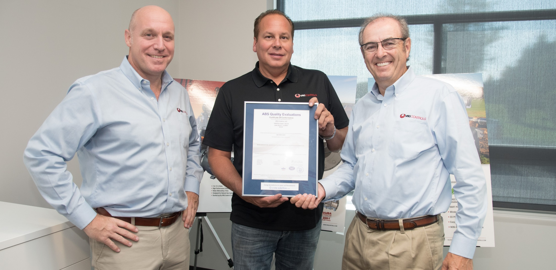
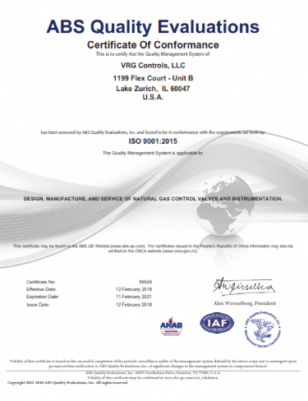
ISO 9001:2015 Accredited

Slide 9
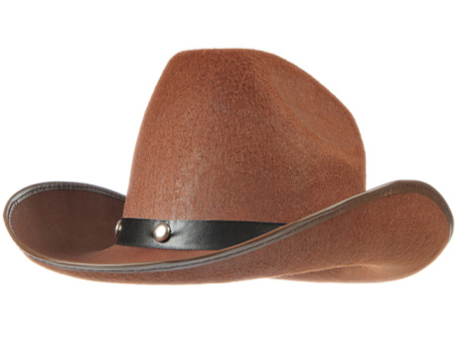
New Houston office – Experienced Pipeline Controls Engineer
This Photo by Unknown Author is licensed under CC BY-NC

Slide 10
Our Customers – Across the USA
Installations in All 50 USA States Except:
Alaska | Hawaii | Idaho | South Dakota

Slide 11
ATEX & PED European Certification Achieved
Pressure Equipment Directive (PED) 2014/68/EU - Compliancy
ATEX Dir. 94/9/EC Explosive Atmospheres - Compliancy

Slide 12
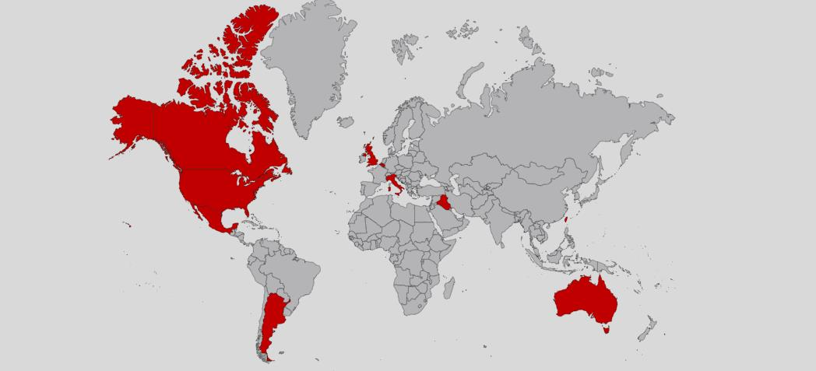
Our Customers – Around the World
Installations in the Following Countries:
United States USA | US Virgin Islands | Belgium | Australia
Canada | United Kingdom UK | Iraq | New Zealand
Mexico | Italy | Taiwan
Chile | Peru | Argentina

Slide 13
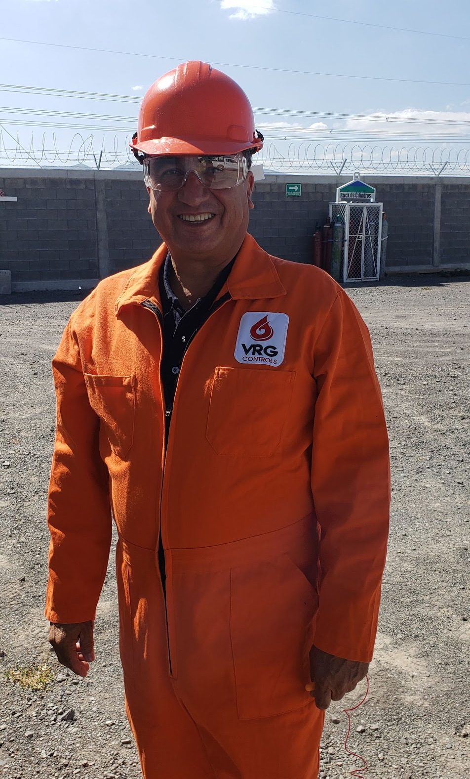
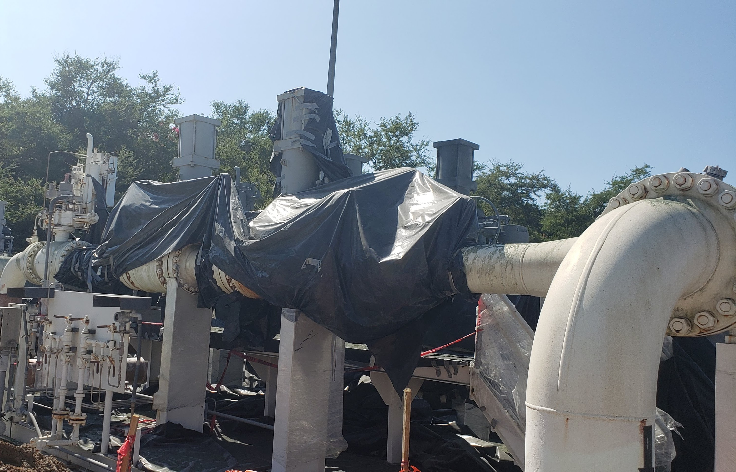
Sales & Field Service Support - Mexico

Slide 14
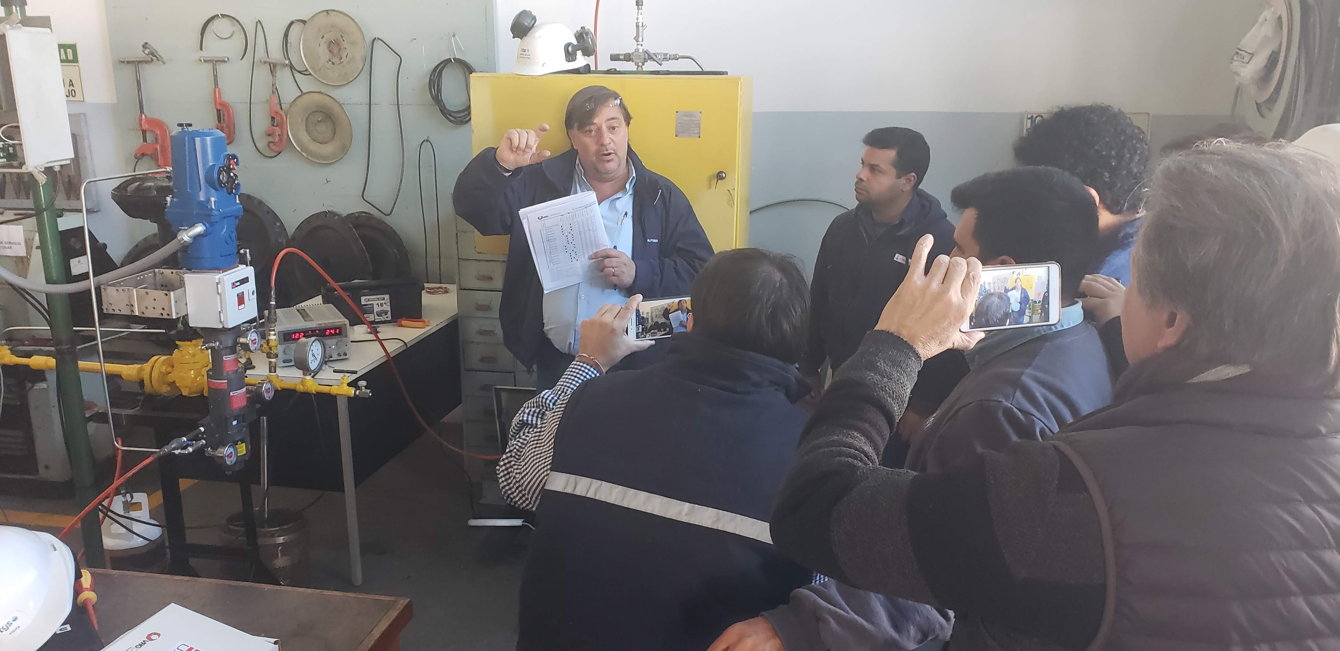
Sales & Field Service Support – Argentina, Chile, Peru

Slide 15
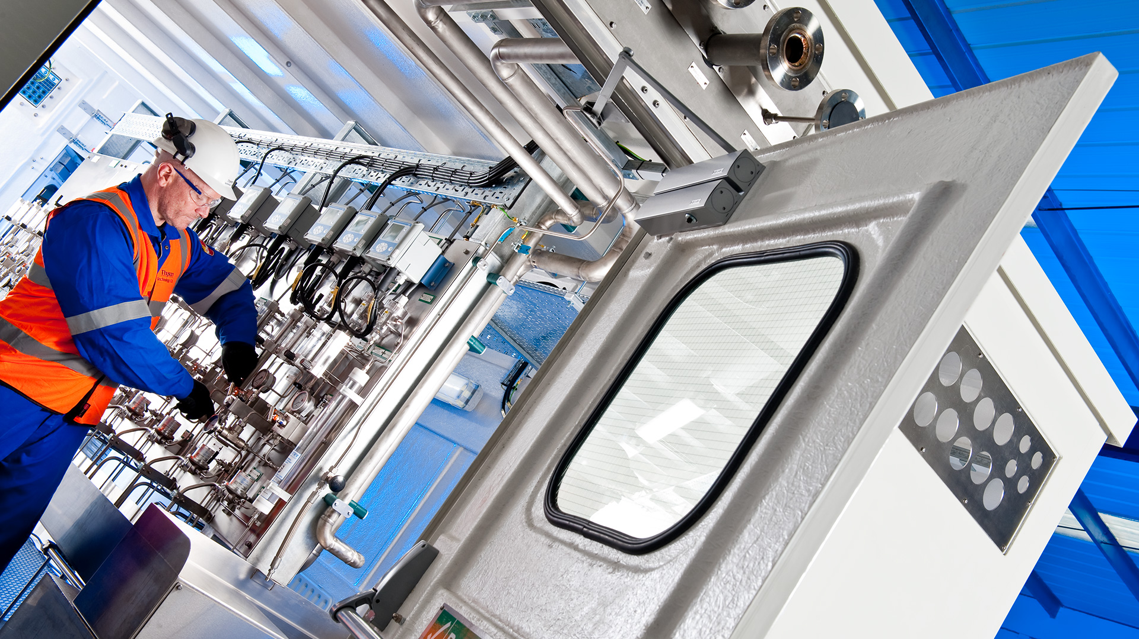
Sales & Field Service Support – United Kingdom

Slide 16
RCVC – New More Stable USB Connection – In Testing
New USB to RS485 Converter – IN TESTING
More Stable Connection Avoid Comm Faults
Transmission distance up to 1000 meters.
Main Chip CP2102(SILICON LABS) ,Industrial chip, high quality, super stable
The Lead PINS include: A +, B-, GND, GND,5V0
Industrial Product with 15KV ESD Protection and TVS Overvoltage Protection
Supports Windows 2000, XP, Vista, Window 7,8,10, Mac OS 9, Mac OS X & Linux.

Slide 17
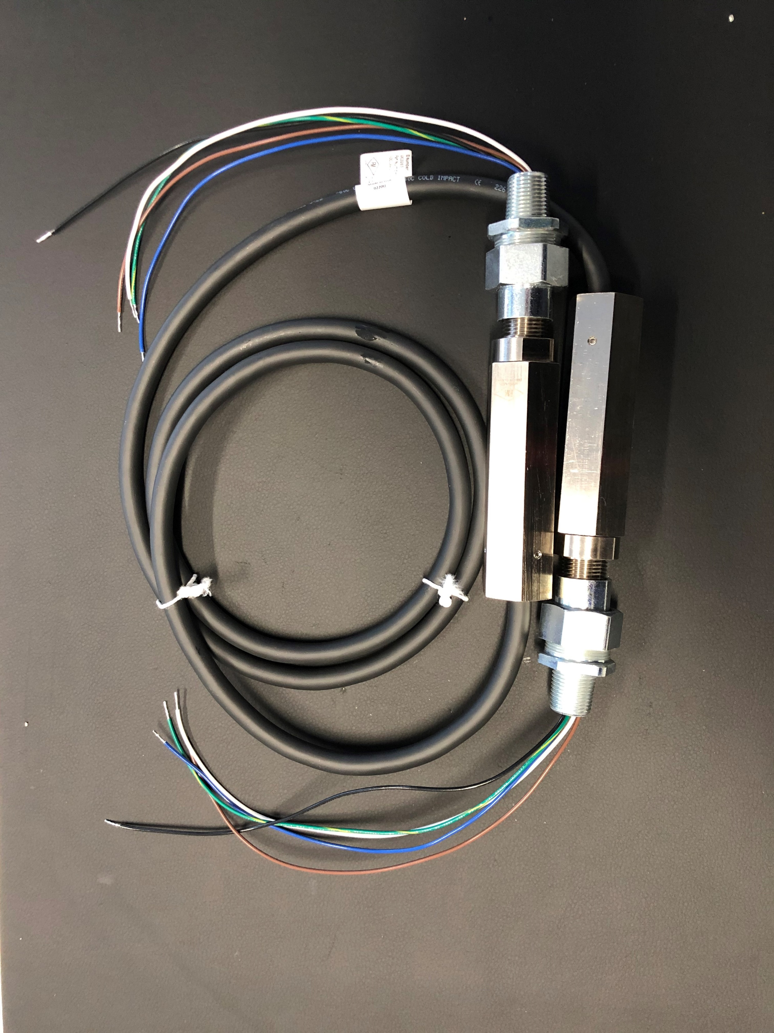
RCVC – New Flexible Cable for Electrical Connections
Class 1 Div. 1 Explosion Proof
One Size Fits All Electrical Cable
Connect RCVC to Solenoid(s)
Connect RCVC to Balluff Transmitter
Eliminates Rigid Ex Proof Conduit
Efficient and Clean Installation
Perfect for Retrofit Installations

Slide 18
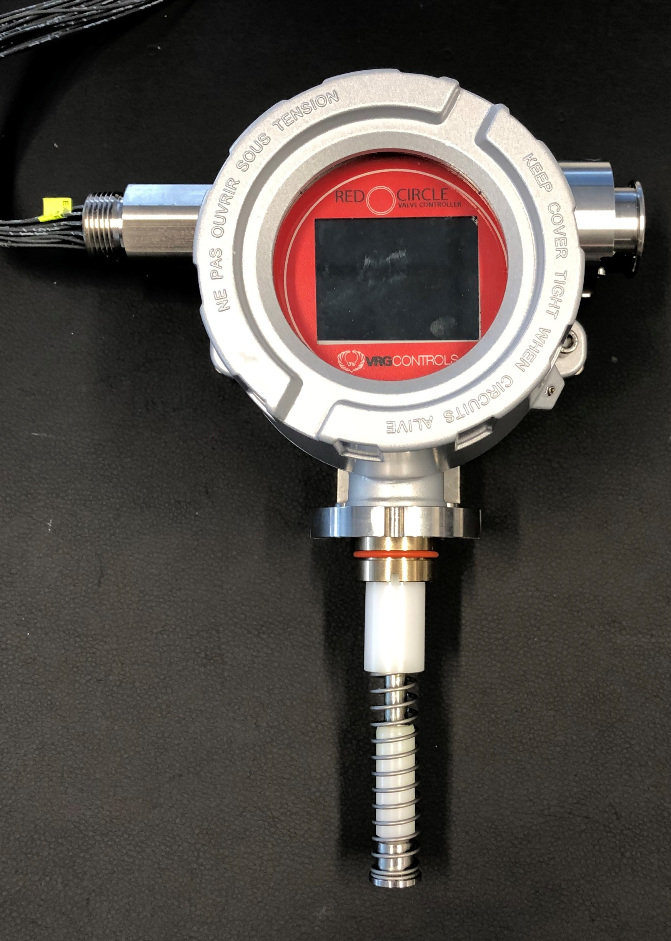
RCVC – New Onboard Transmitter – Linear Type
Eliminates Need for External Transmitter – Balluff, etc…
Eliminates Extra Electrical Connections
Minimize Costs
Ideal for Short Stroke CV Series Linear Control Valves
Facilitate Auto Calibration and Troubleshooting
In Development for All VRG Control Valves
Not Ready for Release
2 in Stroke Max

Slide 19
RCVC – New Onboard Transmitter – Quarter Turn Rotary Type
Eliminates Need for External Transmitter – Balluff, etc…
Eliminates Extra Electrical Connections
Minimize Costs
Ideal for Rotary Control Valves
Universal NAMUR Adaptation
Facilitate Auto Calibration and Troubleshooting
In Development for All VRG Control Valves
Display Orientation Challenged
Not Ready for Release

Slide 20
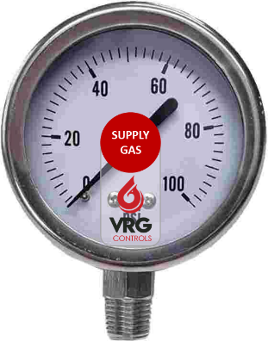
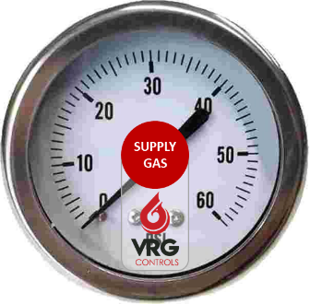
New Vibration Resistant Gages – Non-Liquid Filled
No Liquid Fill
Resistant to Vibration and Cycling
Rugged Design for Pipeline Installations
Stainless Steel Construction - NO BRASS
Available Center Back Mount (CBM) & Bottom Mount (BM)
Improved Gage Labels Avoid Discoloration and Provide Greater Durability
Gages Can Now Be Re-Labeled
0-60 psig
0-100 psig
0-200 psig
0-300 psig
0-600 psig
0-1000 psig
0-2000 psig
Bottom Mount
(BM)
Center Back Mount
(CBM)

Slide 21
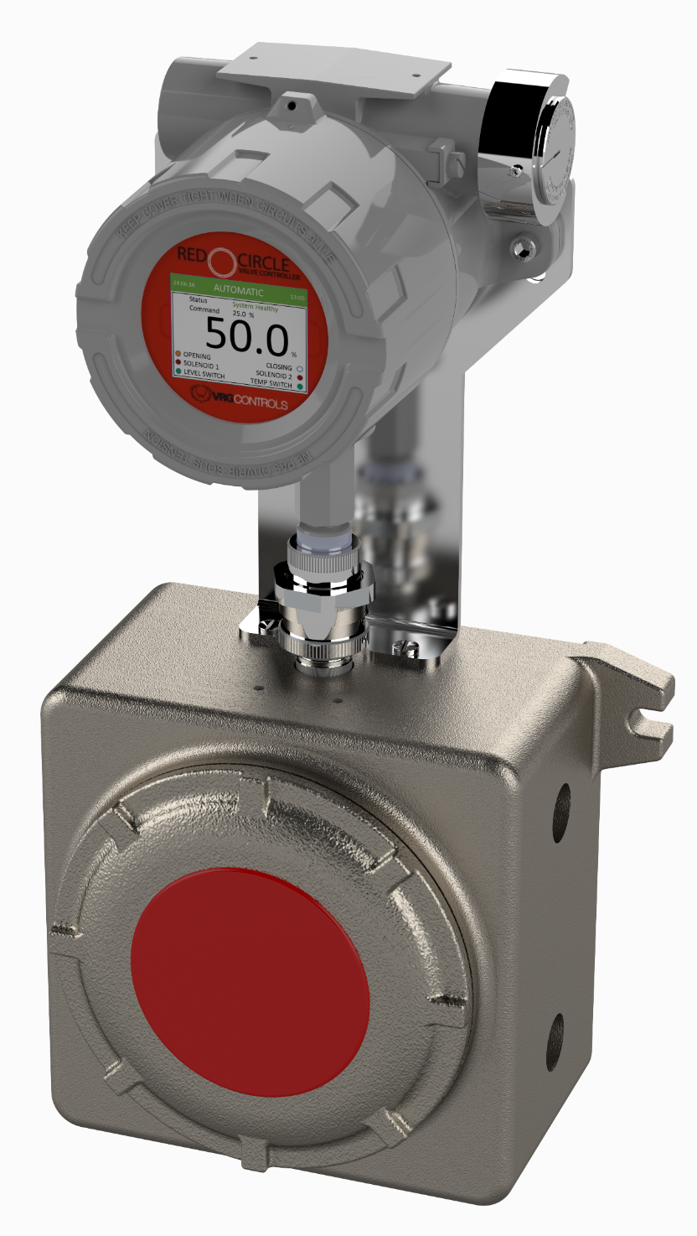
Solidworks Visualize System Implemented
Leverage 3D CAD Data to Create
Photo-Quality Content
Lifelike Images
Animations
Interactive Web Content
Immersive Virtual

Slide 22
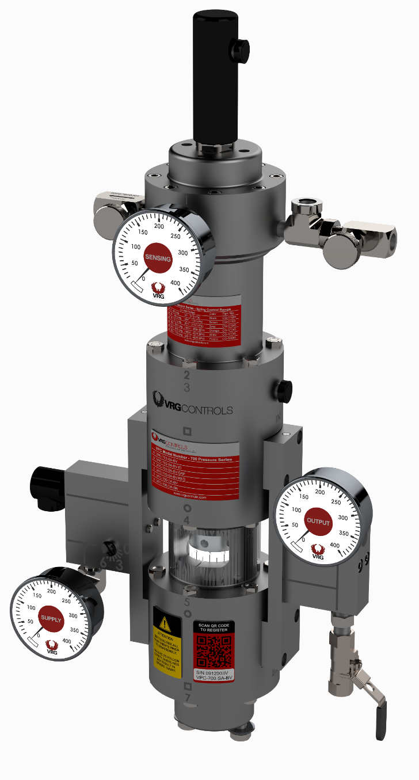
VPC Valve Pilot Controllers
Non-Venting Pneumatic Pressure Controllers
PED & ATEX Certified
Corrosion Resistant Design
Global Sales

Slide 23
PSE&G Replacing All Becker VRP Pilots
PSE&G Public Service Electric & Gas Corporate Decision to Remove & Replace All Becker VRP Pilots Regardless of Age
Installed Base VRP 300-400 Units
Chronic Failures of Becker VRP’s
Desired Uniformity of Installations
VRG Provides Improved…
Service
Accuracy
Reliability
Peoples Gas Chicago Replaced All Becker VRP’s Circa 2015 (130 Units)

Slide 24
RCVC Red Circle Valve Controller
4-20 mA Valve Positioning
ZERO Steady State Emissions
Local or Remote Installations
Designed for Natural Gas
Packed with Features

Slide 25
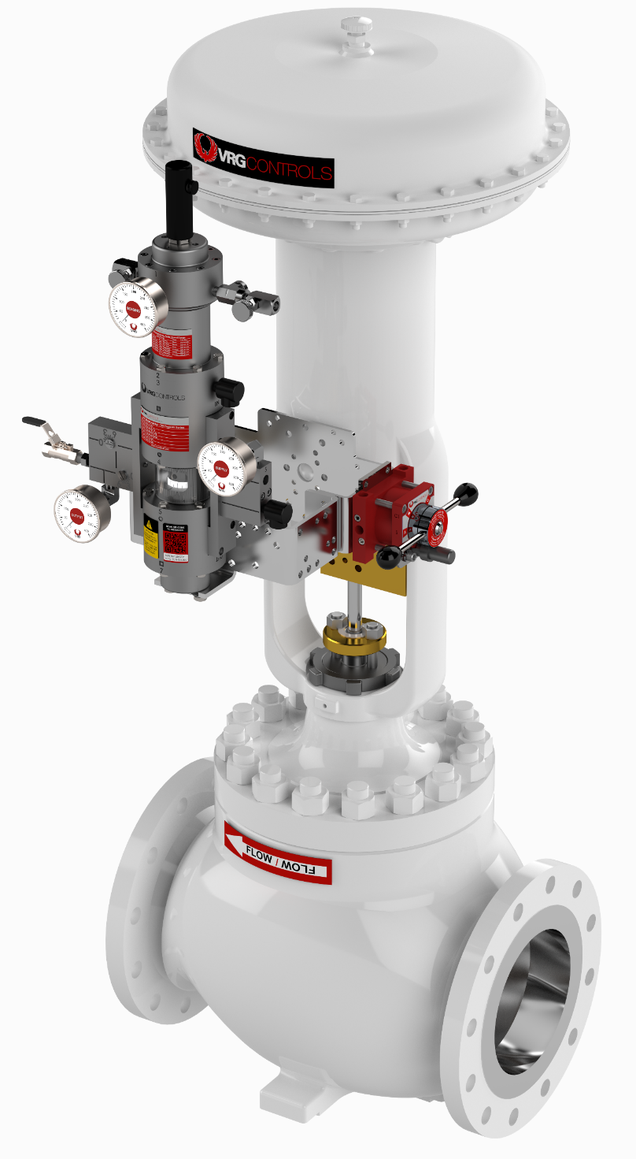
Globe Control Valves – Size 1.0 to 12 in Bore
Sizes 1.0 in to 16 in Bore
Noise Attenuating Trims
Larger 16 in Bore Now Available

Slide 26
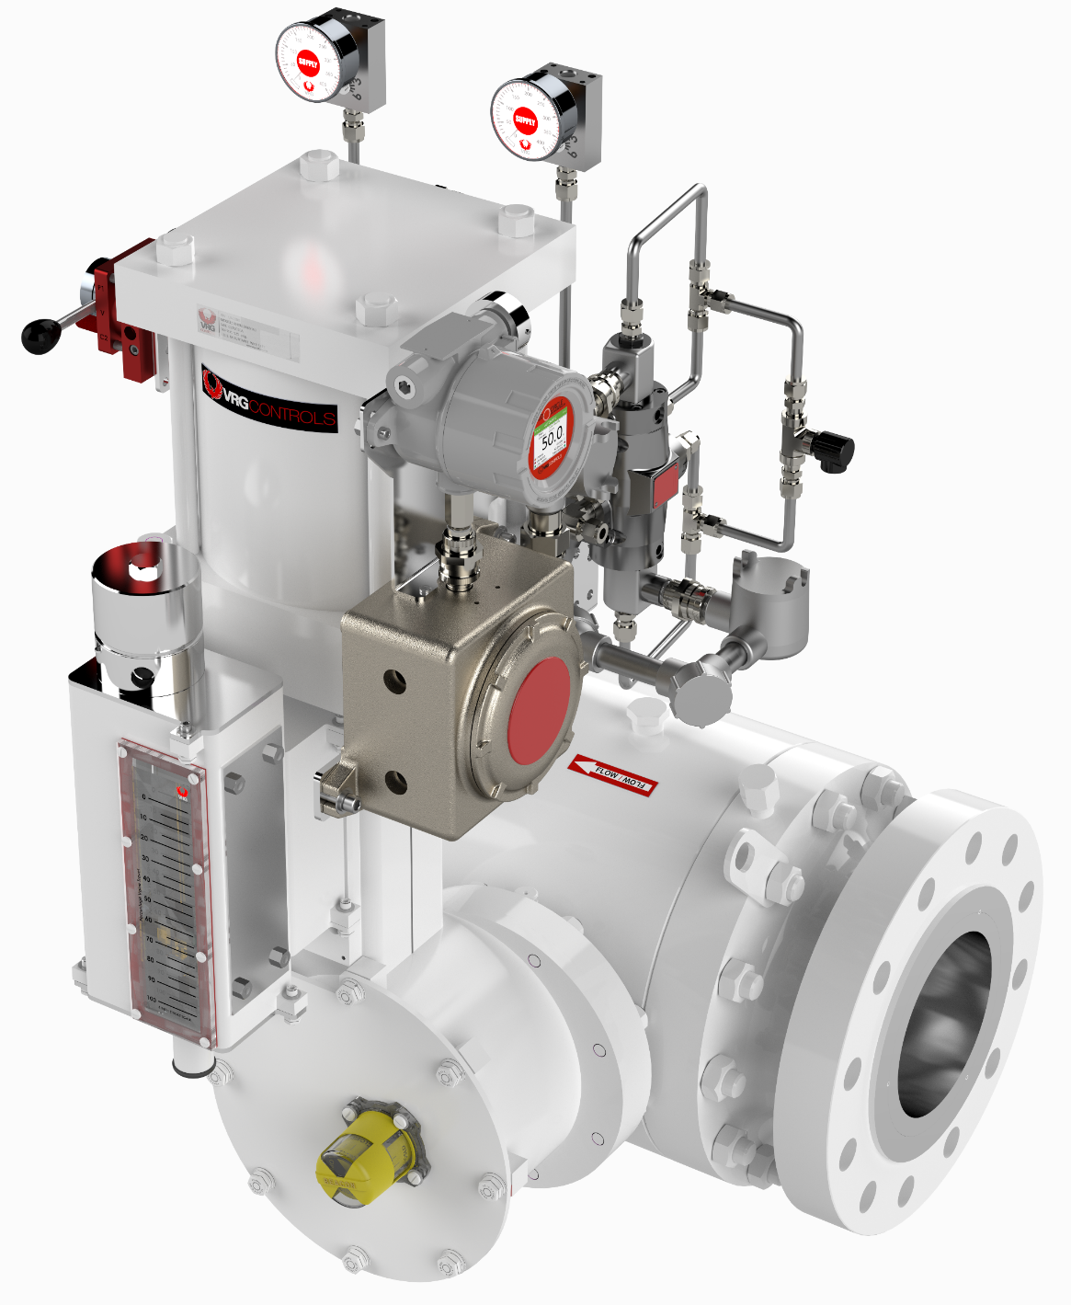
PRCV Pipeline Rotary Control Valves
Sizes 2.0 in to 42 in Bore
NEW 4.0 in PRCV-STHP Size
High Performance Control Trims
Below Ground Design Available

Slide 27
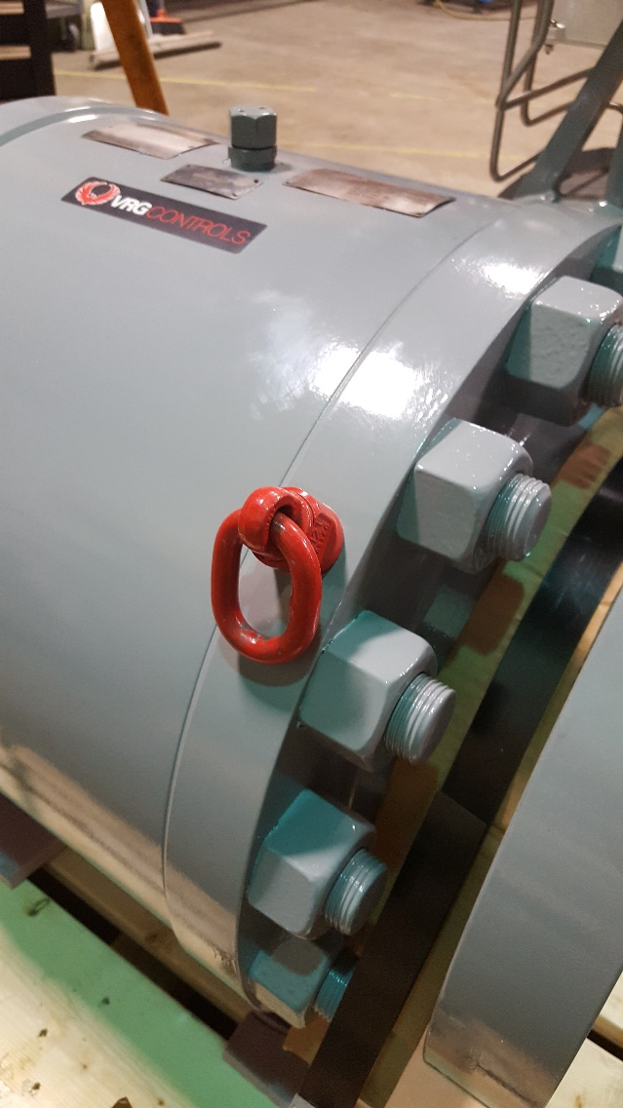
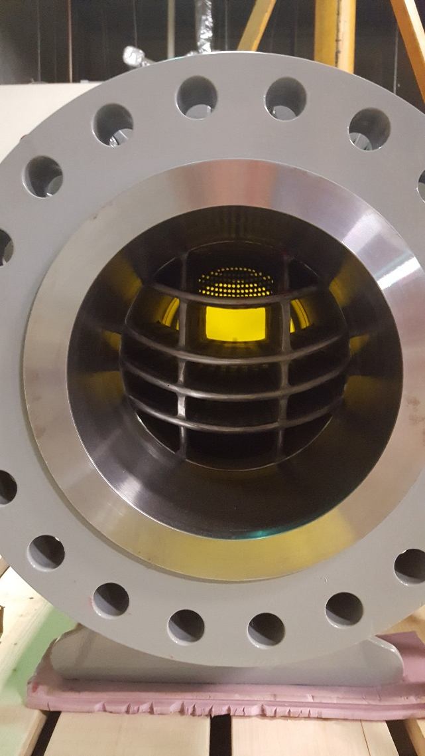
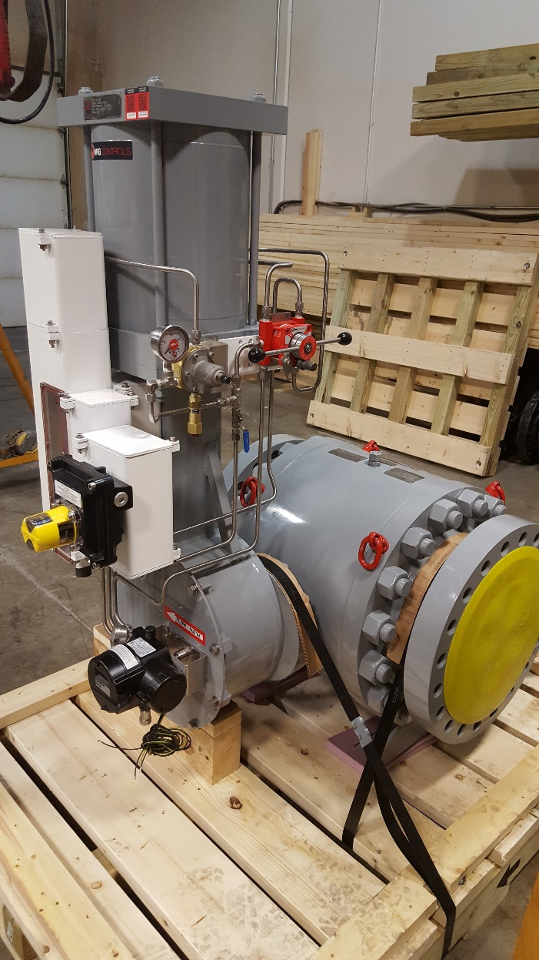
New PRCV-STHP – Ultimate PRCV Performance

Slide 28
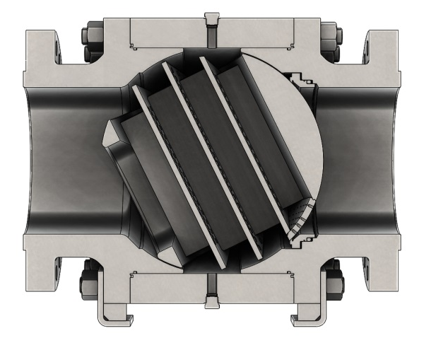
New PRCV-STHP – Ultimate PRCV Performance

Slide 29
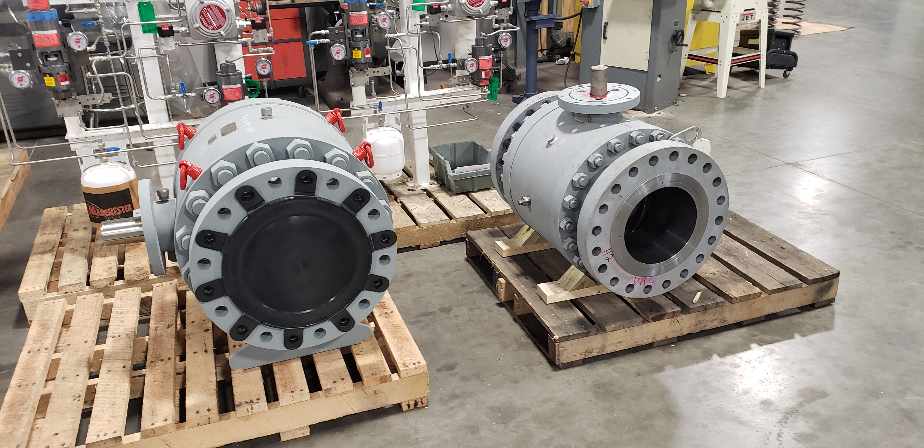
New VP Series – Bigger, Bolder Design
55platform
VPplatform
12 in 600 ANSI RFFE
ASME B16.34 Design
PRCV Body
Valpres VP Platform
12 in 600 ANSI RFFE
API 6D Design
PRCV Body
Grove B5 Platform
Delta / Valvitalia 55 Platform

Slide 30
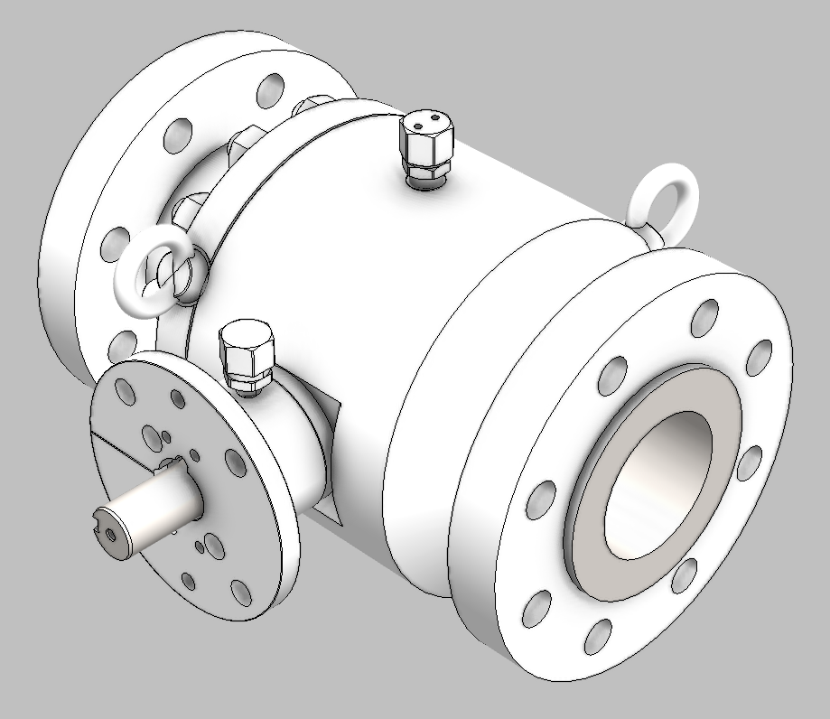
New VP Series – Top Quality Performance at Competitive Price
Offered at Comparable Price to Type 55 and Type B5 Platforms
Packed with High Performance Features
360 Lifting Eyes Standard
High Performance 17-4PH
Stainless Steel Stem
High Performance 17-4PH
Stainless Steel Stem
100% Quality Italian Forgings
100% USA and Italian Content

Slide 31
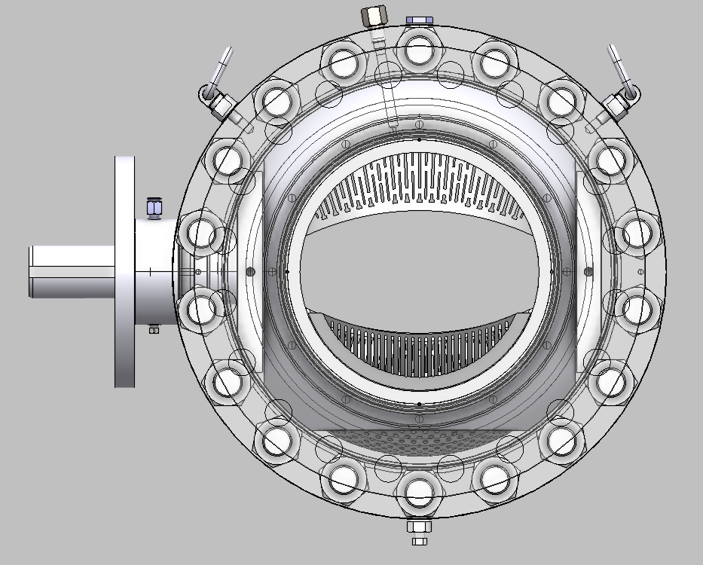
New VP Series – Top Quality Performance at Competitive Price
Dual Body Blowdown
for Flexible Installation
Upstream / Downstream
Seat Lube Fittings
360 Lifting Eyes Standard
Proven Seat Design
Captured Viton O-Ring
Seat Seal w Metal Seat Ring
High Performance 17-4PH
Stainless Steel Stem
ASME B16.34 Design
Heavy Duty Body
Full API 6FA Firesafe Design
All Seals
AVAILABLE TRIMS
PRCV-FP
PRCV-STH1
PRCV-STH2
PRCV-STHP
100% Quality Italian Forgings
100% USA and Italian Content
Dual Stem Ports for
Lubrication and Flush
Dual Body Blowdown
for Flexible Installation

Slide 32
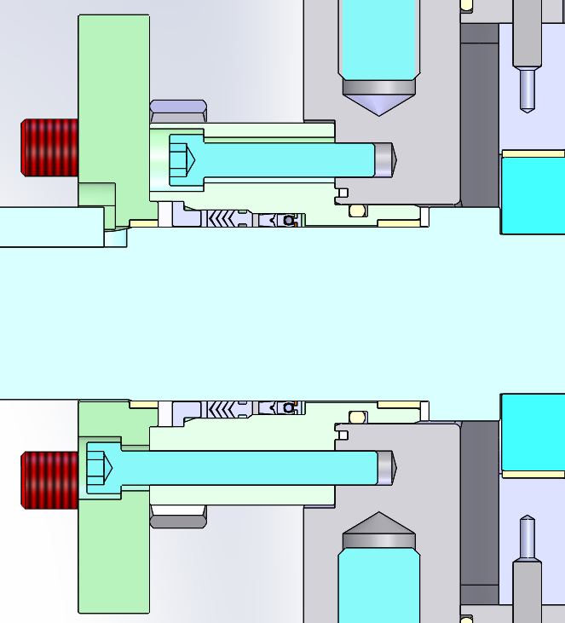
New VP Series – Top Quality Performance at Competitive Price
V-Pack Stem Seal Provides
Highest Performance in Industry
High Performance 17-4PH
Stainless Steel Stem
API 6FA Firesafe Design with
Top Graphite Seal

Slide 33
New VP Series – Top Quality Performance at Competitive Price
High Performance 17-4PH
Stainless Steel Stem
High Integrity Splined
Steam & Ball Connection
Composite POLYGON MRP
Trunnion Bearings
3.0 mil ENP
Ball & Seat Rings
High Strength
F60 Carbon Steel Ball

Slide 34
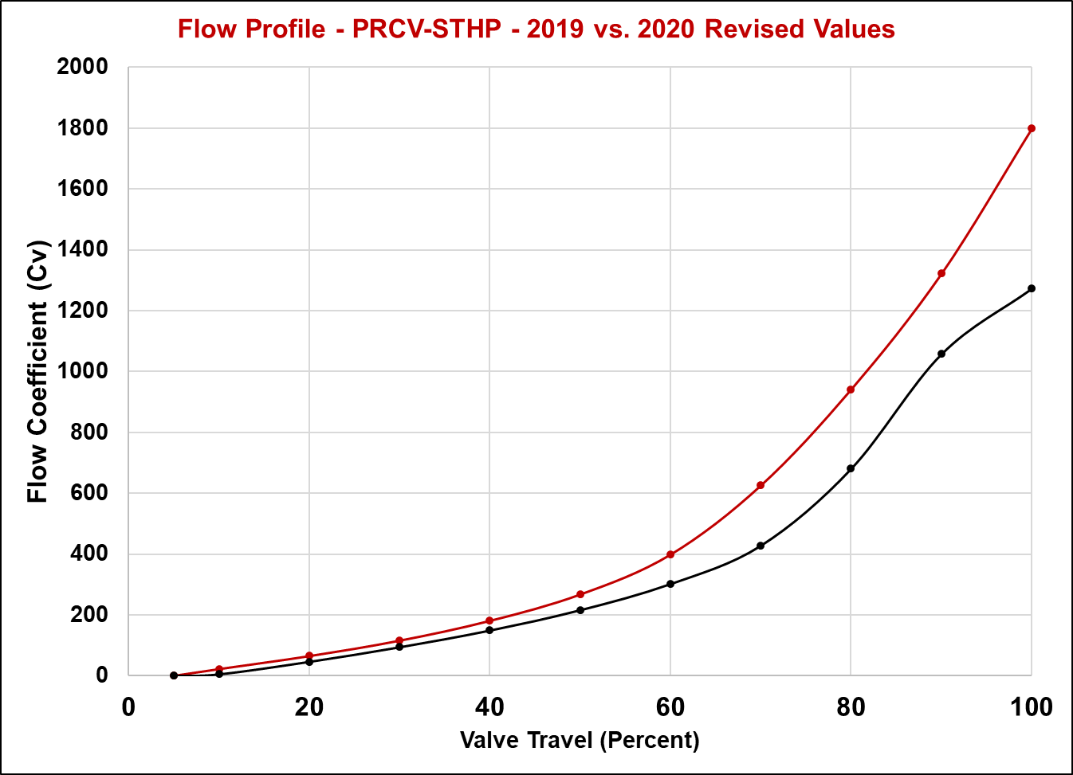
New Revised Capacity and Curve for PRCV-STHP
Increased Capacity
2020
STHP
STHP Curve Revised
As Performance
Data Becomes More Accurate Via
CFD Analysis and Empirical Results
2019
STHP

Slide 35
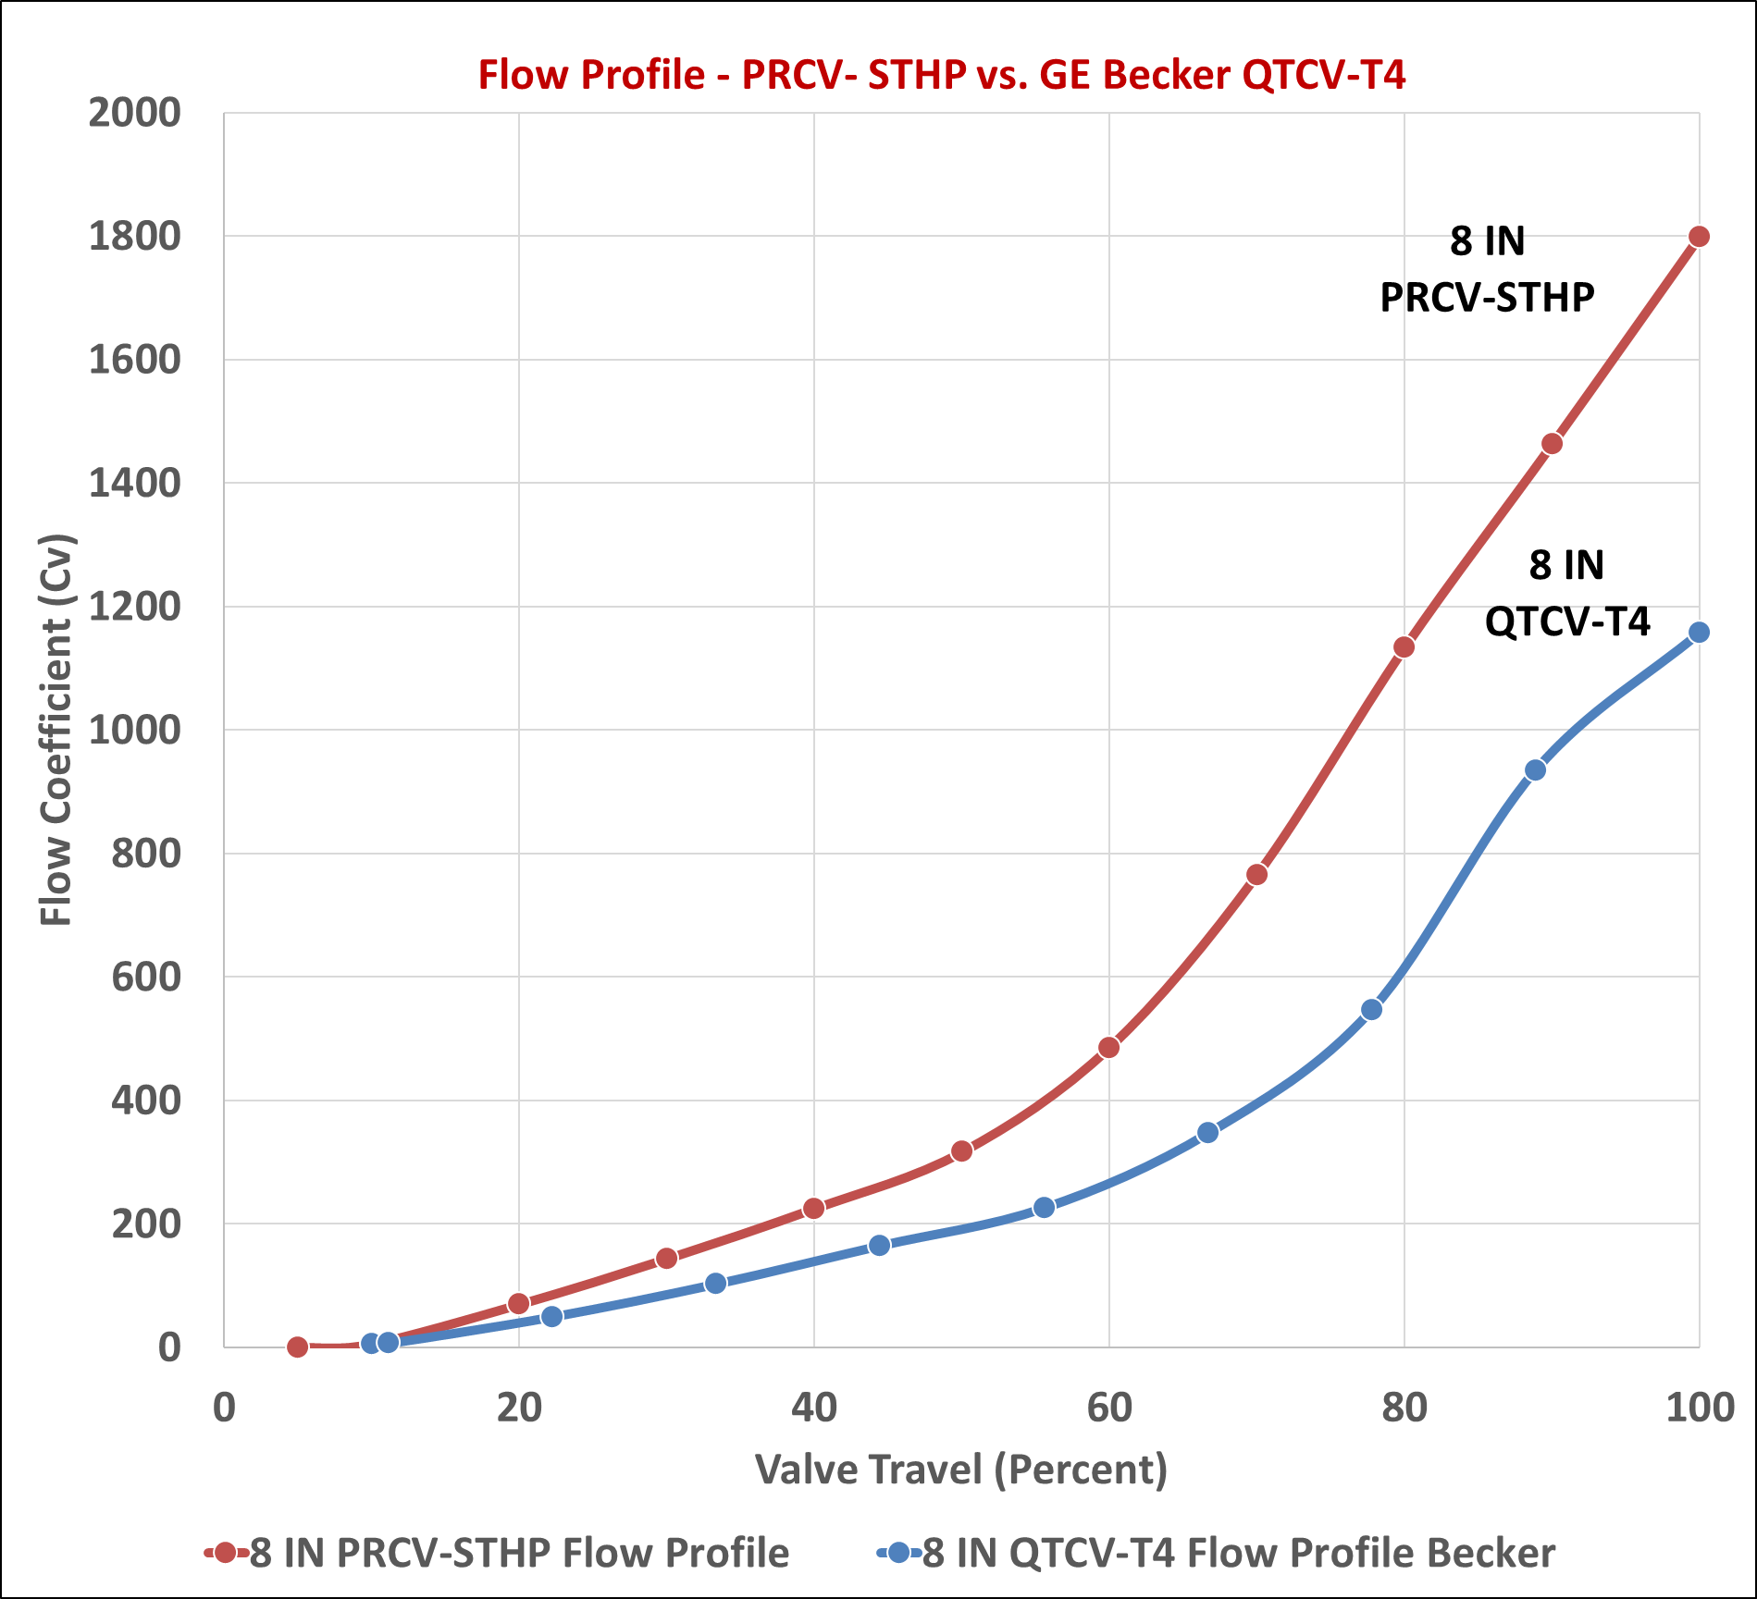
Revised Capacity and Curve for PRCV-STHP 2020
STHP has Higher Cv by Comparison to T4 Design
More Rapid Cv Curve Ramp Up for Better Noise Performance

Slide 36
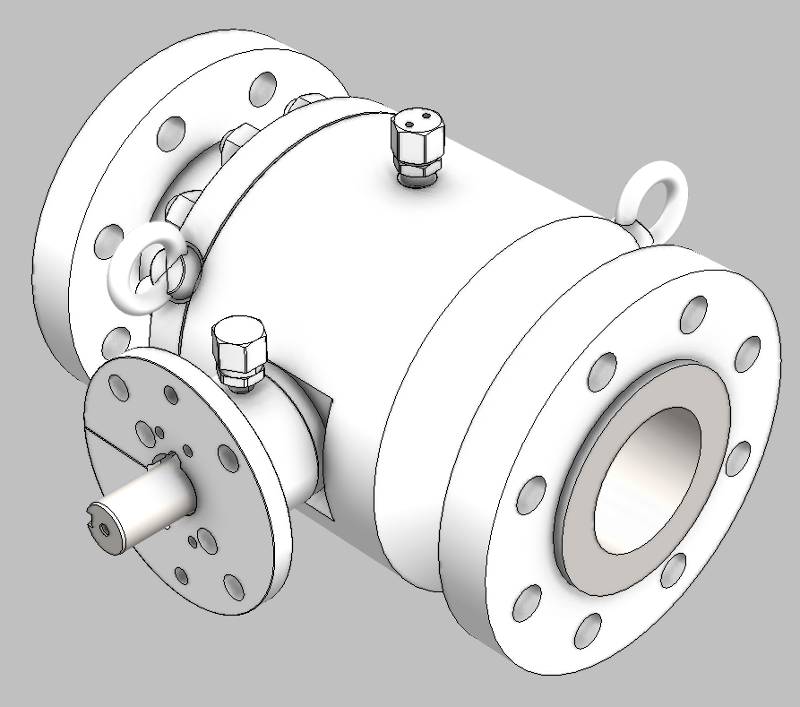
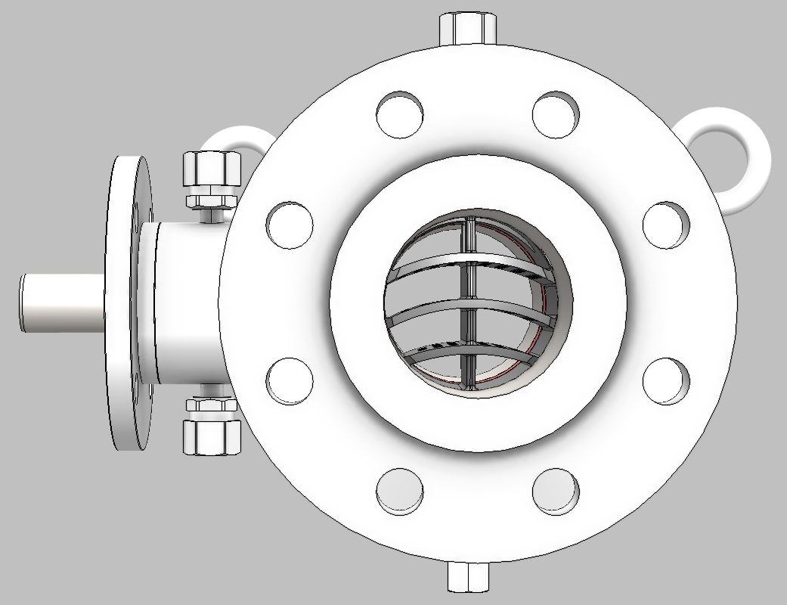
NEW – 4.0 Bore PRCV-STHP Noise Attenuating Control Valves
4 in
NEW Smaller Size – 4.0 in Bore PRCV-STHP

Slide 37
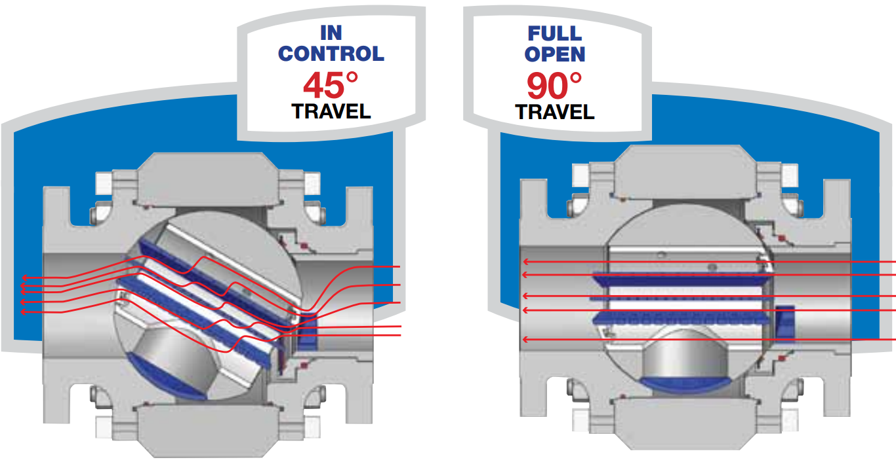
Litigation with GE / Dresser Regarding QTCV-T4 vs. PRCV-STHP Resolved
“843 Patent” of QTCV-T4 Point of Contention
Related to PRCV-STHP Technology
Issue Resolved
VRG to Manufacture PRCV-STHP, PRCV-STH3 & PRCV-STH4 Products

Slide 38
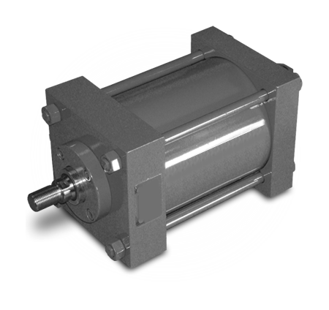
New RHPA Actuator Cylinder Supplier
Easycut™ CS change to A36 Corrosion Proof CS for RHPA Actuators
Mounting Holes on RHPA Actuator Piston
Two Prime Suppliers of Actuator Cylinders to Ensure Quality and Rapid Delivery
Expanded Inventory RHPA Cylinders at VRG
Backward and Forward Parts Interchangeability of All RHPA Repair Kits
Actuator Cylinder Repair Kits in Inventory Fit VRG and Becker-GE
Third Cylinder Supplier in Development

Slide 39
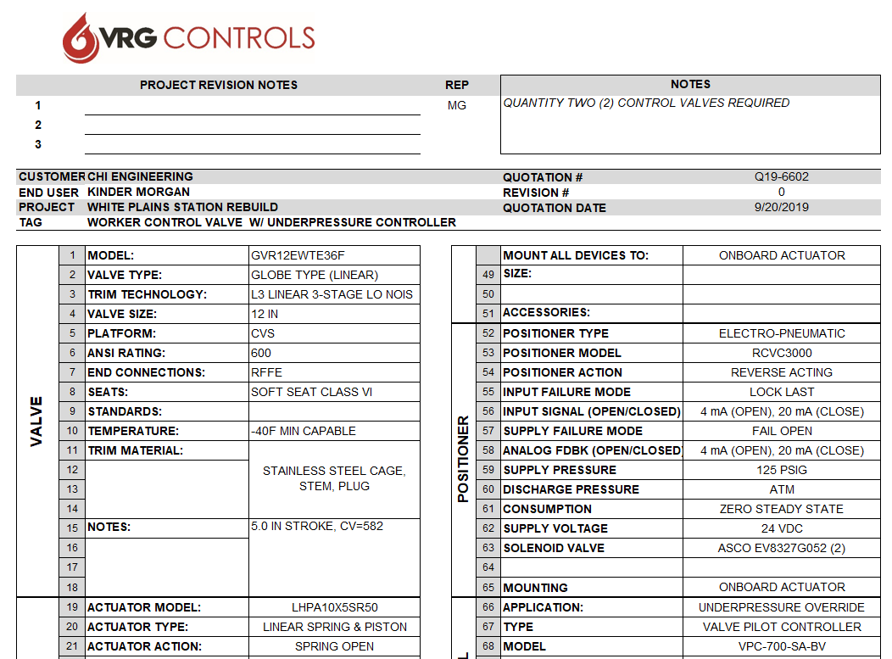
New Control Valve Data Sheet for Easier Specs Presentation

Slide 40
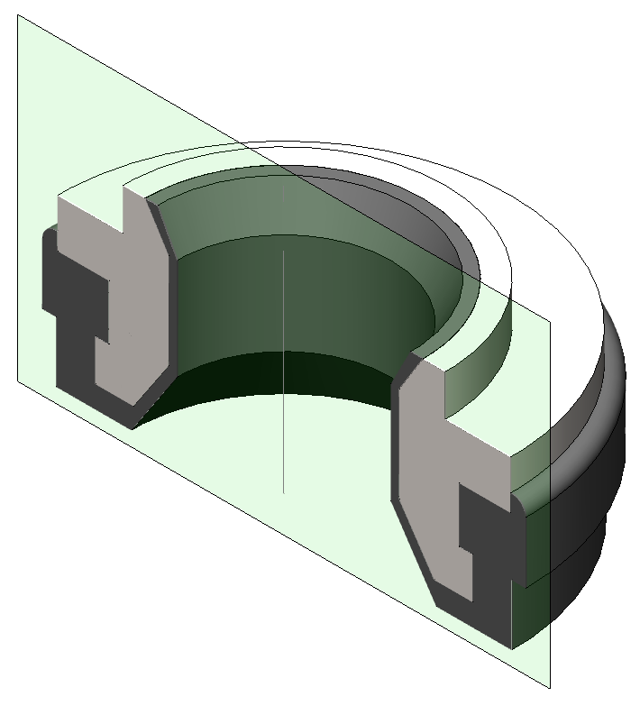
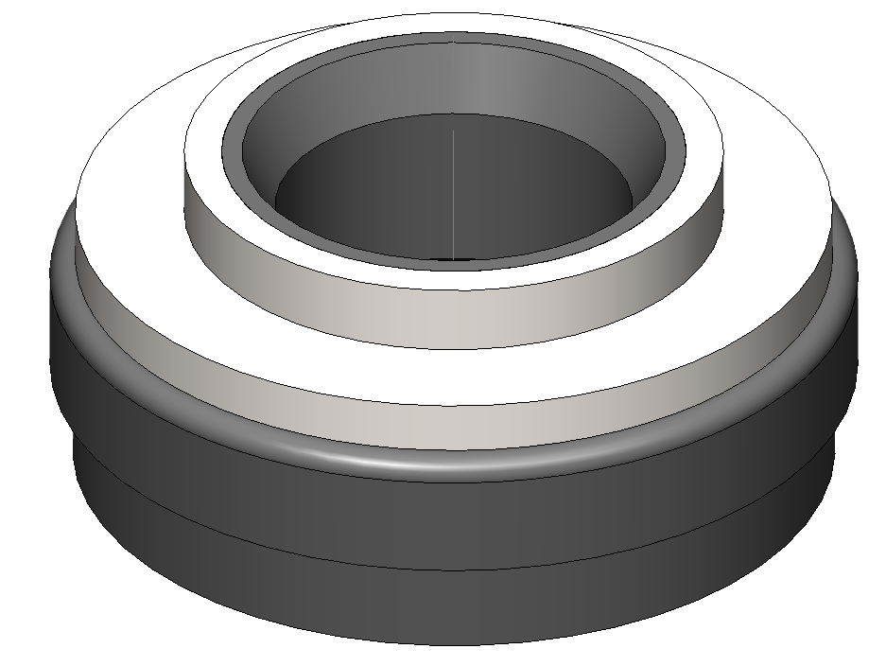
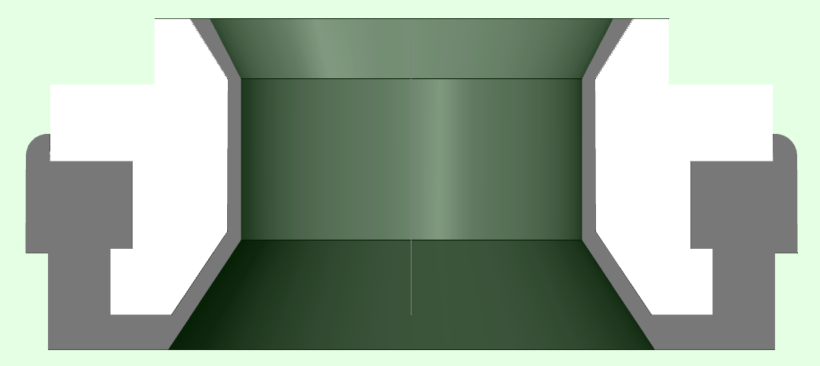
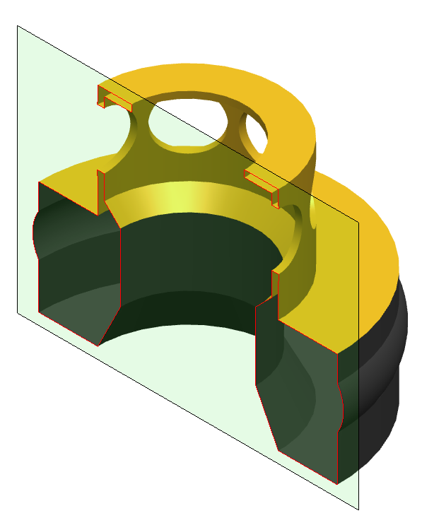
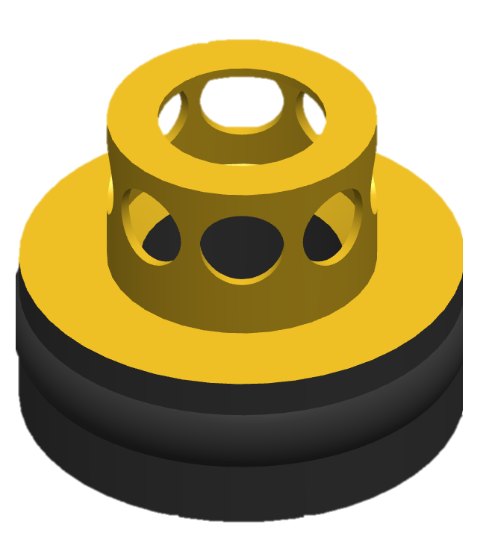
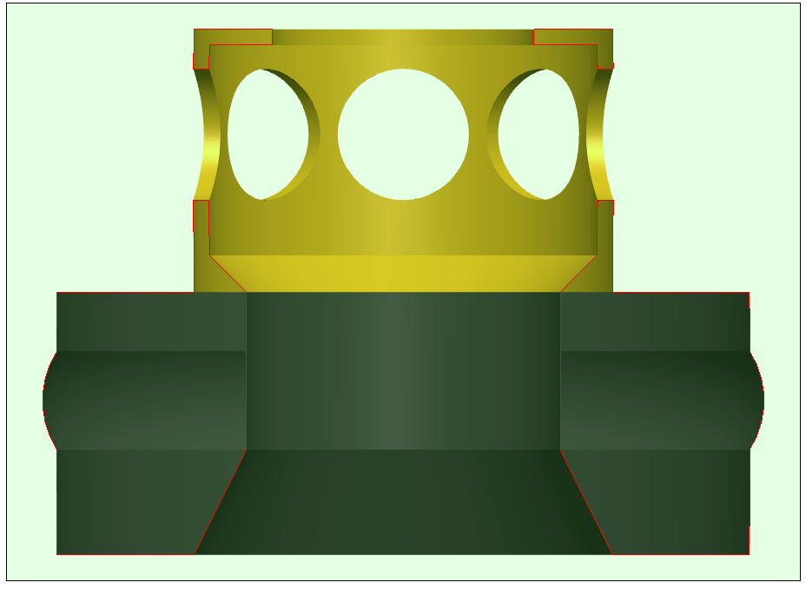
New Improved Balanced Seat – Increased Performance + Stainless Steel
NEW BV Seat Design ( Stainless Steel)
(PD-0247)
BV Seat Structure
BV Seat Molded Buna N
NEW
Optimized
Profile
** PATENT PENDING **
OLD BV Seat Design (Brass)
(PD-0240)
BV Seat “Cage”
BV Seat Structure
OLD
Profile
BV Seat Molded Buna N

Slide 41
New BV Seat Design Improves VPC-BV Sensitivity
NEW BV Seat Design ±.52% Guaranteed (±.26% Probable)
OLD BV Seat Design ±.73% Guaranteed (±.37% Probable)
VPC-SA-BV
VPC-SA-BV-ID
VPC-DA-BV

Slide 42
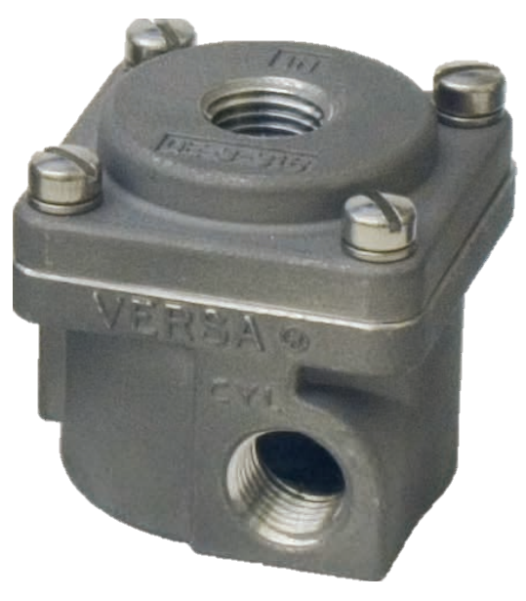
Quick Exhaust Monitor Design
Versa Model QE-3-316
Quick Exhaust Valve
Provides Rapid Response of Monitor Control Valves
Use VPC-SA-BV and Spring Return Actuators
Simple & Cost Effective
Easily Retrofit to Existing Installations
SSCGP Photo Here
IN
OUT
EX

Slide 43
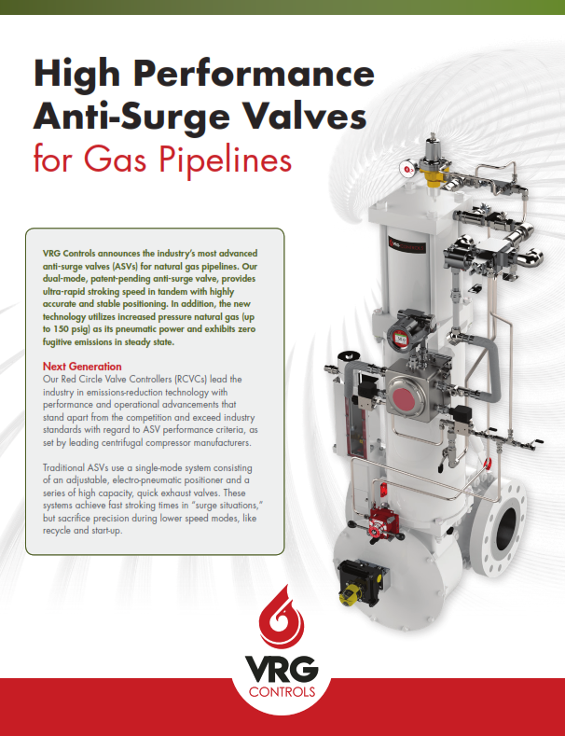
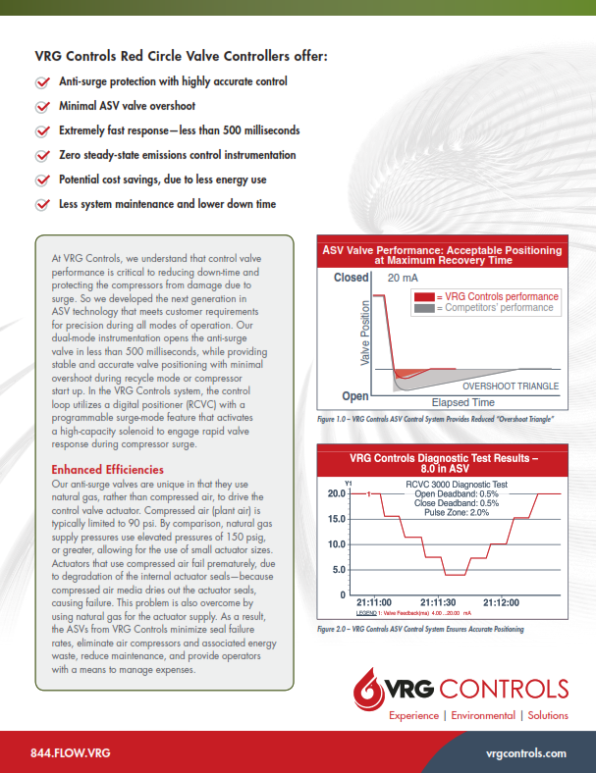
ASV Anti-Surge Valve

Slide 44
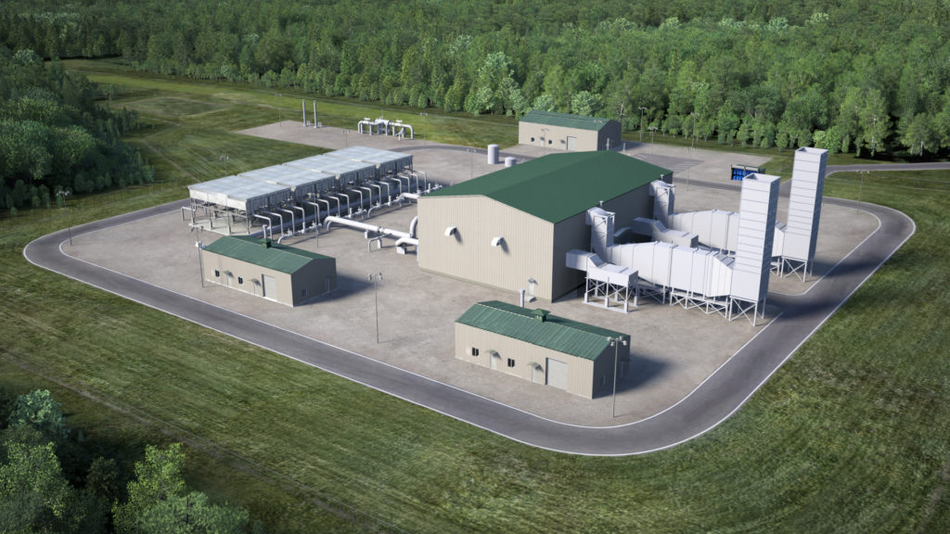
Full Array of Pipeline Compressor Valves Available
Anti-Surge Valves
Recycle Valves
Suction Control Valves
Discharge Control Valves

Slide 45
Pipeline Compressor Subject Matter Expert on Staff
Robert “RC” White – Former Senior Principal Engineer – Solar Turbines
Subject Matter Expert on Gas Pipeline Compressors
Subject Matter Expert on Anti-Surge Valves and Other Compressor Control Valves
Over 25 Years Experience at Solar Turbines

Slide 46
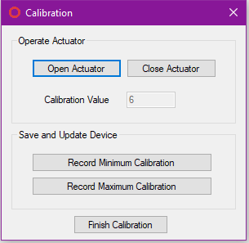
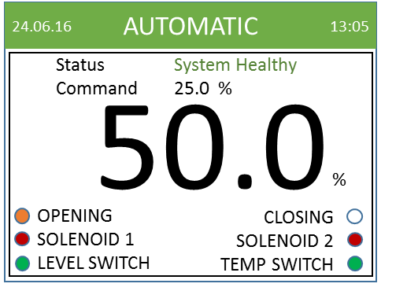
RCVC Stand Alone Program

Slide 47
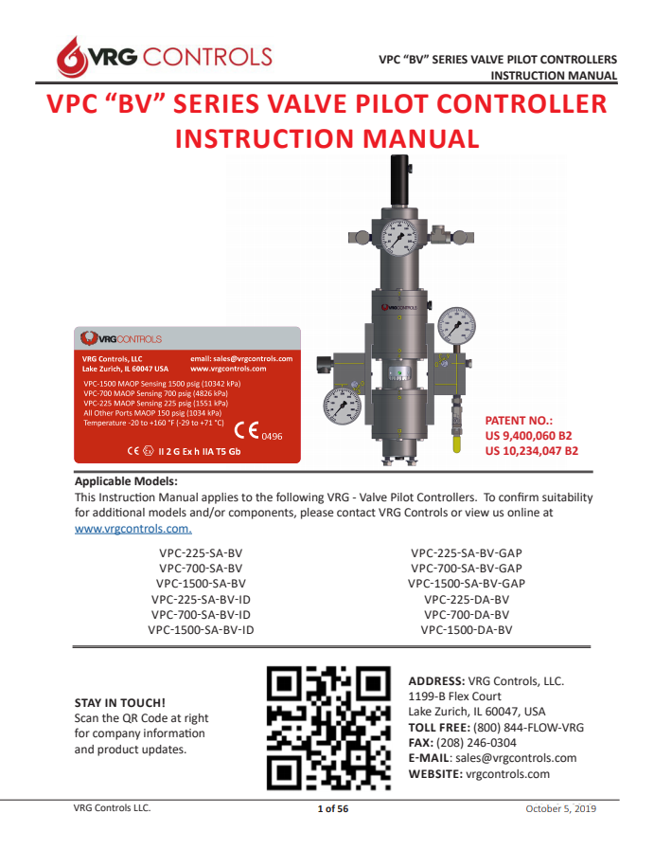
New pilot VPC-BV IOM – Ver. OCT 05 2019
Available for Download at www.vrgcontrols.com
Includes NEW QE Quick Exhaust Valve for Rapid Response Monitor Control Valves
Enhanced Field Tuning Settings

Slide 48
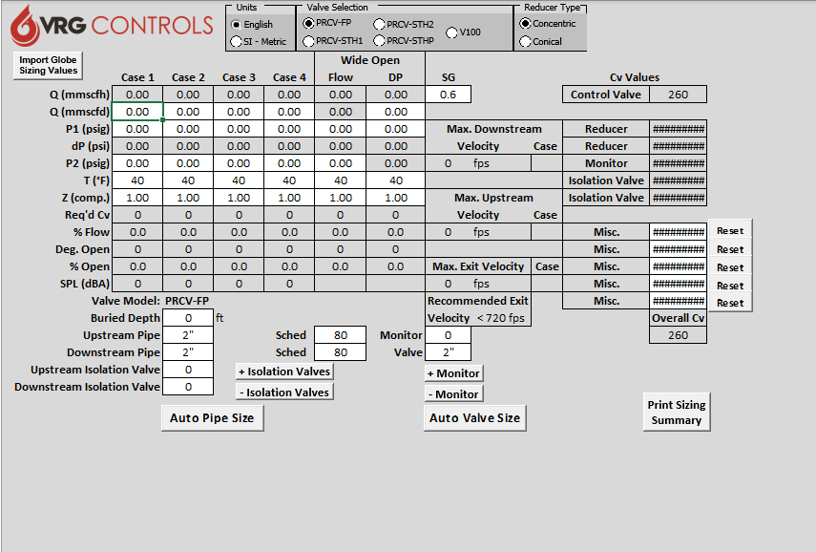
New VRGSize Station Design Program – VRGSize v4.1
NEW 16 in CV-EWT Control Valves
Optimized PRCV-STHP Curves
Minor Corrections
Available for Download at VRGControls.com

Slide 49
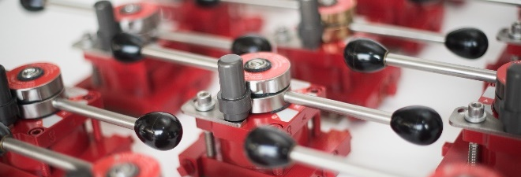
VMO Valve Manual Override Improvements
Now Rated for -40F (-40C) Low Temperature
VMO-250 Redesigned for Improved Performance (Return Springs)
More Thorough Pressure / Leak Testing All VMO’s
-40°F
NOW RATED
This Photo by Unknown Author is licensed under CC BY

Slide 50
True Setpoint Readout Module – TSR6800
+
-
CMR Motor Position Feedback
(Shows Percent Motor Travel)
RTU Analog Input Card
24 VDC
-
+
+
-
True Setpoint Readout Module
(Shows Setpoint – PSIG or Other)
Scale to Custom Range

Slide 51
NAJ Series Noise Attenuating Jackets
Noise Attenuating Jackets Provide 10 dBA Nominal Noise Attenuation Down to 90 dBA Effective
Durable Teflon Impregnated Fiberglass Cloth
Custom Configured Per Valve and/or Piping Configuration
Reinforced Strapping with Stainless Steel Buckles
Available for Control Valves and Complete Piping Runs
Custom Per Application
Onsite Measurement Services

Slide 52
Large Bore Custom Control Valves

Slide 53
Large Bore Custom Control Valves

Slide 54
Pipeline Pressure Control Valves

Slide 55
Pipeline Pressure Control Valves

Slide 56
Large Inventory on Hand

Slide 57
PEC Pipeline Equipment Cabinet – New Taller Size – 6 in Taller
Two (2) Access Methods:
Complete Access by Removal of Entire Top
Front Access by Hinged Lid

Slide 58
PEC Pipeline Equipment Cabinet – New Taller Size 6 in Taller
Taller Design:
OLD Height: 61 in
NEW Height: 68 in
6 in More Clearance
Side Air Vents (2)
Stainless Hinges (2)
Air Struts (2)

Slide 59
Product Sales – Product Quantities Sold To Date MAR 2020
 | VMO | VPC | RCVC | PRCV
Quantity | 5800⁺ | 4000⁺ | 300⁺ | 900⁺
Since | 2014 | 2012 | 2017 | 2014

Slide 60
Our Contact Information
VRG Controls, LLC
Toll-Free: +844-FLOW-VRG (USA & CANADA)
e-Mail: Sales@VRGControls.com
www.VRGControls.com
VRG Controls, LLC
1199 Flex Court, Unit B
Lake Zurich, Illinois 60047 USA
VRG Controls, LLC
Solutions for Natural Gas!
Follow Us:

