Slide 1
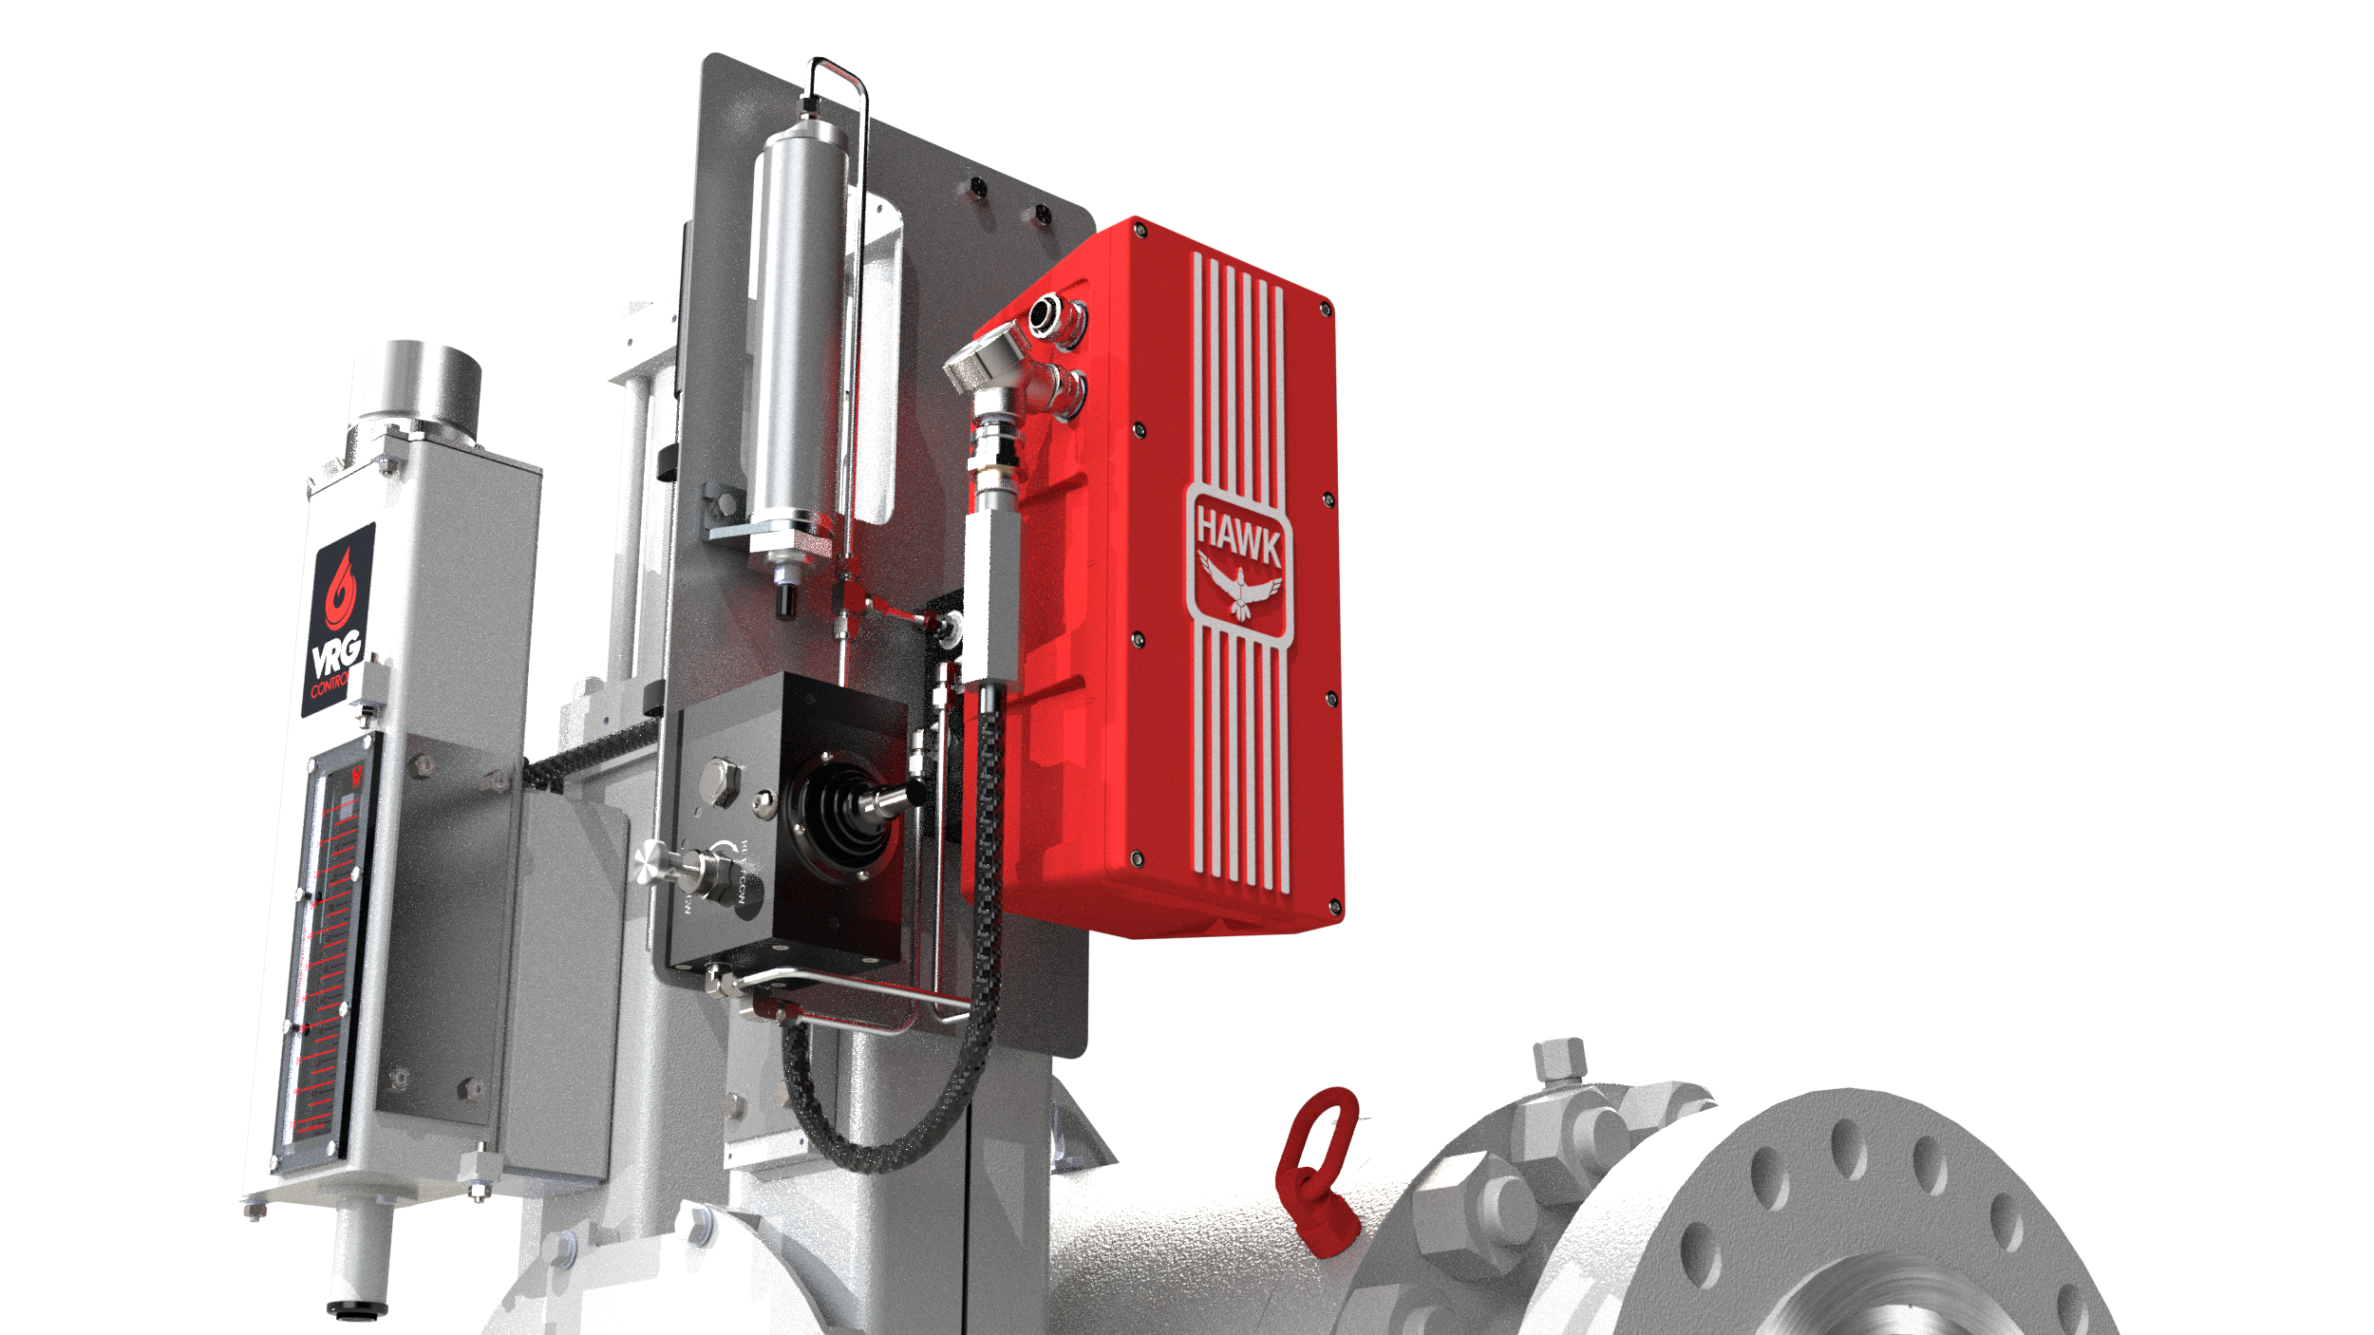
Zero Emission EH Control Valves
PRCV Pipeline Rotary Control Valve
With Hawk EH Modulating Actuator
and Modulating Control System

Slide 2
Electro-Hydraulic “EH” Actuators and Control Systems
Modulating Control Valve Applications
On-Off Isolation Valve Applications
New or Retrofit Installations
ZERO Emissions Electronic Control
Superior Valve Positioning Accuracy
24 VDC Power Primary Solution
Easy Interface to UPS / Battery Backup Systems
Low Power Consumption Ensures Service Reliability
Easy Interface with VRG Controls Control Valves
Compatible with Rotary or Linear Control Valves
Manual Override Standard Accessory
Accumulator Systems Available for Extended Operation
Eliminate Supply Gas Systems
Setting The Trend for Emissions Elimination in Natural Gas Pipelines

Slide 3
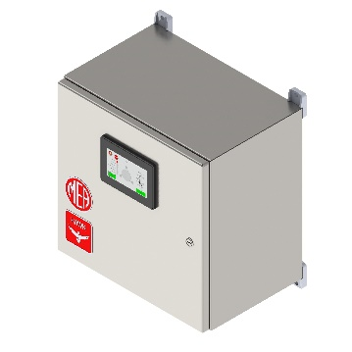
ZERO Emissions Electronic Control + Simple Backup Power
4-20 mA Command
4-20 mA Position Feedback
MEA Hawk
EH Actuator
24 VDC Power
*Other DC / AC Voltages Available
EH Manual
Override
Non-Contact
Position
Feedback
Hawk
EH HPU
VRG Controls
PRCV Control Valve
VRG Crank Arm
Actuator
Interface

Slide 4
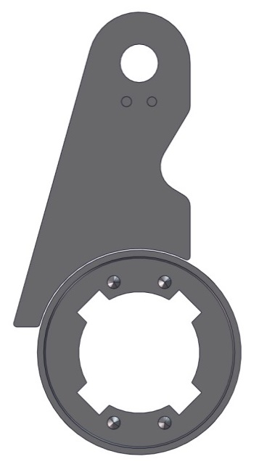
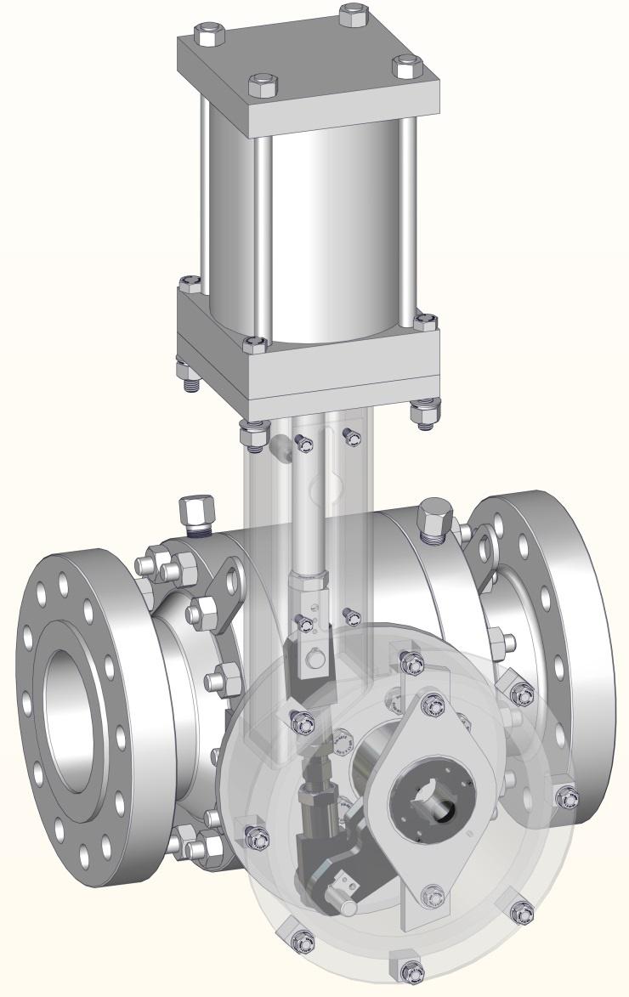
Crank Arm Interface Ideal for Modulating (Control) Applications
Torque Arm Actuator Mechanism Provides Optimum Torque Performance w/ ZERO Lost Motion
MEA Hawk
EH Actuator
EH Manual
Override
4-Position Stem Keyway for Maximum Installation Flexibility
Hawk
EH HPS
Non-Contact
Position
Feedback
Tight Tolerance Clevis Pin w/ Spherical Bearing
VRG Controls
PRCV Control Valve
Dual High Tolerance Torque Arm Bearings Prevent Valve Stem Side Load
Tight Tolerance Torque Arm Pin w/ Spherical Bearing and Retainer System
VRG Crank Arm
Actuator
Interface

Slide 5
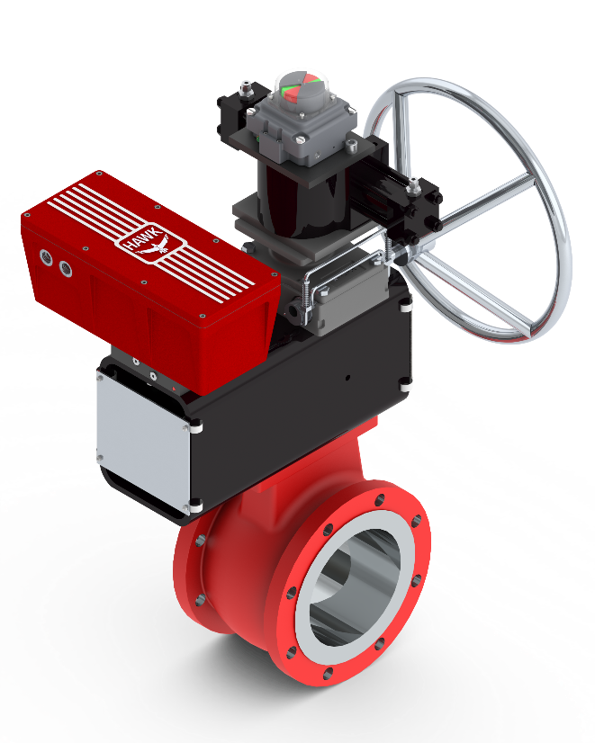
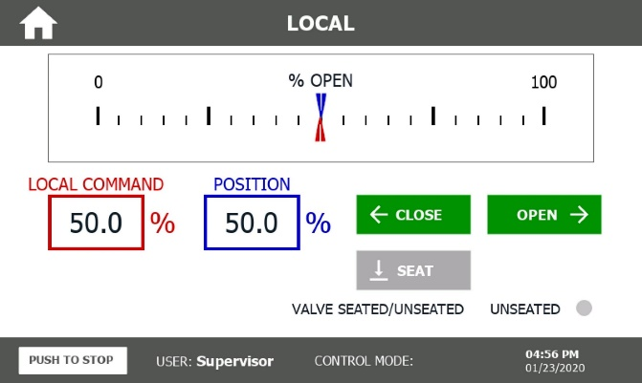
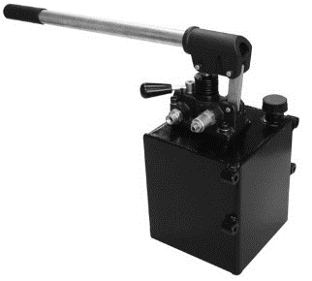
Manual Override Options
Touchscreen (HMI) | Hydraulic Pump | Manual Gear

Slide 6
Technical Specifications
Technical Specifications
Power Supply |  | 24VDC / 120VAC / 208VAC / 240VAC / 480 VAC
Input Options |  | 4-20ma / On-Off Discrete / Modbus / Profinet / Ethernet IP*
ESD or Power Loss Failure Mode Options |  | Open or Closed Via Spring or Accumulator
Ambient Temperatures (Actuator) |  | -20F to +130F (-29C to +54C)(Std) -40F to +110F (-40C to +43C)(Cold Weather Package) +30F to +180F (-1C to +82C)(High Temp Package)
Ambient Temperatures (Controls) |  | -20F to +120F (-29C to +49C) (Std) -40F to +120F (-40C to +49C)(Cold Weather Package)
Position Feedback |  | Non-Contact Electro-Magnetic Feedback - Passive 4-20ma Feedback (Std)
Limit Switches |  | Programmable Electronic (Std)
Hazardous Area Classification |  | Cl 1, Div 2 Certified, grps A, B, C, & D (Standard) Cl 1, Div 1 Certified, grps C, & D (Optional) ATEX Compliant, II 3G EEx nA II T3 -40C ≤ T_{ambient} ≤ 65C* ATEX Compliant, II 2G EEx ‘d’ iiB, T3 -40C ≤ T_{ambient} ≤ 65C**

Slide 7
Performance Specifications
Performance Specifications
Emissions |  | ZERO
Duty Cycle |  | 100% Modulating service
Deadband |  | 0.1%-2% (Standard) As Low as 0.05% (Optional)
Repeatability |  | <0.1%
Resolution |  | <0.01%
Dead Time |  | <80ms
Stiction |  | ZERO
Overshoot |  | ZERO
Rotary Speed |  | Up to 0.2 sec / 90°
Rotary Output |  | 90° Standard Quarter Turn / Up to 360° Available
Rotary Torque Output |  | 2,500 in-lbf – 400,000 in-lbf / (282 Nm to 45,193 Nm)
Linear Speed |  | Up to 0.2 sec / in Stroke
Linear Stroke |  | Up to 60 in (1.52 m)
Linear Thrust Output |  | 2,000 lb_{f} - 100,000 lb_{f} (Consult Factory for Higher Outputs)

Slide 8
Quarterly Maintenance Recommendations
5 / 10 Year Maintenance Recommendations
Task | 3 Months
Hydraulic Fluid Level / Leak | Visual
Hydraulic Fittings & Tubing | Visual
Mount Bolts | Visual
Cable Connections | Visual
HPS Control Enclosure | Visual
HMI User Input Response | Operational
Actuator Control Stability | Visual
Actuator Response | Operational
Actuator Feedback Signal | Visual
Estimated Time to Complete | 30 minutes
Task | 5 Years | 10 Years
Quarterly Maintenance | Perform | Perform
HPS Soft Good Kit | Rebuild | Rebuild
Hydraulic Cylinder Kit | Rebuild | Rebuild
Accumulator / Reservoir Kit | Rebuild | Rebuild
HPS Solenoids | Replace | Replace
Hydraulic Pumps | Replace | Replace
Hydraulic Fluid | Replace | Replace
Servo Motor(s) | -- | Replace
Estimated Time to Complete | 4 Hours | 5 Hours

Slide 9
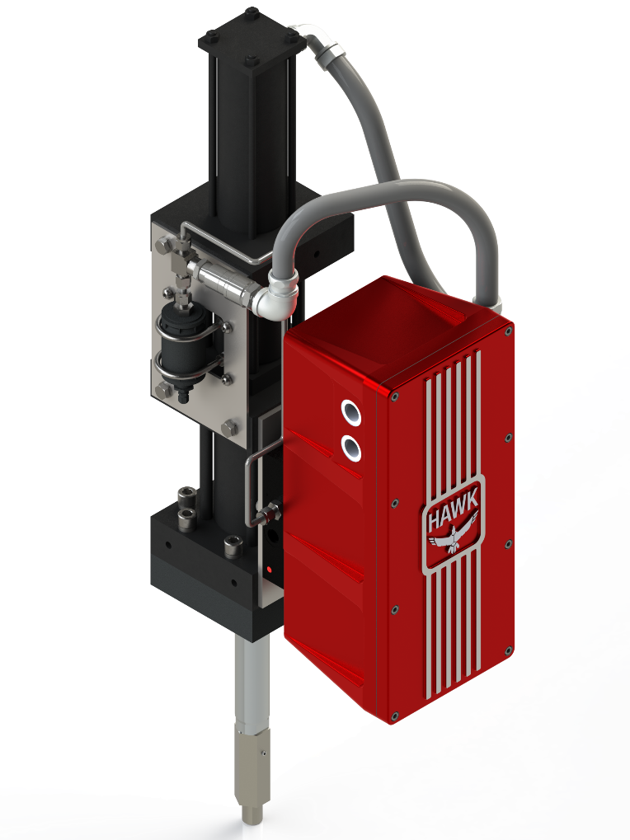
Electro-Pneumatic & Electro-Hydraulic Options
RCVC
Red Circle
Valve Controller
(Electronic)
Tail-rod Instrument Mounting System Standard
HMI
Control Enclosure
PRCV Seat Seals Extended Above Ground
Coal Tar Epoxy Coating on Below Ground Portion
Vented Actuator Housing
Stem Lubrication / Test Extended
Fully Welded Bracket Supports on All Lines
Electro-Hydraulic
Actuator Power
Module
(Linear Output)
All Port Extension Lines ASME Code Welded and Hydro-tested
Drain Line / Blowdown Extended

Slide 10
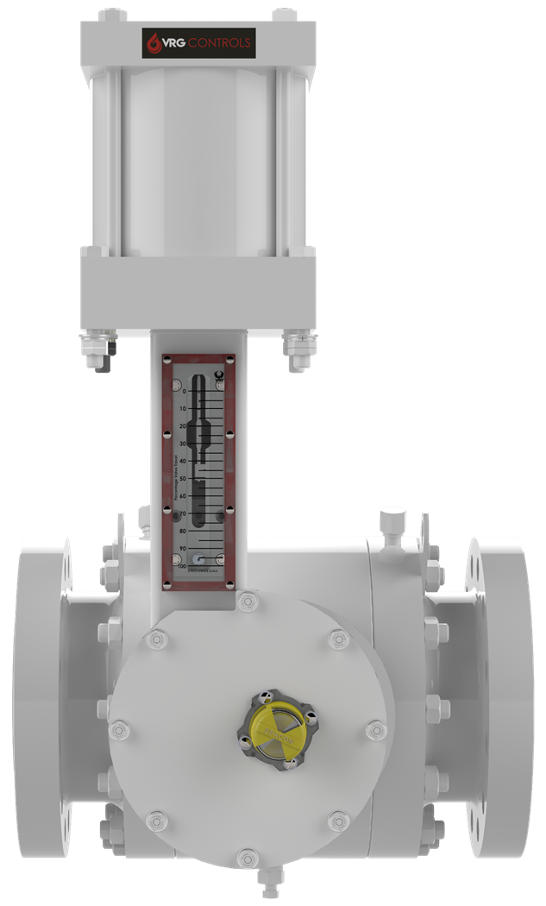
Interchangeable Linear Power Modules Crank Arm Actuators – Above Ground
Above Ground Installation
VRG Controls RHPA Actuator
*Compatible w Becker RPDA Actuators
ELECTRO-HYDRAULIC ACTUATOR POWER MODULE (LINEAR OUTPUT) | PNEUMATIC ACTUATOR POWER MODULE (LINEAR OUTPUT)

Slide 11
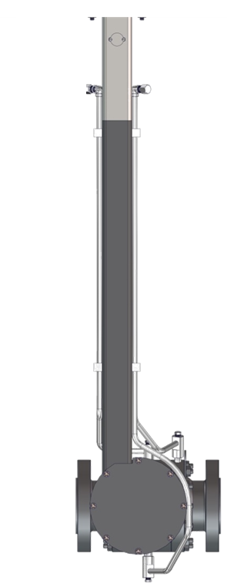
Interchangeable Linear Power Modules Crank Arm Actuators – Below Ground
ELECTRO-HYDRAULIC ACTUATOR POWER MODULE (LINEAR OUTPUT) | PNEUMATIC ACTUATOR POWER MODULE (LINEAR OUTPUT)
Below Ground
Installation
VRG Controls
RHPA Actuator
*Compatible w Becker RPDA Actuators

Slide 12
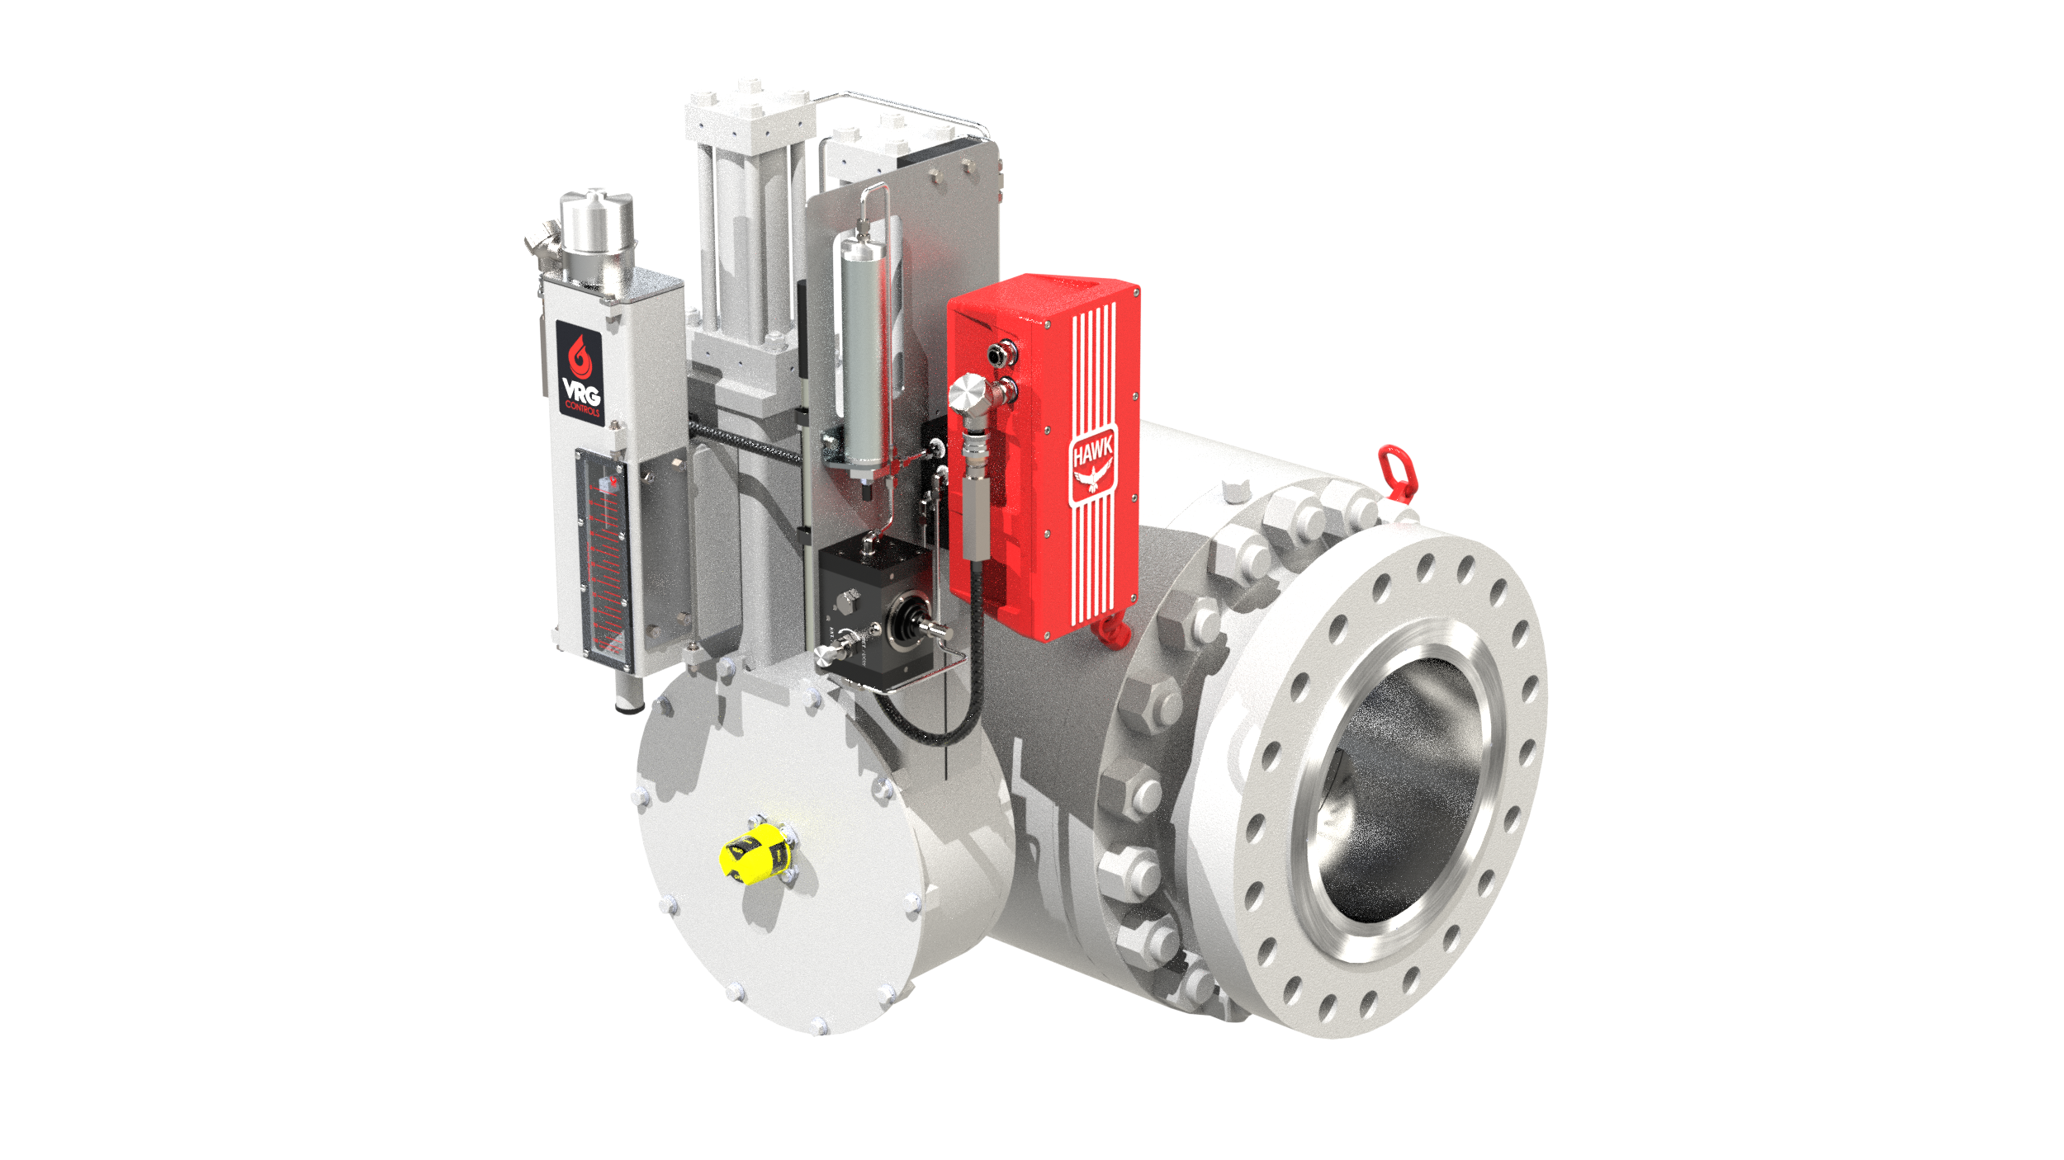
ZERO Emissions Electronic Control + Simple Backup Power
ELECTRO-HYDRAULIC ACTUATOR POWER MODULE SINGLE ACTUATOR
ELECTRO-HYDRAULIC ACTUATOR POWER MODULE DUAL ACTUATOR

Slide 13
ZERO Emissions Electronic Control + Simple Backup Power
Control Enclosure
RHPA-EH Hydraulic Cylinders (Pistons)
External Reservoir
Hawk Hydraulic Power Source (HPS)
Balluff Linear Position Transmitter
Visual Travel Indicator
HMI Interface / Screen
Hydraulic Handpump
PRCV Pipeline Rotary Control Valve
RHPA Crank Arm Assembly

Slide 14
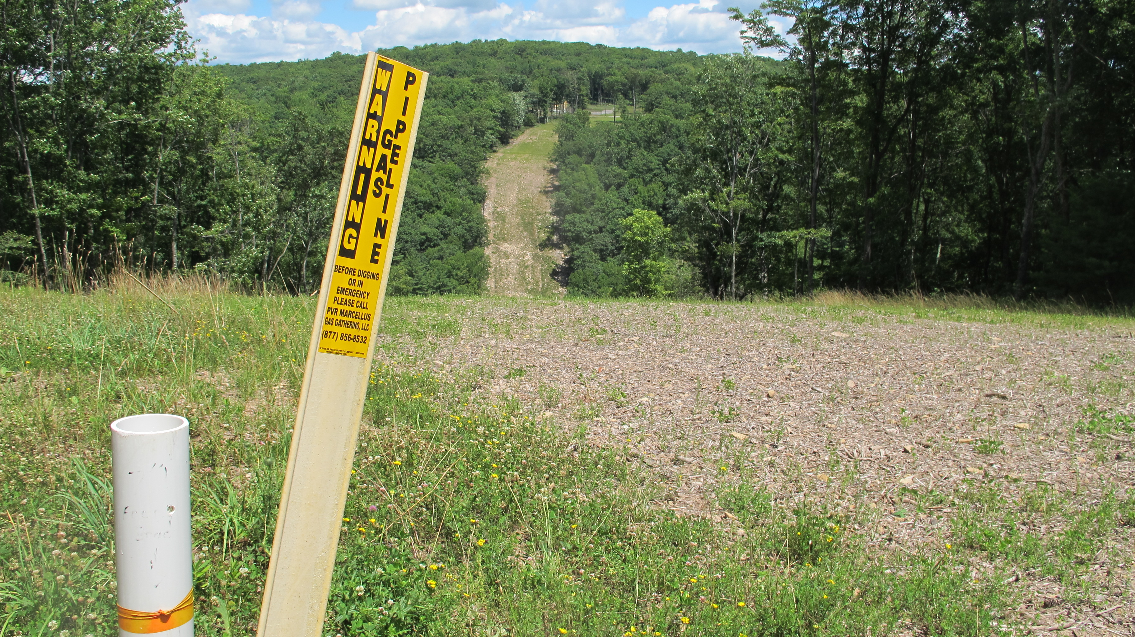
Gas Pipeline Applications
M&R Facilities | Pipeline Compressors | Mainline Facilities
Volumetric Control Electronic Pressure Control Power Plant Fuel Gas Feed | Anti-Surge Control Station Recycle Hot Gas Bypass Compressor Fuel Gas Feed Inlet Guide Vane | Mainline OPP Mainline Isolation Crossover Flow Control

Slide 15
Other Applications – Active Customer List
Buckeye Partners LP
Energy Transfer *
Enterprise Products Partners LP *
Epic Midstream
Kinder Morgan Inc.
Magellan
Mark West (AML expected)
Plains Midstream
Sonatrach
Suncor Energy *
TC Energy (AML expected)
Trans Mountain
Valero Energy Corp.
Akron Energy (Power generation)
Alyeska Pipeline Service Co. (Power generation for terminal)
Arcelor Mittal SA (Steel milling)
Asarco (Mining)
CAP Acero (Steel milling)
Cenovus Energy (Upstream oil and gas)
ConocoPhillips Co. (Upstream oil and gas)
Dakota Gasification Co. (Carbon capture via injection)
Exxon Mobil Corp. (Refining)
Formosa Plastics Corp. (Chemical refining)
Freeport LNG Development LP (LNG terminal gas flow control)
*Denotes Formal AML Listing

Slide 16
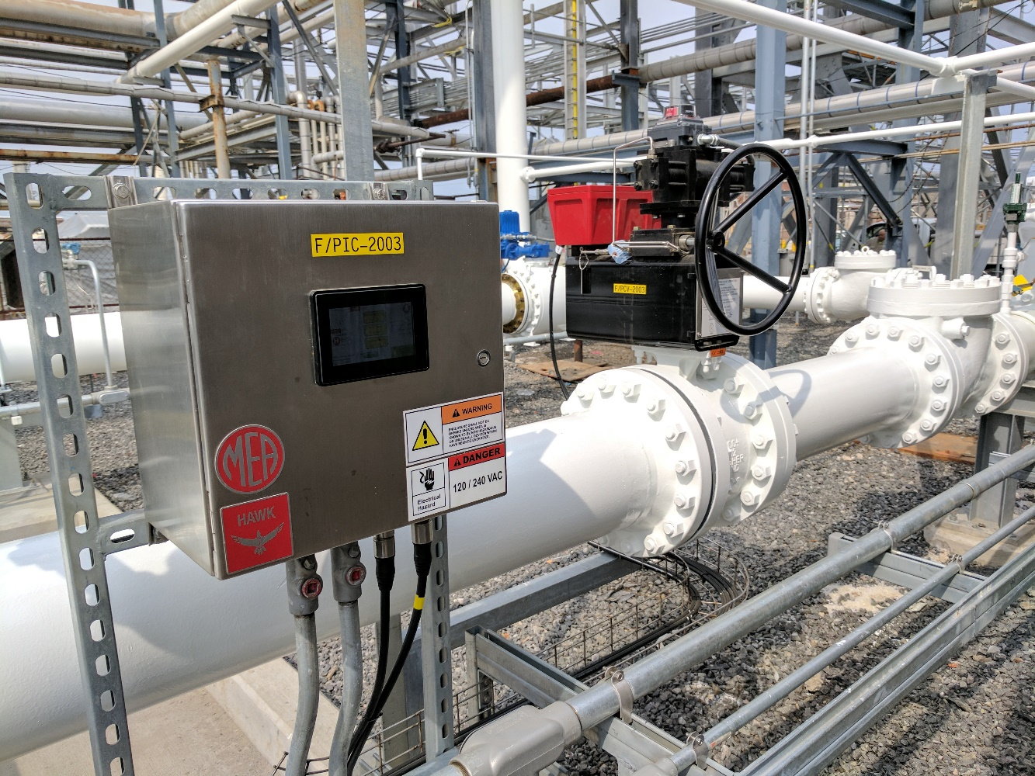
Other Applications – Active Customer List
Freeport-McMoRan Inc. (Mining) *
HF Sinclair Corp. (Refining)
Little Rock AR Water District (Wastewater)
Pertamina Corp. (Refining) *
Procter and Gamble Co. (Power generation for manufacturing facility)
Singapore Refining Co. (Refining) *
Taiwan Power Co. (Power generation)
Teck Resources (Mining)
TotalEnergies SE (Refining)
U.S. Navy (Propellant flow control)
*Denotes Formal AML Listing

Slide 17
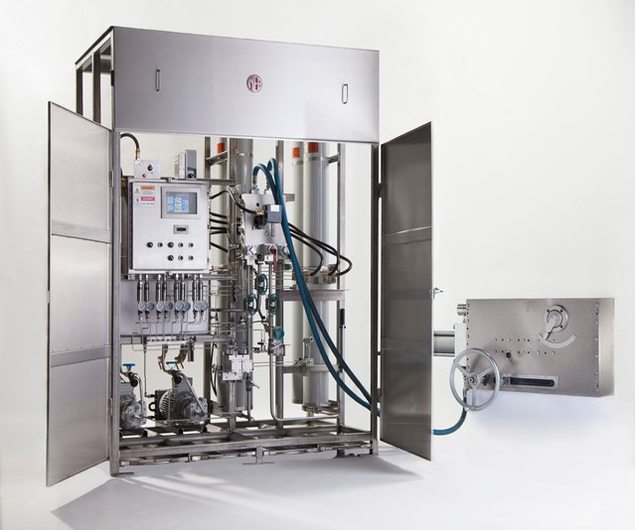
MEA – Active Customer List
BP PLC *
CEPSA *
Chevron Corp. *
Citgo Petroleum Corp. *
Colombian Petroleum Co. (Ecopetrol) *
Delek Group Ltd.
Flint Hills Resources LLC
Hindustan Petroleum Corp. Ltd. *
Imperial Oil *
Indian Oil Corp. Ltd.*
Inter Pipeline
Irving Oil *
*Denotes Formal AML Listing

Slide 18
MEA – Active Customer List
KazMunayGas
Marathon Petroleum Corp.*
Pemex*
Petróleo Brasileiro SA (Petrobras)
Petroliam Nasional Berhad (PETRONAS)
Phillips 66 Co.*
PJSC Gazprom
REPSOL
S-Oil Corp.*
Shell PLC *
Ssandyong Oil Refining Co. Ltd.
Wyoming Pipeline Co. LLC*
*Denotes Formal AML Listing

Slide 19
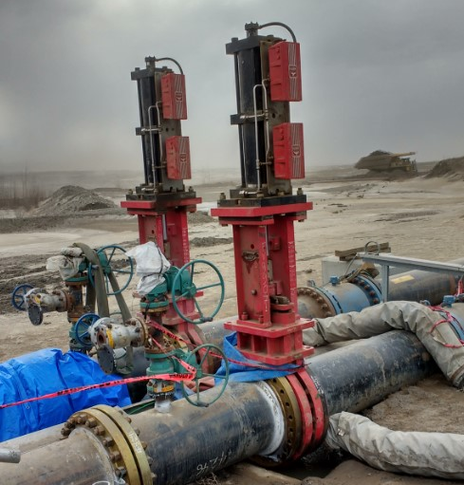
Gas Pipeline - Installation Example
End User: Suncor
Application: Flow Control
Background: Eliminates need for traditional HPCU and associated preventative maintenance.
Valve: Slurryflo 24 in Gate Valve

Slide 20
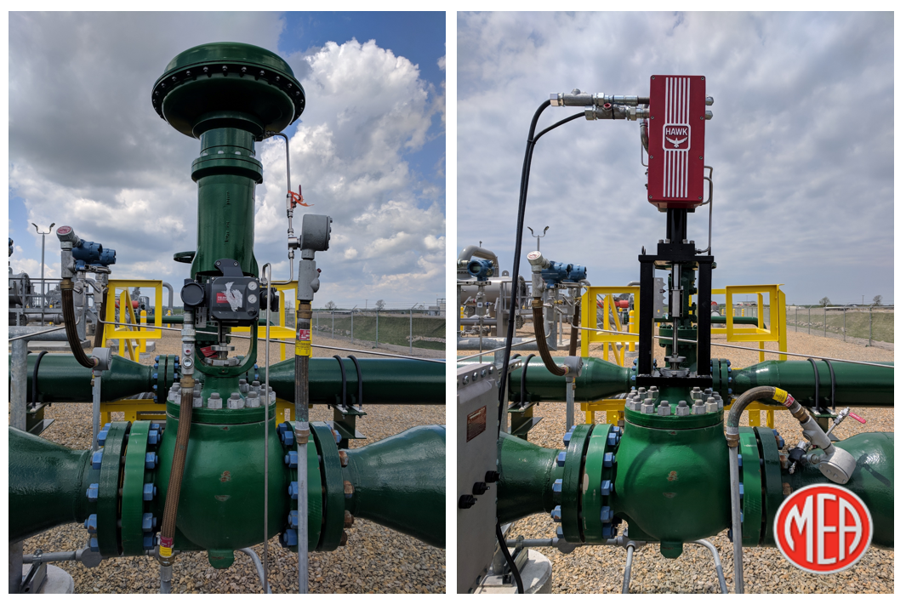
Gas Pipeline - Installation Example
BEFORE
Fisher E-Body Control Valve w 667 Actuator / DVC Controller
AFTER
Fisher E-Body Control Valve
MEA Hawk Actuator

Slide 21
Liquids Pipeline - Installation Example
End User: Enterprise Products
Application: Flow Control Valve
Background: Replacement of the obsolete Rexa actuator
Valve: 6” Samson 3241 series Globe Valve

Slide 22
Liquids Terminal - Installation Example
End User: Energy Transfer
Application: Pump Recirculation
Valve: Fisher 12” V300

Slide 23
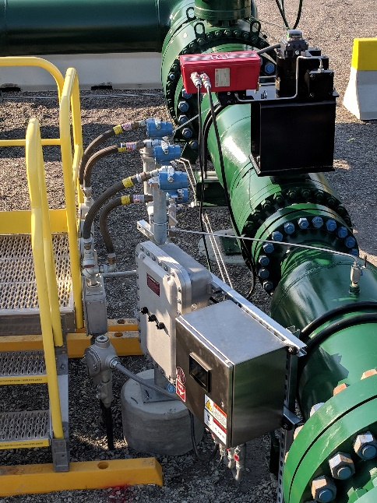
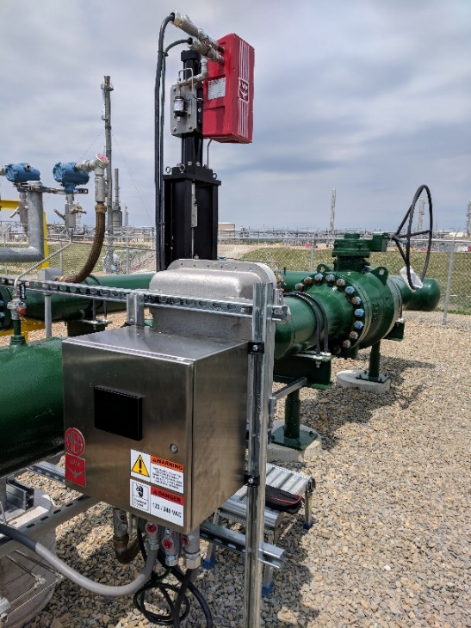
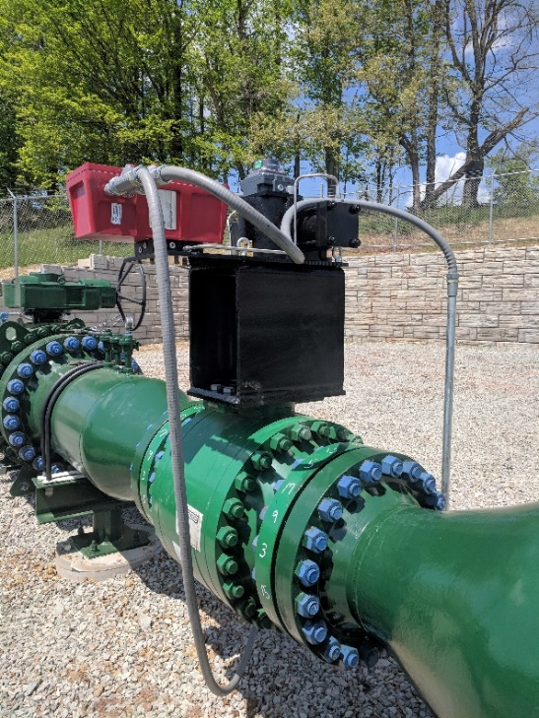
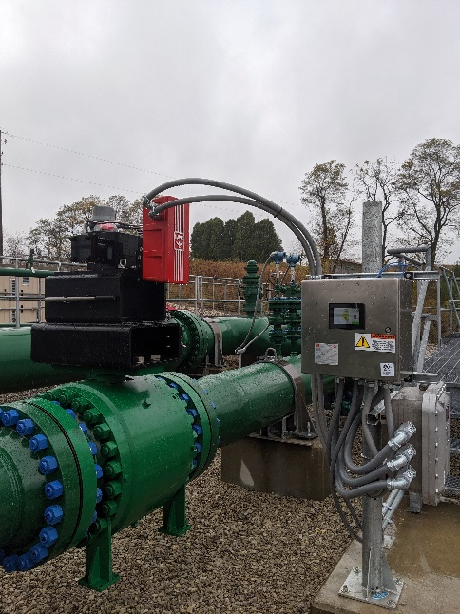
Gas Pipeline - Installation Example
End User: Mark West
Application: Flow Control Valves
Valve: Various

Slide 24
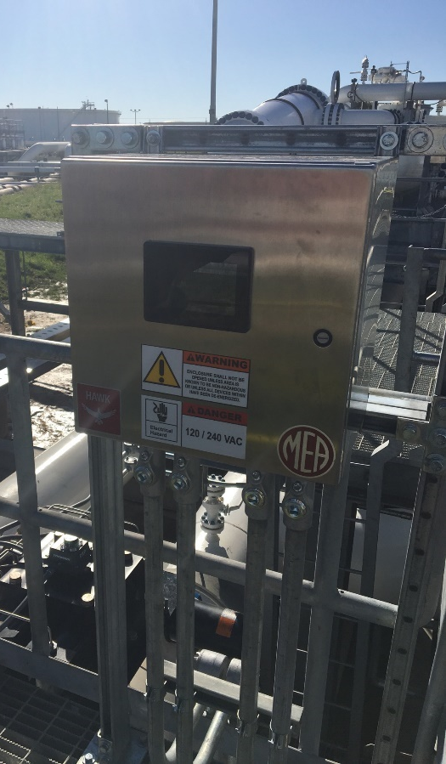
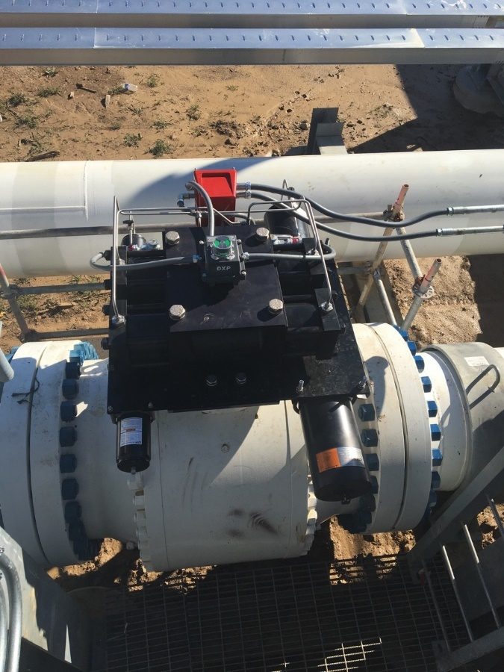
Liquids Pipeline - Installation Example
End User: Energy Transfer
Application: Terminal Inlet Valve
Valve: 36” Grove Ball Valve

Slide 25
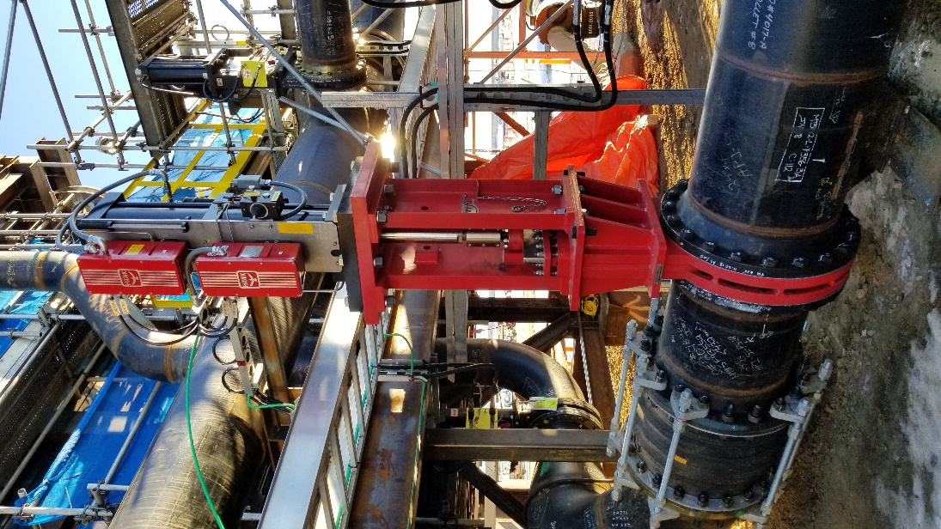
Refining Oil Sands- Installation Example
End User: Suncor
Application: Flow Control
Background: Eliminates need for traditional HPCU
and associated preventative maintenance.
Valve: Slurryflo 24” Gate Valve

Slide 26
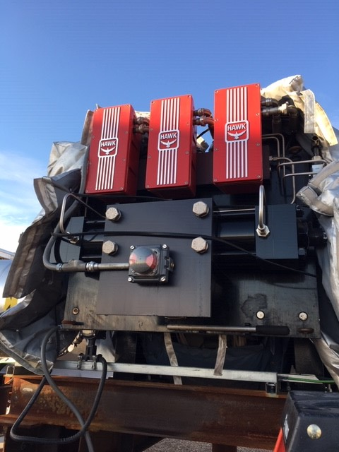
Liquids Pipeline - Installation Example
End User: TransCanada
Application: Pressure / Flow Control
Valve: Metso Neles 16” Q-Ball Valve

Slide 27
Oil Sands Refining- Installation Example
End User: Suncor
Application: Pump Recirculation
Valve: Fisher 16” V250, Ball Valve

Slide 28
About Us – VRG Control, LLC
Privately Held & Founded 1965
Privately Held & Founded 2012
Located Chicago Metro Area
Focused on Natural Gas Transmission
Leader Emissions Reduction Technologies
Direct Factory Support for NICOR
Global Support Network
Control Valves from 2 in to 42 in Bore
Natural Gas Regulation Products
Rapid Response Experienced Support
Large Inventory of Parts in Stock
Most Qualified Support for Becker Products
Becker Compatible Parts in Stock
Factory and Onsite Training Available

Slide 29
About Us – MEA, Inc.
Privately Held & Founded 1965
Located Chicago Metro Area
Teamed with VRG Controls to Support NICOR / AGL
Leader Electro-Hydraulic Valve Actuation
Direct Factory Support in Tandem w VRG for NICOR
Global Support Network
Modulating Control and On-Off Isolation Applications
Natural Gas Regulation Products
Rapid Response Experienced Support
Large Inventory of Parts in Stock
“Unlimited” Size / Type Valve Automation Capabilities
Retrofit or New Valve Automation Applications
Factory and Onsite Training Available

Slide 30
VRG Controls, LLC
Toll-Free: +844-FLOW-VRG (USA & CANADA)
e-Mail: Sales@VRGControls.com
www.VRGControls.com
VRG Controls, LLC
1199 Flex Court, Unit B
Lake Zurich, Illinois 60047 USA
VRG Controls, LLC
More Experience. Less Emissions!

