Slide 1
RCVC Red Circle Valve Controller
Common Tasks
Troubleshooting
Software Updates
ver 030620

Slide 2
RCVC - Common Setup Tasks
Hi Resolution Color TFT Programmable Display with Intuitive and Easy Read Menu
Rotary Control Switch Provides Non-Invasive Menu Navigation and Setup
4-20 mA Analog Command Signal Input OR ±24 VDC Discrete Pulse Positioning
PLUG & PLAY REPLACEMENT FOR BECKER/GE DNGP POSITIONER
ZERO Steady State Emissions with Ability to Discharge to Pressure System for Complete Atmospheric Emissions.
Class 1, Div. 1 Ex Proof Terminal Strip Housing Provides Generous Room for Easy Wire Termination
RCVC Electrical Ports and Mounting Brackets Provide Flexible Configuration. 100% Compatible with Existing Becker/GE DNGP & EFP Enclosures for Easy Retrofit
RCVC May be Installed Directly on Control Valve or Remotely in Control Cabinet or RTU Building
RED
CIRCLE
VALVE CONTROLER

Slide 3
RCVC - Common Setup Tasks - Calibrating Command & Retransmission Signals
Go to Analog Inputs and select COMMAND SIGNAL
Select Calibration (and New Calibration with Nav Wheel)
Input 4ma signal and save. Input 20ma signal and save Retransmission Signal
Go to Application -> Physical I/O -> Analog Outputs and select FEEDBACK
Select Calibration (and New Calibration with Nav Wheel)
Set 4ma in Min and 20ma in Max. Check with RTU for accuracy

Slide 4
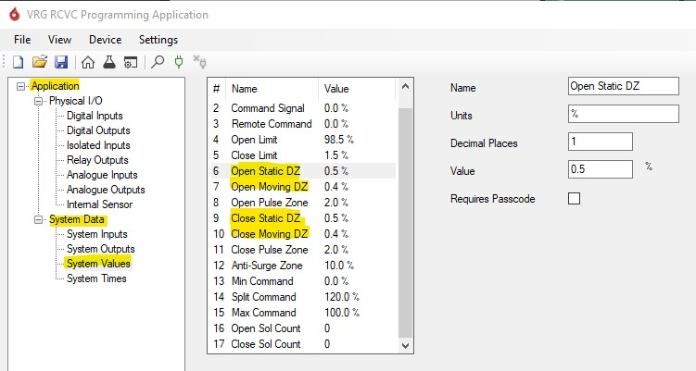
RCVC - Common Setup Tasks - Adjusting Dead Bands and Pulse Zone
Go to Application -> System Data -> System Values
Select Open Static/Open Moving and Close Static/Close Moving
Change to desired value, if cycling increase both values. (Static DB must be 0.1% greater than Moving DB)
Accept the new values and test to ensure cycling has stopped

Slide 5
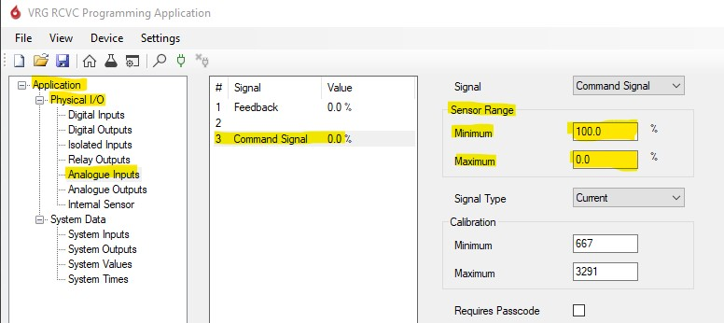
RCVC - Common Setup Tasks - Reversing Valve Action
Go to Application -> Physical I/O -> Analog Inputs and select COMMAND
Go to SENSOR RANGE, Change MIN to 0.0 and MAX to 100, This will change valve operation to open on increasing
To change back just set MIN to 100 and MAX to 0.0, this will change valve operation to close on increasing
Go to Application -> Physical I/O -> Analog Outputs and select FEEDBACK
Go to SENSOR RANGE, Change MIN to 0.0 and MAX to 100, This will change valve operation to open on increasing
To change back just set MIN to 100 and MAX to 0.0, this will change valve operation to close on increasing
Make sure that the sensor range for COMMAND (Input) and FEEDBACK (output) match
DO NOT ADJUST SENSOR RANGE FOR ANALOG INPUT FEEDBACK!!!!

Slide 6
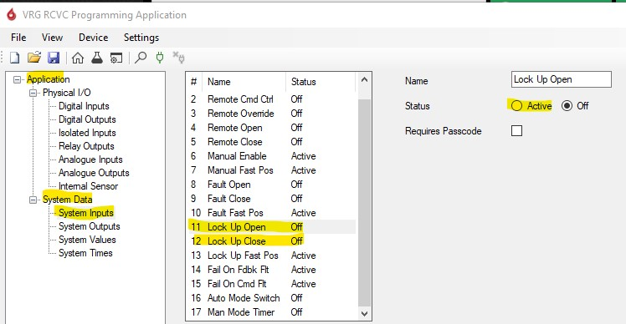
RCVC - Common Setup Tasks - Engage Lock Up
Go to Application -> System Data -> System Inputs
Select Lock Up Open and change status to active
Select Lock Up Close and change status to active
This will energize the solenoid when the vale reaches full open or full close position (Note: this can prevent cycling at full open and close positions but can also reduce the life of the solenoids.)

Slide 7
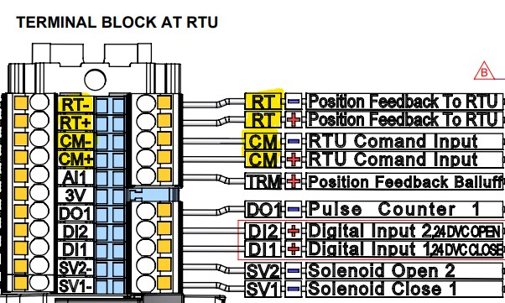
RCVC - Common Troubleshooting – Feedback / Command Retrans Failure
Check all wire connections to ensure wires are landed properly
Make sure that both command and feedback loops are powered by the RTU
Verify with loop calibrator if the RTU does not see the Retransmission signal or the RCVC does not see Command signal

Slide 8
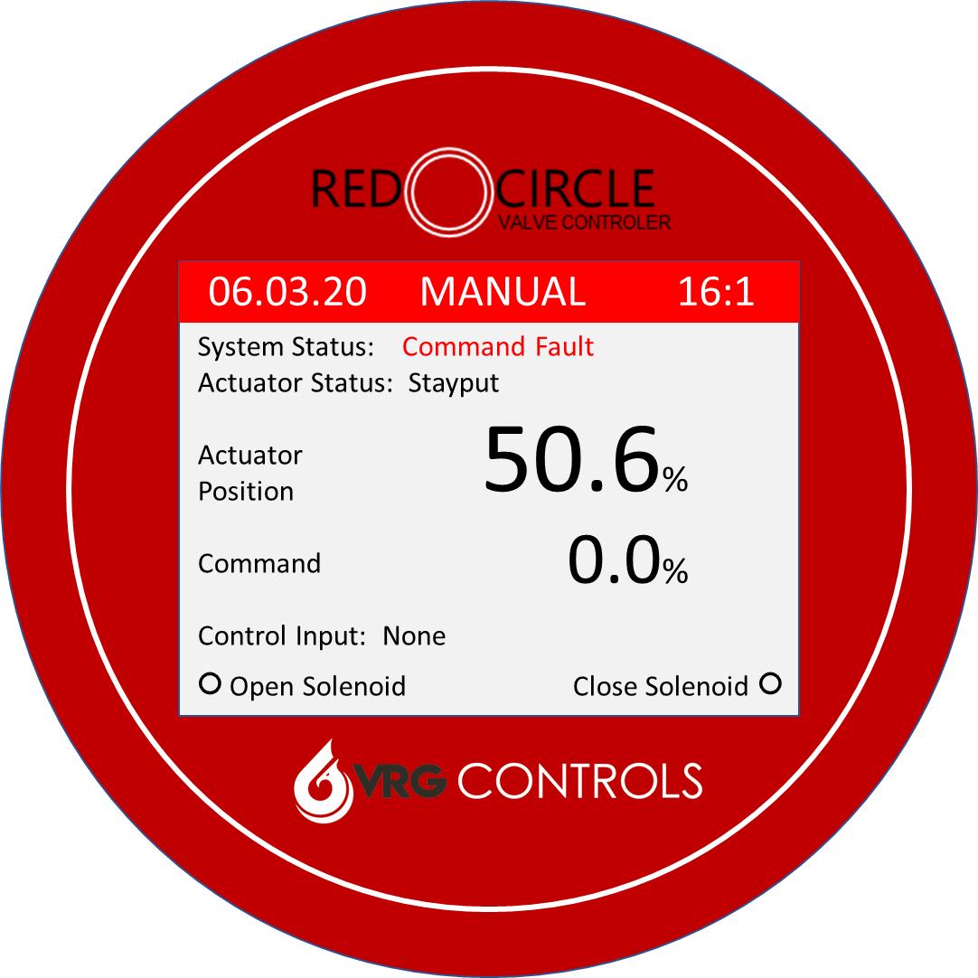
RCVC - Common Troubleshooting – Check for Leaks
Using the RCVC move the valve to 50% then switch RCVC to manual mode.
Monitor the Actuator position to see if there is any movement. If the valve moves there is a leak in the system
To find the leak close off block valves and set VMO to manual. This will isolate parts of the tubing so it will be easier to find the leak
When no leak can be found on the tubing, but actuator position still changes check the solenoids for leaks.

Slide 9
RCVC - Common Troubleshooting – Check for Leaks
RCVC Leak Check Logic Table
Act | Action | Control Valve Drift | Tubing Leak? | Solenoid Leak?
RHPA-DA | DA | Toward OPEN | CLOSE Side | Check All Ports
RHPA-DA | DA | Toward CLOSE | OPEN Side | Check All Ports
RHPA-SR | STO¹ | Toward OPEN | OUTPUT Tubing Loop | Open Solenoid
RHPA-SR | STO¹ | Toward CLOSE | N/A | Close Solenoid
RHPA-SR | STC² | Toward CLOSE | OUTPUT Tubing Loop | Close Solenoid
RHPA-SR | STC² | Toward OPEN | N/A | Open Solenoid
Notes:
STO = Spring to Open
STC = Spring Close

Slide 10
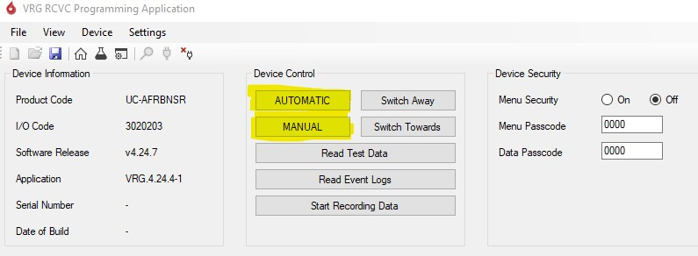
RCVC - Common Troubleshooting – Auto / Manual Lock Up
With the current software sometimes the RCVC will stay locked in automatic mode and can not be changed to manual mode when using the scroll wheel.
This can be fixed by power cycling the unit or by clicking the automatic and manual buttons on the software.

Slide 11
RCVC – New Software Interface
Ability to view and save Event logs as a PDF
Easier to use interface with simplified value adjustments.
Easier and more accurate Remote calibration features.
More reliable and stable USB connection (new USB Connector)
Auto-calibration for Balluff/Westlock Feedback to RCVC
Program stores setup files for ease of use

Slide 12
Our Contact Information
VRG Controls, LLC
Toll-Free: +844-FLOW-VRG (USA & CANADA)
e-Mail: Sales@VRGControls.com
www.VRGControls.com
VRG Controls, LLC
1199 Flex Court, Unit B
Lake Zurich, Illinois 60047 USA
VRG Controls, LLC
Solutions for Natural Gas!
Follow Us:

Slide 13
RCVC – New Software Interface
06.03.20 MANUAL 16:1
System Status: Command Fault
Actuator Status: Stayput
Actuator
Position
Command
Control Input: None
○ Open Solenoid Close Solenoid ○
50.6%
0.0%

