Slide 1


RCVC
Red Circle
Valve Controller
07/27/26

Slide 2
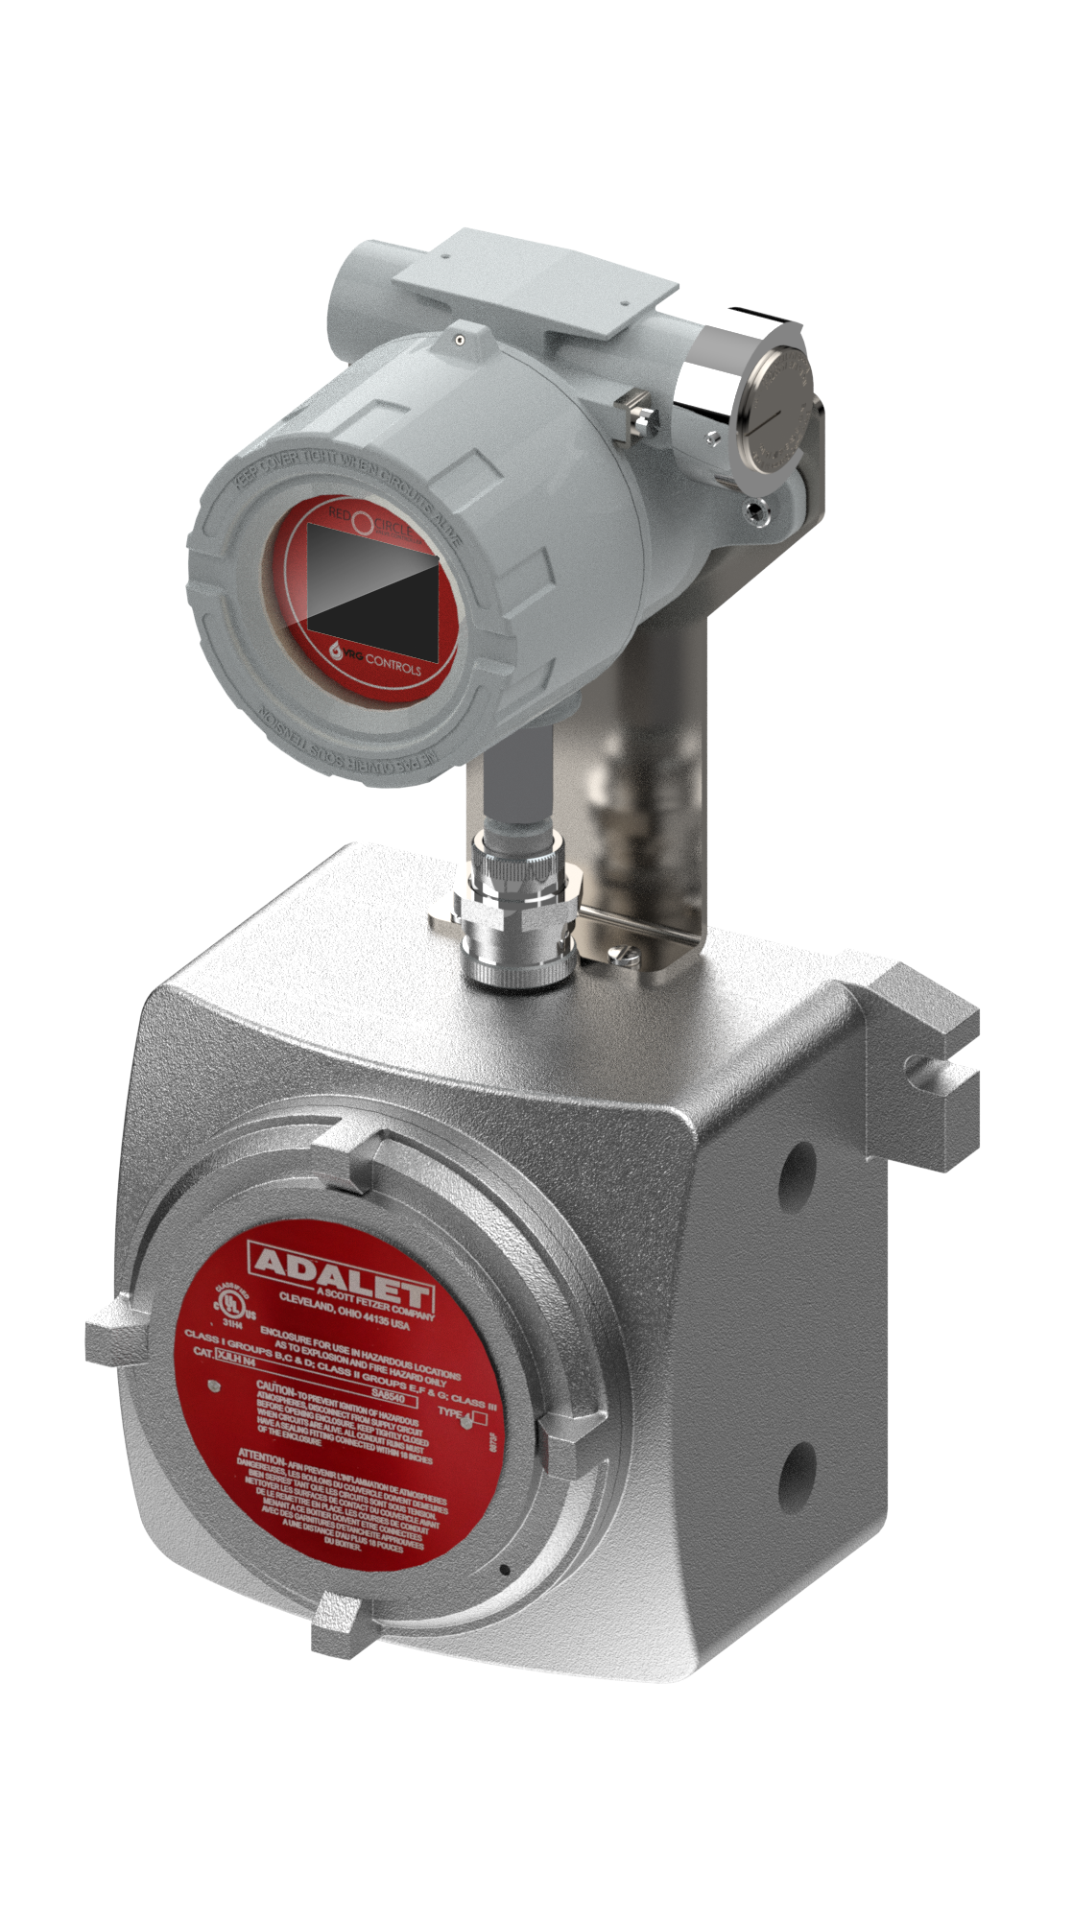

RCVC Red Circle Valve Controller
Rugged and Intelligent Valve Control with Zero Steady State Emissions for Natural Gas Control Valves
  The VRG Red Circle Valve Controller provides accurate positioning of natural gas control valves via electronic signal. The RCVC can accept analog or discrete input signals. The RCVC is compatible with all VRG Controls control valve actuators and may also be installed on virtually any design of pneumatic control valve actuator. The Red Circle Control Valve features zero steady state consumption with an ability to discharge emissions to a suitable nearby pressure system. The high-pressure capability of the RCVC system allows for efficient use of more compact pneumatic actuators. The RCVC is equipped with the most advanced programmable control capabilities, diagnostics and operational features to ensure the highest performance and easiest integration on new or retrofit applications.
RED
CIRCLE
VALVE CONTROLER
RCVC Red Circle Valve Controller

Slide 3
Features and Functions Designed For Gas Pipelines
Rotary Control Switch Provides Non-Invasive Menu Navigation and Setup
Hi Resolution Color TFT Programmable Display with Intuitive and Easy Read Menu
4-20 mA Analog Command Signal Input OR ±24 VDC Discrete Pulse Positioning
PLUG & PLAY REPLACEMENT FOR BECKER/GE DNGP POSITIONER
ZERO Steady State Emissions with Ability to Discharge to Pressure System for Complete Atmospheric Emissions.
Class 1, Div. 1 Ex Proof Terminal Strip Housing Provides Generous Room for Easy Wire Termination
RCVC Electrical Ports and Mounting Brackets Provide Flexible Configuration. 100% Compatible with Existing Becker/GE DNGP & EFP Enclosures for Easy Retrofit
RCVC May be Installed Directly on Control Valve or Remotely in Control Cabinet or RTU Building
RED
CIRCLE
VALVE CONTROLER

Slide 4
RCVC Exclusive Features – Only with VRG!
RCVC Override – Apply 24 VDC to OPEN/CLOSE Valve – No Additional Hardware Required
OPEN/CLOSE on loss 24 VDC Power Supply – For Spring Return Actuated Control Valves
Directionally Adjustable Deadband and Pulse Control in OPEN or CLOSE Direction
Alarm Output (24 VDC) to Indicate Failure of:
  Command Signal
  Feedback Signal
  RCVC Placed in Manual Mode
  Any RCVC System Fault
Pulse Control Allows Adjustable “Asymptote Response” to Eliminate Valve Overshoot
Alarm Output (24 VDC ) can Register in Control System and/or Trigger a Device Such as Solenoid Valve
  Can Swap Between VPC Control and RCVC Control via Alarm Output
  Anti-Surge Control Valves use Alarm Output for Rapid Surge Response
RED
CIRCLE
VALVE CONTROLER

Slide 5
RCVC Standard Features – Designed for Natural Gas
Lock Last Position on Loss of 4-20 mA Command and/or 24 VDC Power Supply
Supply Pressure (Pneumatic) from 30 psig to 250 psig
ZERO Steady State Gas Emissions
Gas-Tight to Ensure any Discharge Directed Safely Outside Building or Enclosure
Discharge to a Pressure System up to 200 psig for Complete Elimination of Emissions
Rotary Control Switch Provides Non-Invasive Menu Navigation and Setup
Class 1, Div 1 Explosion Proof Designed for Natural Gas
Easy RCVC Reversible Action (Reverse / Direct)
“RCVC-REM” Version Designed for Remote Install in Building
Solenoid Counter Pulse Signal May be Communicated Remotely
HART Protocol for Advanced Communication and Remote Configuration Features
USB Link for Setup and Diagnostics of RCVC System
Portable Data Settings for Safeguard and Consistent Configuration
RED
CIRCLE
VALVE CONTROLER

Slide 6
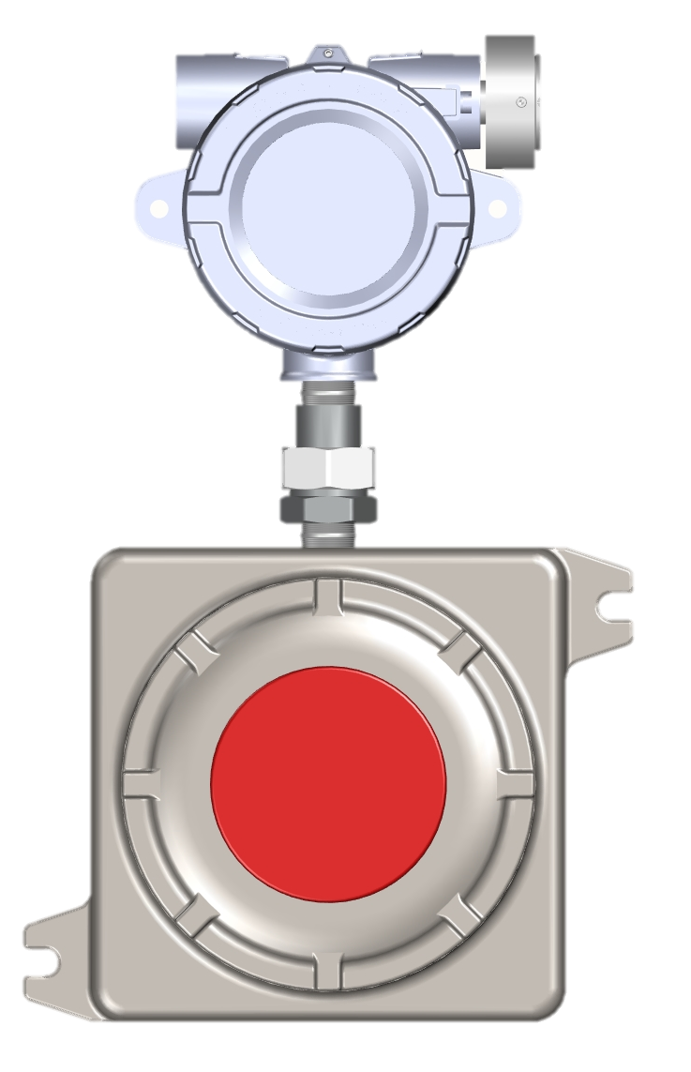
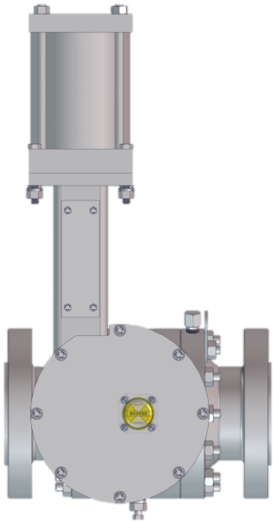

RCVC Schematic – Hi Pressure Double Acting Configuration
Line Pressure
RED
CIRCLE
Supply Regulator
RED CIRCLE
VALVE CONTROLLER
Class 1, Div 1
VALVE CONTROLER
RHPA-DA
Rotary High Pressure Actuator
OPEN
Signal
Adjust Orifices
(Optional)
Micropulse Linear Position Sensor
EX
4-20 mA Command Signal
CLOSE
Signal
24 VDC Power
4-20 mA Feedback Signal
PRCV Pipeline Rotary Control Valve

Slide 7
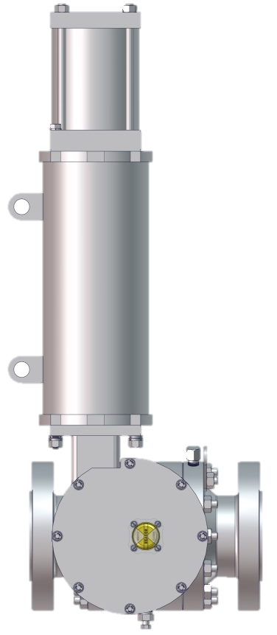
RCVC Schematic – Hi Pressure Single Acting Configuration
Supply Regulator
RED
CIRCLE
Line Pressure
VALVE CONTROLER
RHPA-SR
Rotary High Pressure Actuator
OPEN
Signal
S
RED CIRCLE
VALVE CONTROLLER
Class 1, Div 1
Spring to
CLOSE
CLOSE
Signal
Micropulse Linear Position Sensor
S
EX
4-20 mA Command Signal
4-20 mA Feedback Signal
24 VDC Power
PRCV Pipeline Rotary Control Valve

Slide 8
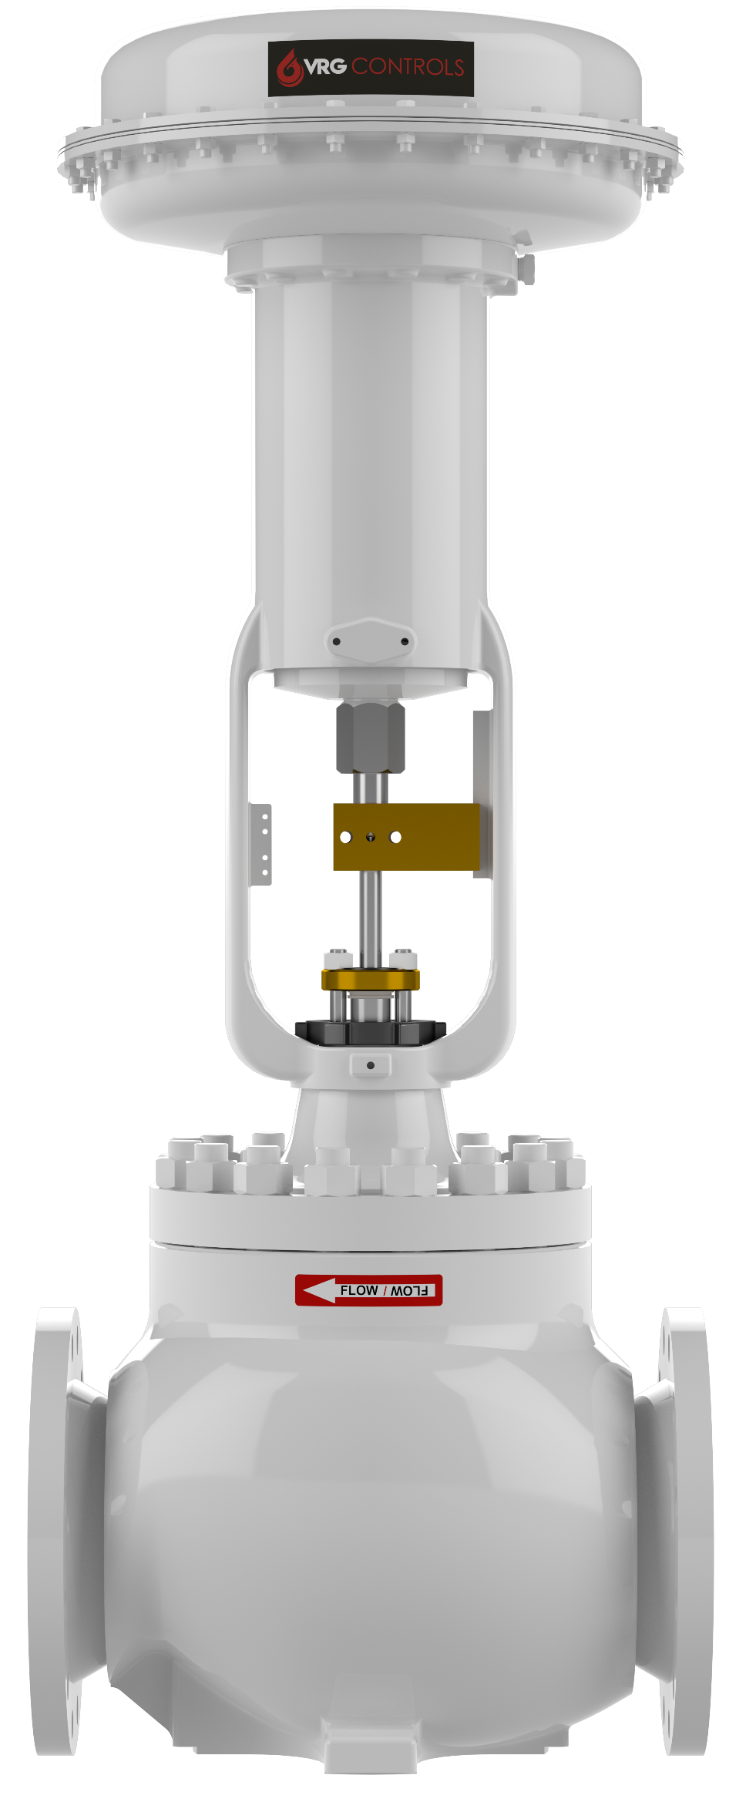
RCVC Schematic – Low Pressure Single Acting Configuration
Supply Regulator
RED
CIRCLE
LD Series Linear Diaphragm Actuator
Line Pressure
VALVE CONTROLER
CLOSE
Signal
S
Spring to
OPEN
RED CIRCLE
VALVE CONTROLLER
Class 1, Div 1
OPEN
Signal
S
Micropulse Linear Position Sensor
EX
4-20 mA Command Signal
4-20 mA Feedback Signal
24 VDC Power
CVET Series
Control Valve

Slide 9
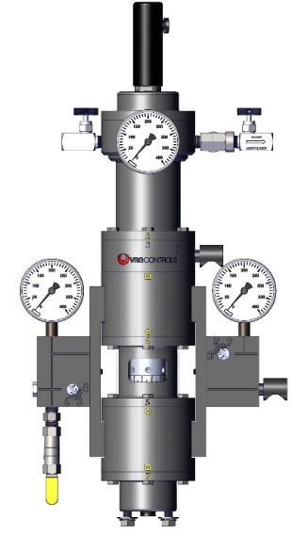
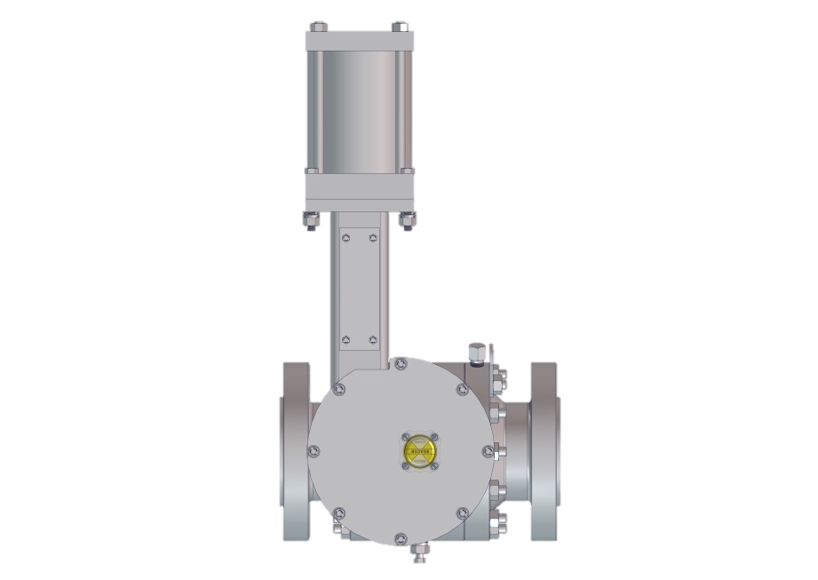
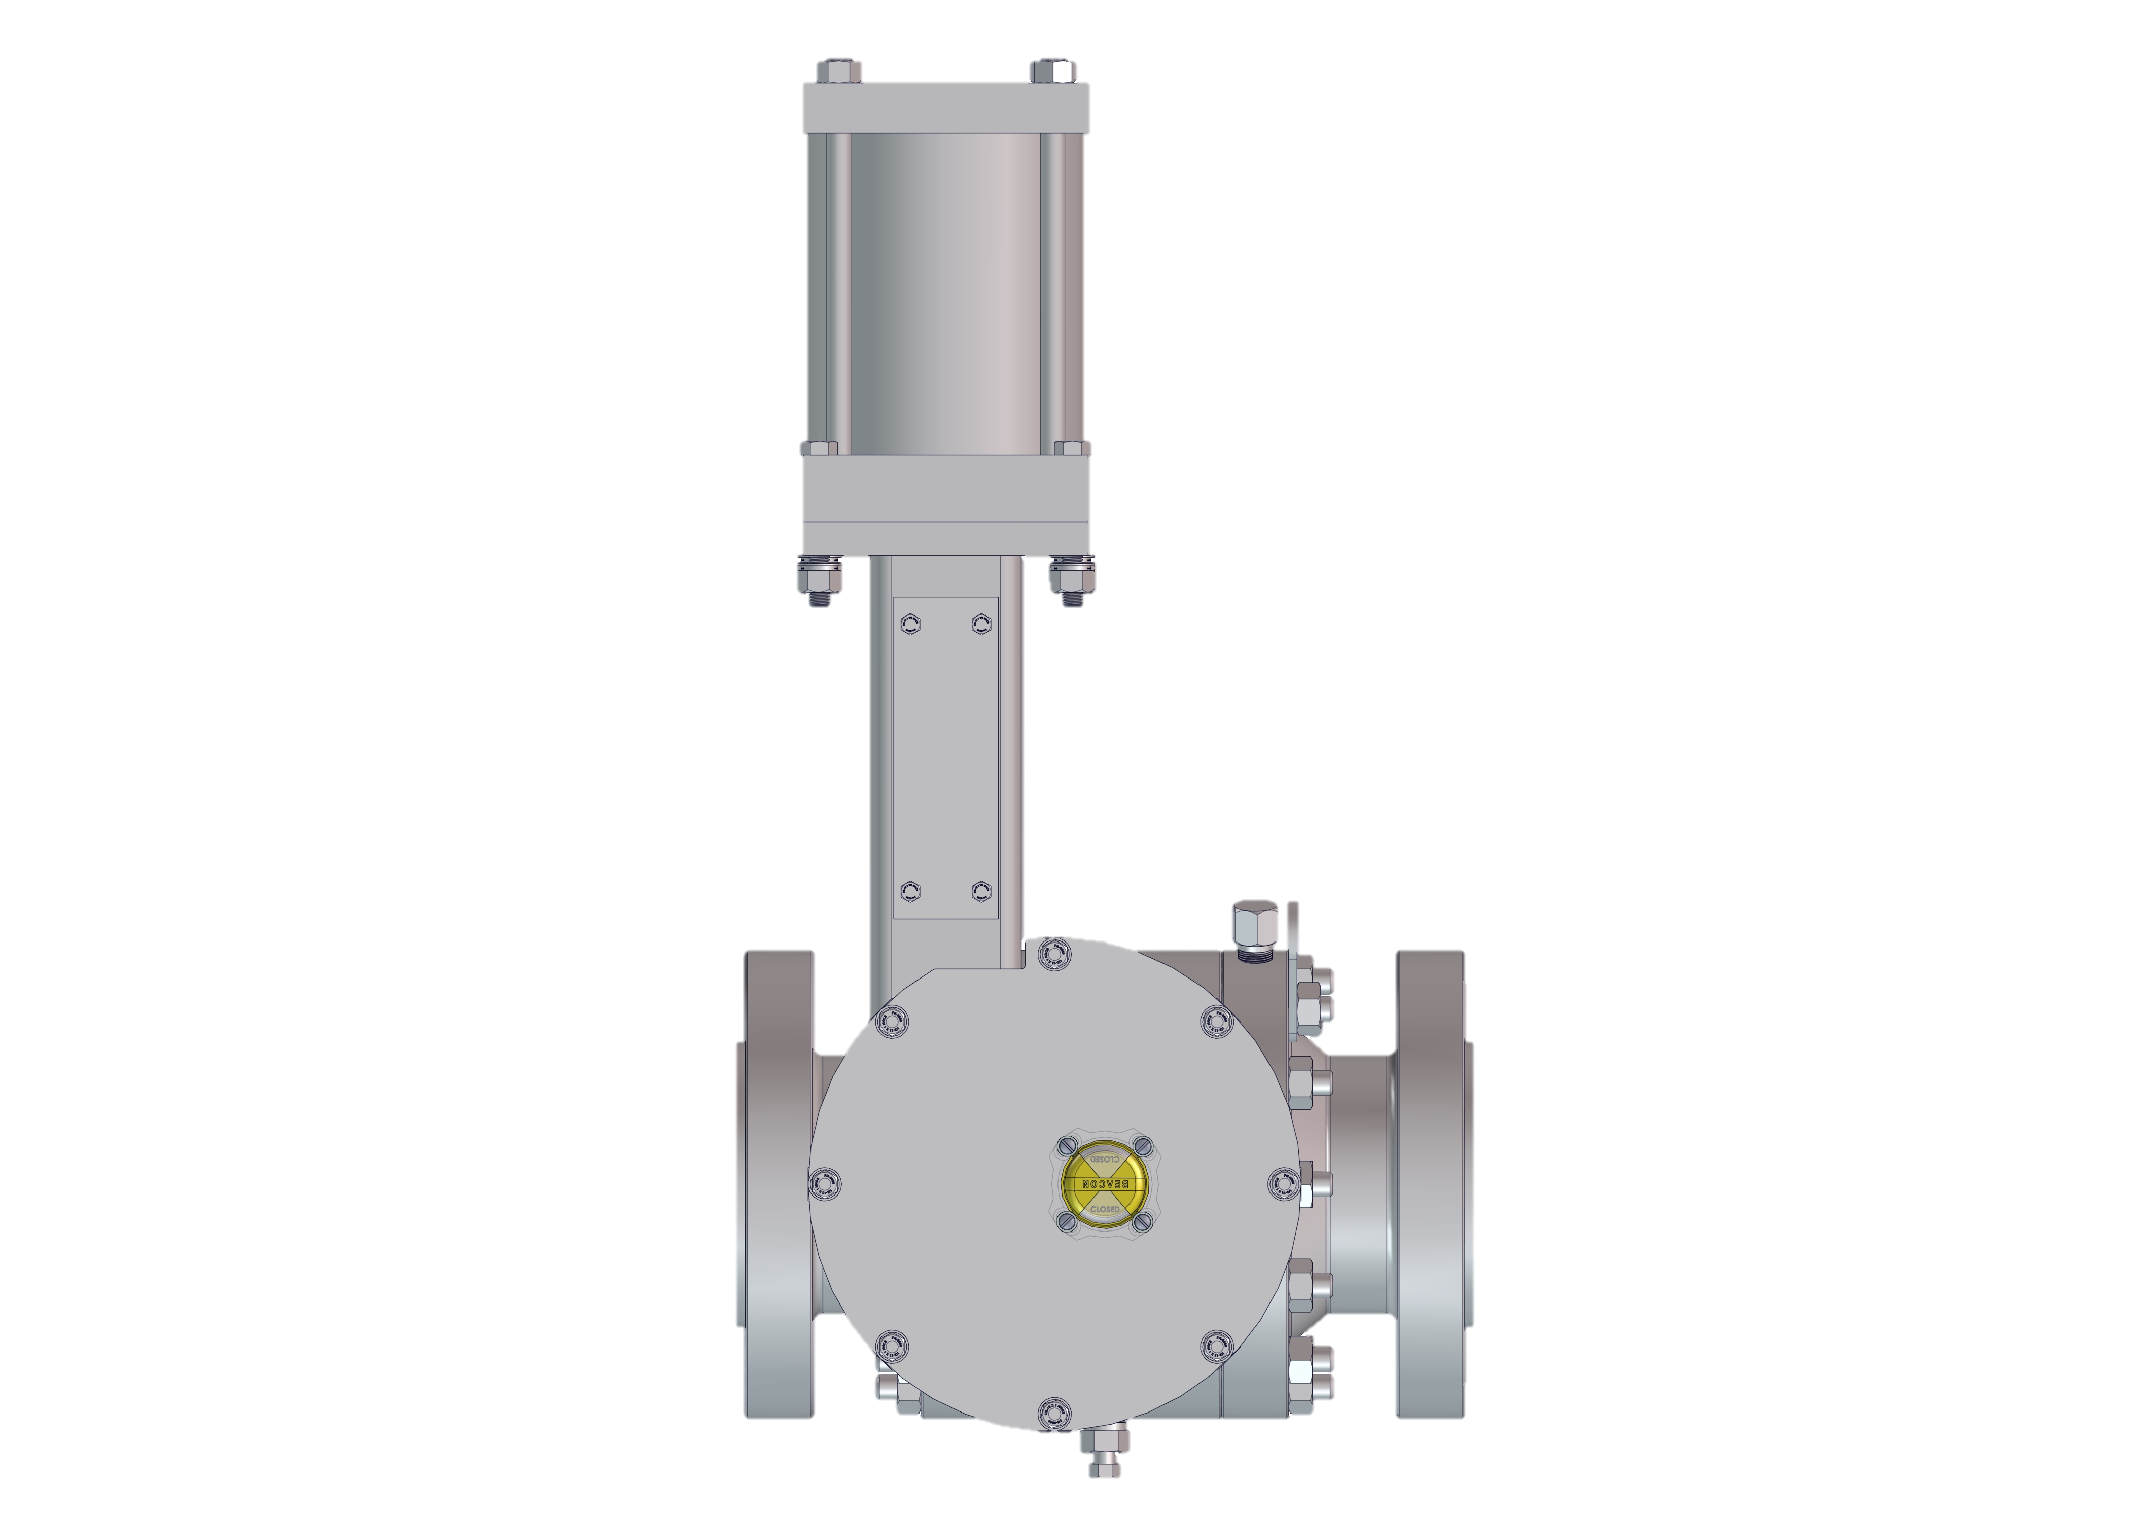
PCO Pressure Control Override – Low Pressure Single Acting
RED
CIRCLE
HSR
VALVE CONTROLER
Supply Regulator
Line Pressure
LD Series Linear Diaphragm Actuator
CLOSE
Signal
S
RED CIRCLE
VALVE CONTROLLER
Class 1, Div 1
Spring to
OPEN
OPEN
Signal
S
Micropulse Linear Position Sensor
EX
4-20 mA Feedback Signal
CVET Series
Control Valve
4-20 mA Command Signal
24 VDC Power
Downstream
Pressure
P₂

Slide 10
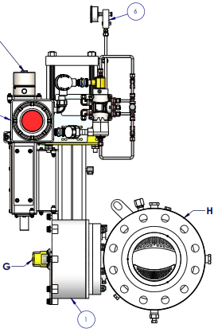
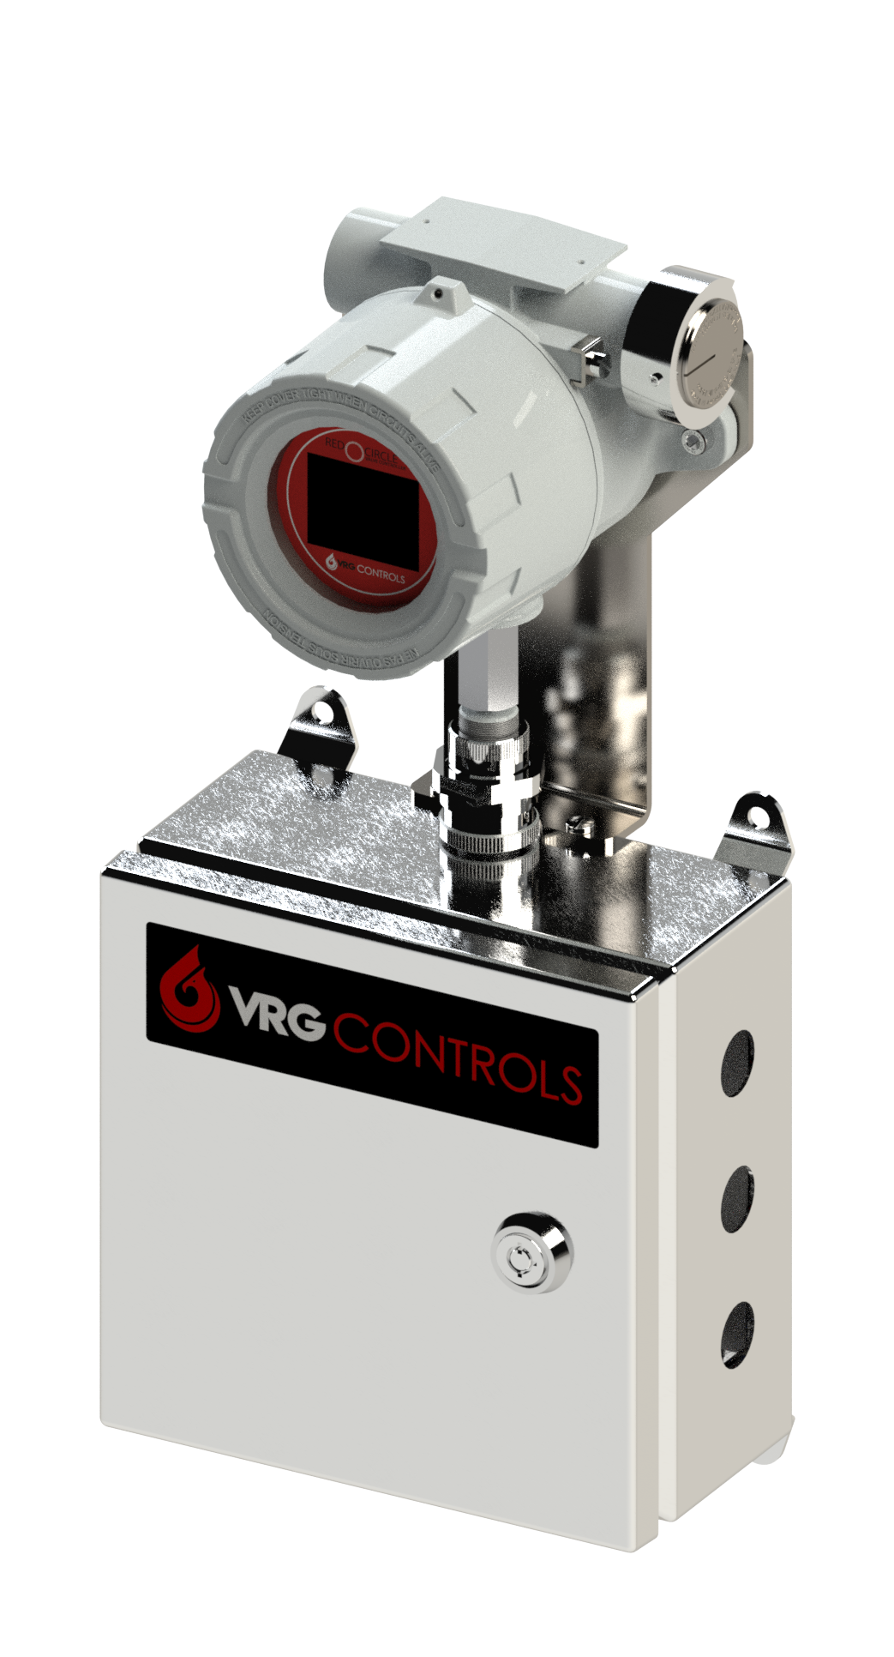
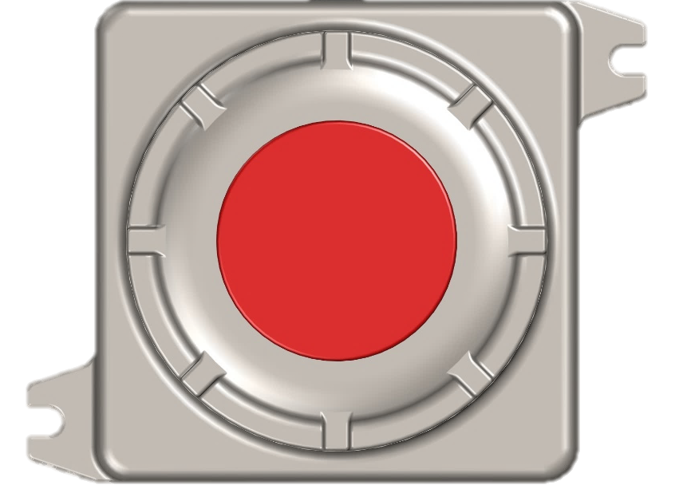
RCVC Remote Installation Configuration
Primary Remote RCVC Components
RCVC Remote Module
RCVC Remote Terminal Box
Balluff Linear Feedback
RCVCSOLDA (AAA) Solenoid Pack
Linear Feedback Module
(BALLUFF)
3
1
4
2
RCVC Remote Junction Box
RCVCREMJUNC
RCVC3000 Remote
Install Configuration
RCVC3000REM
RTU BUILDING
EX-PROOF Cl. 1, Div 1

Slide 11
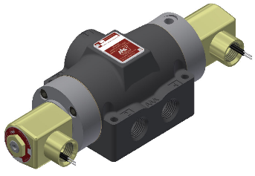

RCVC Solenoid Pack Selection – Double Acting
 | Double Acting Standard Pressure Solenoid Pack | Double Acting High Pressure Solenoid Pack
Supply | 20 – 150 psig | 151 – 250 psig
Model | AAA Model SY4X (Internal Pilot) | AAA Model SY4XZ (External Pilot)
Voltage | 24 VDC | 24 VDC
Type | 3-Position, 5-Way Self-Centering | 3-Position, 5-Way Self-Centering
Other Specs | Cv 0.50, 24 VDC, 3-Position, 5-Way, Self-Centering, Internal Pilot, Mod. Temperature (-20F), Aluminum Construction, Universal, UL CSA CE Approved, Ex Proof Cl. 1 Div 1., Buna N Elastomers, .500 NPT Primary Ports, 0.125 NPT Exhaust Ports, Tapped Exhaust | Cv 0.50, 24 VDC, 3-Position, 5-Way, Self-Centering, External Pilot, Mod. Temperature (-20F), Aluminum Construction, Universal, UL CSA CE Approved, Ex Proof Cl. 1 Div 1., Buna N Elastomers, 0.500 NPT Primary Ports, 0.125 NPT EX-Pilot / Exhaust Ports, Tapped Exhaust

Slide 12
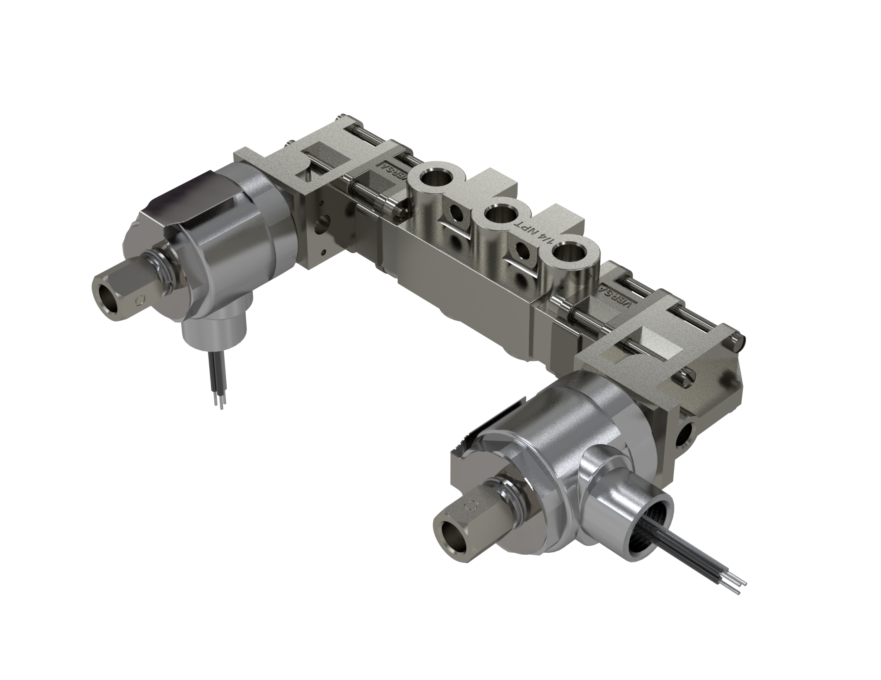

RCVC Solenoid Pack Selection – Double Acting
 | Double Acting Standard Pressure Solenoid Pack
Supply | 20 – 150 psig
Model | Versa VXX-4323-316-H2-ME-S-XXL-44-D024 VRG Part No. BA-7315
Voltage | 24 VDC
Type | 4-Way, 3-Position, Blocked Center Double Solenoid-Pilot Spring Center
Other Specs | Cv 1.8, 24 VDC, 4-Way, 3-Position, Blocked Center Double Solenoid-Pilot Spring Center, Internal Pilot, Mod. Temperature (-20F), 316SS Construction, Cl I, Grps C,D - Cl II, Grps E,F,G - Cl I, Div 2, Grps A,B,C,D - Cl II, Div 2, Grps E,F,G, Buna N Elastomers, 0.250 FNPT Primary Ports, Tapped Exhaust

Slide 13
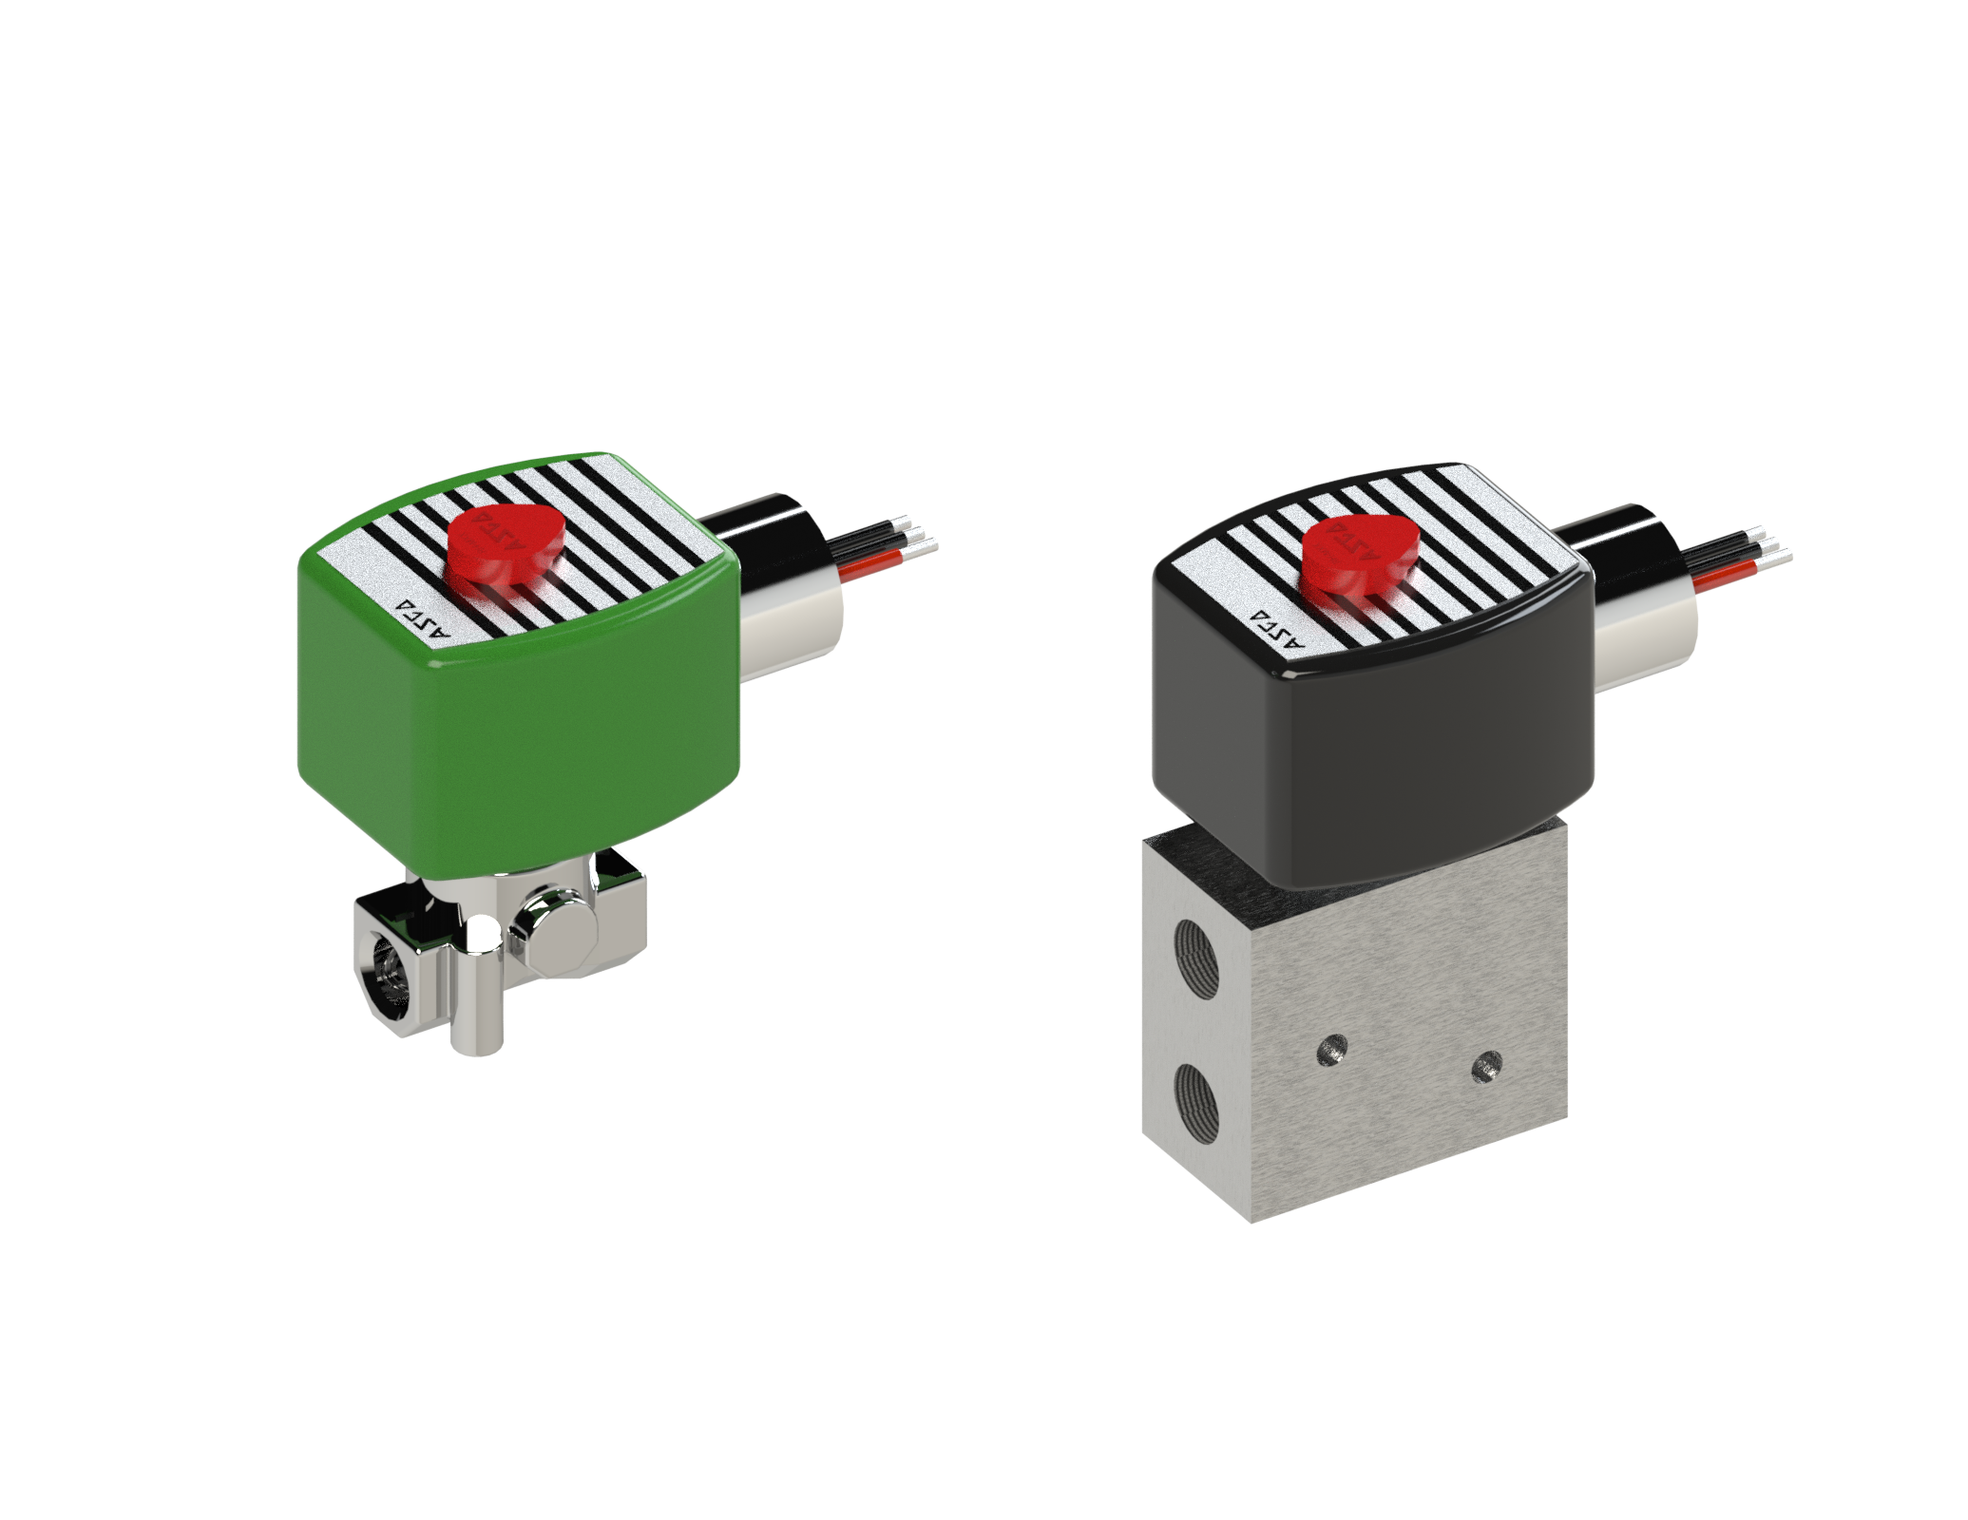

RCVC Solenoid Pack Selection – Single Acting
 | Single Acting High Pressure Solenoid Pack | Single Acting Low Pressure Solenoid Pack
Supply | 41 - 150 psig | 20 – 40 psig
Model | ASCO EV8327G052 (QTY 2) | ASCO 8262G220 (QTY 2)
Voltage | 24 VDC | 24 VDC
Type | 2-Position, 3-Way One Port Plugged 2/2 | 2-Position, 2-Way
Other Specs | Cv 0.50, 24 VDC, 2-Position, 3-Way (One Port Plugged), Low Temp. (-40F), Stainless Steel Body, Universal, UL CSA CE Approved, Ex Proof Cl. 1 Div. 1., Buna N Elastomers, 0.250 NPT Ports, Tapped Exhaust. One (1) for CLOSE and One (1) for OPEN. | Cv 0.50, 24 VDC, 2-Position, 2-Way, Low Temp (-40F), Stainless Steel Body, Universal, UL CSA CE Approved, Ex Proof Cl. 1 Div 1., Buna N Elastomers, 0.250 NPT Ports, Tapped Exhaust. One (1) for CLOSE and One (1) for OPEN.

Slide 14
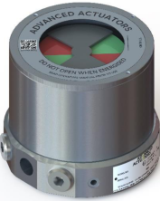
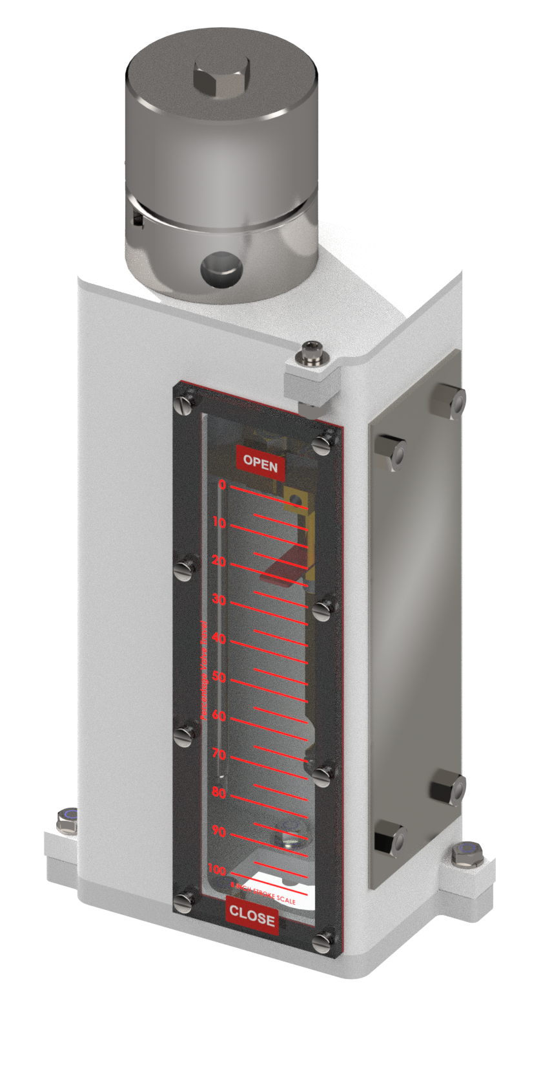
RCVC Feedback and Limit Switch Components
 | Rotary Feedback Module | Linear Feedback Module
Model | Rover A-HR-FS-H-2-M-3N-V-US-522 | Balluff BTL7-E501-M0153-J-DEXC-TA12
Type | Rotary Feedback w Limit Switches | Micropulse Linear Position Sensor
Limit Switches | SP-DT, DP-DT, QTY 2, Mechanical | Not Available
Visual Indicator | Beacon High Visibility Position Indicator | Linear Travel Scale (10% Increments)
Other Specs | VRG ROVER EXd Rotary Feedback w Limit Switches / AA ID: A-HR-FS-H-2-M-3N-VX-US-622 / 4-20 mA + Mechanical Limit Switches (2) / HART / CSA + IECEx / Hi Visibility Indicator (Red_Green) / NAMUR Mount / VRG Part. BA-9893 | 4-20 mA Micropulse Transducer, 0.250 FNPT Elec. Connections, UL CSA CE Approved, Ex Proof Cl. 1 Div 1, Stroke Lengths Available: 4, 6, 8, 12 and “SHORT LENGTH” 2.0 IN or less adjustable, Linear Feedback Mounting Kits Available

Slide 15

RCVC Primary Module Specifications
Model: | RCVC-2000 Red Circle Valve Controller
Installation: | Valve Mount or Remote Installation
Diagnostics: | Onboard Graphical Performance Evaluation
Display: | High Resolution, Programable, Multi-Color Display
Command Signal: | 4 – 20 mA Analog OR 24 VDC Discrete Pulse
Feedback Signal: | 4 – 20 mA (Internal or External Loop Power) Remote/Local Trigger Counter Digital Feedback
Deadband: | Adjustable 0.1% to 2.0% Travel, Typically Set 0.5% Standard
Hysteresis: | 0.5% Full Scale (with standard Rotary Position Feedback Module
Linearity: | 0.5% Full Scale (with standard Rotary Position Feedback Module
Failure Mode: | OPEN, CLOSE, or LOCK on Loss Command Signal
Consumption: | ZERO STEADY-STATE Bleed to Pressure System Capable
Rating: | EXPLOSION PROOF, Class 1, Div. 1
Connections: | ½ FNPT Pneumatic Connections Port ¾ FNPT Electrical Connections
Temperature: | -20°F to +120°F (-29°C to +49°C)
Compatibility: | Dimensions, Ports, Connections 100% Compatible with Existing GE/Becker DNGP Replacement
Communication: | USB Computer Interface
Manual Override: | Local Manual Valve Positioning Onboard
Adjustment: | Non-Intrusive Local Thumbwheel Adjustment
Area Classification: | Class 1, Div. 1 EXPLOSION PROOF
REQUIRES PAIRED SOLENOID VALVE(S) ASSEMBLY
PAIRED VALVE POSITION TRANSMITTER

Slide 16
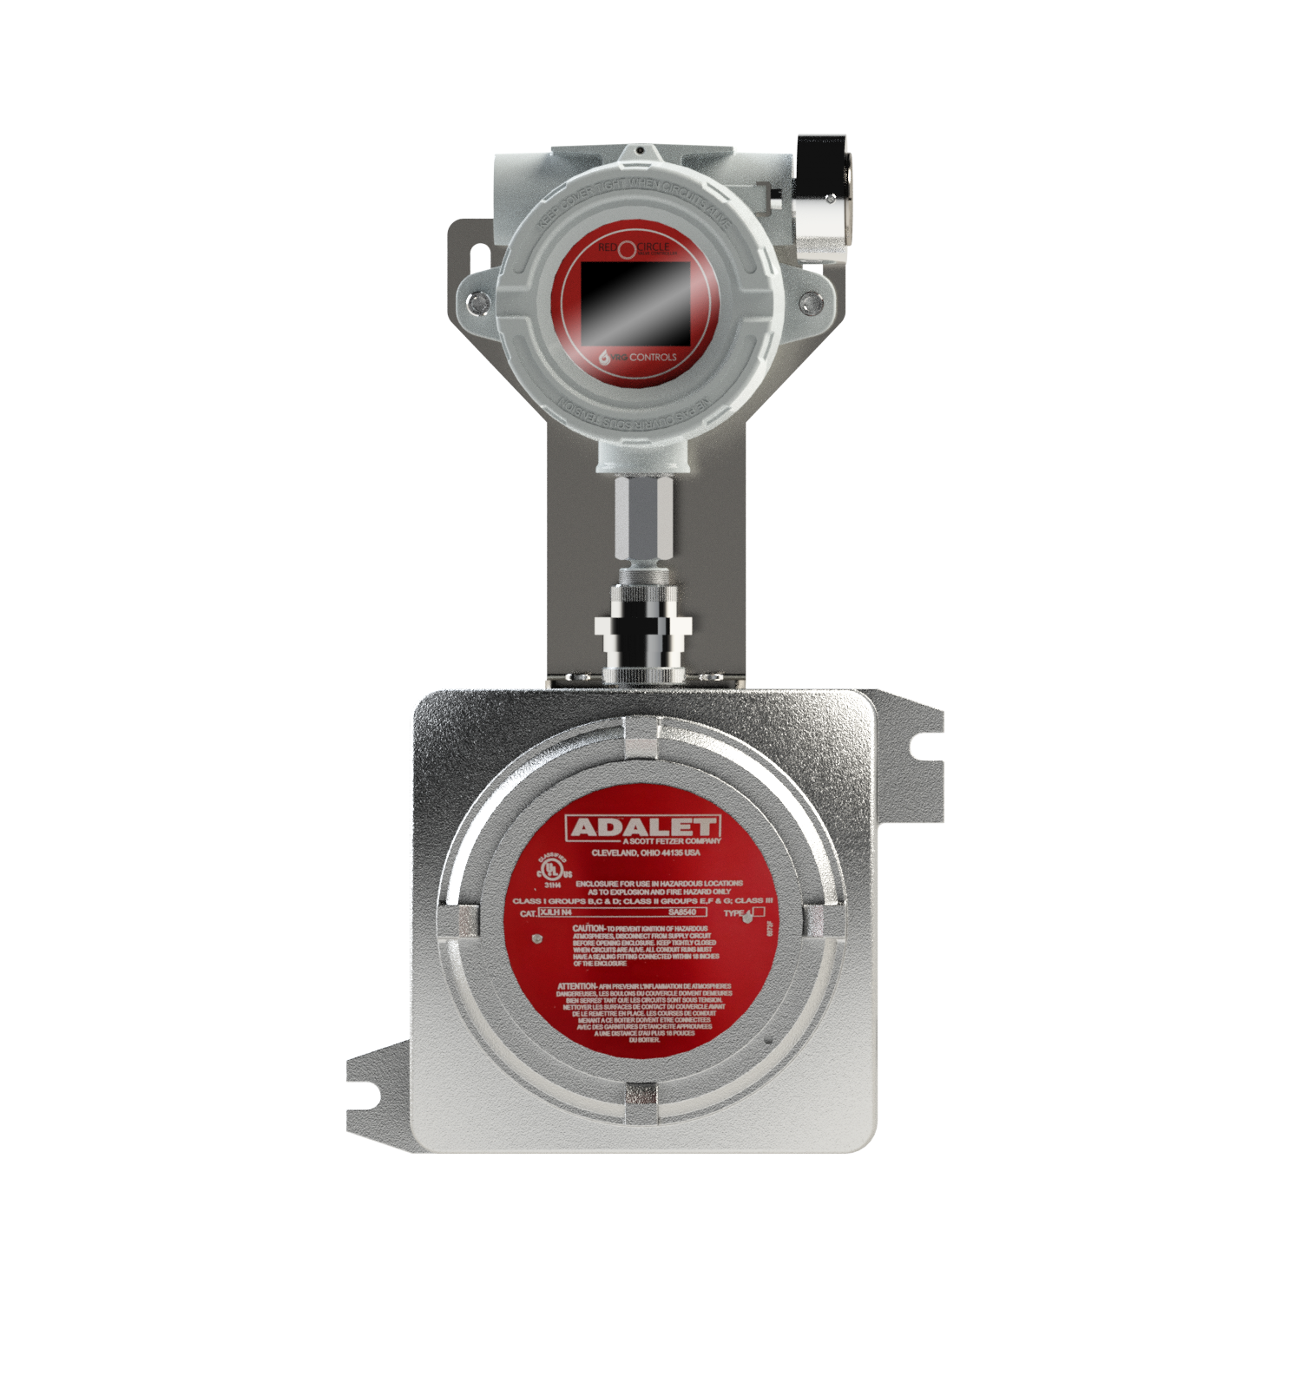
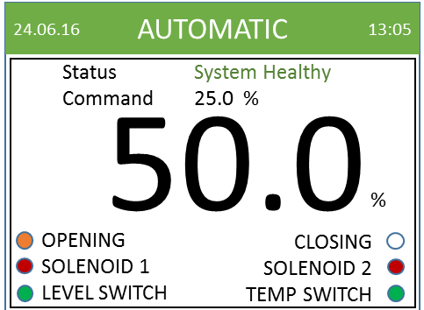
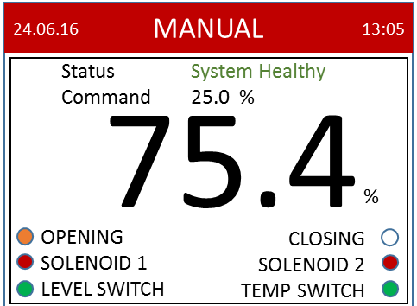
Easy Setup and Configuration via Menu Driven Platform
RED
CIRCLE
VALVE CONTROLER
High-resolution multicolor multipurpose display controlled via Bluetooth, geared for ease-of-access

Slide 17
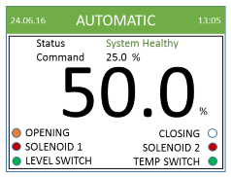
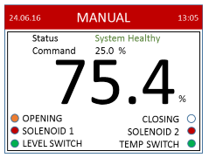
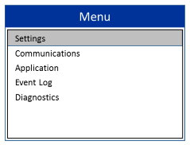
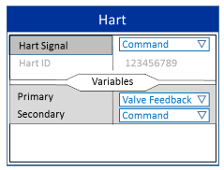
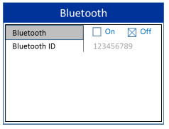
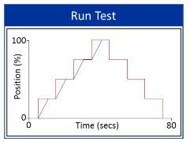
Sample of RCVC Menu Screens
AUTOMATIC Mode | MANUAL Mode | Main Top Level Setup Menu
HART Top Level Menu | BLUETOOTH Top Level Menu | Example STEP TEST Output Graph
RED
CIRCLE
VALVE CONTROLER

Slide 18
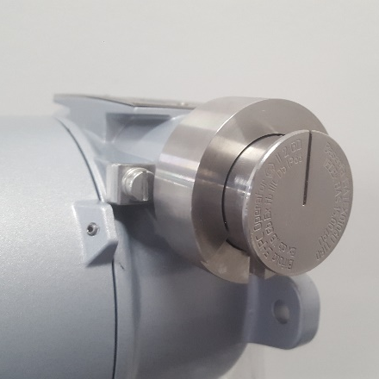
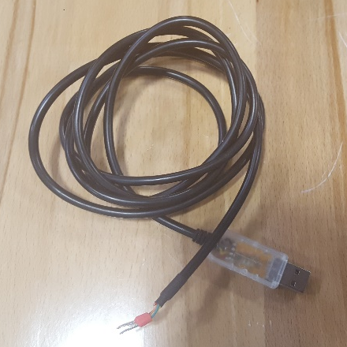
RCVC 3000 Configuration Methods
Navigation Wheel
Setup Application via USB Setup Cable
Navigation Wheel
USB Setup Cable
RCVC Setup Program

Slide 19
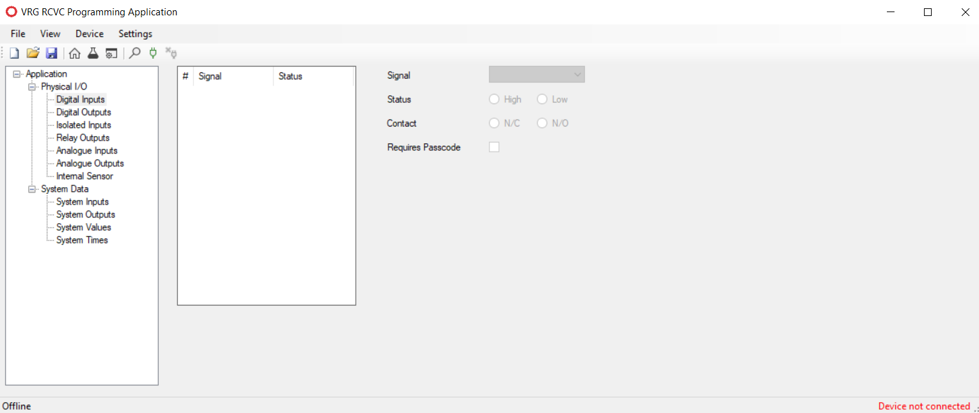

RCVC 3000 Configuration Methods – NEW Standalone EXE Program
EXE Eliminates Excel / VBasic Version Setup Program

Slide 20
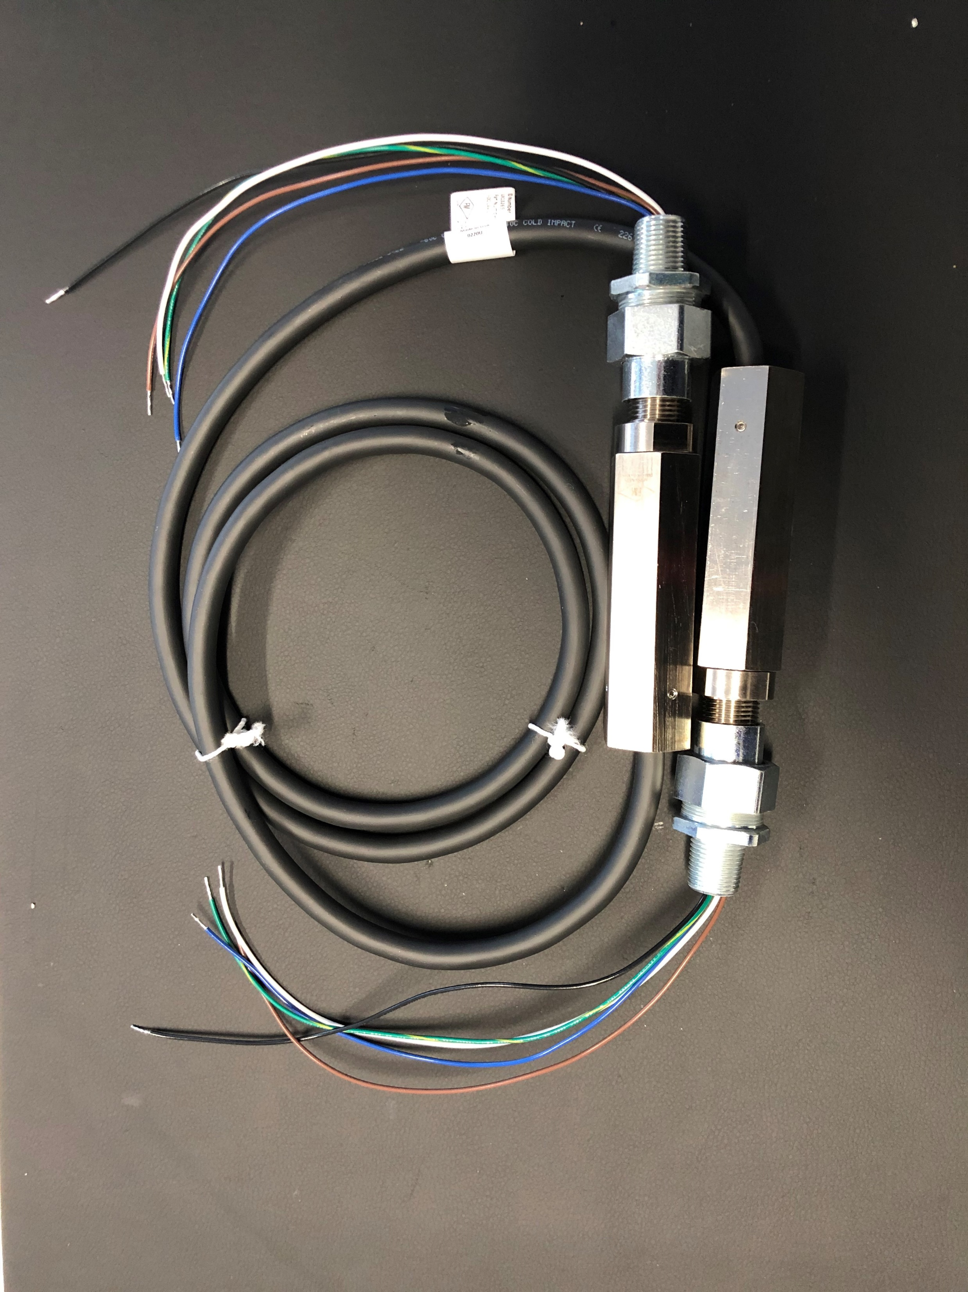
RCVC – New Flexible Cable for Electrical Connections
Class 1 Div. 1 Explosion Proof
One Size Fits All Electrical Cable
Connect RCVC to Solenoid(s)
Connect RCVC to Balluff Transmitter
Eliminates Rigid Ex Proof Conduit
Efficient and Clean Installation
Perfect for Retrofit Installations

Slide 21
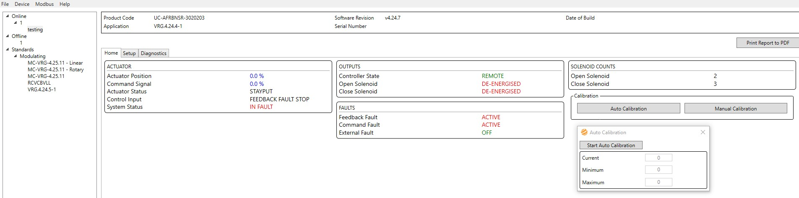
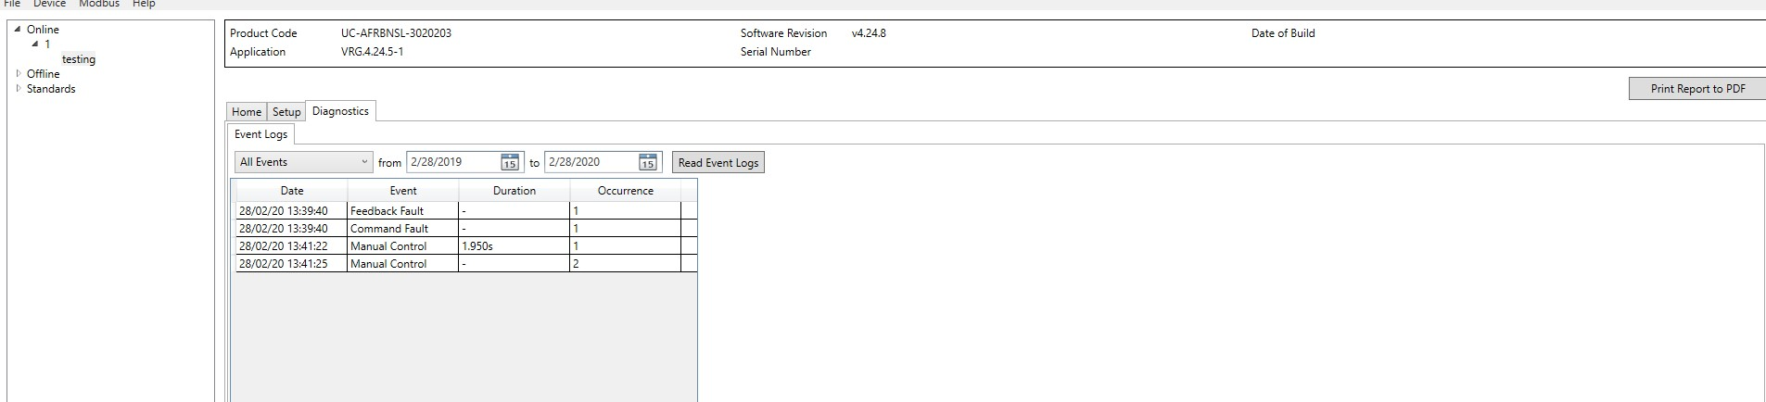
RCVC New Program Interface – Under Development
Auto Calibration Tab
Event Log Tab

Slide 22
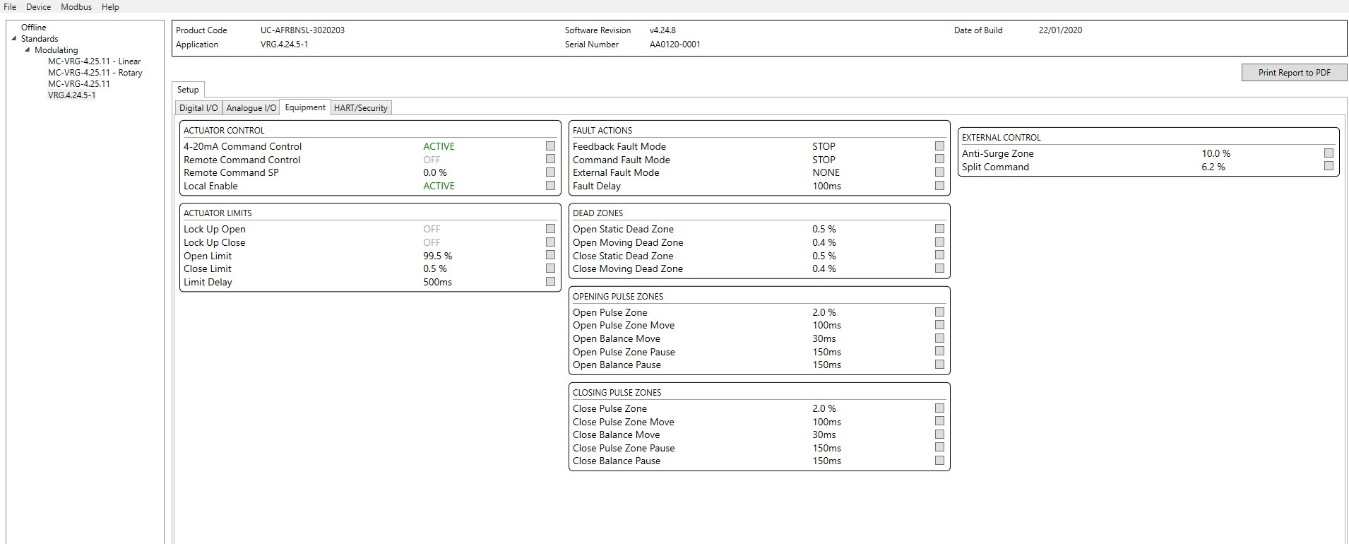
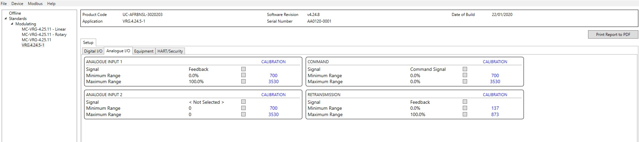
RCVC New Program Interface – Under Development
Equipment Tab
New RCVC “IO” Input/Output Tab

Slide 23
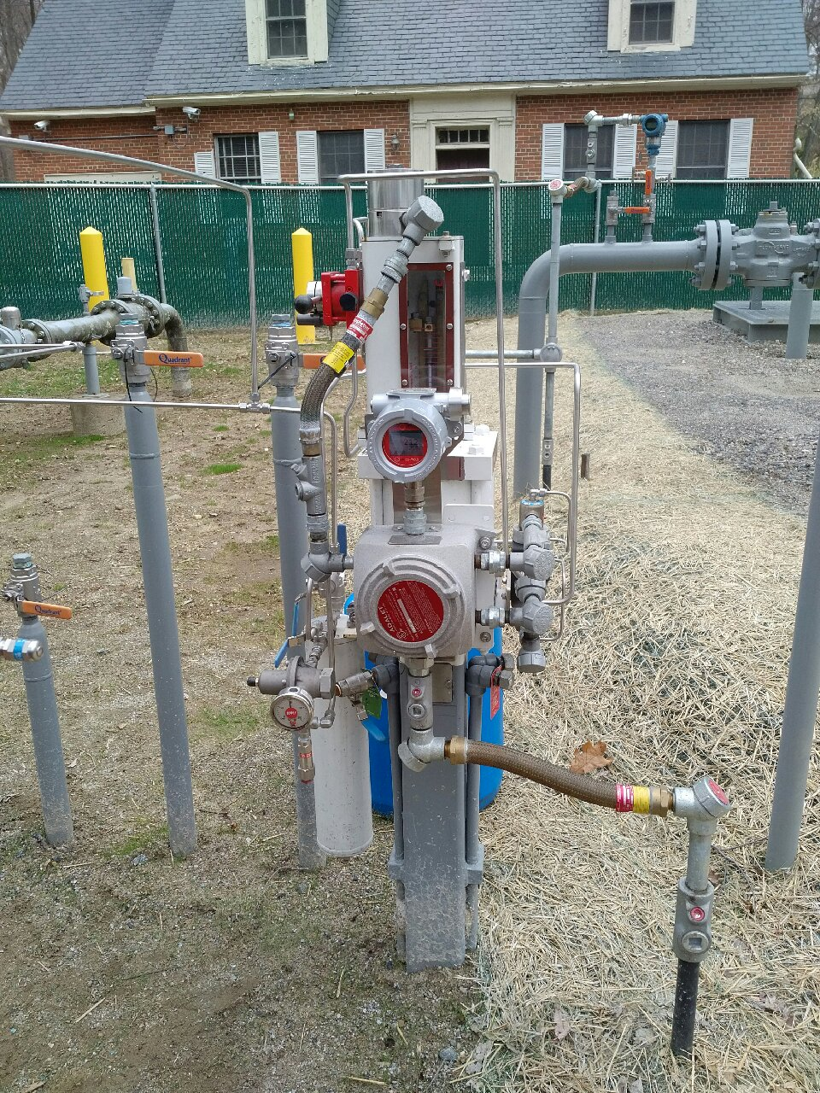
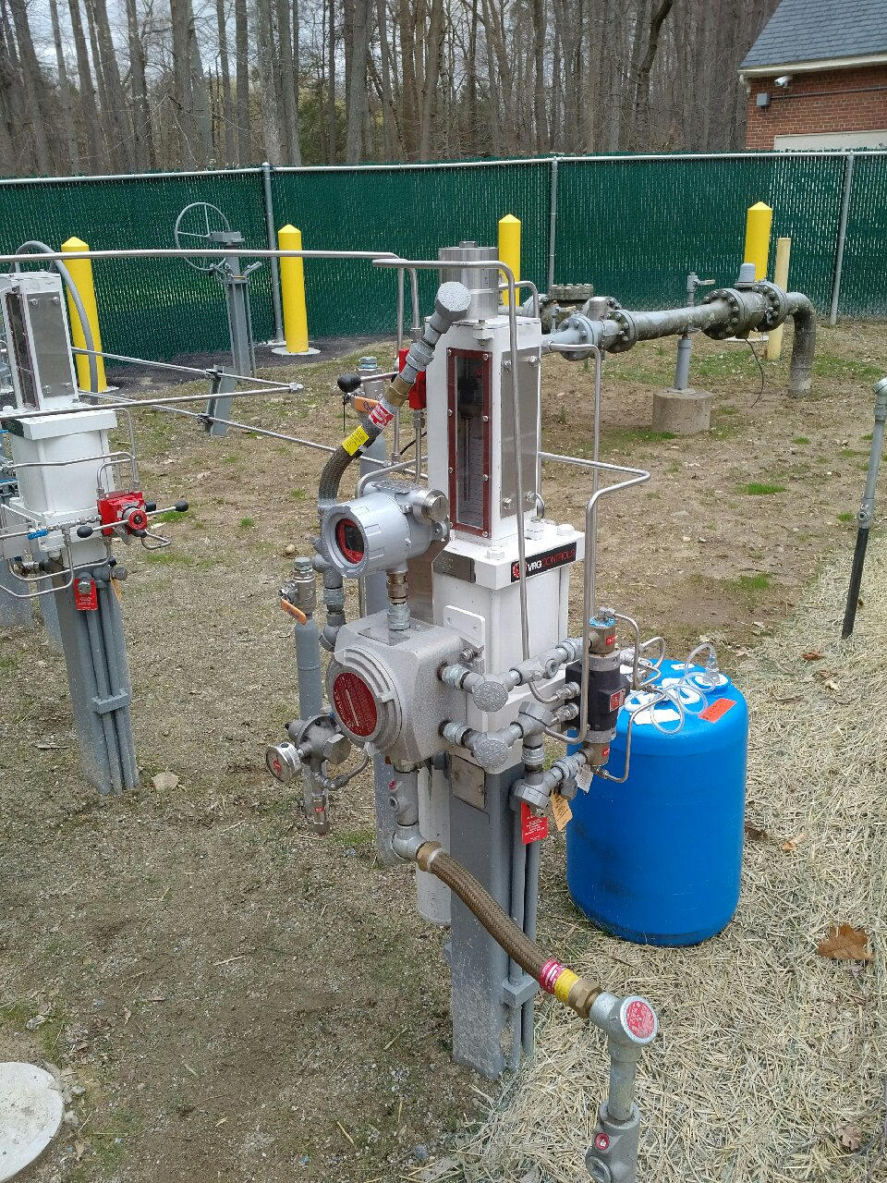
RCVC Application – Kinder Morgan – Rye NY Meter Station FCV
Direct Mount / Double Acting
Below Ground Control Valve

Slide 24
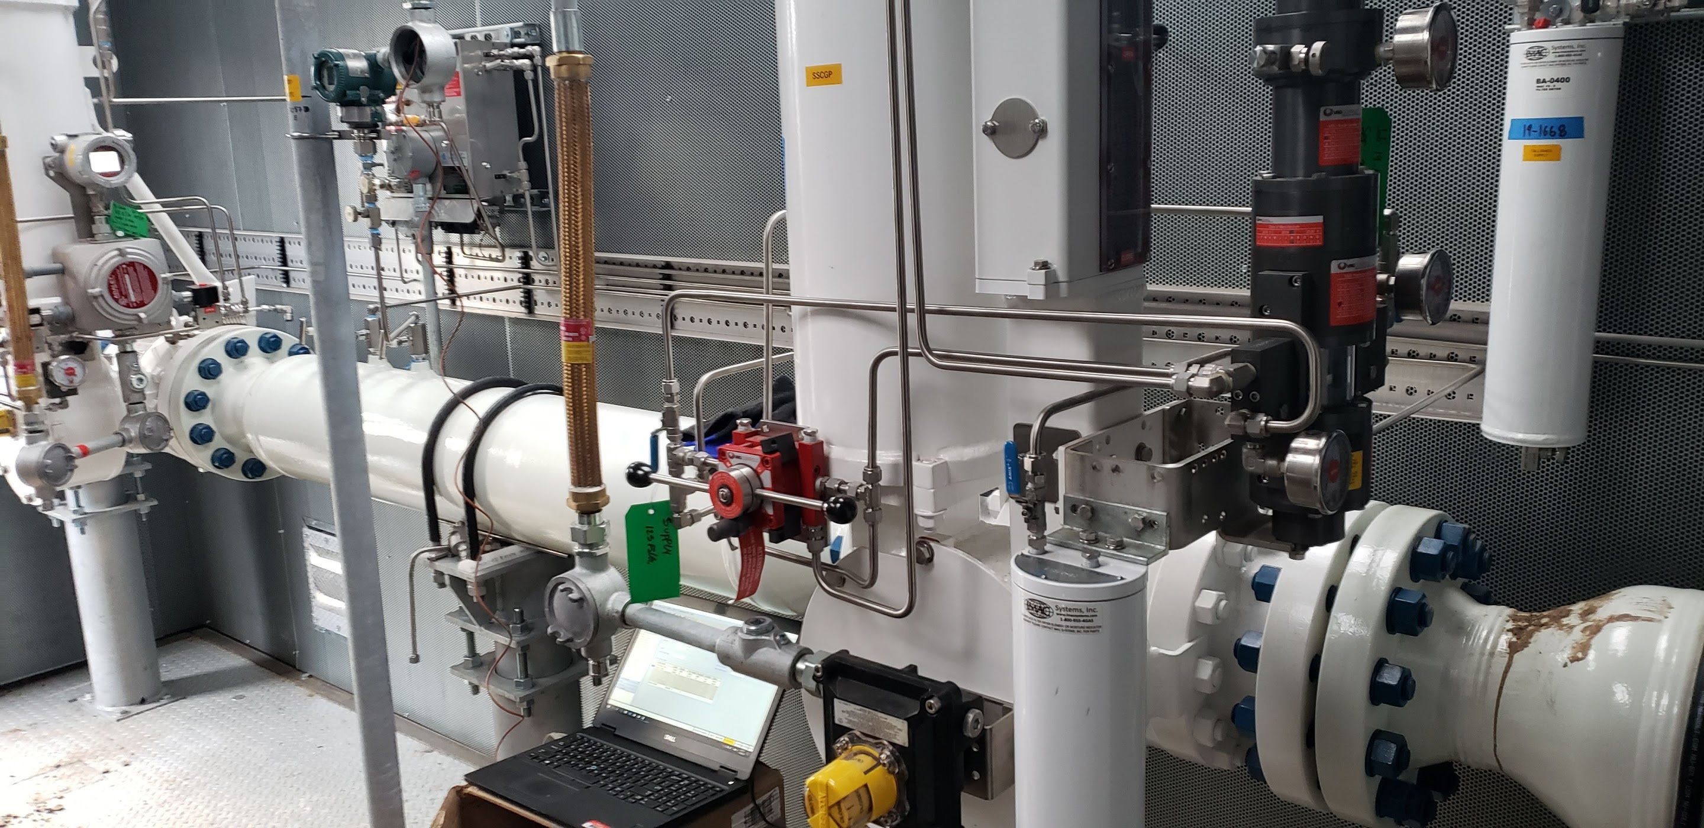
RCVC Application – SSCGP VPC 1st Stage Cut w RCVC Flow Control
P2
Pi
P1

Slide 25
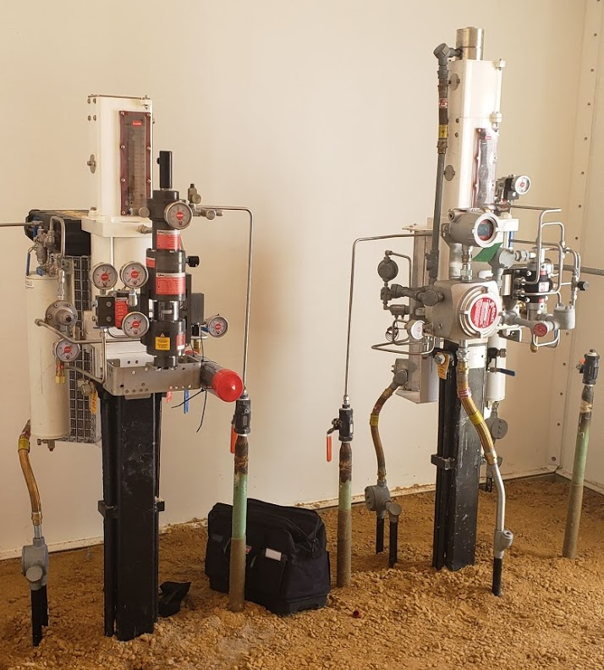
RCVC Application – NICOR Electronic Pressure Control

Slide 26
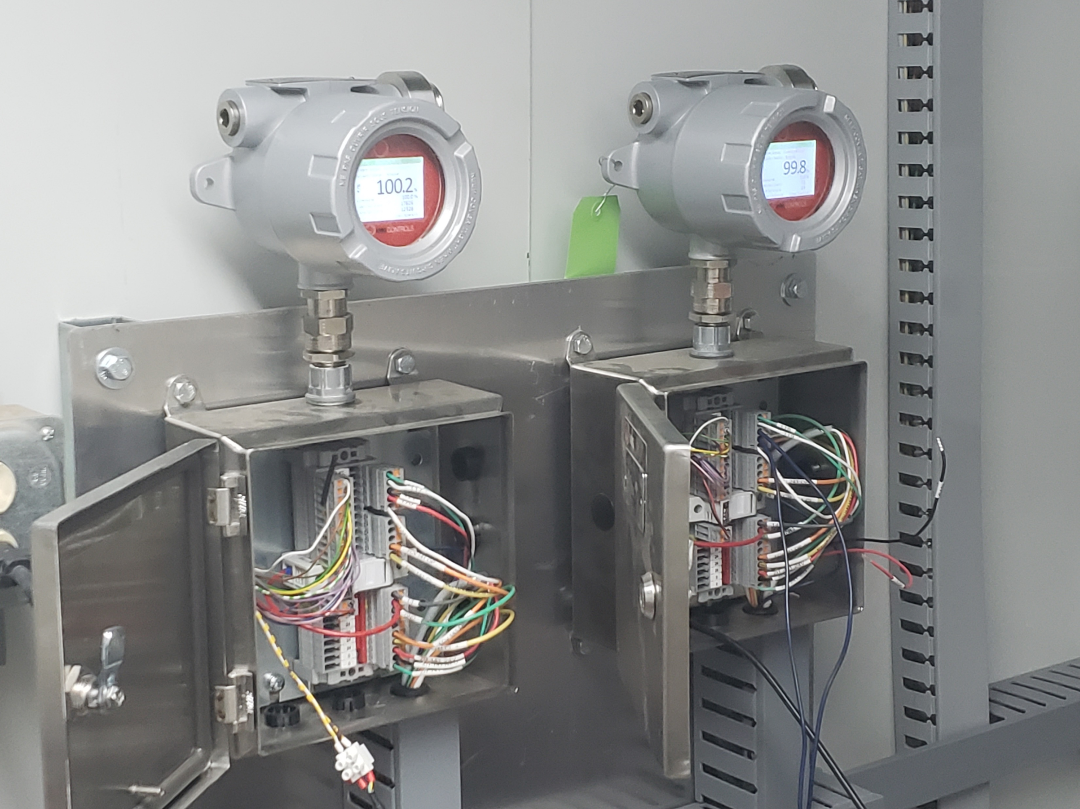
RCVC Application – SWG Corp. – Remote RCVC Installation
Remote Mount RCVC Configuration

Slide 27
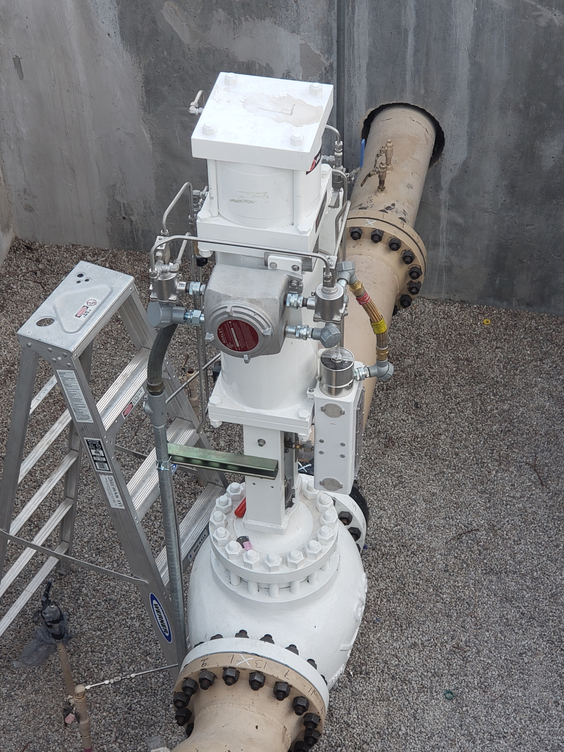
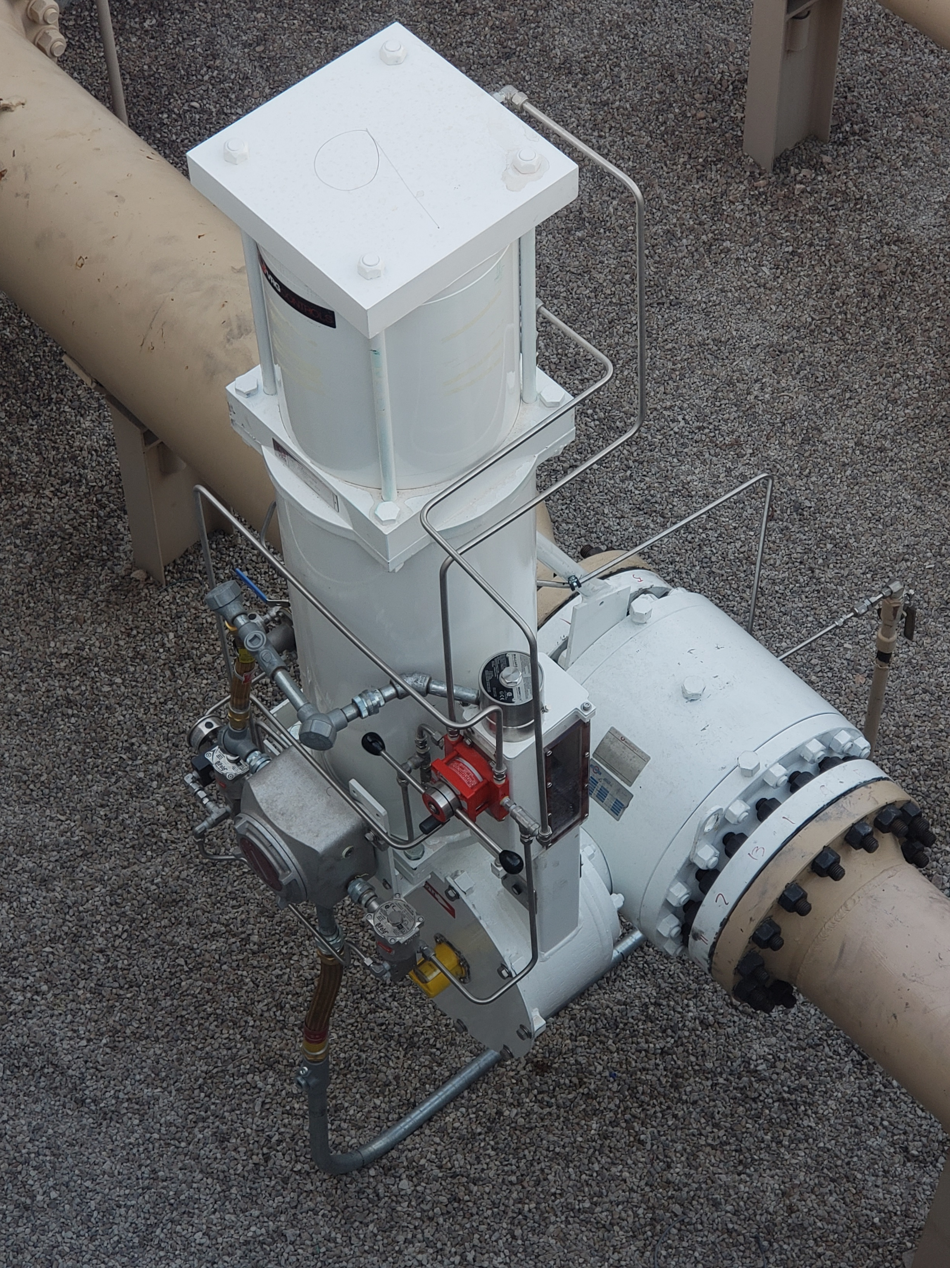
RCVC Application – SWG Corp. – Remote RCVC Installation
LHPA-SR Actuated Globe Valve
RHPA-SR Actuated PRCV Control Valve

Slide 28
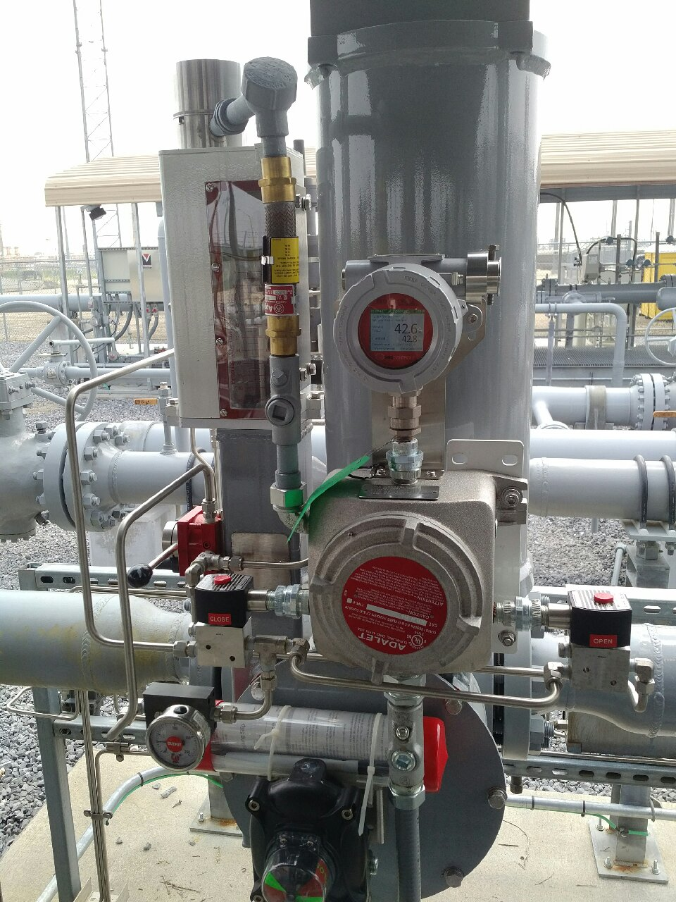
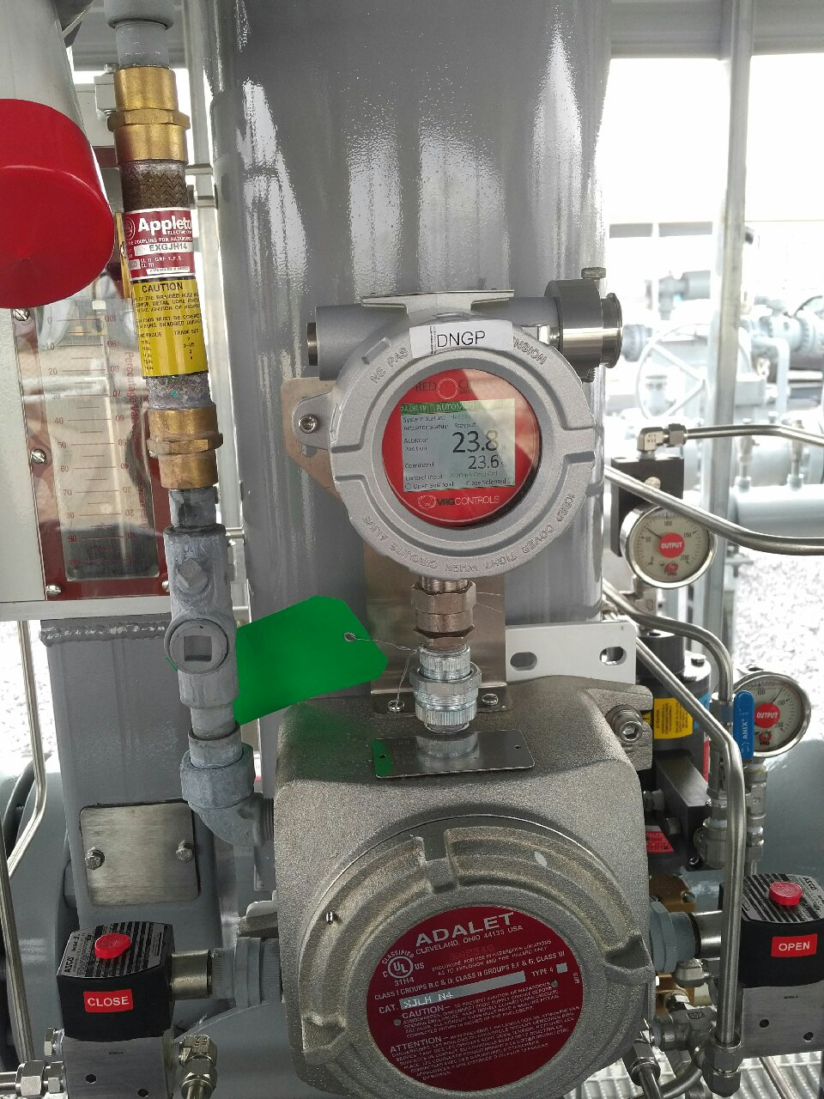
RCVC Application – BWPL Little Gypsy – High Pressure Spring Return
Direct Mount / Single Acting
Direct Mount / Single Acting

Slide 29




Our Contact Information
VRG Controls, LLC
Toll-Free: +844-FLOW-VRG (USA & CANADA)
e-Mail: Sales@VRGControls.com
www.VRGControls.com
VRG Controls, LLC
1199 Flex Court, Unit B
Lake Zurich, Illinois 60047 USA
VRG Controls, LLC
Solutions for Natural Gas!
Follow Us:

