Slide 1
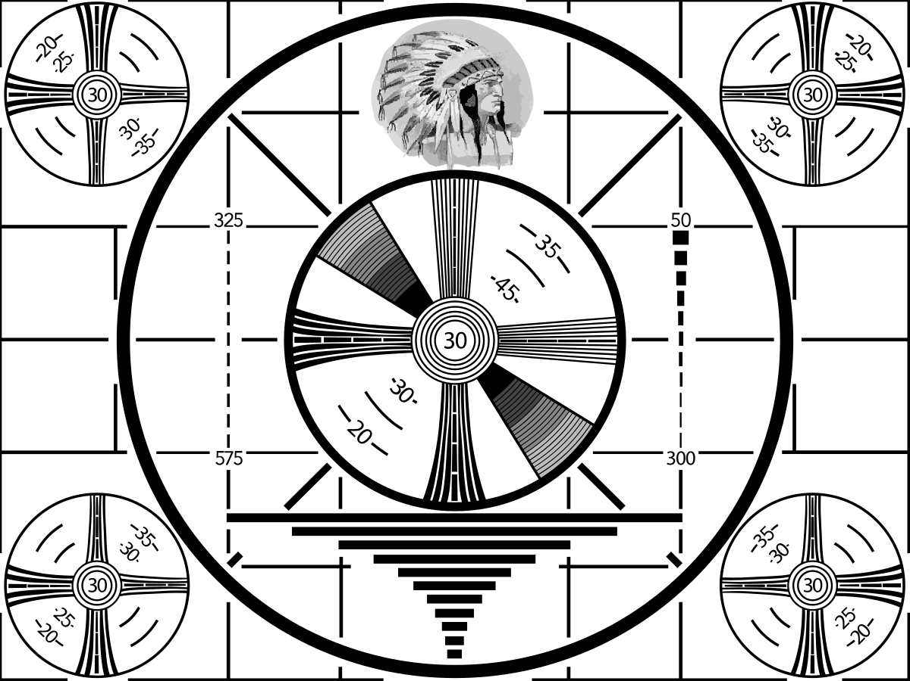
VRG Controls
Noise Attenuation
Solutions for Large
Flow Volume
Natural Gas
M&R Stations
Ver 040920
STAY TUNED
PROGRAM WILL START SHORTLY

