Slide 1
Typical Skid Design – High Volume M&R Stations
VRG Controls
Noise Attenuation Solutions
for Large Flow Volume
Natural Gas M&R Stations
Ver 72723
More Expertise. Less Emissions.

Slide 2
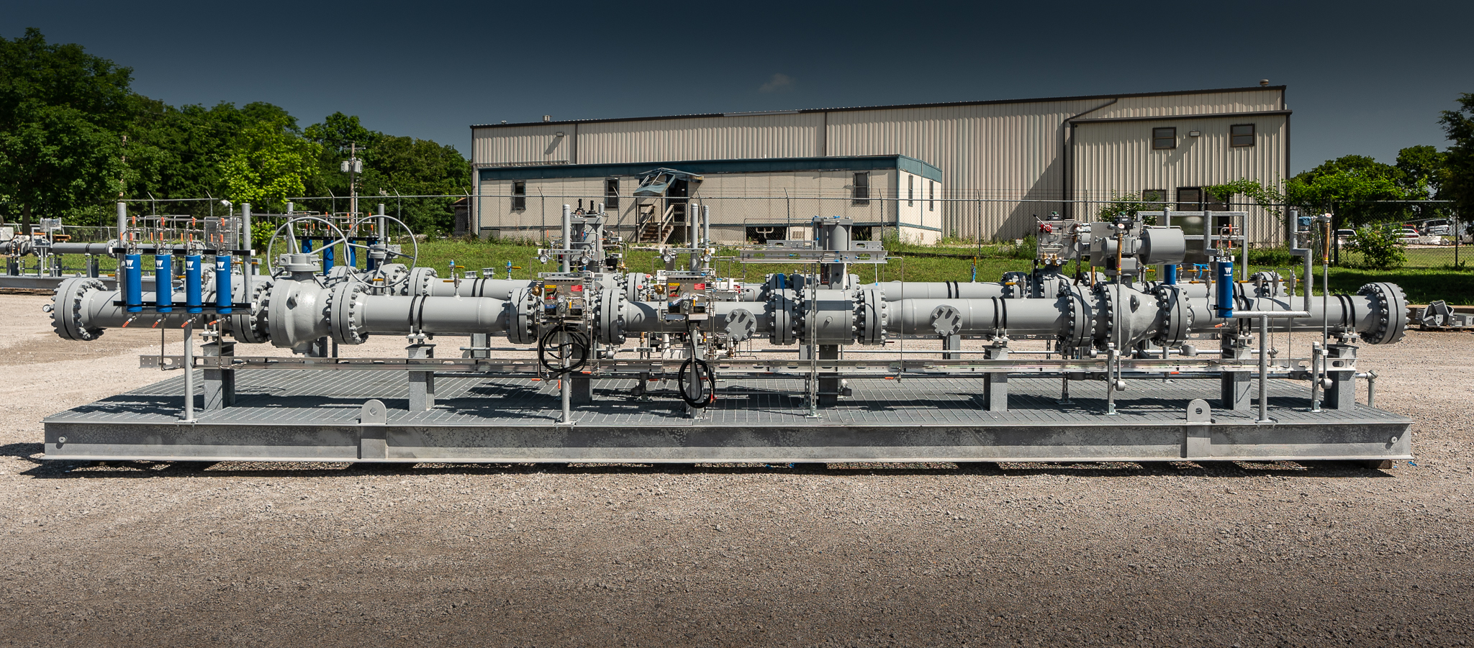
Typical Skid Design – High Volume M&R Stations

Slide 3
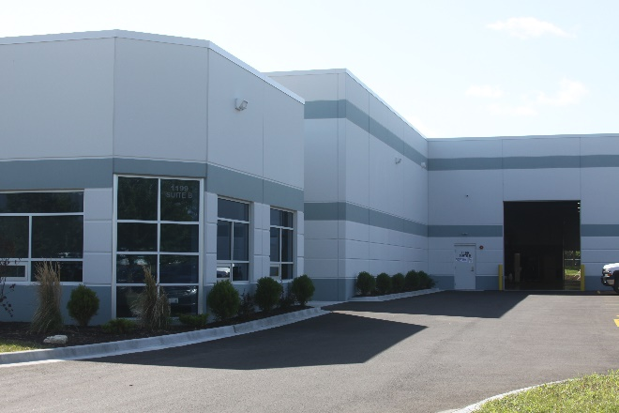
Company Overview
Instrumentation and Control Valves for Gas Pipeline Regulation
Environmentally Friendly - LOW or ZERO Emissions
Complete Solutions Rather Than Commodity Products
Founded 2012
Headquartered in Chicago Metro Area
Facilities in:
Chicago, IL (2)
Houston, TX (2)
Denver, CO (1)

Slide 4
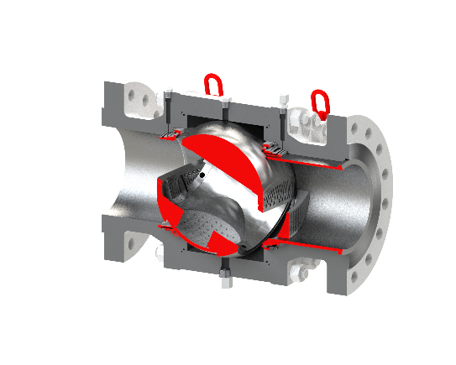
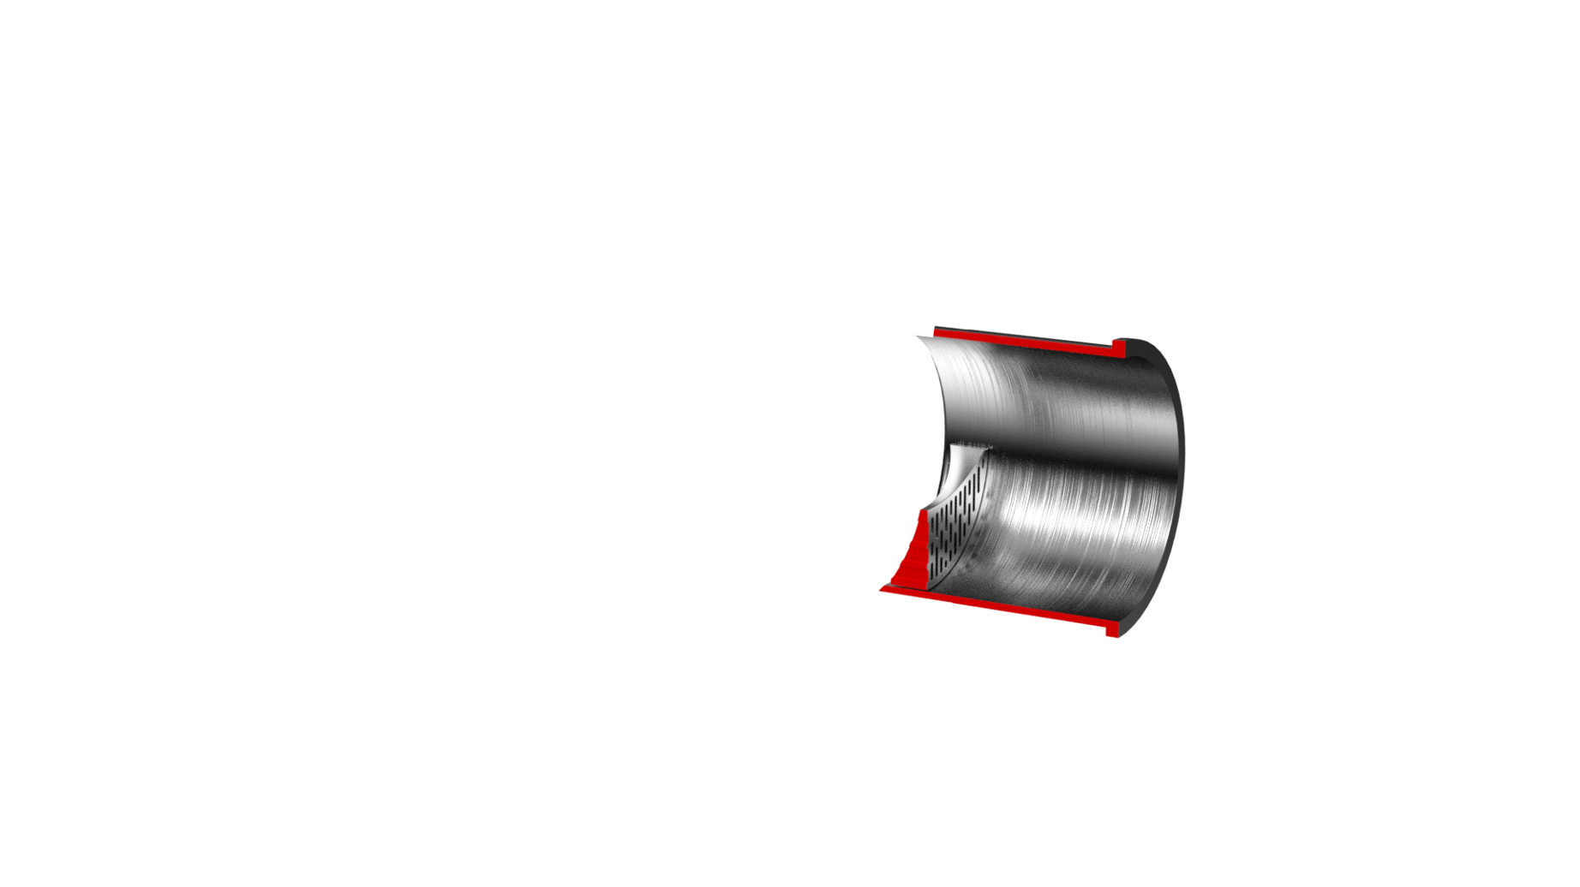
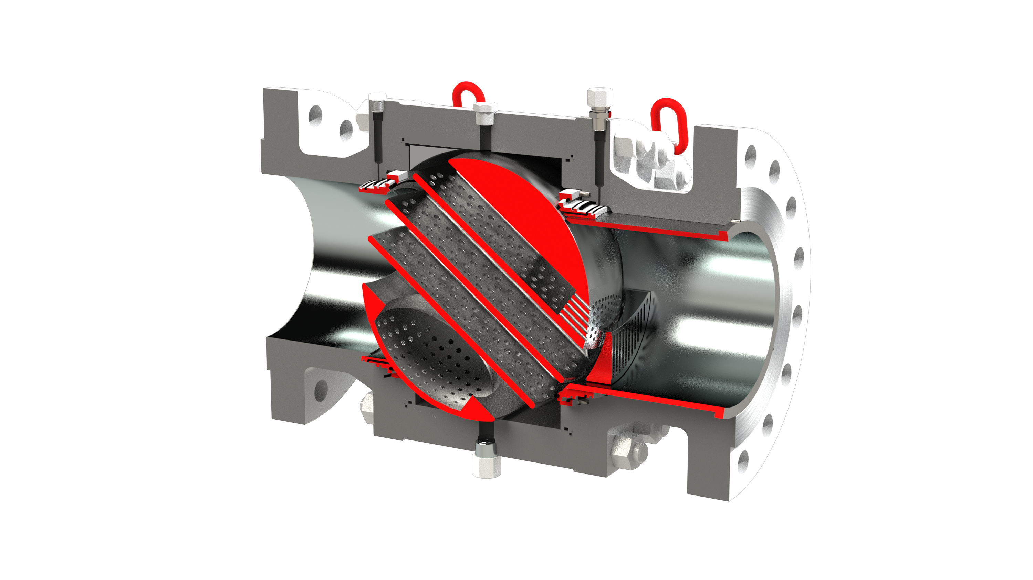
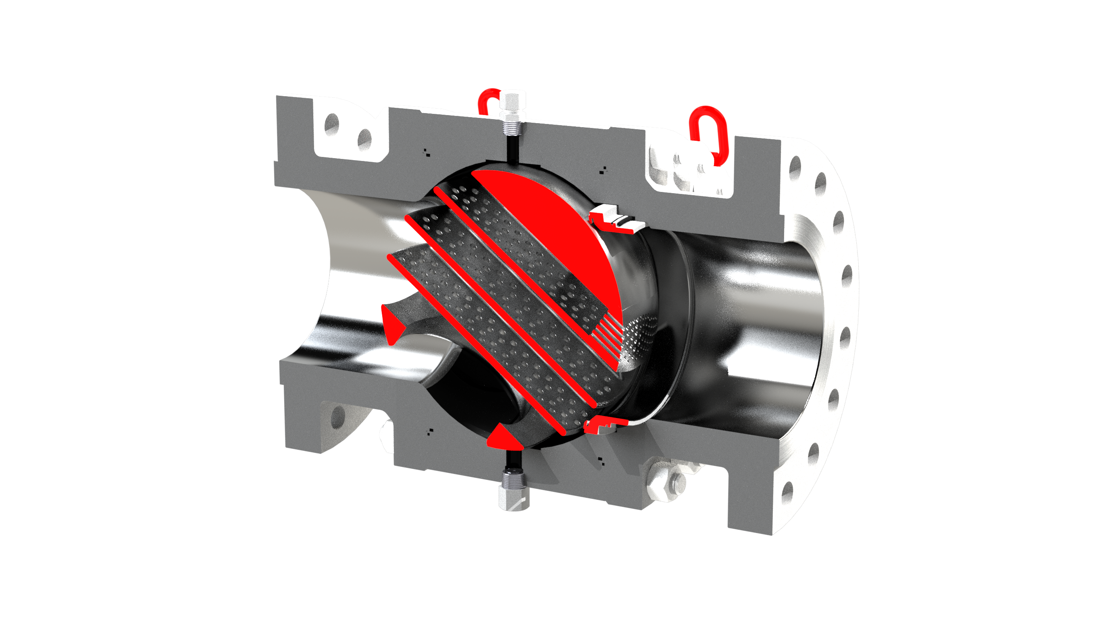
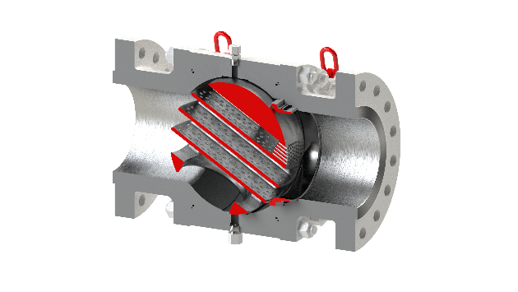
Noise Attenuation Solutions – PRCV Control Valves
PRCV Series | PRCV-FP | PRCV-STH1 | PRCV-STH2 | PRCV-STH4 | PRCV-STH5 | PRCV-STHP
Size Range | 2 in to 42 in* | 6 in to 24 in* | 6 in to 24 in* | 16 in to 24 in* | 6 in to 12 in* | 4 in to 24 in*
Trim Type | Full Port | Stealth Trim Level 1 | Stealth Trim Level 2 | Stealth Trim High Performance | Stealth Trim High Performance | Stealth Trim High Performance
Trim Technology | N/A | Upstream Var Diffuser Downstream Var Diffuser | Upstream Var Diffuser Upstream Fix Diffuser Downstream Var Diffuser Var Ball Diffuser | Upstream Var Diffuser Upstream Fix Diffuser Var Ball Diffuser Parallel Diffuser Plates | Upstream Var Diffuser Upstream Fix Diffuser Parallel Diffuser Plates | Upstream Var Diffuser Parallel Diffuser Plates
Relative Capacity | Maximum Capacity | High Capacity | High Capacity | High Capacity | High Capacity | High Capacity
Max Range-Ability | 100:1 | 300:1 | 300:1 | 300:1 | 300:1 | 300:1
Shutoff | API 6D Bubble Tight | Class VI | Class V | Class V | Class V | Class V
Seats | 2X Seats Soft Seats Std Double Piston Effect (DPE) Metal Seats Optional | 2X Seats Soft Seats Std Double Piston Effect (DPE) Metal Seats Optional | 1X Upstream Soft Seats Std Double Piston Effect (DPE) Metal Seats Optional | 1X Upstream Soft Seats Std Double Piston Effect | 1X Upstream Metal Seats Std Double Piston Effect | HM1X Upstream Metal Seats Std Double Piston Effect (DPE)
Notes:
Add PRCV-STH4, Add PRCV-STH5 to TABLE. Update Values in Table.

Slide 5
PRCV-FP Full Port Design – Cutaway View
Seat Lubrication Ports (2)
FP
DESIGN
Lifting Swivels (4)
Downstream Seat
Upstream Seat
Body Drain
Valve Ball Element

Slide 6
PRCV-FP Flow Profile
Watch Video
https://www.youtube.com/watch?v=JOs2xb_CbFk
FP
DESIGN

Slide 7
PRCV-STH1 Stealth Trim – Cutaway View
Seat Lubrication Ports (2)
STH1
DESIGN
Lifting Swivels (4)
Upstream Variable Diffuser
Downstream Seat
Valve Ball Element
Upstream Seat
Upstream Fixed Diffuser
Body Drain

Slide 8
PRCV-STH1 Flow Profile
Watch Video
https://www.youtube.com/watch?v=Be1-YxPOpIU&t=25s
STH1
DESIGN

Slide 9
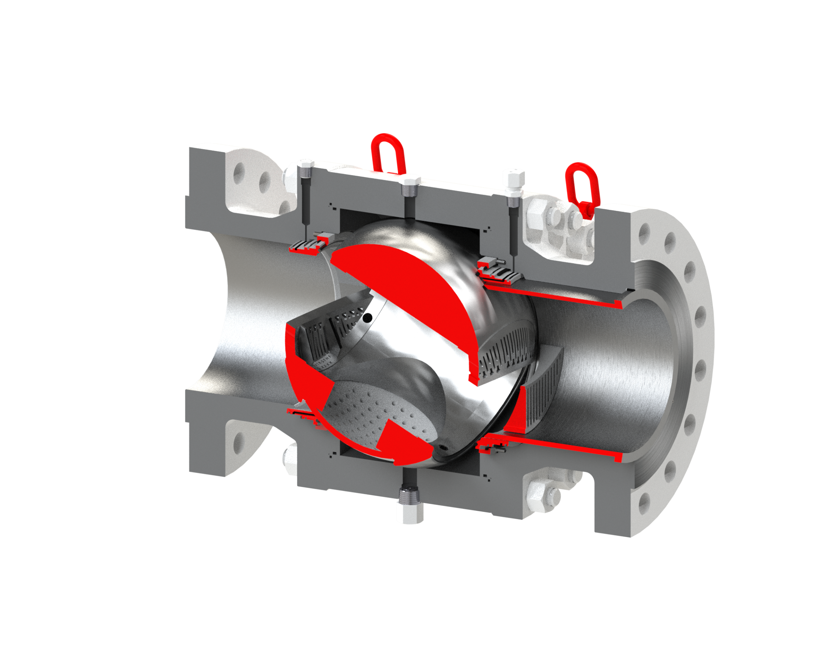
PRCV-STH2 Stealth Trim – Cutaway View
PRCV Flow Profile Comparison
Upstream Seat Lubrication Port (1)
Lifting Swivels (4)
STH2
DESIGN
Upstream Variable Diffuser
Downstream Variable Diffuser
Upstream Fixed Diffuser
Downstream Ball Diffuser
Upstream Seat
Body Drain

Slide 10
PRCV-STH2 Flow Profile
Watch Video
https://www.youtube.com/watch?v=p1oGn2P_7F0&t=25s
STH2
DESIGN

Slide 11
PRCV-STH4 Stealth Trim – Cutaway View
PRCV Flow Profile Comparison
Lifting Swivels (4)
STH4
DESIGN
Upstream Variable Diffuser
Upstream Fixed Diffuser
Downstream Ball Diffuser
Upstream Seat
Parallel Plate Diffusers
Body Drain

Slide 12
PRCV-STH4 Flow Profile
STH4
DESIGN

Slide 13
PRCV-STH5 Stealth Trim – Cutaway View
PRCV Flow Profile Comparison
Lifting Swivels (4)
STH5
DESIGN
Upstream Variable Diffuser
Upstream Fixed Diffuser
Downstream Ball Relief Bore
Upstream Seat
Body Drain
Parallel Plate Diffusers

Slide 14
PRCV-STH5 Flow Profile
Watch Video
https://www.youtube.com/watch?v=uL-0zaixj9U
STH5
DESIGN

Slide 15
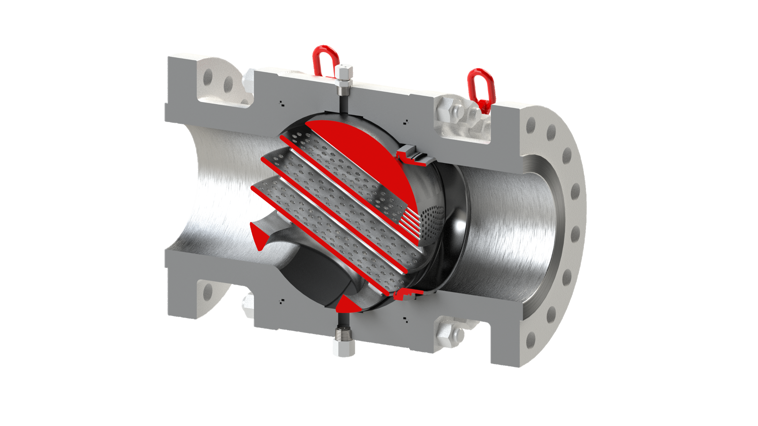
PRCV-STHP Stealth Trim – Cutaway View
PRCV Flow Profile Comparison
Lifting Swivels (4)
STHP
DESIGN
Upstream Variable Diffuser
Downstream Ball Relief Bore
Body Drain
Upstream Seat
Parallel Plate Diffusers

Slide 16
PRCV-STHP Flow Profile
Watch Video
https://www.youtube.com/watch?v=KP5vQVL_NrQ&t=17s
STHP
DESIGN

Slide 17
PRCV Flow Profile Comparisons – All Models
Notes:
UPDATE TO INCLUDE STH4 AND STH5

Slide 18
PRCV Flow Profile Comparisons – STH Stealth Trim Models Only
Notes:
UPDATE TO INCLUDE STH4 AND STH5

Slide 19
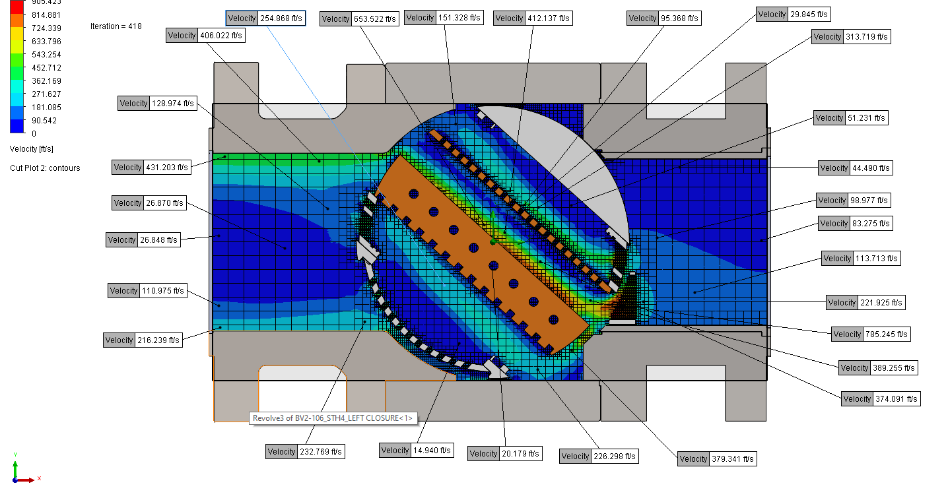
PRCV-STH4 CFD Computational Flow Dynamics – In Development
VELOSITY, FT/SEC

Slide 20
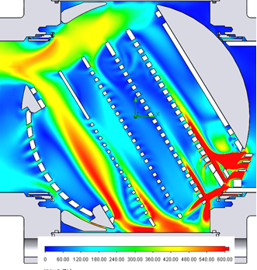
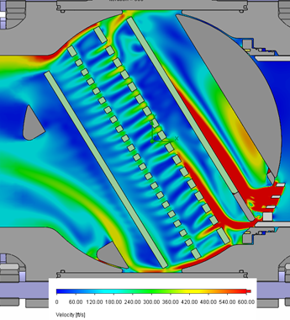
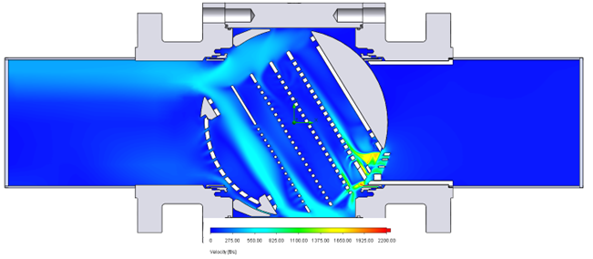
CFD Computational Flow Dynamics – In Development
VELOSITY, FT/SEC

Slide 21
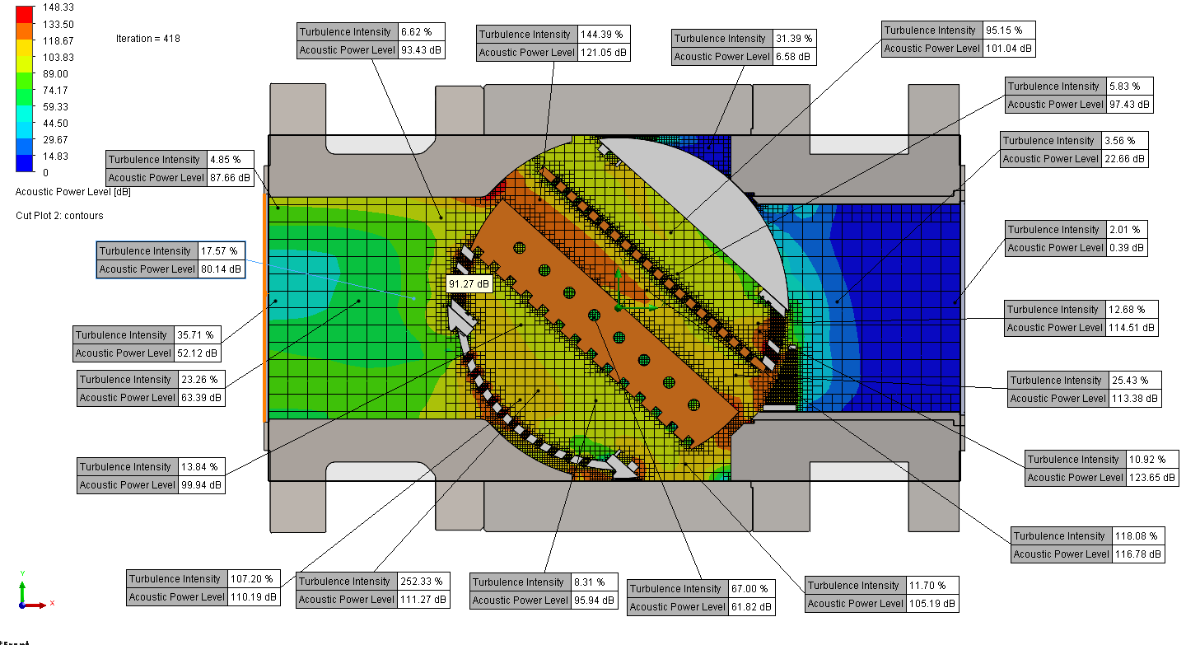
PRCV-STH4 CFD Computational Flow Dynamics – In Development
ACOUSTIC POWER LEVEL, dB

Slide 22
PRCV Operation Videos - YouTube
PRCV-FP
PRCV-STH1
PRCV-STH2
PRCV-STHP
PRCV-STH5
CLEAN SWEEP
VP PLATFORM
LEFT HAND vs. RIGHT HAND STEM INTERCHANGE
Notes:
UPDATE WITH LINKS TO YOUTUBE FOR NEW PRCV VIDEOS FP, STH1, STH2, STH4, STHP, STH5

Slide 23
Noise Attenuation Solutions – PRCV Control Valves
5250
2148
2105
1799
1179
1241
Notes:
ADD PRCV-STH4, PRCV-STH5

Slide 24
Noise Attenuation Solutions – PRCV Control Valves
27
27
25
15
Typical Max Noise Attenuation (dBA)
7
0
Notes:
ADD PRCV-STH4, PRCV-STH5

Slide 25
Noise Attenuation Profile – PRCV-STH Models
Notes:
ADD PRCV-STH4, PRCV-STH5

Slide 26
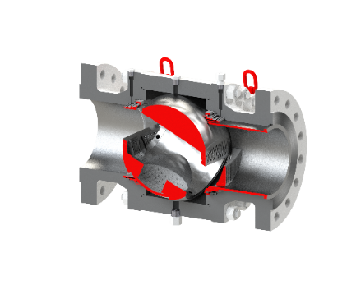
Noise Attenuation Solutions – PRCV Control Valves
PRCV Model | Typical Ideal Pressure Drop Range | Typ. Max Noise Attenuation | Comparable GE / Becker Model
PRCV-FP | 200 psid* | 0* | FPCV
PRCV-STH1 | 100-300 psid | 7 dBA | QTCV-T1
PRCV-STH2 | 300-500 psid | 15 dBA | QTCV-T2
PRCV-STH4 | > 500 psid | 27 dBA | QTCV-T4
PRCV-STH5 | > 500 psid | 27 dBA | NO EQUAL
PRCV-STHP | > 500 psid | 25 dBA | NO EQUAL
Notes:
ADD PRCV-STH4, PRCV-STH5

Slide 27
Noise Attenuating Technologies – CV Series Globe Valves
Design Considerations
Excellent for Power Plant Fuel Gas Feed
Primary Flow Runs
Trim Run
Beware of High Exit Velocities
Available Linear or Equal Percentage Profile
High Noise Attenuation with Reduced Capacity
FLOW

Slide 28
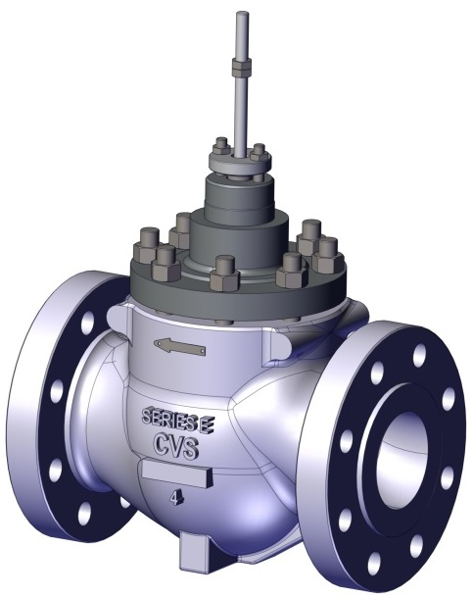
Noise Attenuation Solutions – PRCV Control Valves
CV Trim | CVEZ | CVET | CVET – LEVEL I | CVET – LEVEL II | CVET – LEVEL III
Size Range | 1 in to 4 in | 2 in to 16 in | 2 in to 16 in | 2 in to 16 in | 2 in to 16 in
Design Standard | API-6D / ASME B16.5 API 6FA | API-6D / ASME B16.5 API 6FA | API-6D / ASME B16.5 API 6FA | API-6D / ASME B16.5 API 6FA | API-6D / ASME B16.5 API 6FA
ANSI Range | 150 – 900 ANSI | 150 – 900 ANSI | 150 – 900 ANSI | 150 – 900 ANSI | 150 – 900 ANSI
End Connections | RFFE, RTJ | RFFE, RTJ | RFFE, RTJ | RFFE, RTJ | RFFE, RTJ
Trim Type | Unbalanced | Balanced | Balanced | Balanced | Balanced
Performance Trim Technology | Plug Linear Equal Percent | Linear Equal Percent | Drilled Hole Noise Trim Linear Equal Percent | Drilled Hole Noise Trim Linear Equal Percent | Drilled Hole Noise Trim Linear Equal Percent
Relative Capacity | Moderate | Moderate | Moderate | Restricted | Restricted
Max Noise Attenuation | N/A | N/A | 10-15 dBA | 15-20 dBA | 25 dBA
Compatible Buried Applications | NO | NO | NO | NO | NO
Max Range-Ability | 50:1 | 30:1 | 30:1 | 30:1 | 30:1
Shutoff | Class V | Class V Class VI | Class V Class VI | Class V Class VI | Class V Class VI
Seats | Metal Seats – Standard | Metal Seats Optional Soft Seats – Standard | Metal Seats Optional Soft Seats – Standard | Metal Seats Optional Soft Seats – Standard | Metal Seats Optional Soft Seats – Standard

Slide 29
Noise Attenuation Solutions – PRCV Control Valves
Linear Trim
Equal Percent Trim

Slide 30
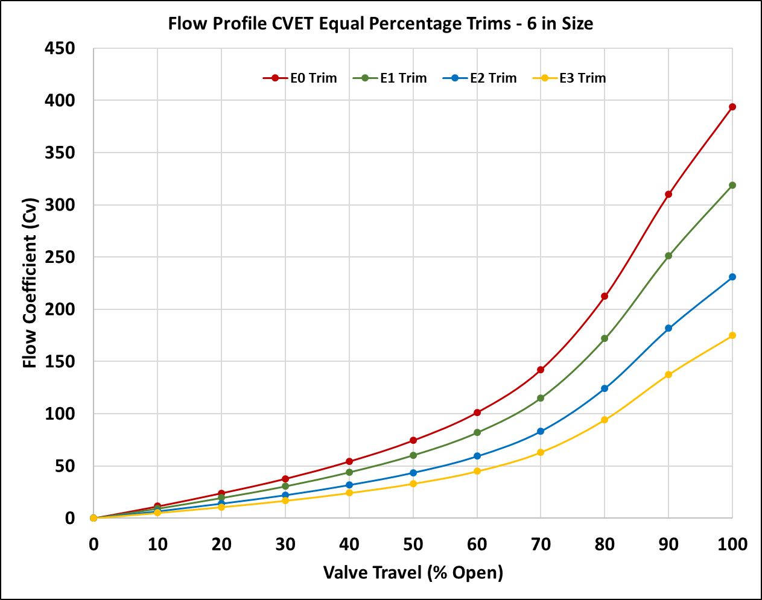
CV-ET Control Valves – Equal Percent Trim Flow Profiles

Slide 31
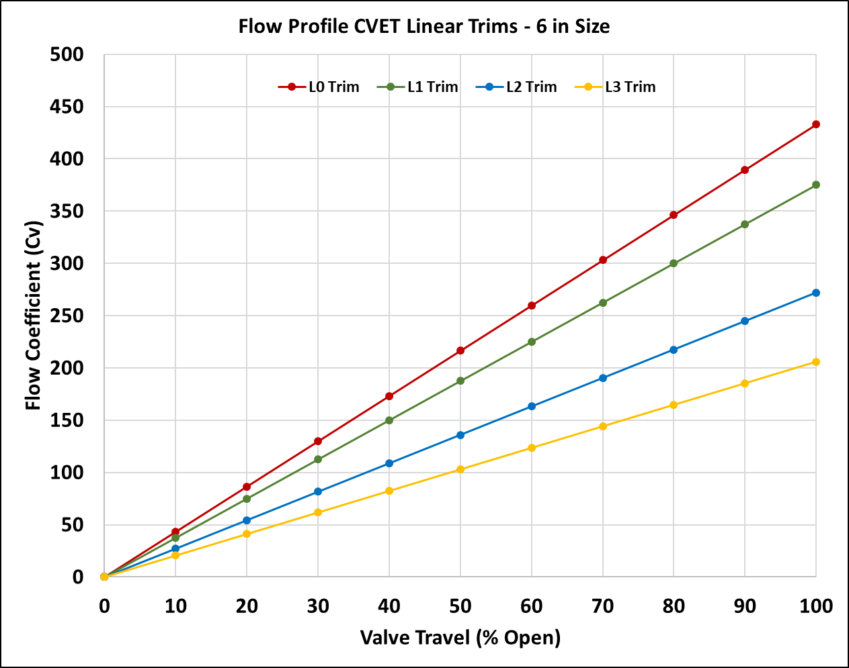
CV-ET Control Valves – Linear Trim Flow Profiles

Slide 32
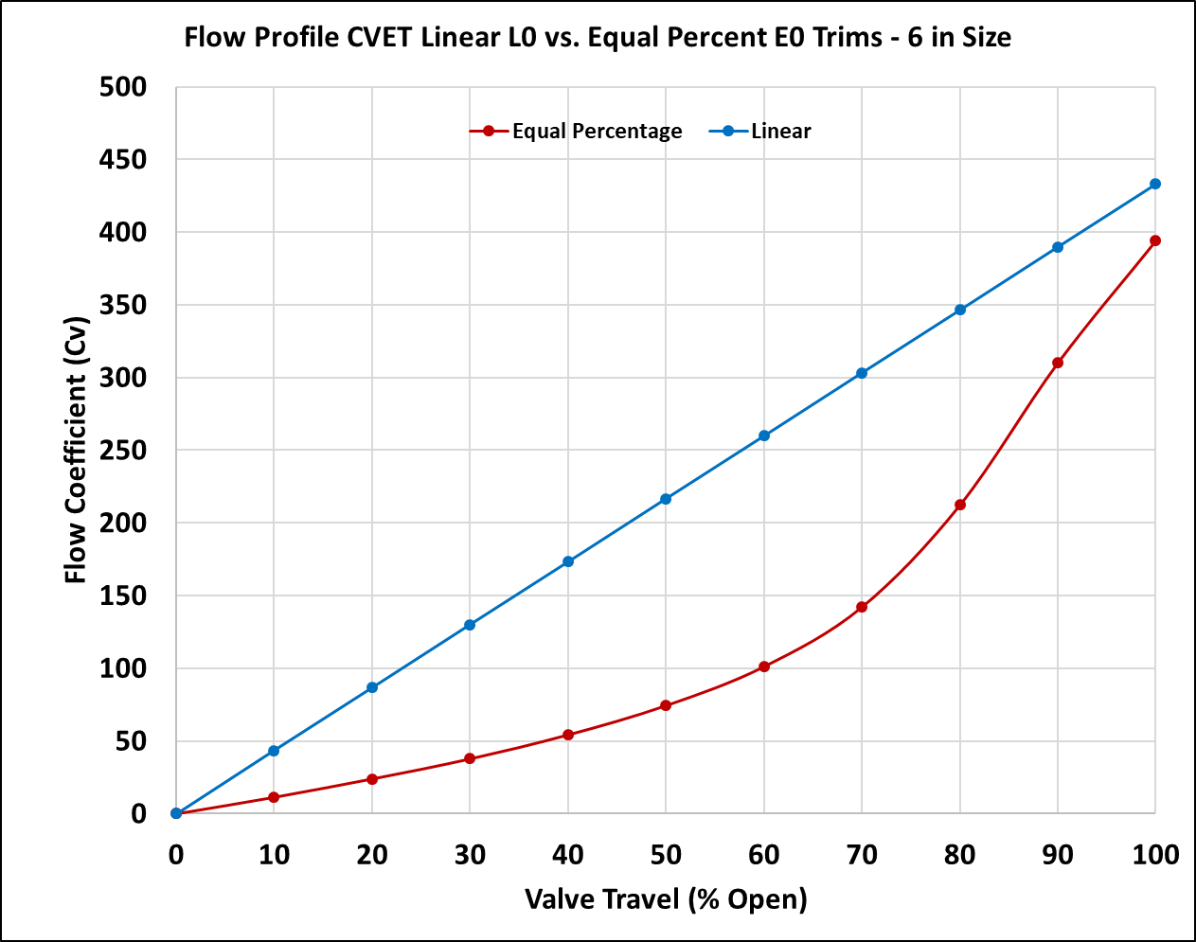
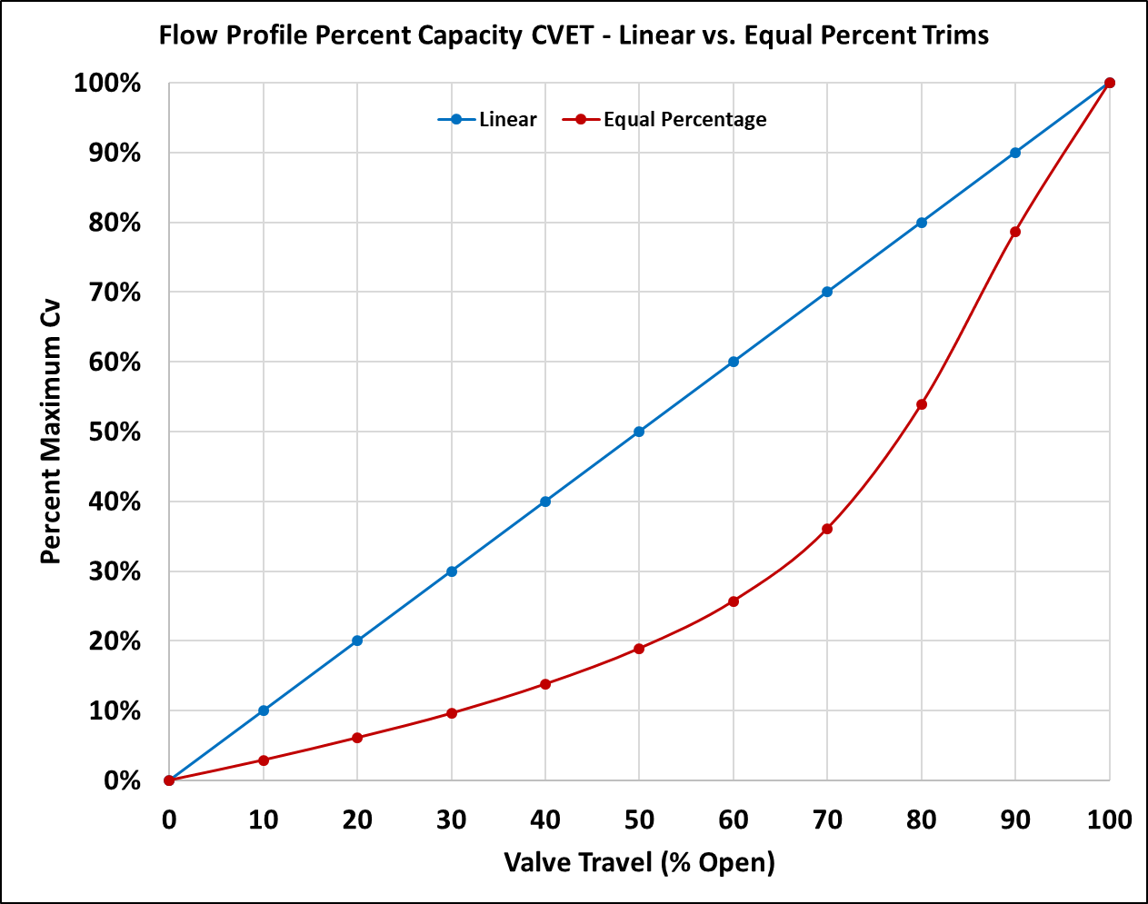
CV-ET Control Valves – Linear vs. Equal Percent Trim – 6 in Bore

Slide 33
Noise Attenuation Solutions – PRCV Control Valves

Slide 34
Noise Attenuation Solutions – High Volume M&R Stations
Pressure Drop Ratio | Recommended Control Valve
ΔP Ratio > 0.8 | CV-ET Linear Control Valve
0.6 > ΔP Ratio > 0.8 | CV-ET Linear Control Valve OR PRCV-STHP / PRCV-STH4 / PRCV-STH5
0.3 > ΔP Ratio > 0.6 | PRCV-STH2
0.1 > ΔP Ratio > 0.3 | PRCV-STH1 OR PRCV-FP
*For ABOVE GROUND Station Installations
$ΔP Ratio= \frac{(P_{1−}P_{2)}}{P_{1}}$

Slide 35
Control Valve Rangeability Summary
Control Valve | Min Control |  | Max Control**
PRCV-FP | 1.0% Flow | 10° Open | 90% Flow | 83° Open
PRCV-STH1 | 0.33% Flow | 5° Open | 85% Flow | 83° Open
PRCV-STH2 | 0.10% Flow | 7° Open | 85% Flow | 83° Open
PRCV-STHP | 0.50% Flow | 9° Open | 85% Flow | 83° Open
CV-ET EQ% | ≈3.0% Flow | 10% Open | ≈79% Flow | 90% Open
CV-ET LINEAR | 10% Flow | 10% Open | 90% Flow | 90% Open
CV-EZ EQ% | ≈3.0% Flow | 10% Open | ≈79% Flow | 90% Open
CV-EZ LINEAR | 10% Flow | 10% Open | 90% Flow | 90% Open
** NOTE THAT CONTROL VALVE CAN PROVIDE ADDITONAL CAPACITY AT HIGHER FLOWS.
MAX CONTROL LIMIT PROVIDES FACTOR SAFETY FOR DESIGN CAPACITY

Slide 36
Axial Flow Valves – Control Valves
High Capacity
Aggressive Noise Attenuation
Combine the Noise Attenuating Features of CV Linear “Globe Valve” with the Capacity of a PRCV Rotary Control Valve
Patented Internal Crank Arm Modulating Design Eliminates “Meshing Gear Concept”
Balanced Design Lessens Required Actuator Thrust
Actuated with VRG Controls Modulating Control Actuators:
LHPA-DA Linear SA (Pneumatic)
LHPA-SR Linear SR (Pneumatic)
E/H Hawk Linear (Electro-Hydraulic)
Linear Electric
Watch Video at:
https://www.youtube.com/watch?v=y73-6wR6YR4

Slide 37
Axial Flow Valves – Control Valves
Watch Video at:
https://www.youtube.com/watch?v=y73-6wR6YR4
Valve Full Closed Position

Slide 38
Axial Flow Valves – Control Valves
Watch Video at:
https://www.youtube.com/watch?v=y73-6wR6YR4
Valve Full Open Position

Slide 39
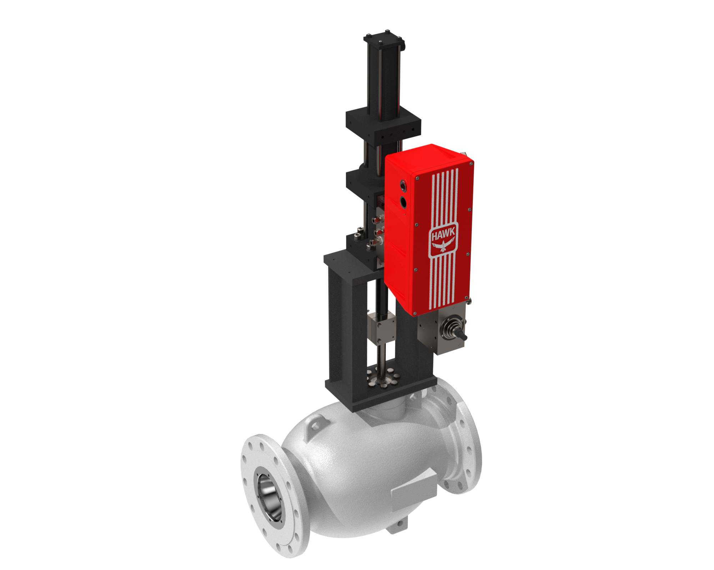
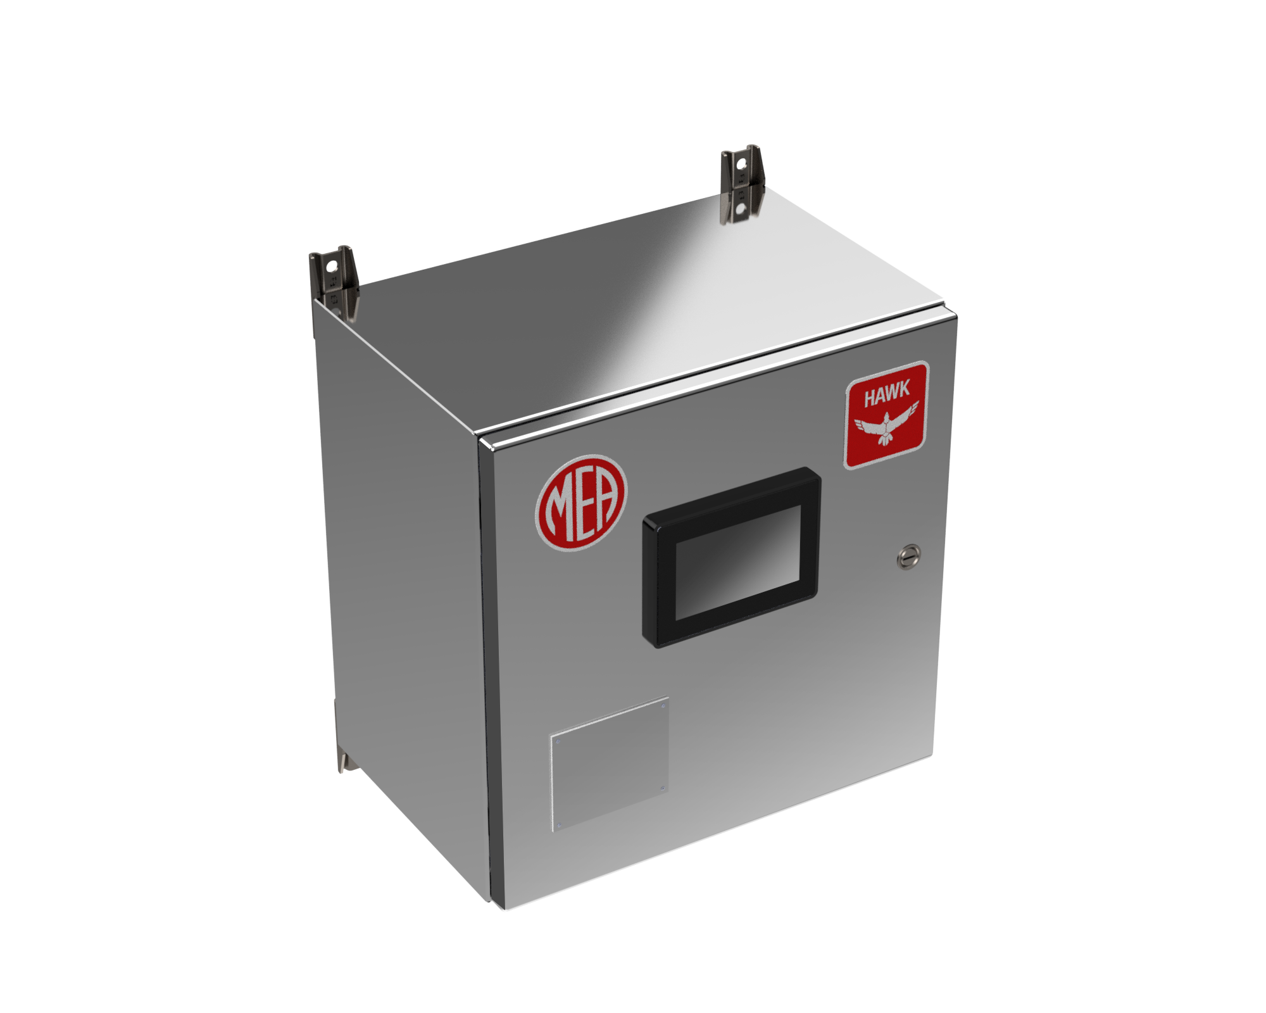
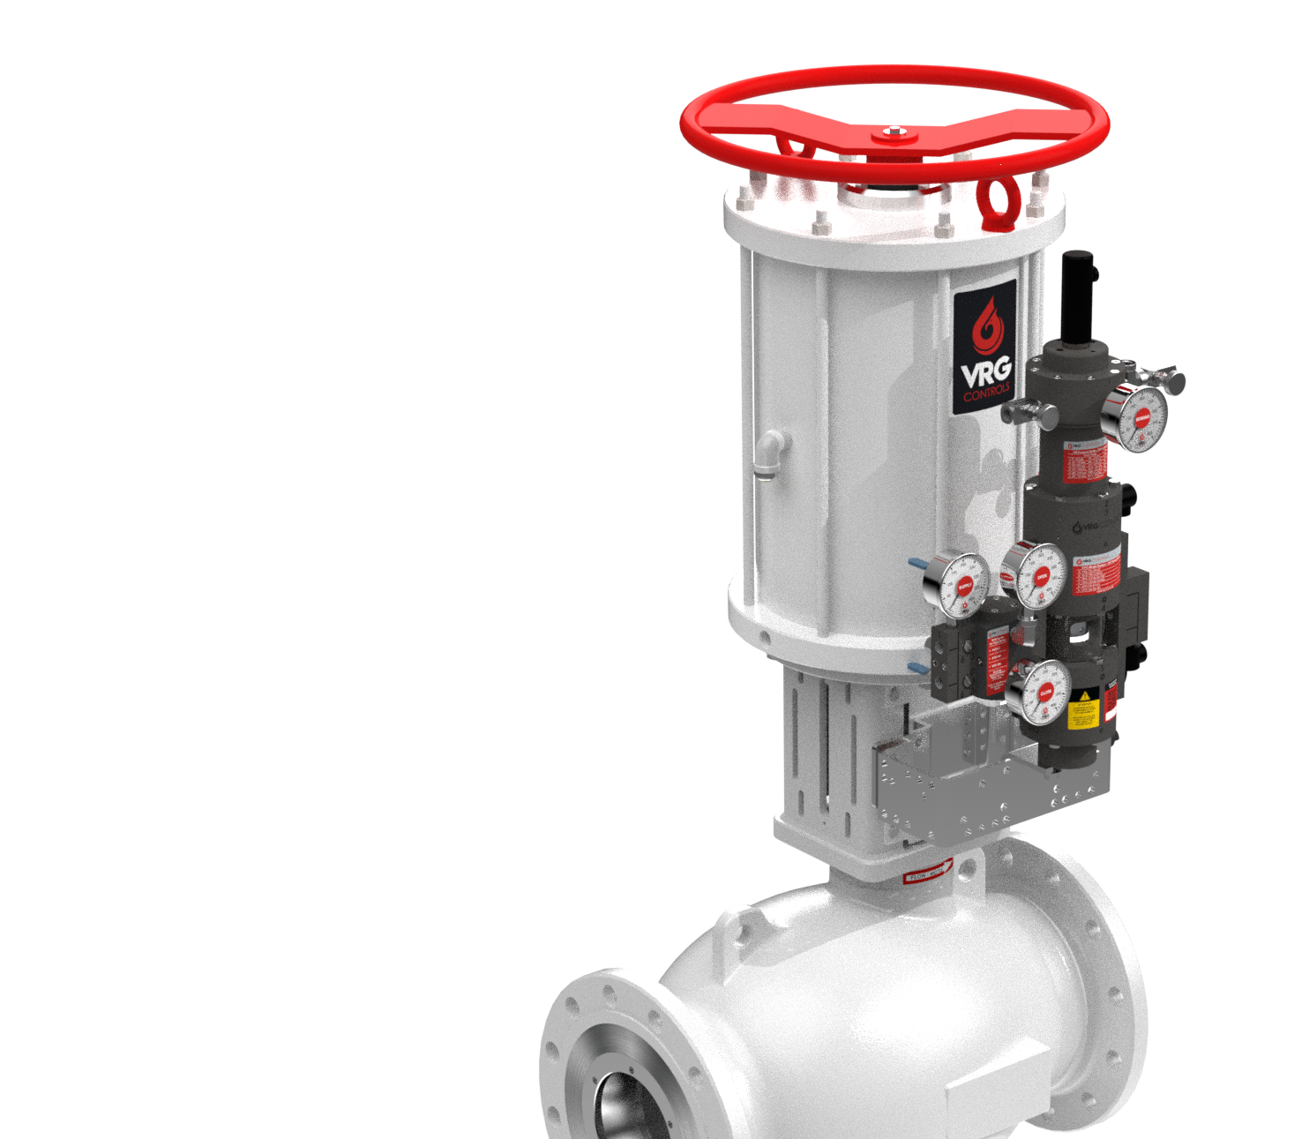
Axial Flow Valves – Control Valves
Electro-Hydraulic Actuated (DA) - Worker
Pneumatically Actuated (STC) - Monitor

Slide 40
Maximum Control Valve Exit Velocity Recommendations
Control Valve | Max Exit Velocity
PRCV-FP | <720 fps
PRCV-STH1 | <450 fps
PRCV-STH2 | <450 fps
PRCV-STHP | <450 fps
CV-ET EQ% | <450 fps
CV-ET LINEAR | <450 fps
CV-EZ EQ% | <450 fps
CV-EZ LINEAR | <450 fps
DIA.

Slide 41
Maximum Pipe Flow Velocity Recommendations
Control Valve | Station Concept | VRGSize Max Flow Velocity in Pipe
PRCV-FP | Above Ground | 100 fps
PRCV-STH1 PRCV-STH2 PRCV-STHP | Above Ground | 150 fps
PRCV – All Models | Below Ground | 200 fps
CONTROL VALVE
UPSTREAM
BLOCK VALVE
DOWNSTREAM
BLOCK VALVE
UPSTREAM
PIPE (D1)
REDUCER FITTING
INCREASER FITTING
DOWNSTREAM
PIPE (D2)
UPSTREAM PIPE VELOCITY
CONTROL VALVE
EXIT VELOCITY
DOWNSTREAM PIPE VELOCITY
FLOW

Slide 42
Maximum Allowable Noise Prediction Recommendations
Control Valve | Station Concept | VRGSize Max Allowable Noise
PRCV-FP PRCV-STH1 PRCV-STH2 PRCV-STH4 PRCV-STHP PRCV-STH5 | Above Ground | 110 dBA
PRCV-FP PRCV-STH1 PRCV-STH2 PRCV-STH4 PRCV-STHP PRCV-STH5 | Below Ground | 130 dBA **PRIOR TO BURIED DEPTH
V100 | Above Ground | 100 dBA

Slide 43
Control Valve Shutoff Ratings
Control Valve | Control Valve Type | Seat Type | Shutoff Class
V100 | Rotary | Soft Seat | Class VI
V100 | Rotary | Metal Seat | Class IV
PRCV-FP | Rotary | Soft Seat | API-6D Bubble Tight
PRCV-STH1 | Rotary | Soft Seat | Class VI
PRCV-STH2 | Rotary | Soft Seat | Class V
PRCV-STH4 | Rotary | Soft Seat | Class VI
PRCV-STHP | Rotary | Metal Seat | Class V
PRCV-STH5 | Rotary | Metal Seat | Class V
CV-EZ | Linear | Metal Seat | Class V
CV-ET | Linear | Soft Seat – STD | Class VI
CV-ET | Linear | Metal Seat Stellite – OPTION | Class V
CV-ET | Linear | Metal Seat Stainless Steel - OPTON | Class IV

Slide 44
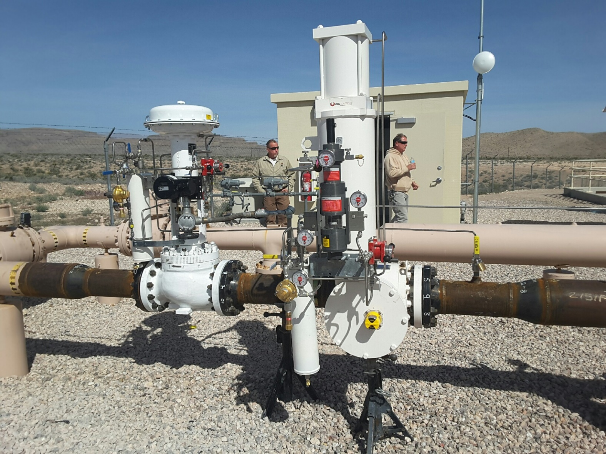
Noise Attenuating Technologies – CV Series Globe Valves
Flow Control Valve & Monitor Overpressure Protection
APEX CT Power Plant Fuel Gas Feed
Southwest Gas Corp. – Las Vegas, NV USA

Slide 45
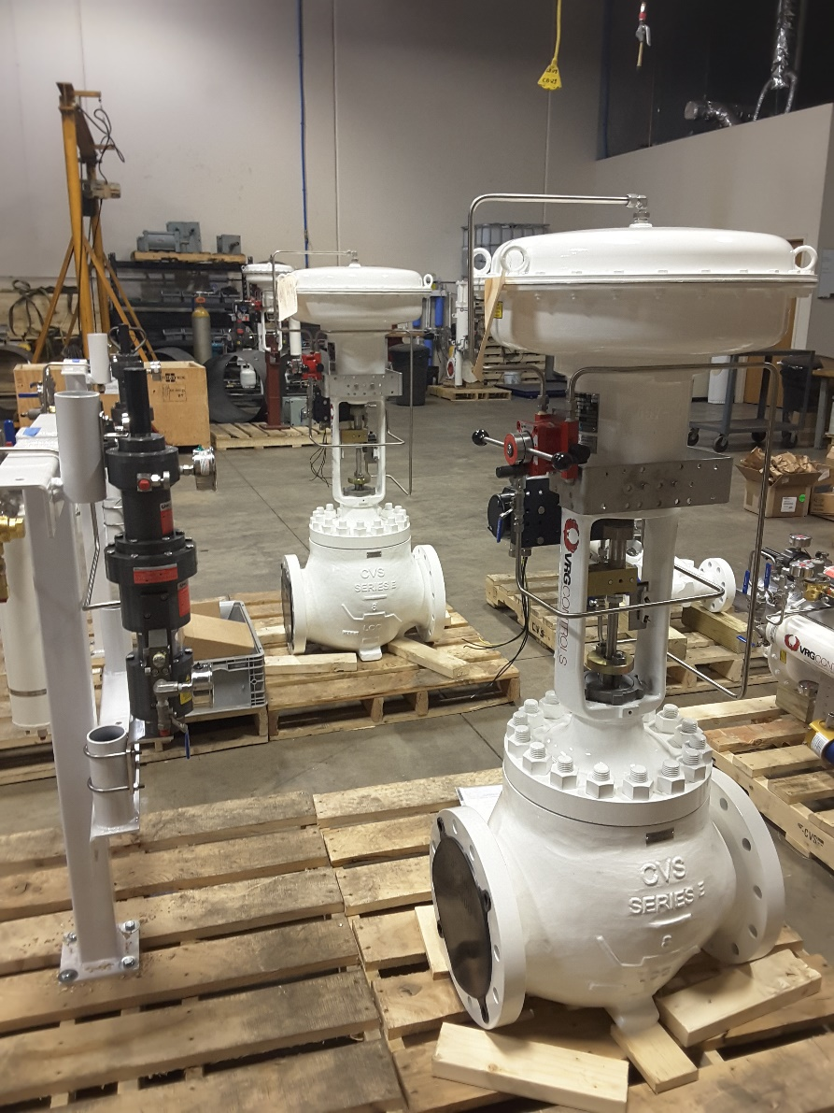
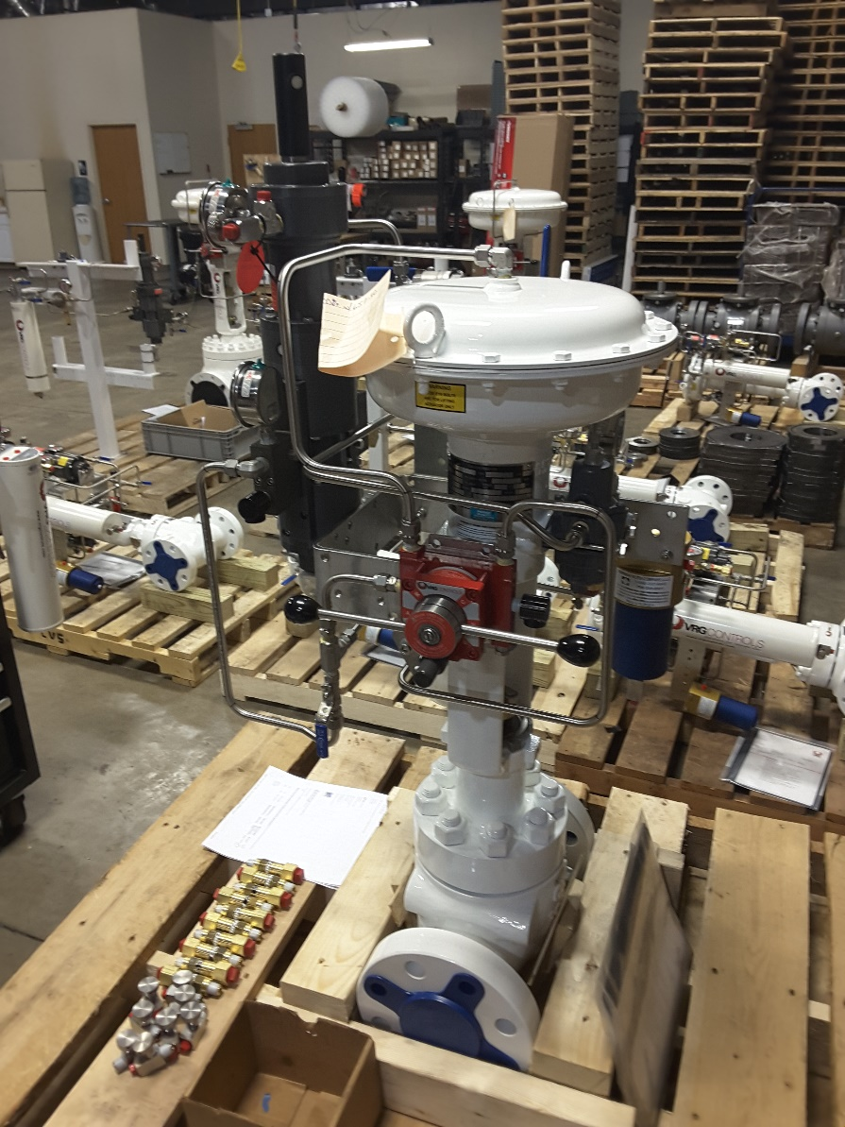
Noise Attenuating Technologies – CV Series Globe Valves
CVET Series Control Valves Prepare for Shipment
VRG Controls Factory – Lake Zurich, IL USA

Slide 46
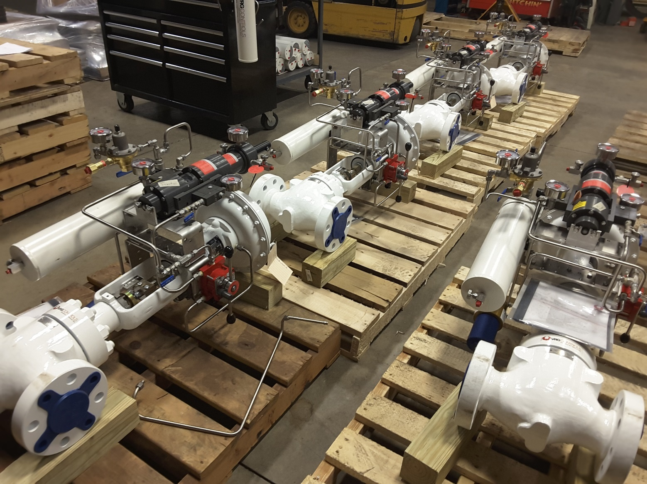
Noise Attenuating Technologies – CV Series Globe Valves
CVET Series Control Valves Prepare for Shipment
VRG Controls Factory – Lake Zurich, IL USA

Slide 47
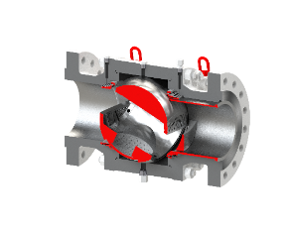
Noise Attenuation Solutions – PRCV Control Valves
PFCV-STHP | PRCV-STH2 | PRCV-STH1 | PRCV-FP
Notes:
Add PRCV-STH4 and PRCV-STH5

Slide 48
Noise Attenuation Solutions – Station Design Considerations
Design Concept
Below Ground
Pipe Schedule Selection
Pipe Size Selection
Split Range Control (Cascade)
Tandem Control
Noise Dissipation vs. Distance
Pipe Lagging
Building Enclosure
Inline Control Valve Silencers

Slide 49
Noise Attenuation Solutions – Design Concept
Design Concept |  | Design Concept | Net Difference
Stick Build Design | vs | Skid Build Design | + 5 dBA Due to Vibration
Simple Design | vs | Long Pipe Runs w/ High Population Pipe Bends *Measurement & Regulation Skid Connected Above Ground | + 5 dBA Due to Vibration and Bends
Below Ground Design | vs | Above Ground Design | + 25-30 dBA

Slide 50
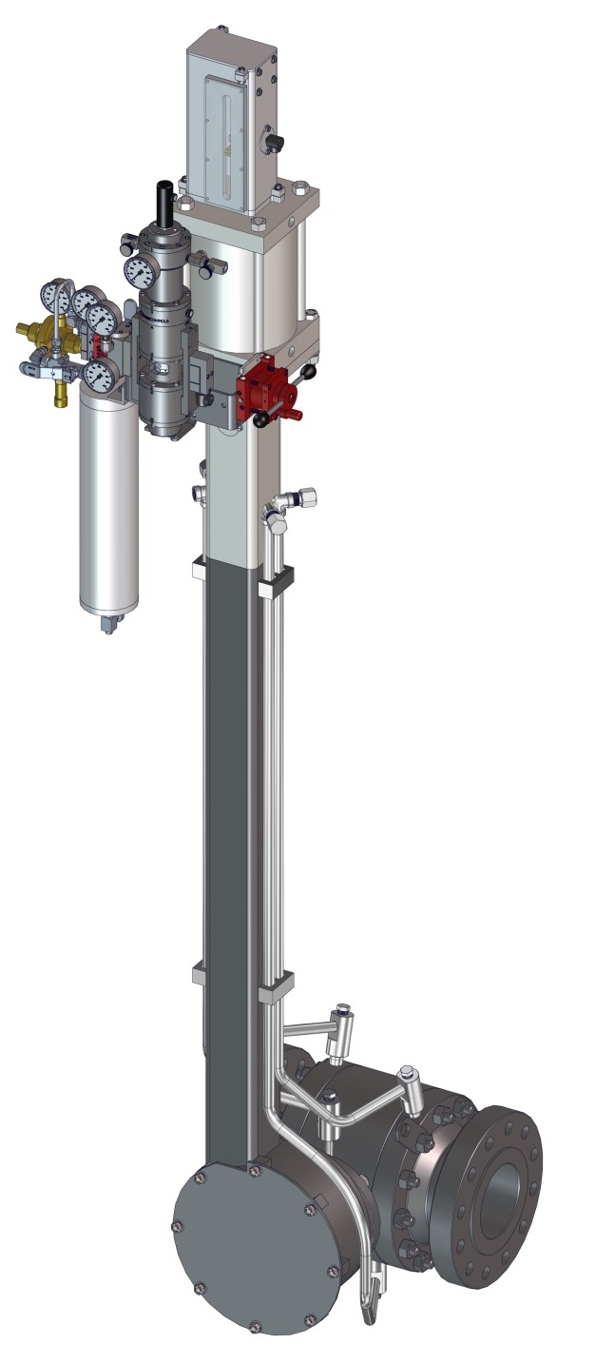
Station Design Considerations - Below Ground
Unique Below Ground Option Provides Maximum Performance Natural Gas Regulation Station Design
Most Cost Effective Noise Attenuation Available
Crank Arm Design Provides Only Truly Viable Control for Below Ground Station
Ideal Solution for High Pressure, High Volume Pipeline Station Design
Minimize Heat Loss via Burial
Lubrication and Drain Lines Extended Above Ground for Ease of Maintenance.
No Need For Excavation to Perform Preventative Maintenance and Performance Evaluation
Smaller Station Footprint and Lower Project Costs
Smaller Diameter Upstream & Downstream Piping / Isolation Valves
25 dBA Noise Attenuation Minimum (3 ft. Depth)
Replace Existing Becker Below Grade Control Valves
Grade Level
Our Technology

Slide 51
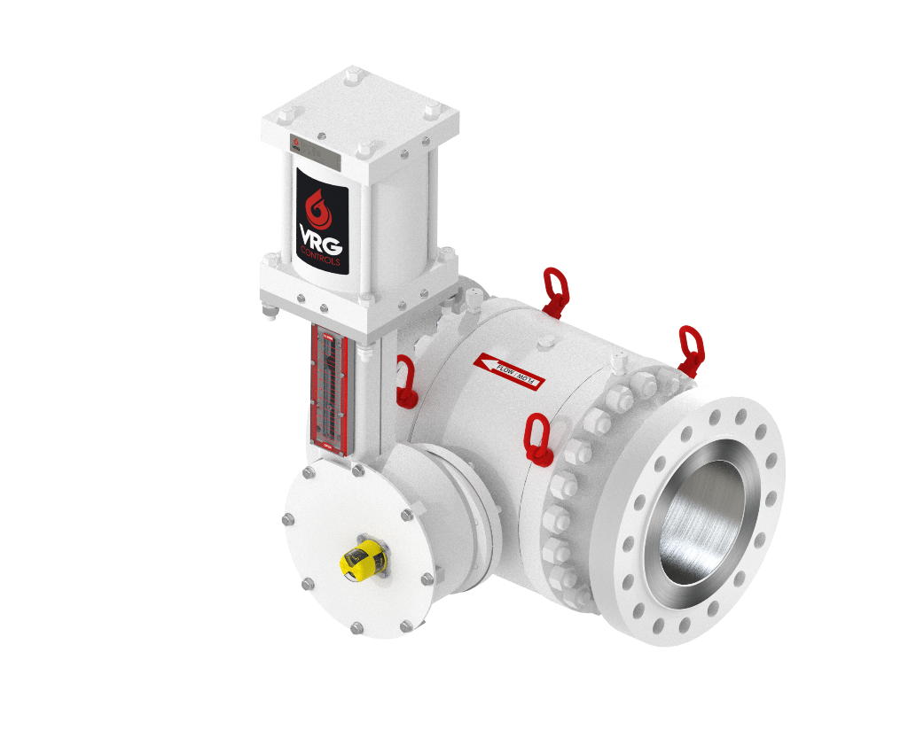
Station Design Considerations - Below Ground
Key Design Considerations:
Downstream Piping Must be Maintained Below Ground for Maximum Distance to Avoid Bringing Noise Above Ground
Below Ground Installation Does Provide Effective Source Attenuation Over Distance
Metering Located Upstream of Control Valves
Grade Level
ABOVE
GROUND
DESIGN
BELOW
GROUND
DESIGN

Slide 52
Station Design Considerations - Below Ground
Key Design Components Ensure Maintain-Ability and Trouble-Free Operation Without Excavation
Tail-rod Instrument Mounting System Standard
Vented Actuator Housing
PRCV Seat Seals Extended Above Ground
Coal Tar Epoxy Coating on Below Ground Portion
Fully Welded Bracket Supports on All Lines
Stem Lubrication / Test Extended
Drain Line / Blowdown Extended
All Port Extension Lines ASME Code Welded and Hydro-tested

Slide 53
Station Design Considerations - Below Ground
Worker Regulator
Monitor Regulator
Optimize Station M&R Station Design with Less Overall Costs
25 dBA Noise
Attenuation (3 Ft.)
BURIED DEPTH

Slide 54
Station Design Considerations - Below Ground

Slide 55
Noise Attenuation Solutions – Below Ground When Pipe Comes Above Ground
Downstream Pipe Distance from Control Valve | Effective Below Ground Noise Attenuation
0 – 200 ft | 10 dBA
200 ft – 1.0 Mile | 10 – 25 dBA
1.0 Mile OR Greater | 25 dBA or Greater
DOWNSTREAM
PIPE
DISTANCE

Slide 56
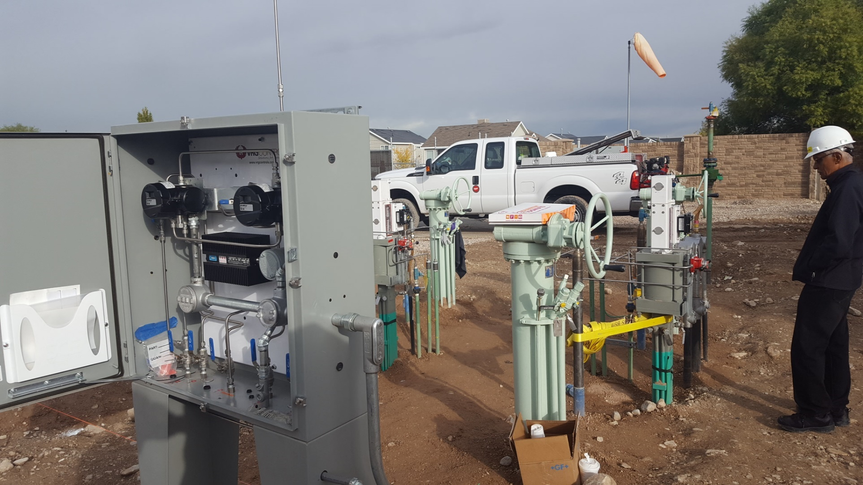
Station Design Considerations - Below Ground
Below Ground PRCV-FP Control Valves
Equipped with Remote PMV DG3 Positioner and VMO150
Kern River Gas Transmission
Hunter Meter Station

Slide 57
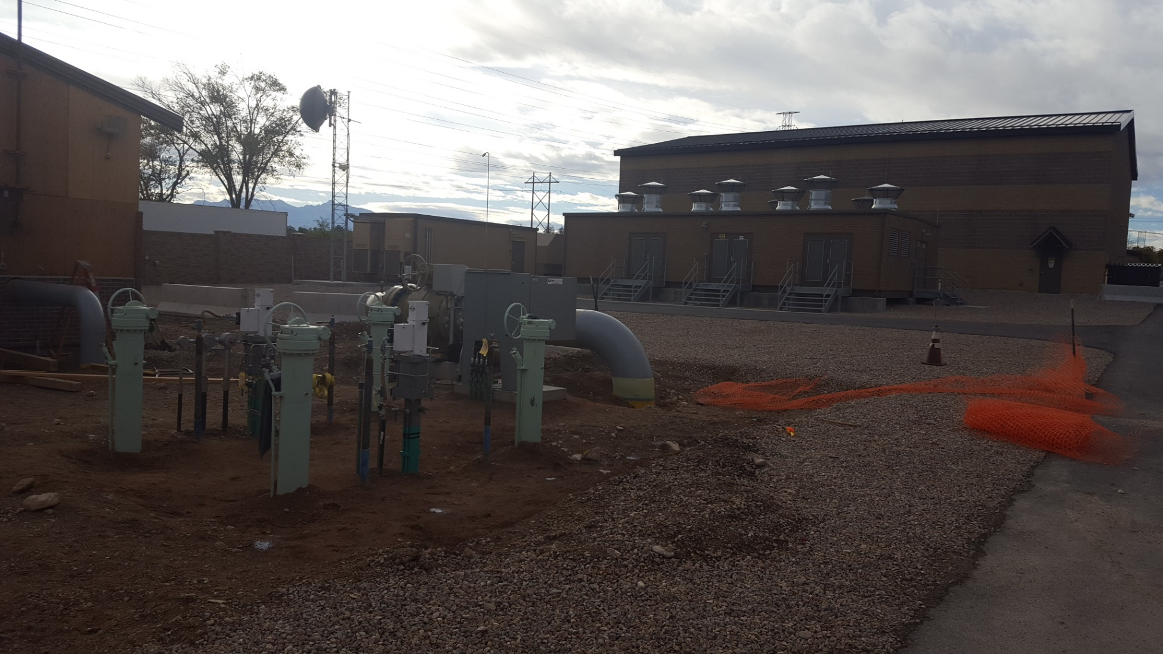
Station Design Considerations - Below Ground
Below Ground PRCV-FP Control Valves
Equipped with Remote PMV DG3 Positioner and VMO150
Kern River Gas Transmission
Hunter Meter Station

Slide 58
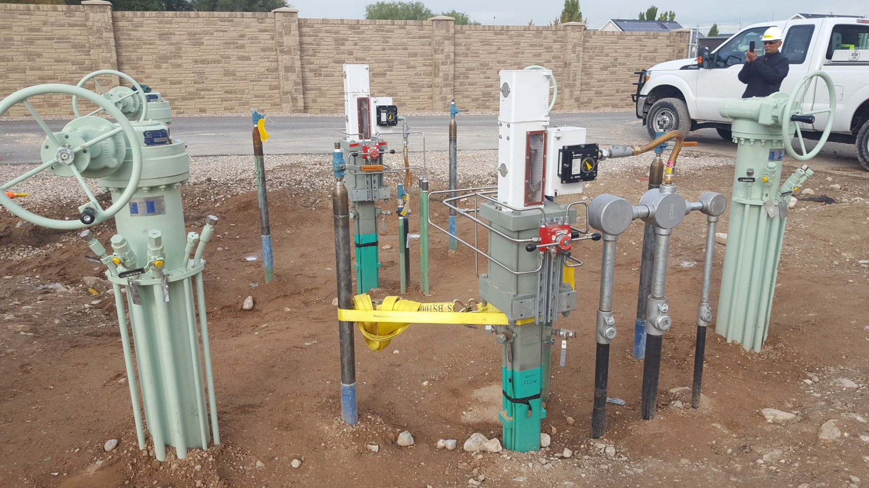
Station Design Considerations - Below Ground
Below Ground PRCV-FP Control Valves
Equipped with Remote PMV DG3 Positioner and VMO150
Kern River Gas Transmission
Hunter Meter Station

Slide 59
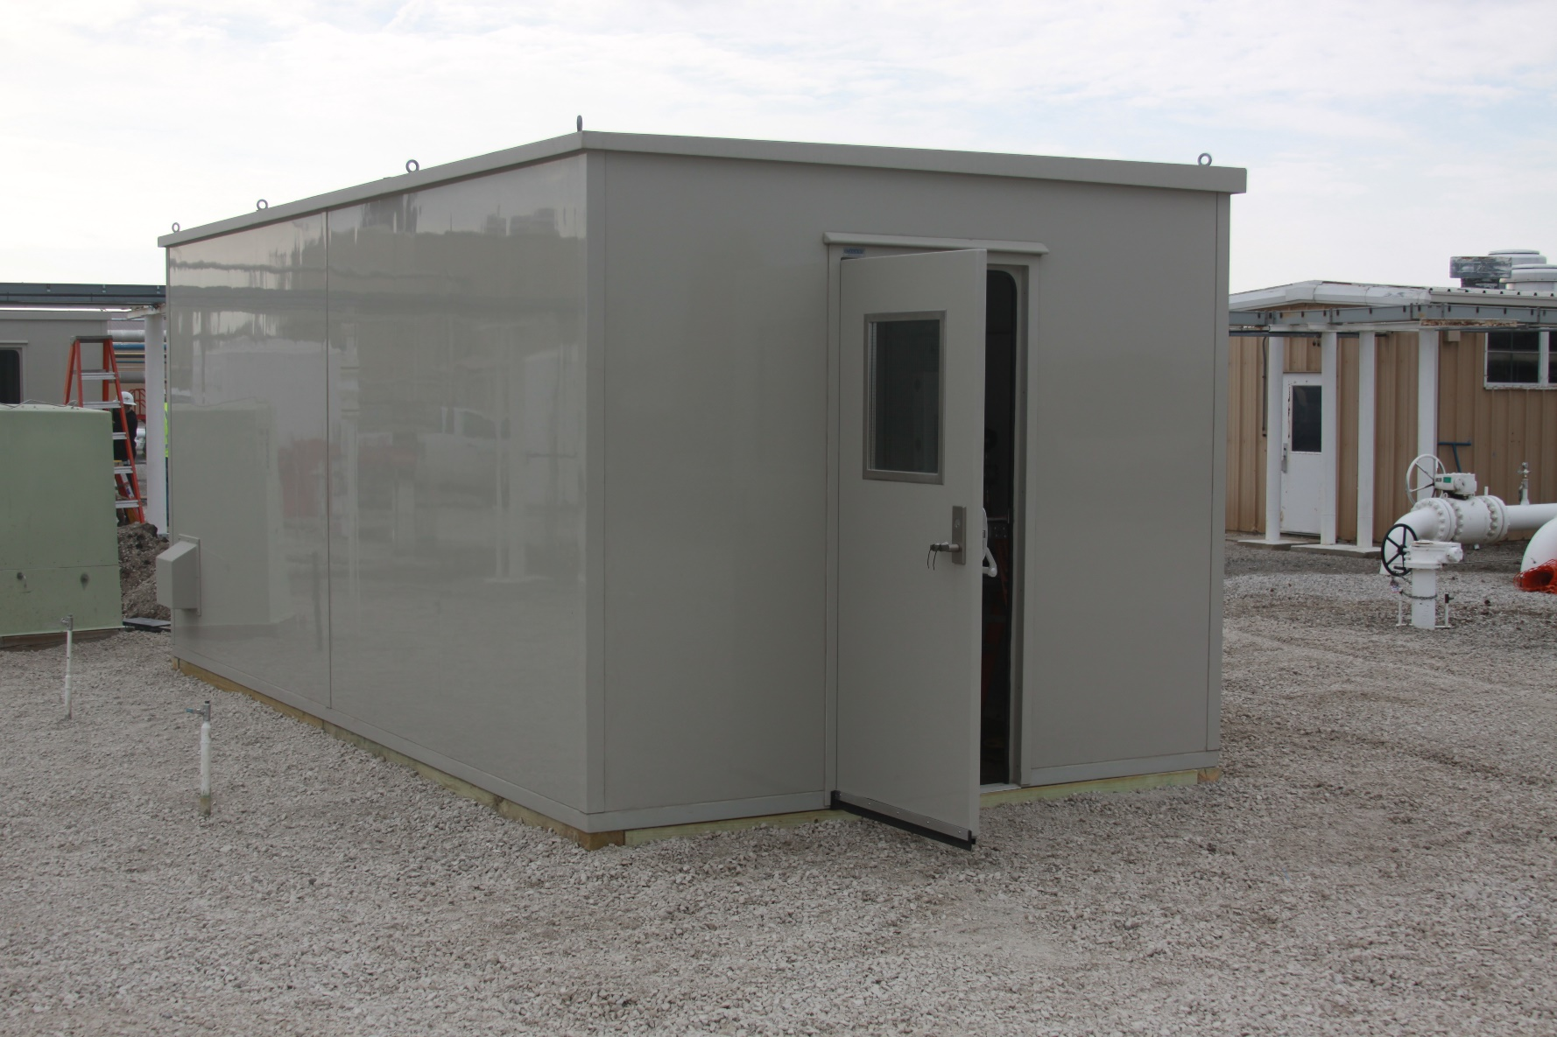
Station Design Considerations - Below Ground
Enclosure with VRG Controls Below Ground PRCV Control Valves
Located at Natural Gas Storage Facility
NICOR Gas / AGL Resources
Ancona Storage Facility

Slide 60
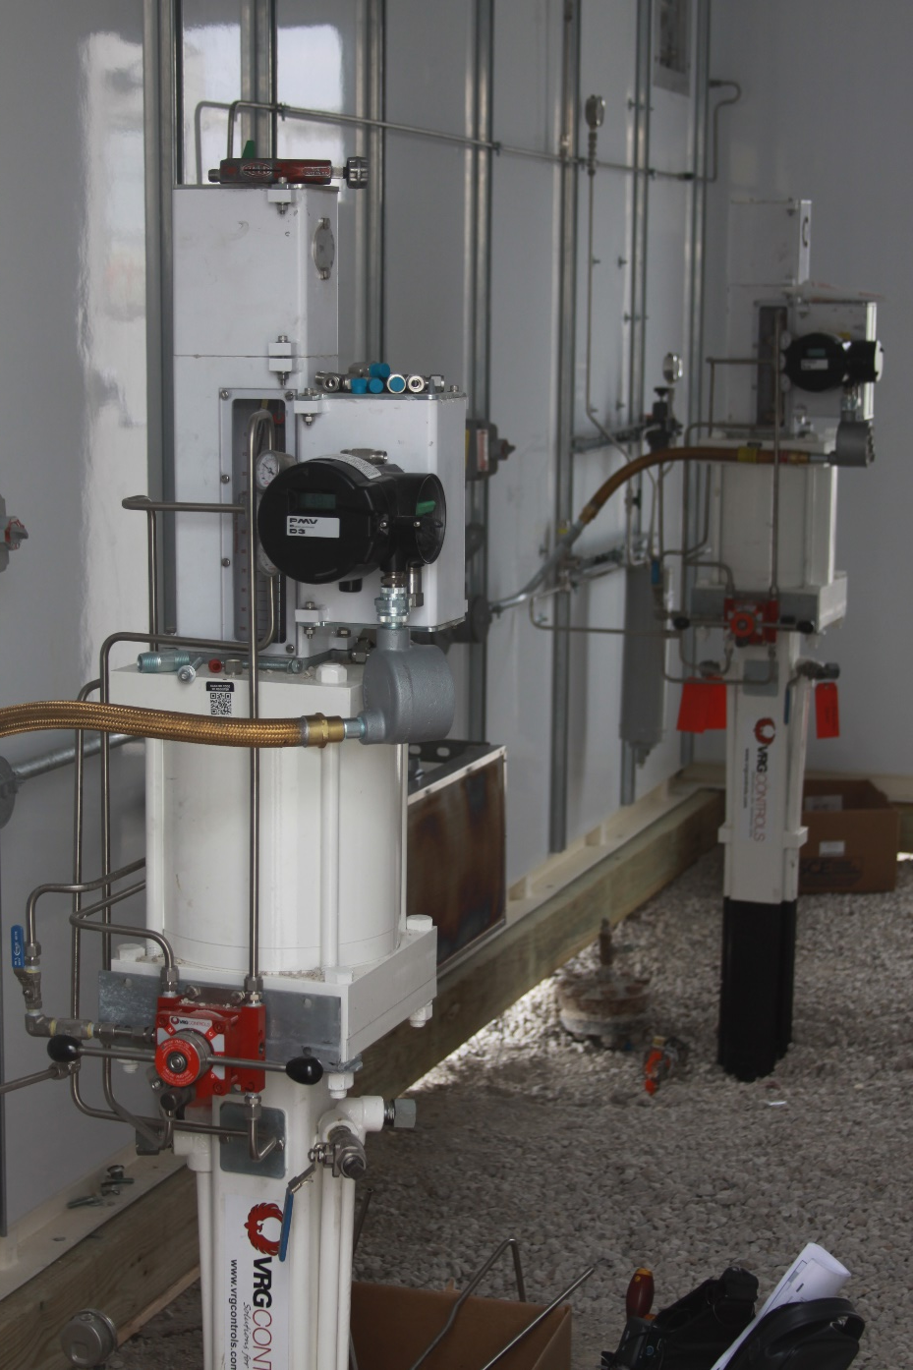
Station Design Considerations - Below Ground
Below Ground PRCV-FP Control Valves
Equipped with PMV DG3 Positioner and VMO150
NICOR Gas / AGL Resources
Ancona Storage Facility

Slide 61
Station Design Considerations – Pipe Size Selection
Q= 400 MMSCFD
P₁= 850 psig
P₂= 650 psig
T= 60⁰F
12" IN PRCV-FP
104 dBA | 103 dBA | 102 dBA | 101 dBA | 100 dBA | 99 dBA
V=188fps | V=130fps | V=100fps | V=73fps | V=58fps | V=47fps

Slide 62
Station Design Considerations – Pipe Schedule Selection
Q= 400 MMSCFD
P₁= 850 psig
P₂= 650 psig
T= 60⁰F
12" IN PRCV-FP
10 | 20 | 30 | STD | 40 | 60 | 80 | 100 | 120 | 140 | 160 | Noise Decibels
107 | 107 | 105 | 104 | 103 | 100 | 99 | 97 | 95 | 94 | 93 | Pipe Schedule

Slide 63
Station Design Considerations – Split Range Control (Cascade)
Key Design Considerations:
Higher Flow Volume = Higher Noise
Higher Flow Velocity = Higher Noise
Broadcasting Flow Across Two or More Runs Lessens Velocity and Noise
May be configured for Pressure Control or Volumetric Flow Control
VRG Size Provides “Split Range” Evaluation Tool for Analysis

Slide 64
Station Design Considerations – Noise Dissipation vs. Distance
Below Ground PRCV-FP Control Valves
Equipped with Remote PMV DG3 Positioner and VMO150
Kern River Gas Transmission
Hunter Meter Station

Slide 65
Station Design Considerations – Noise Dissipation vs. Distance
$$Distance Attenuation=10 × \log_{10}{\frac{D}{4}}$$

Slide 66
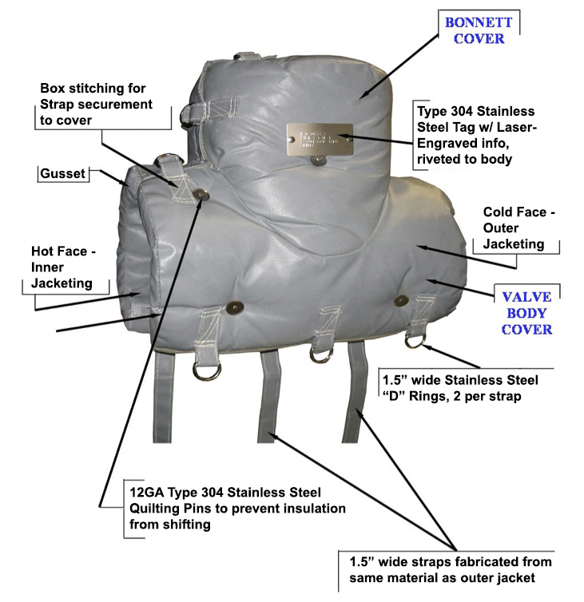
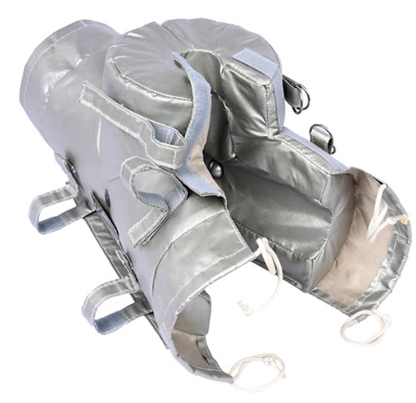
Station Design Considerations – Pipe Lagging
Effective For Higher Base Noise >100 dBA
5 – 10 dBA Noise Attenuation
Must Apply Lagging on Noise Source To Downstream Pipe Reentry into Ground
Utilized at Kinder Morgan

Slide 67
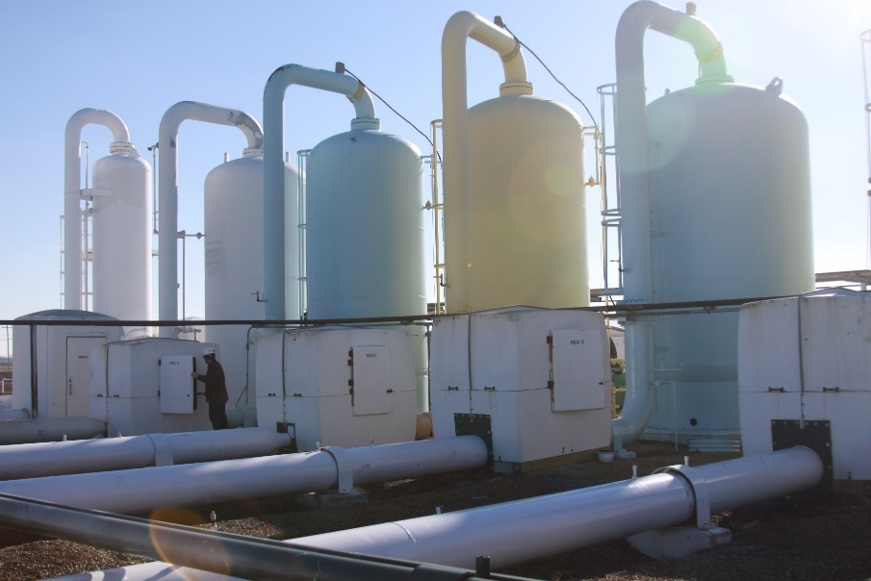
Station Design Considerations – Building Enclosure
Best Results with Fiberglass Cabinets
Typical Maximum Attenuation 20 dBA
Additional Noise Attenuation with Building Insulation and 2nd Skin

Slide 68
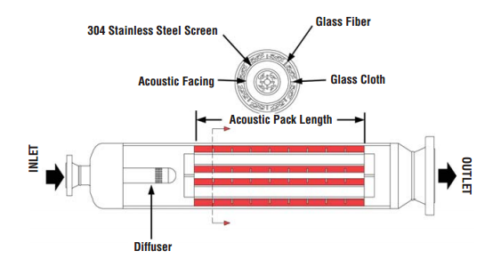
Station Design Considerations – Inline Control Valve Silencers

Slide 69
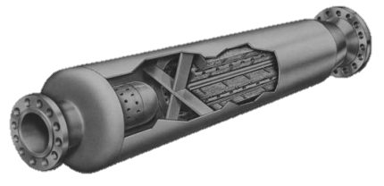
Station Design Considerations – Inline Control Valve Silencers
Overall Pressure Drop Must be Shared with Inline Control Valve Silencer for Maximum Effect and Cost Effectiveness
Typ. 20 PSID Minimum Pressure Drop Across Silencer
Typ. Maximum Noise Attenuation 50 dBA
May be Combined with Other Noise Attenuating Technologies:
Below Ground Control Valves
PRCV-STH1
PRCV-STHM
PRCV-STHP
Pipe Lagging

Slide 70
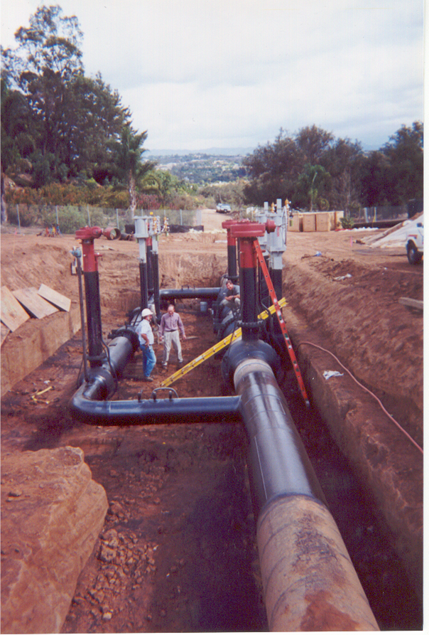
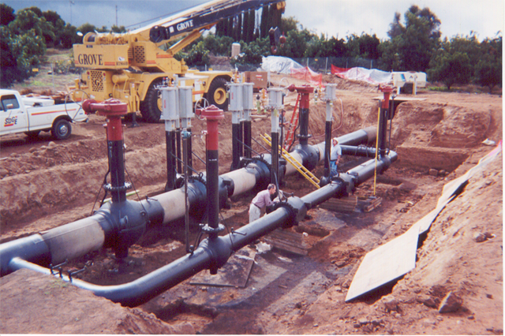
Station Design Considerations - Below Ground
Below Ground Control Valves
Equipped with Inline Control Valve Silencer
San Diego Gas & Electric
Fallbrook Regulator Station

Slide 71
Station Design Considerations – Combined Noise Solutions
Attenuation Technology | Max Noise Attenuation | Above Ground Combined Solutions | Below Ground Combined Solutions
PRCV + Quiet Trim | 25 dBA | ● | ●
CV Globe Valve + Quiet Trim | 25 dBA | ●
Below Ground | 25 dBA |  | ●
Inline Silencer | 50 dBA | ● | ●
Pipe Lagging | 10 dBA | ●
Building or Enclosure | 20 dBA | ● | ●
Distance | See Formula | ● | ●
Cascade (Split Flow) | Consult VRG Size | ● | ●

Slide 72
Station Design Considerations – VRG Size - Operating Conditions
Spec | Symbol | MAX Cv | Min Cv | Max Noise | Units
Flow | Q | Q_{MAX} | Q_{MIN} | Q_{MAX} | MMSCFD
Inlet Pressure | P1 | P1_{MIN} | P1_{MAX} | P1_{MAX**} | PSIG
Outlet Pressure | P2 | P2_{MAX} | P2_{MIN} | P2_{MIN} | PSIG
Gas Temperature | T | T_{MAX} | T_{MIN} | T_{MAX} | °F
CAUTION
**FOR MAX NOISE CASE NOTE THAT UPSTREAM PRESSURE MAY DECAY AT Q_{MAX}.
CONSULT PROCESS ENGINEER TO DETERMINE “TRUE” PROCESS CONDITIONS

Slide 73
Williams to PSE&G Westampton Pressure Regulation
Single cut from the Williams/Transco delivery/line pressure to the PSE&G 60 psig system.
Overpressure protection shall be by use of a wide-open monitor and redundant full capacity relief valves.
Redundancy will be provided by designing for two (2) regulator runs sized for one hundred percent (100%) Station capacity each. Unless this results in requiring control valves larger than twelve inches (12”) nominal diameter, in which case the design shall be for three (3) regulator runs each sized for fifty (50%) of Station capacity.
Separate regulator run shall be included sized for 25% of maximum station flow, to accommodate summer flow conditions
Each regulator run shall consist of two identical control valves or regulators, one functioning as a wide-open monitor and the other as the worker.

Slide 74
Williams to PSE&G Westampton Pressure Regulation
Each control valve shall be operated by a VRG pilot with remote set point adjustment by means of an electric actuator. Each control valve shall be equipped with a valve position transmitter.
Each control valve shall be designed with independent power gas supply with filter and heater, bleed gas line and downstream sensing line such that the failure of a single instrument line could not cause a failure of more than one control valve.
Each regulator run will have an upstream and downstream block valve, these block valves shall be full ported ball type equipped with electric motor actuators.
These actuators shall have local, remote and manual override operation capability and valve position switches. The valves shall be operable from a remote-control panel located outside the building.

Slide 75
Williams to PSE&G Westampton Pressure Regulation

Slide 76
Gillis Station Design Considerations
Spec | Symbol | MAX Cv | Min Cv | Max Noise | Typical | Units
Flow | Q | 785 | TBA | 785 | 785 | MMSCFD
Inlet Pressure | P1 | 600 | 1440 | 1440 | 1000 | PSIG
Outlet Pressure | P2 | TBA 90% OPEN | 600 | 600 | 800 | PSIG
Gas Temperature | T | 60 F | 60 F | 60 F | 60 F | °F
Notes:
Customer Specified Pipe 16 in SCH XH
Max Cv Condition Based Upon Control Valve 90% Open
Pressure Control
WORKER + MONITOR COMBINATION

Slide 77
Gillis Station Design Considerations
Notes:
Customer initially requested Three (3) Run Station w 12 in PRCV Control Valves
After reviewing over Skype, agreed that 10 in PRCV-STHP solution would be a much better fit considering overall application – max dP, noise, piping, etc…
The customer also had the option to reduce their piping from 16 in to 12 in, as it would meet the downstream velocity requirements in normal operation. This would save money on piping and block valves through each run.
OPTIONAL – Converted the station to BG (Below Ground) for comparison. Lower Cost Trim, Smaller DIA Pipe and Best Noise Attenuation.

Slide 78
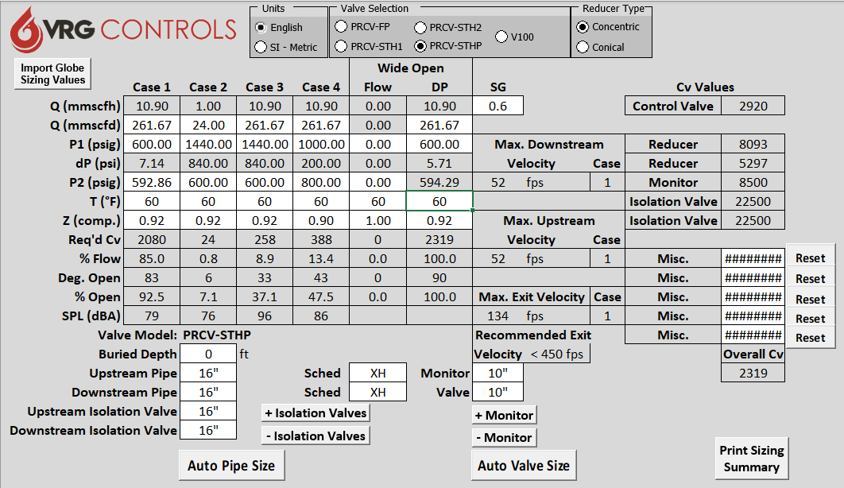
Gillis Station – 3 Runs – Above Ground - 10 in PRCV-STHP - 1 of 2
3 RUNS X 261.67 MMSCFD = 785 MMSCFD TOTAL STATION FLOW

Slide 79
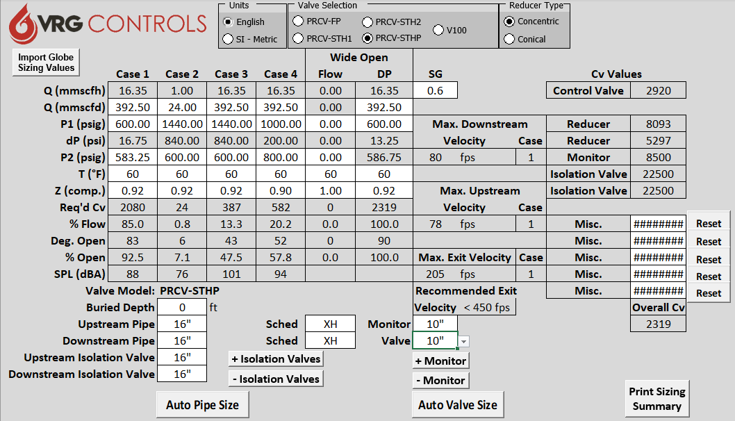
Gillis Station – 3 Runs – Above Ground - 10 in PRCV-STHP - 2 of 2
IF ONE (1) RUN FAILS – ABNORMAL OPERATING CONDITIONS OKAY
2 RUNS X 392.50 MMSCFD = 785 MMSCFD TOTAL STATION FLOW

Slide 80
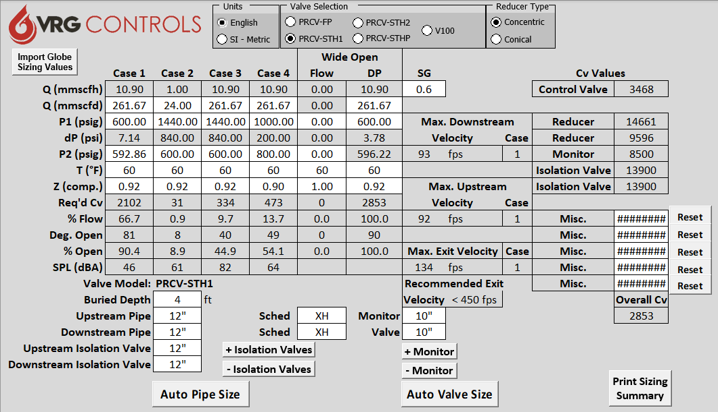
Gillis Station – 3 Runs – Below Ground - 10 in PRCV-STH1 - 1 of 2
3 RUNS X 261.67 MMSCFD = 785 MMSCFD TOTAL STATION FLOW

Slide 81
Gillis Station – 3 Runs – Below Ground - 10 in PRCV-STH1 - 2 of 2
IF ONE (1) RUN FAILS – ABNORMAL OPERATING CONDITIONS OKAY
2 RUNS X 392.50 MMSCFD = 785 MMSCFD TOTAL STATION FLOW

Slide 82
Gillis Station – Summary Analysis – 12 in PRCV-STHP vs. 10 in PRCV-STHP AG
OPTION 1 - 3 RUNS 12 IN PRCV-STHP – ABOVE GROUND INSTALLATION
Application | Control Valve | Action | Control | Est Noise | Est. Unit Price | QTY | Total
WORKER | 12 in PRCV-STHP | DA | RCVC | 96 dBA / 101 dBA | $87K | 3 EA | $261K
MONITOR | 12 in PRCV-FP | STC | VPC | N/A | $60K | 3 EA | $180K
 |  |  |  |  |  |  | $441K
NOTES:
Customer Original Request for 12 in PRCV Control Valves
Adjacent Pipe 16 in SCH XH
Est Noise Reported as ALL RUNS ACTIVE & LOSS ONE (1) RUN “AOC”
OPTION 2 - 3 RUNS 10 IN PRCV-STHP – ABOVE GROUND INSTALLATION
Application | Control Valve | Action | Control | Est Noise | Est. Unit Price | QTY | Total
WORKER | 10 in PRCV-STHP | DA | RCVC | 96 dBA / 101 dBA | $68K | 3 EA | $204K
MONITOR | 10 in PRCV-FP | STC | VPC | N/A | $41K | 3 EA | $123K
 |  |  |  |  |  |  | $327K
NOTES:
Adjacent Pipe 16 in SCH XH
Est Noise Reported as ALL RUNS ACTIVE & LOSS ONE (1) RUN “AOC”

Slide 83
Gillis Station – Summary Analysis -
OPTION 2 - 3 RUNS 10 IN PRCV-STHP – ABOVE GROUND INSTALLATION
Application | Control Valve | Action | Control | Est Noise | Est. Unit Price | QTY | Total
WORKER | 10 in PRCV-STHP | DA | RCVC | 96 dBA / 101 dBA | $68K | 3 EA | $204K
MONITOR | 10 in PRCV-FP | STC | VPC | N/A | $41K | 3 EA | $123K
 |  |  |  |  |  |  | $327K
NOTES:
Adjacent Pipe 16 in SCH XH
Est Noise Reported as ALL RUNS ACTIVE & LOSS ONE (1) RUN “AOC”
OPTION 3 - 3 RUNS 10 IN PRCV-STH1 – BELOW GROUND INSTALLATION
Application | Control Valve | Action | Control | Est Noise | Est. Unit Price | QTY | Total
WORKER | 10 in PRCV-STHP | DA | RCVC | 82 dBA / 87 dBA | $56K | 3 EA | 168
MONITOR | 10 in PRCV-FP | STC | VPC | N/A | $47K | 3 EA | 141
 |  |  |  |  |  |  | $309K
NOTES:
Adjacent Pipe 12 in SCH XH – COST SAVING ON ISOLATION VALVES AND PIPE
Est Noise Reported as ALL RUNS ACTIVE & LOSS ONE (1) RUN “AOC”

Slide 84
Momentum Station Design Considerations – VRG Size - Operating Conditions
Spec | Symbol | MAX Cv | Min Cv | Max Noise | Typical | Units
Flow | Q | 785 | TBA | 785 | 785 | MMSCFD
Inlet Pressure | P1 | 750 | 1440 | 1440 | 1000 | PSIG
Outlet Pressure | P2 | P₁ – 5.0 psid | P₁ – 10.0 psid | P₁ – 10.0 psid | P₁ – 10.0 psid | PSIG
Gas Temperature | T | 60 F | 60 F | 60 F | 60 F | °F
Pipe Specified 16 in SCH XH
Q = 785 MMSCFD = LOW Q CALC
P1 = 1440 – 750 psig
ΔP = 5-10 psid
T = 60F
VOLUMETRIC CONTROL
CASE 2 = CALC LOW CONTROL

Slide 85
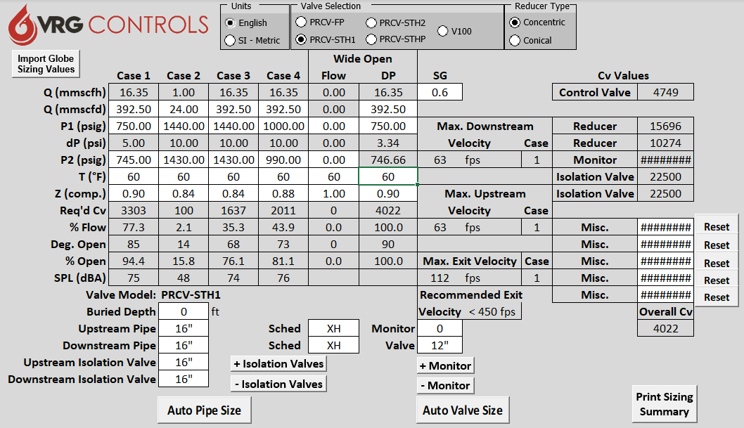
Momentum Station – 2 Runs – Above Ground - 12 in PRCV-STH1 - 1 of 2
RUN 2 RUNS SPLIT 50% FLOW

Slide 86
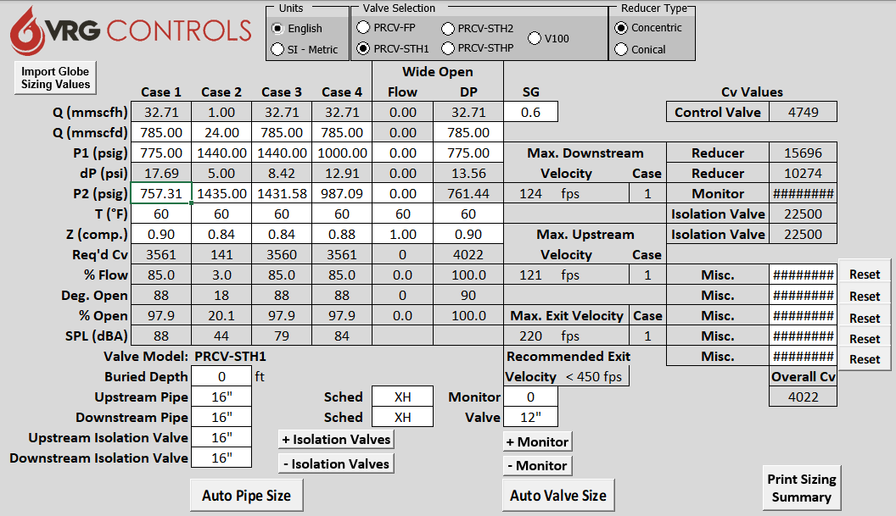
Momentum Station – 2 Runs – Above Ground - 12 in PRCV-STH1 - 2 of 2
IF ONE (1) RUN FAILS – ABNORMAL OPERATING CONDITIONS OKAY

Slide 87
Momentum Station – Summary Analysis
OPTION 1 - 3 RUNS 10 IN PRCV-STHP – ABOVE GROUND INSTALLATION
Application | Control Valve | Action | Control | Est Noise | Est. Unit Price | QTY | Total
WORKER | 10 in PRCV-STHP | DA | RCVC | 96 dBA / 101 dBA | $68K | 3 EA | $204K
MONITOR | 10 in PRCV-FP | STC | VPC | N/A | $41K | 3 EA | $123K
 |  |  |  |  |  |  | $327K
NOTES:
Adjacent Pipe 16 in SCH XH
Est Noise Reported as ALL RUNS ACTIVE & LOSS ONE (1) RUN “AOC”
OPTION 2 - 3 RUNS 10 IN PRCV-STH1 – BELOW GROUND INSTALLATION
Application | Control Valve | Action | Control | Est Noise | Est. Unit Price | QTY | Total
WORKER | 10 in PRCV-STHP | DA | RCVC | 82 dBA / 87 dBA | $56K | 3 EA | 168
MONITOR | 10 in PRCV-FP | STC | VPC | N/A | $47K | 3 EA | 141
 |  |  |  |  |  |  | $309K
NOTES:
Adjacent Pipe 12 in SCH XH – COST SAVING ON ISOLATION VALVES AND PIPE
Est Noise Reported as ALL RUNS ACTIVE & LOSS ONE (1) RUN “AOC”

Slide 88
PHP-HPL & OPL Station Design Considerations – Operating Conditions
Pipe Specified 16 in SCH XH
Q = 200 – 2.0 MMSCFD
P1 = 1350 psig
P2 = 550 - 1100 psig
T = 80F
VOLUMETRIC CONTROL
CASE 2 = CALC LOW CONTROL

Slide 89
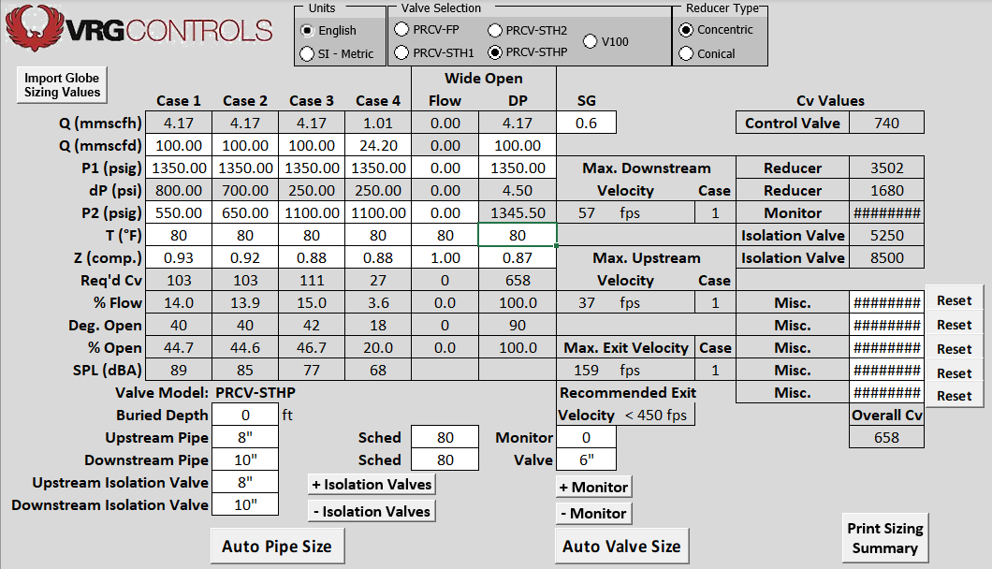
PHP-HPL & OPL – 2 Runs – Above Ground - 6 in PRCV-STHP - 1 of 2

Slide 90
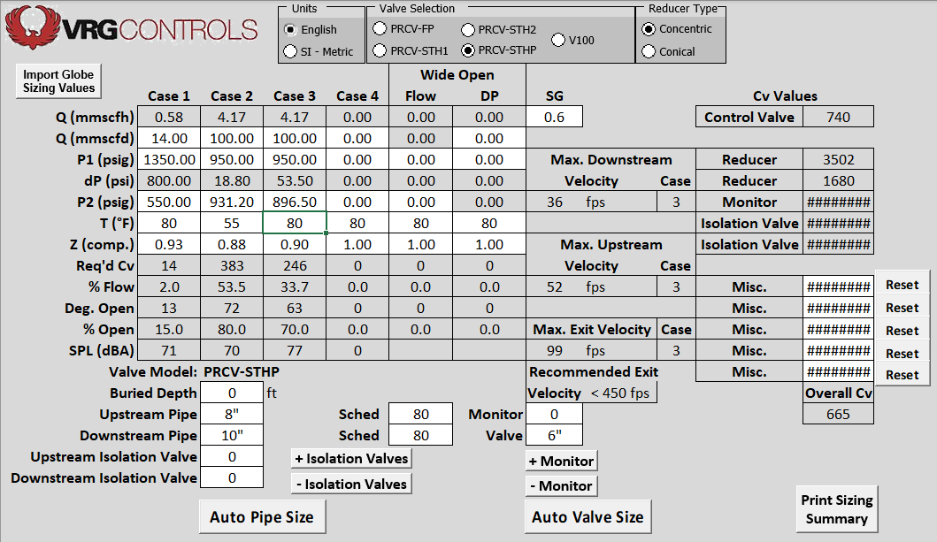
PHP-HPL & OPL – 2 Runs – Above Ground - 6 in PRCV-STHP - 2 of 2
SUPPLEMENTAL SIZING CONDITIONS

Slide 91
PHP-HPL & OPL – 1 Run – Below Ground - 6 in PRCV-STH2 - 1 of 2

Slide 92
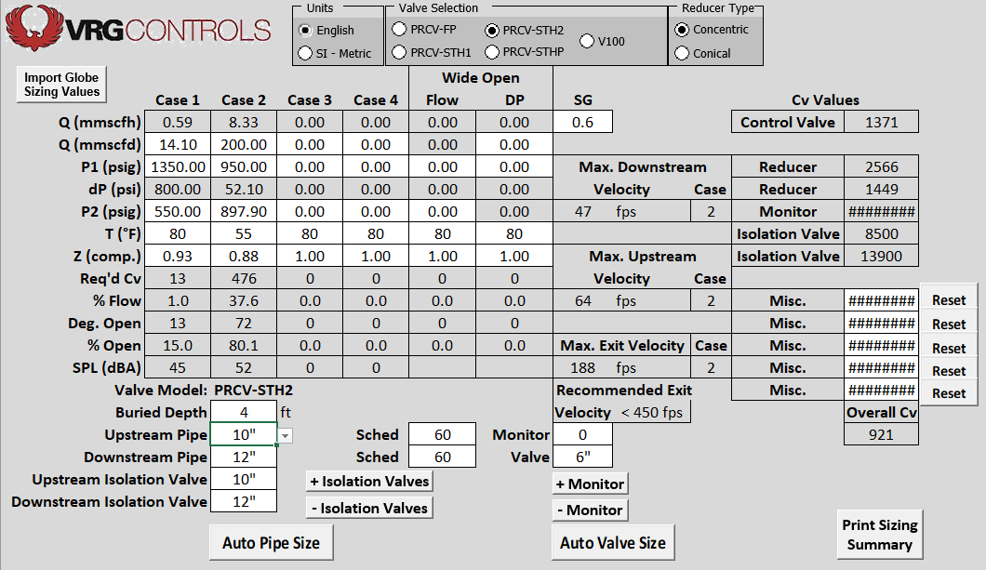
PHP-HPL & OPL – 1 Run – Below Ground - 6 in PRCV-STH2 - 2 of 2
SUPPLEMENTAL SIZING CONDITIONS

Slide 93
PHP-HPL & OPL – Summary Analysis
OPTION 1 - 2 RUNS 6 IN PRCV-STHP – ABOVE GROUND INSTALLATION
Application | Control Valve | Action | Control | Est Noise | Est. Unit Price | QTY | Total
WORKER | 6 in PRCV-STHP | DA | RCVC | 89 dBA | $49K | 2 EA | $98K
NOTES:
Adjacent Pipe 8 in SCH 80 & 10 in SCH 80
Est Noise Reported as ALL RUNS ACTIVE & LOSS ONE (1) RUN “AOC”
OPTION 2 - 1 RUNS 6 IN PRCV-STH2 – BELOW GROUND INSTALLATION
Application | Control Valve | Action | Control | Est Noise | Est. Unit Price | QTY | Total
WORKER | 6 in PRCV-STH2 | DA | RCVC | 74 dBA | $46K | 1 EA | $46K
NOTES:
ONLY ONE (1) RUN REQUIRED
Adjacent Pipe 10 in SCH 80 & 12 in SCH 80
Est Noise Reported as ALL RUNS ACTIVE & LOSS ONE (1) RUN “AOC”

Slide 94
Williams Centerville – Station Inlet 5 Runs
4
5
3
2
1

Slide 95
Williams Centerville – Runs 2, 3, 4, and 5

Slide 96
Williams Centerville – Run 1 and Run 2

Slide 97
Williams Centerville – Station Layout

Slide 98
Williams Centerville – Bristol 624 Controllers – Susceptible to Cycling

Slide 99
Williams Centerville – NEW VPC Valve Pilot Controllers – Stable & Accurate

Slide 100
Williams Centerville – Noise at Station Fence Line
60.4 dBA

Slide 101
Station Design Considerations – VRG Size - Free Download at www.vrgcontrols.com

Slide 102
Station Design Considerations – VRG Size - Free Download at www.vrgcontrols.com

Slide 103
Station Design Considerations – Sulfur Deposition Issues
Notes:
Numerous Stations in Florida and Other Locations Exhibit Sulfur Deposition on Control Valves
Pilot Operated Regulators and Linear Cage-Guided Control Valves Clog Very Quickly and Fail
PRCV-STHP Rotary Control Valves Not Affected Significantly. Accommodate Minor Clogging.
Sulfur Buildup STHP Not Affected
Installed at Following Stations: Vandola, Polk, Shady Hill
Pilot Operated and Cage Guided Solutions Lasted 3 Months Before Failure
PRCV-STHP installed for Two (2) Years + Without Problems
Seven (7) STHP Valves
P1=1200 psig, P2=450 psig, Q=100 - 200 MMSCFD
Florida Gas Transmission FGT, TECO Peoples Gas

Slide 104
Our Contact Information
VRG Controls, LLC
Toll-Free: +844-FLOW-VRG (USA & CANADA)
e-Mail: Sales@VRGControls.com
www.VRGControls.com
VRG Controls, LLC
1199 Flex Court, Unit B
Lake Zurich, Illinois 60047 USA
VRG Controls, LLC
Solutions for Natural Gas!
Follow Us:

