Slide 1
CV Series Linear
Control Valves
ver 022421

Slide 2
CVET Linear Control Valves – Product Features
Installed Base of Over 1,000 CV Series Control Valves Globally by “VRG Controls”
Over 20 Years Experience with CV Series Control Valves in Natural Gas Transmission Applications
Ideally Suited For Natural Gas Control Applications.
Can Accommodate Moderate and Severe Service.
Cage Guided Design Features Trim Options to Address Characterized Flow And Noise Attenuation Per Application.
The Modular Format Can Accept A Variety Of Actuator And Trim Configurations To Match Your Application Needs.

Slide 3
Paired with Patented VRG Control Solutions for Natural Gas Industry
VMO Series
Valve Manual Override
VPC Series
Valve Pilot Controller
RCVC Series
Red Circle Valve Controller

Slide 4
CVET Linear Control Valves – Product Features
Flexible Design Control Valve for Moderate to Small Flow Volumes
Interchangeable Trims for Characterization and Effective Noise Attenuation
Key Applications
Low to Moderate Flow Rates
More Aggressive Pressure Drop Ratio
Power Plant Fuel Gas Feed
“Trim” Type Control Runs
Natural Gas Transmission Pipelines
Natural Gas LDC Gate Stations

Slide 5
CVET Linear Control Valves – Product Features
Top-entry Design
Equal Percentage Characterized Trims Available for Max Range-Ability
High Performance Trims Options Available for Aggressive Applications
Multi-Stage Noise Attenuating Trim Available
Low Temp Carbon Steel and NACE Trim Standard
Soft Seat Class VI Shut Off Available For All Trims
High C_{V} to Size Ratio
Streamlined Flow Path To Optimize Capacity
Wide Range Of Material Options
Backed Up By VRG Controls Sizing & Selection

Slide 6
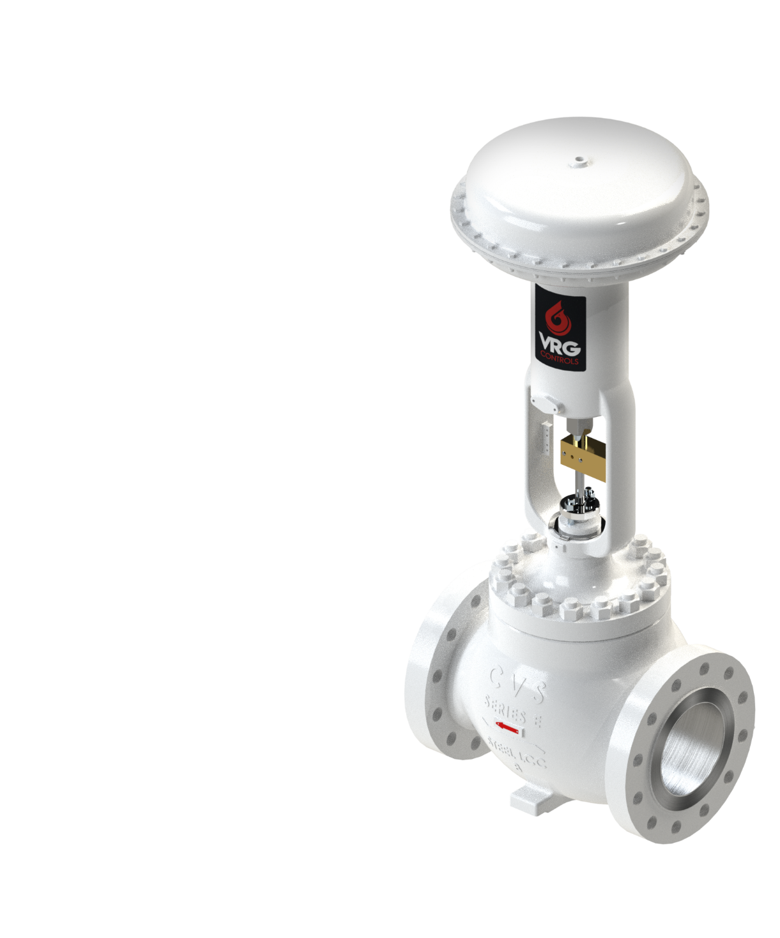
CVET Linear Control Valves – Specifications Overview
Component | Value
Sizes | 1 in to 12 in Nominal Bore
Styles | Reduced Bore & Oversized Connections
Pressure / Temperature Rating | Per ASME 150, 300, 600, 900*
Shell Test | Hydrostatic Shell Test Per ASME B16.34-2009
Seat Test | Hydrostatic Seat Test Per FCI 70-2-2—2 ASME B16.34-2009
End Connections | RFFE, Weld End, RTJ
Valve Trim | Full Port, Reduced Port, Low Recovery, Multi-Stage, Hi Duty
Flow Characteristics | Linear, Equal Percentage, Quick Opening
Temperature Range | -50° F to + 360° F
Trim Materials | Stainless Steel (NACE MRO175)
Body Materials | LCC (Low Temp Carbon Steel)
Shutoff Class | Class IV, Class V, Class VI Designs Available
Actuation | Spring & Diaphragm, Spring & Piston, DA Piston
Gland Packing | Live Loaded Zero Emissions
Coating | VRG Epoxy Primer CL21 83021, SP-10 (WHITE)
Sizing & Selection | Proprietary VRG Station Design Program

Slide 7
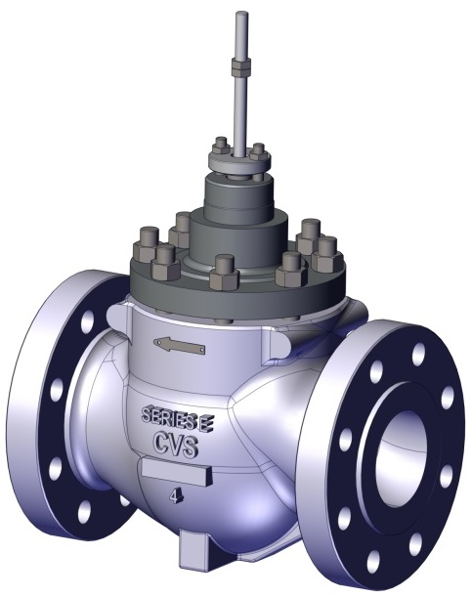
CVET Linear Control Valves – Product Overview
CV Trim | CVEZ | CVET | CVET – LEVEL I | CVET – LEVEL II | CVET – LEVEL III
Size Range | 1 in to 4 in | 2 in to 12 in | 2 in to 12 in | 2 in to 12 in | 2 in to 16 in
Design Standard | ASME B16.5 ASME B16.34 | ASME B16.5 ASME B16.34 | ASME B16.5 ASME B16.34 | ASME B16.5 ASME B16.34 | ASME B16.5 ASME B16.34
ANSI Range | 150 – 900 ANSI | 150 – 900 ANSI | 150 – 900 ANSI | 150 – 900 ANSI | 150 – 900 ANSI
End Connections | RFFE, RTJ | RFFE, RTJ | RFFE, RTJ | RFFE, RTJ | RFFE, RTJ
Trim Type | Unbalanced | Balanced | Balanced | Balanced | Balanced
Performance Trim Technology | Plug Linear Equal Percent | Linear Equal Percent | Drilled Hole Noise Trim Linear Equal Percent | Drilled Hole Noise Trim Linear Equal Percent | Drilled Hole Noise Trim Linear Equal Percent
Relative Capacity | Moderate | Moderate | Moderate | Restricted | Restricted
Max Noise Attenuation | N/A | N/A | 10-15 dBA | 15-20 dBA | 25 dBA
Max Range-Ability | 50:1 – EQ% | 33:1 – EQ% 20:1 - LIN | 33:1 – EQ% 10:1 - LIN | 33:1 – EQ% 10:1 - LIN | 33:1 – EQ% 10:1 - LIN
Shutoff | Class IV– STD Class V - OPT | Class IV Class V Class VI | Class IV Class V Class VI | Class IV Class V Class VI | Class IV Class V Class VI
Seats | Stainless Steel - STD Stellite - OPT | Stainless Steel – OPT (IV) Stellite – OPT (V) Soft Seat – STD (VI) | Stainless Steel – OPT (IV) Stellite – OPT (V) Soft Seat – STD (VI) | Stainless Steel – OPT (IV) Stellite – OPT (V) Soft Seat – STD (VI) | Stainless Steel – OPT (IV) Stellite – OPT (V) Soft Seat – STD (VI)

Slide 8
CV Series Linear Control Valve – Available Size Range
Valve Size | CVEZ | CVET E0 & L0 | CVET E1 & L1 | CVET E2 & L2 | CVET E3 & L3
1 in | STANDARD | NA | NA | NA | NA
1.5 in | STANDARD | NA | NA | NA | NA
2 in | STANDARD | STANDARD | STANDARD | STANDARD | STANDARD
3 in | STANDARD | STANDARD | STANDARD | STANDARD | STANDARD
4 in | STANDARD | STANDARD | STANDARD | STANDARD | STANDARD
6 in | NA | STANDARD | STANDARD | STANDARD | STANDARD
8 in | NA | STANDARD | STANDARD | STANDARD | STANDARD
10 in² | NA | STANDARD | STANDARD | STANDARD | STANDARD
12 in² | NA | STANDARD | STANDARD | STANDARD | STANDARD
Notes:
2 in to 8 in Size CVET are “ET” Type Body Configuration
10 in and 12 in Size CVET are “EWT” Type Body Configuration
Standard ANSI Pressure Ratings: 300, 600, 900 ANSI, Other ANSI RATINGS AVAILABLE

Slide 9
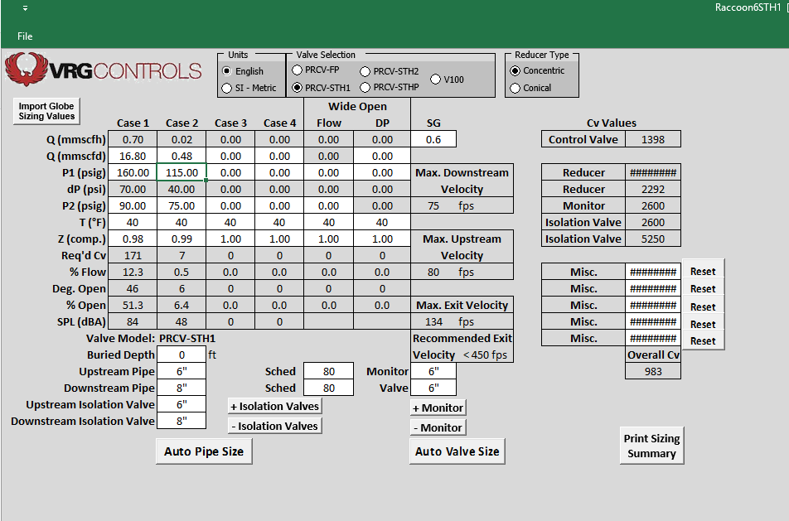
VRGSize Station Design and Control Valve Sizing Program
FREE Download at www.vrgcontrols.com
Size & Select CVEZ & CVET Globe Valves
Design ABOVE and BELOW GROUND Stations, including piping and monitors
Analyze Control Valve Performance
Calculate Predicted Noise
Save as DATA file or print to PDF

Slide 10
PRCV & CVET Control Valve Flow Capacity Analysis
PFCV-STHP | PRCV-STH2 | PRCV-STH1 | PRCV-FP

Slide 11
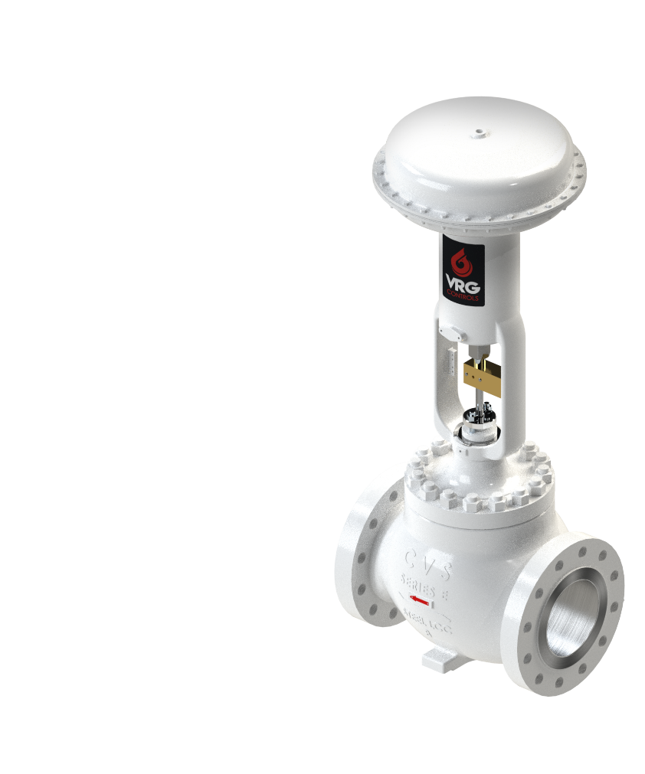
CV Series Linear Control Valve – CVET Capacity vs. Trim Comparison
Linear Trim
Equal Percent Trim

Slide 12
CV Series Linear Control Valve – Typical Noise Attenuation Comparison

Slide 13
CV Series Linear Control Valve – Typical Application Guidelines
Pressure Drop Ratio | Recommended Control Valve
ΔP Ratio > 0.8 | Globe Control Valve
0.6 > ΔP Ratio > 0.8 | Globe Control Valve OR PRCV Pipeline Rotary Control Valve
< 0.6 | PRCV Pipeline Rotary Control Valve
*For ABOVE GROUND Station Installations
$ΔP Ratio= \frac{(P_{1−}P_{2)}}{P_{1}}$

Slide 14
CV Series Linear Control Valve – Min & Max Control Range
Control Valve | Min Control |  | Max Control**
PRCV-FP | 1.0% Flow | 10° Open | 90% Flow | 83° Open
PRCV-STH1 | 0.33% Flow | 5° Open | 85% Flow | 83° Open
PRCV-STH2 | 0.33% Flow | 7° Open | 85% Flow | 83° Open
PRCV-STHP | 0.50% Flow | 9° Open | 85% Flow | 83° Open
CV-ET EQ% | ≈3.0% Flow | 10% Open | ≈79% Flow | 90% Open
CV-ET LINEAR | 10% Flow | 10% Open | 90% Flow | 90% Open
CV-EZ EQ% | ≈2.0% Flow | 5% Open | ≈79% Flow | 90% Open
CV-EZ LINEAR | 5% Flow | 5% Open | 90% Flow | 90% Open
** NOTE THAT CONTROL VALVE CAN PROVIDE ADDITONAL CAPACITY AT HIGHER FLOWS.
MAX CONTROL LIMIT PROVIDES FACTOR SAFETY FOR DESIGN CAPACITY

Slide 15
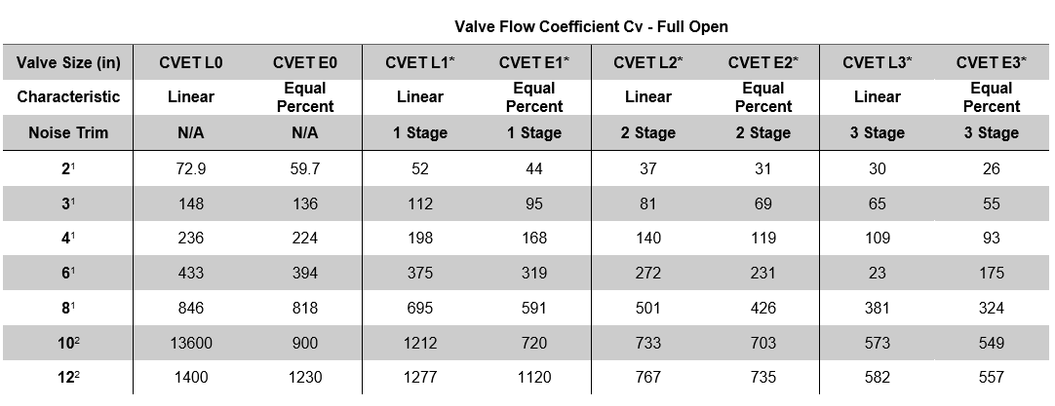
CV Series Linear Control Valve – CVET Full Open Flow Coefficients

Slide 16
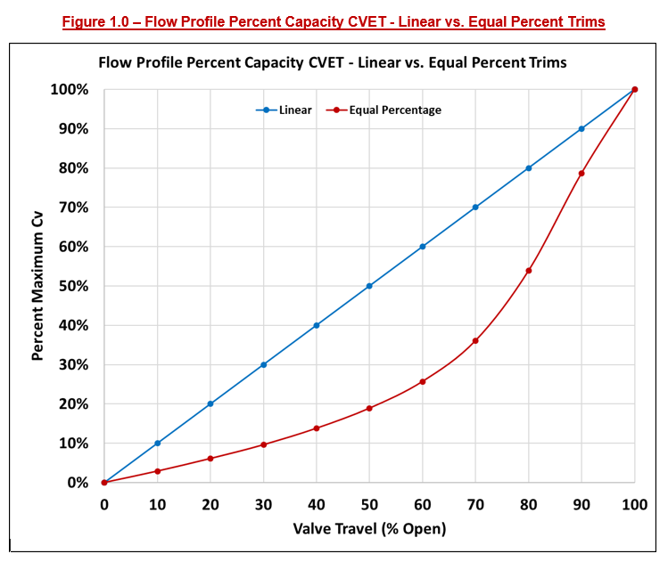
Flow Profile Percent Capacity CVET – Linear vs. Equal Percent Trims

Slide 17
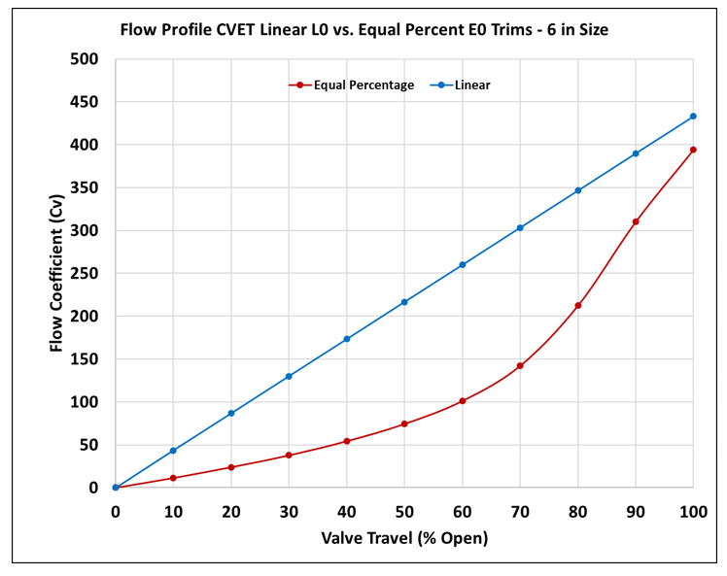
Flow Profile Percent Capacity CVET – Linear L0 vs. Equal Percent E0 Trim

Slide 18
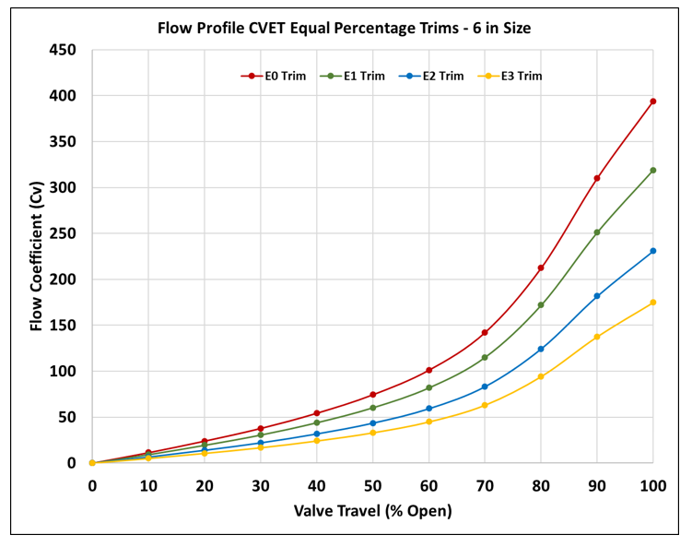
Flow Profile CVET Equal Percent Trims – 6 in Size

Slide 19
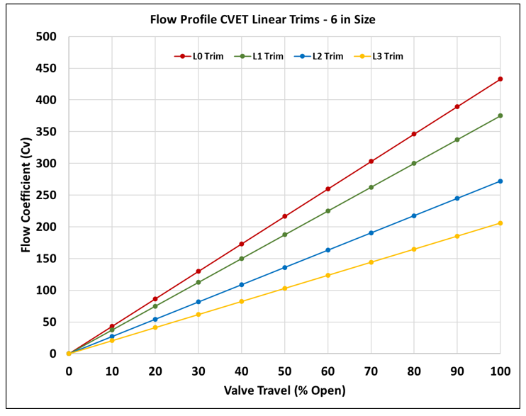
Flow Profile CVET Linear Trims – 6 in Size

Slide 20
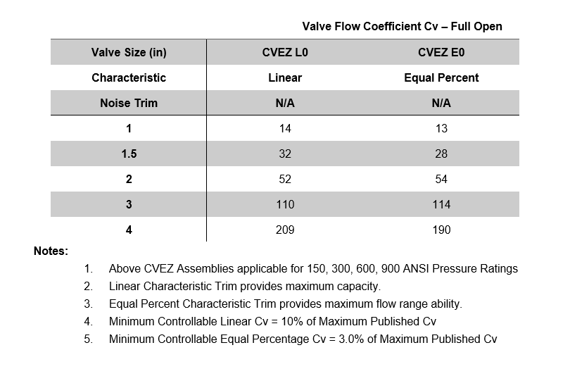
CV Series Linear Control Valve – CVEZ Full Open Flow Coefficients

Slide 21
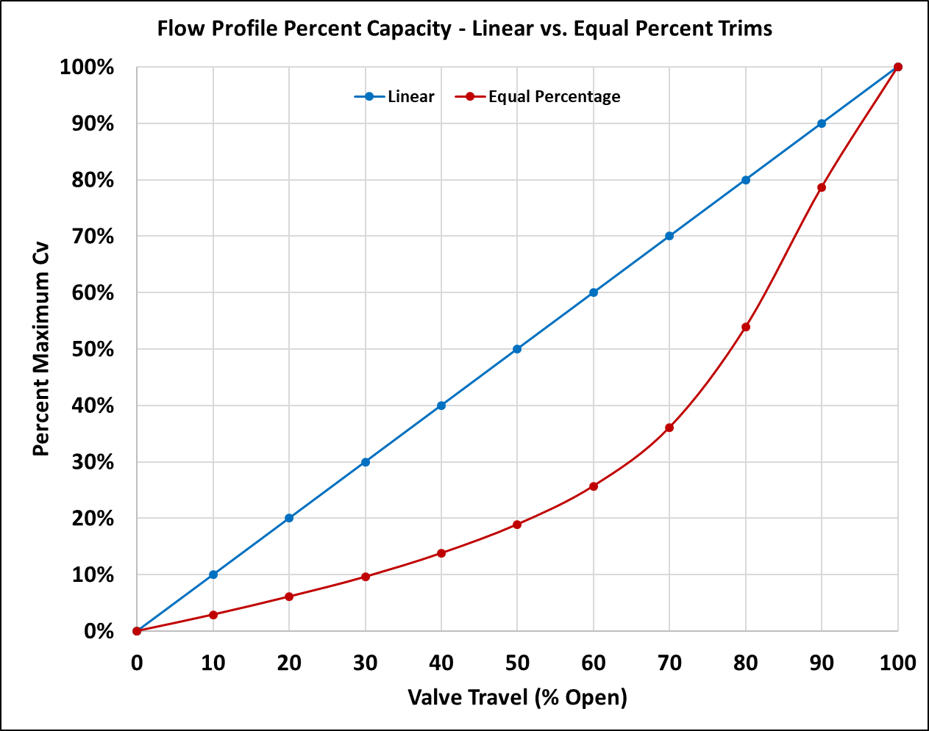
Flow Profile Percent Capacity – CVEZ Linear vs. Equal Percent Trims

Slide 22
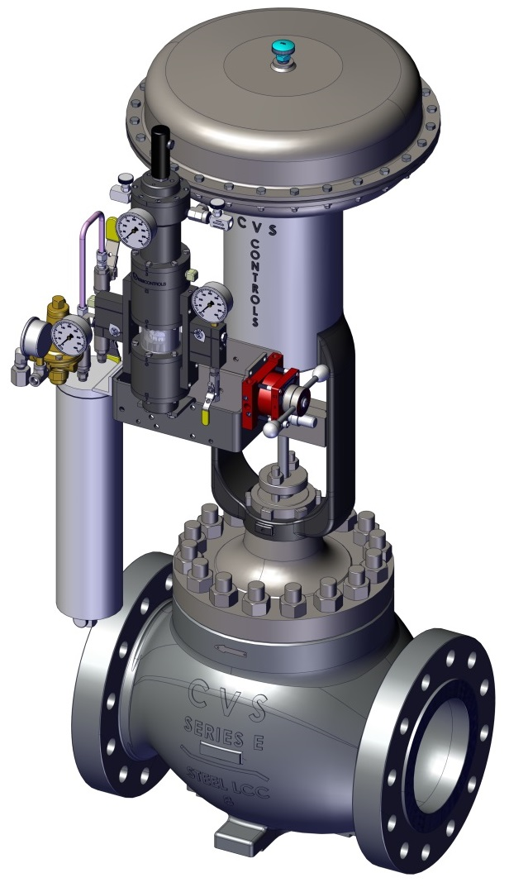
LD Linear Diaphragm (Spring Return) Actuators
LD Linear Diaphragm Actuators for High Thrust at Low Supply Pressure
VRG Control Instrumentation Ideal for Natural Gas Applications
Sizes from 1.0 in to 12 in Bore
150, 300, 600 and 900 ANSI Ratings
Full Range of Noise Attenuation Trims w
Equal Percent or Linear Flow Characterization
CVET Series
Linear Control Valves

Slide 23
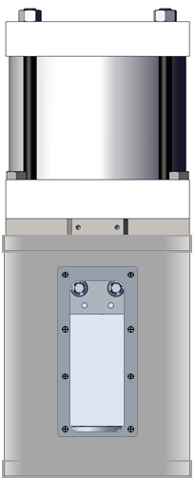
LHPA-DA Linear High Pressure Actuators (Double Acting)
High MAOP Allows
Bleed to Pressure
ZERO ATM Emissions
High MAOP Allows
Bleed to Pressure
ZERO ATM Emissions
High Thrust for Large CVET Control Valves
High Thrust for Large CVET Control Valves
Compact
High Pressure
LHPA-DA Actuator
Compact
High Pressure
LHPA-DA Actuator
Closed Yoke Design
Submersible
Ideal for Vaults
Open Yoke Design
CVET Series
Linear Control Valves
w LHPA-DA Series
Linear High Pressure Actuator
(Double Acting, Open Yoke)
CVET Series
Linear Control Valves
w LHPA-DA Series
Linear High Pressure Actuator
(Double Acting, Closed Yoke)

Slide 24
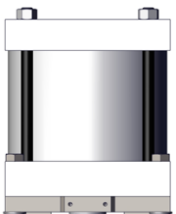
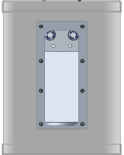
LHPA-SR Linear High Pressure Actuators (Spring Return)
High MAOP Allows
Bleed to Pressure
ZERO ATM Emissions
High Thrust
Low Pressure
LD Actuator
High Thrust for Large CVET Control Valves
High Thrust for Large CVET Control Valves
Compact
High Pressure
LHPA-SR Actuator
High MAOP Allows
Bleed to Pressure
ZERO ATM Emissions
Compact
High Pressure
LHPA-SR Actuator
Closed Yoke Design
Submersible
Ideal for Vaults
Open Yoke Design
CVET Series
Linear Control Valves
w LD Series Diaphragm Actuator
CVET Series
Linear Control Valves
w LHPA-SR Series
Linear High Pressure Actuator
(Spring Return, Open Yoke)
CVET Series
Linear Control Valves
w LHPA-SR Series
Linear High Pressure Actuator
(Spring Return, Closed Yoke)

Slide 25
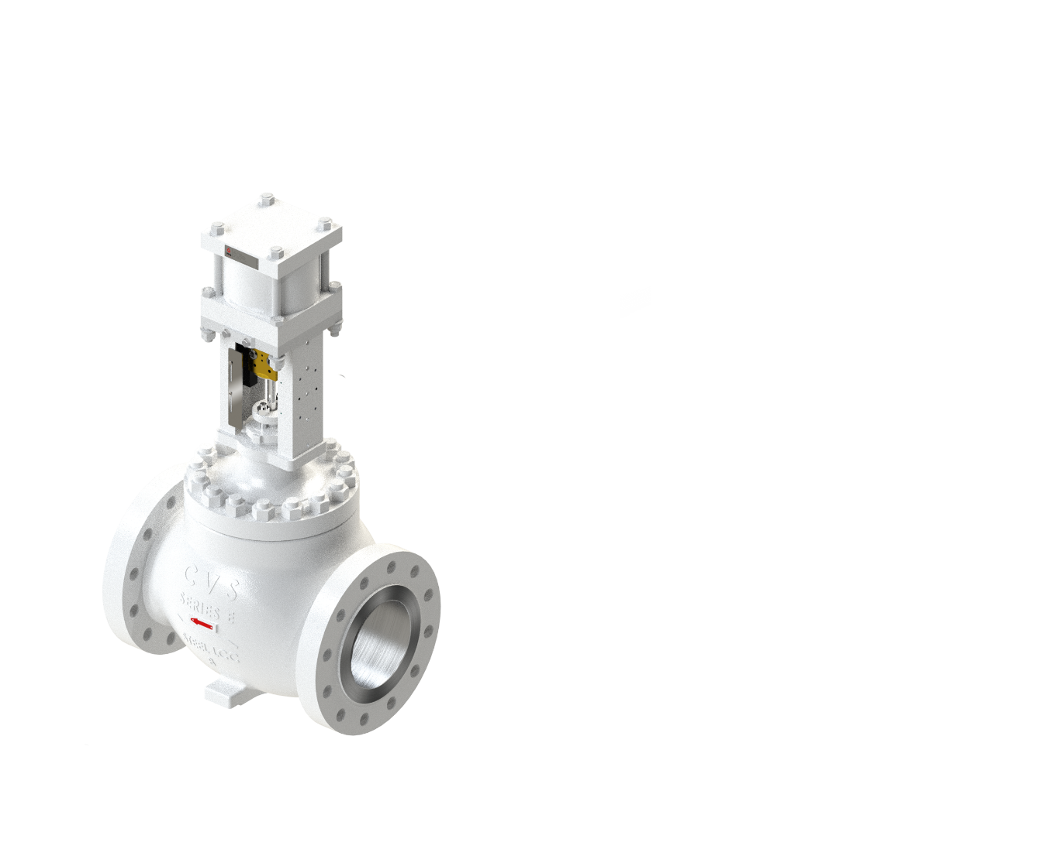
8 in Bore CV-ET Control Valve “Line Up” w Actuator Options
8”
8”
8”
8”
diaphragm globe valve
AA-1500
AA-2710
AA-1700
LHPA-DA
LHPA-SR STO
LHPA-CY-DA-IND
8” GV1-086FI-A01

Slide 26
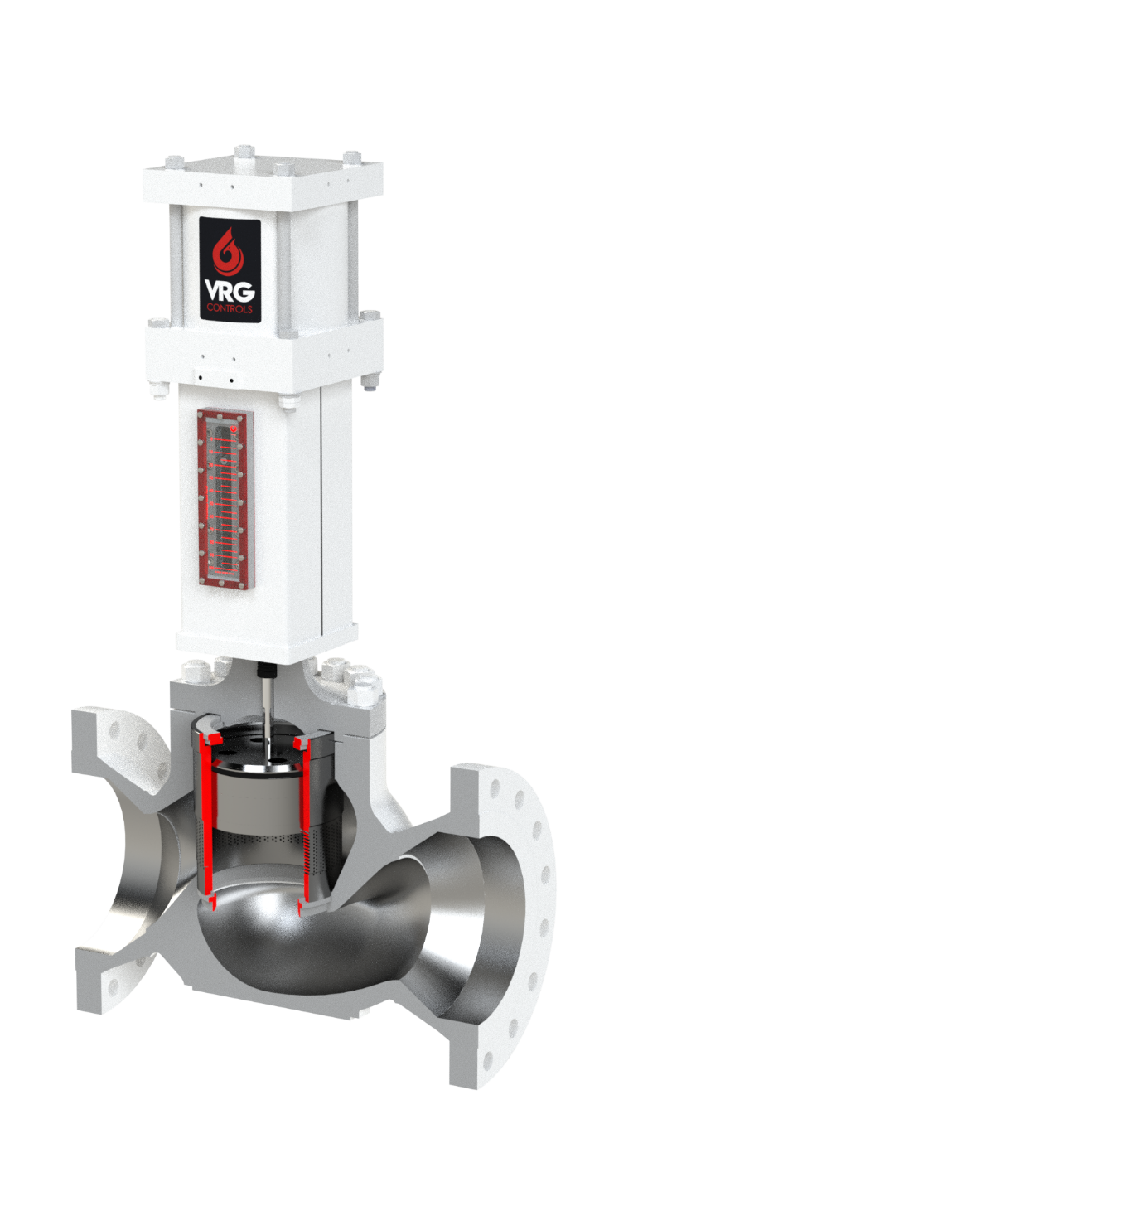
8 in Bore CV-ET Control Valve “Valve Regulator”
CLOSED
12” GV1-1283FI
5” STROKE – FULL OPEN
FLOW
AA-1700
AA-1700
LHPA-CY-DA-IND
LHPA-CY-DA-IND

Slide 27
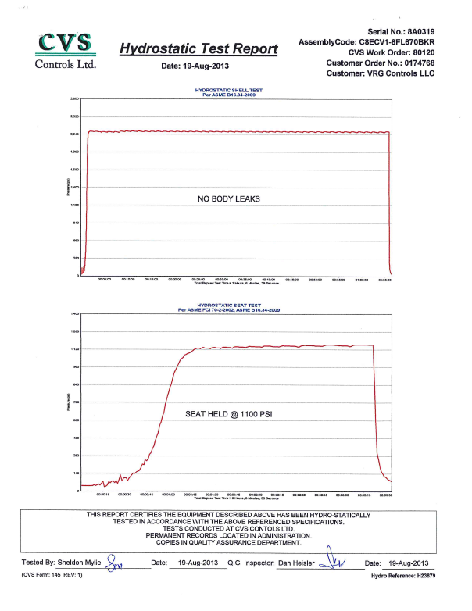
Fully Documented Hydrotesting Testing on All CV Series
Hydrostatic Shell Test
Per ASME B16.34-2009
Hydrostatic Seat Test
Per FCI 70-2-2—2
ASME B16.34-2009

Slide 28
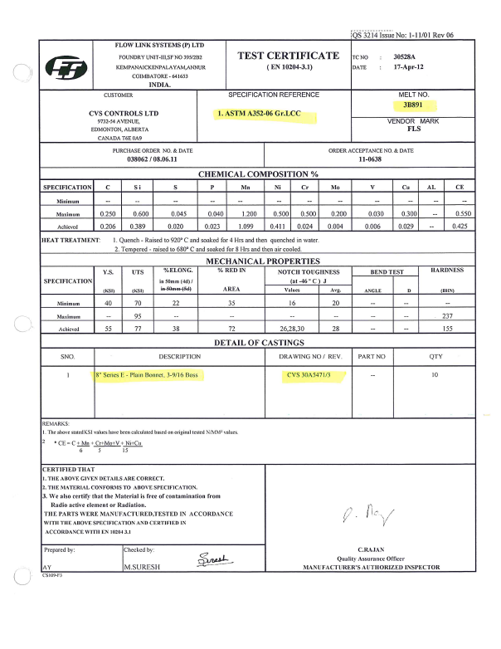
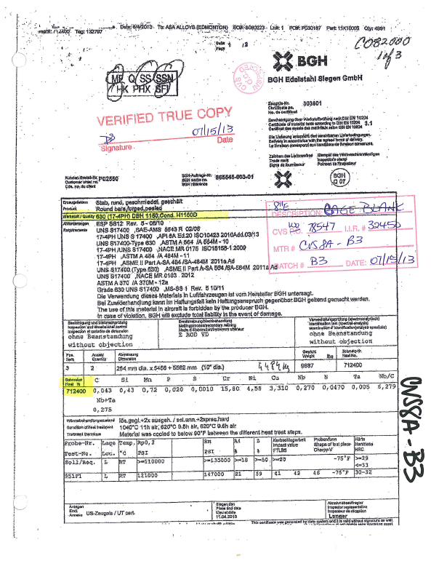
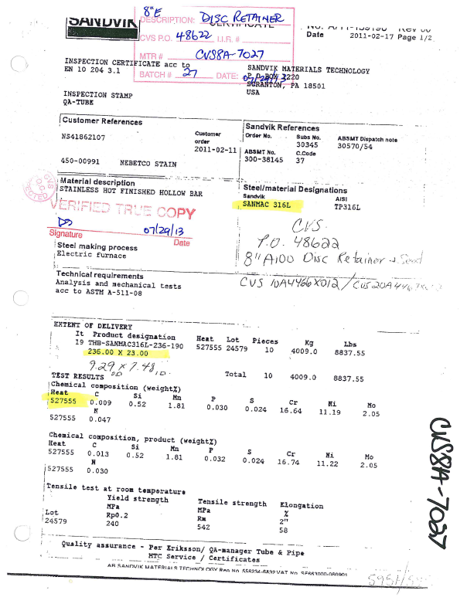
Fully Documented Materials and Testing on All CV Series

Slide 29
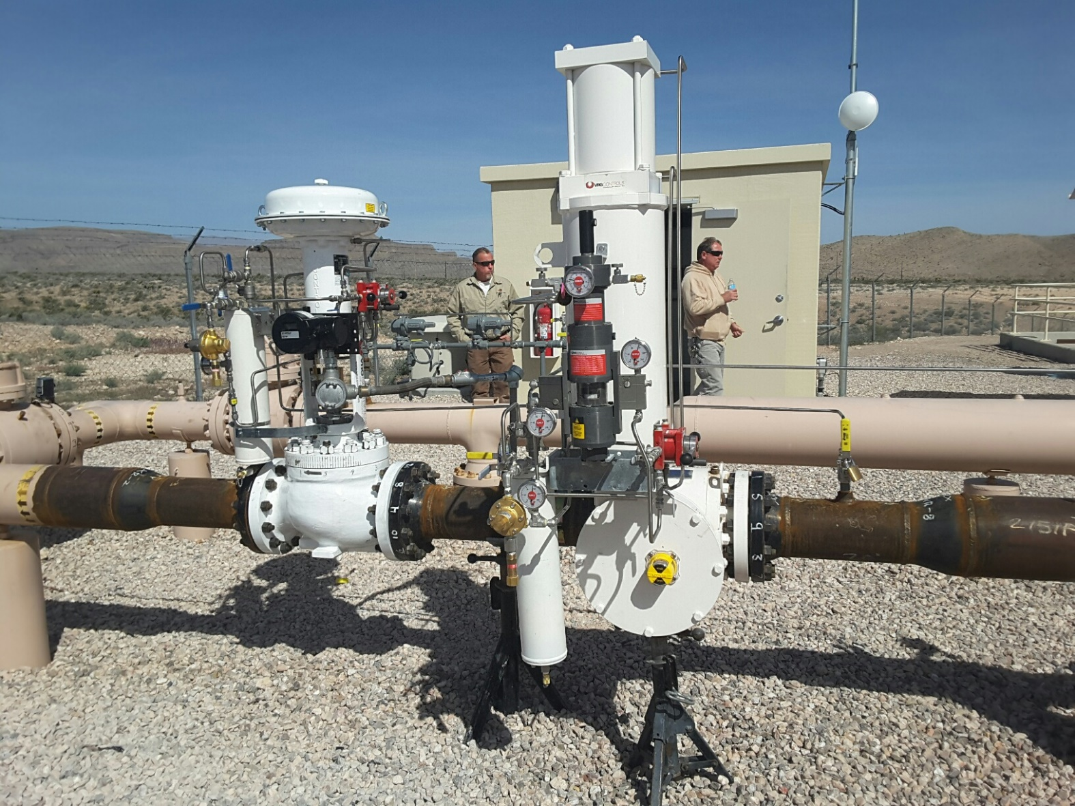
CV Series Linear Control Valves – Application 1
Flow Control Valve & Monitor Overpressure Protection
APEX CT Power Plant Fuel Gas Feed
Southwest Gas Corp. – Las Vegas, NV USA

Slide 30
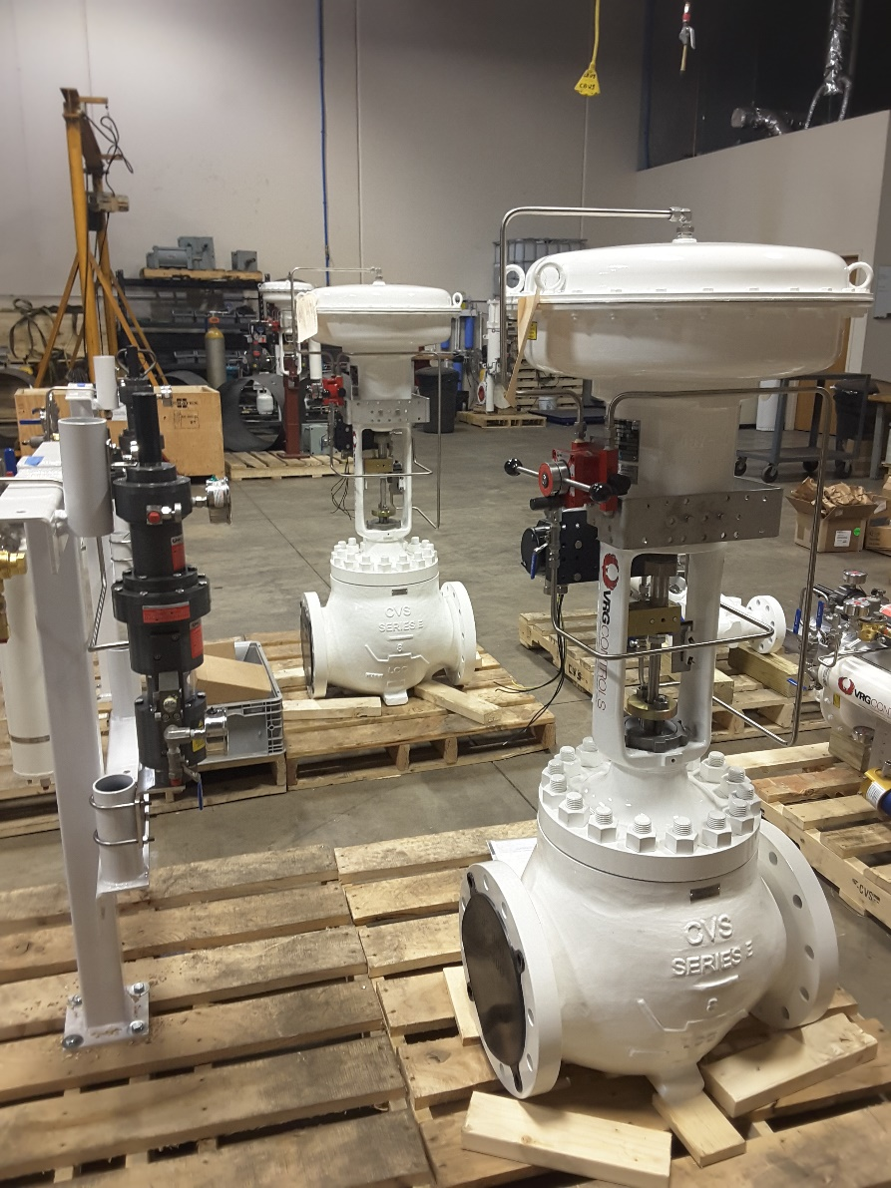
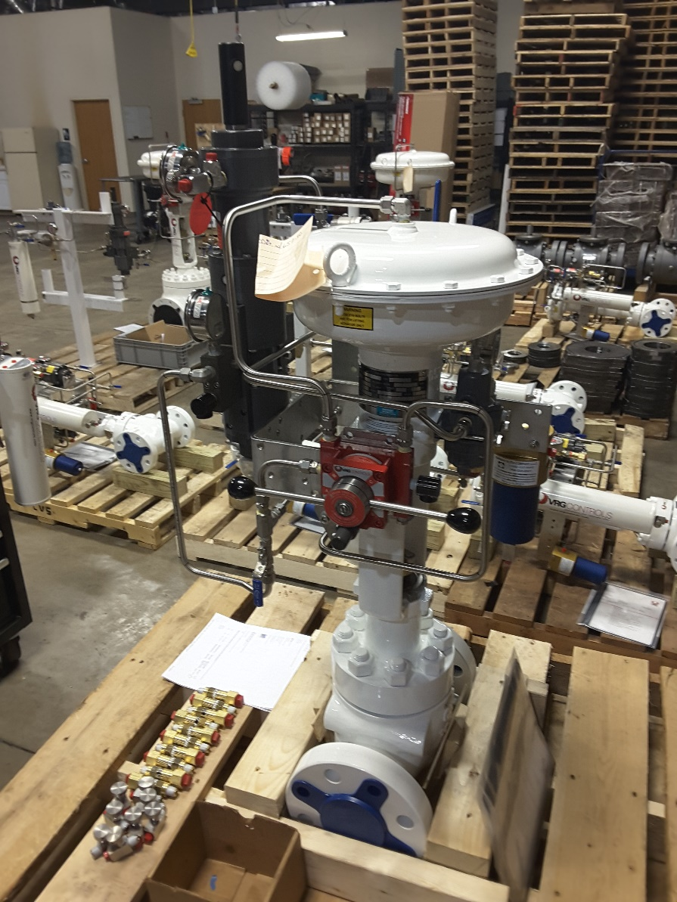
CV Series Linear Control Valves – Application 2
CVET Series Control Valves Prepare for Shipment
VRG Controls Factory – Lake Zurich, IL USA

Slide 31
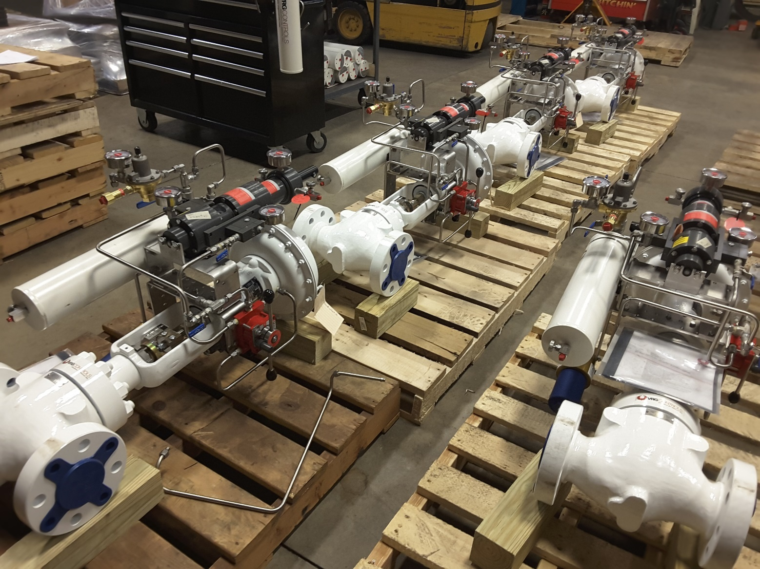
CV Series Linear Control Valves – Application 3
CVET Series Control Valves Prepare for Shipment
VRG Controls Factory – Lake Zurich, IL USA

Slide 32
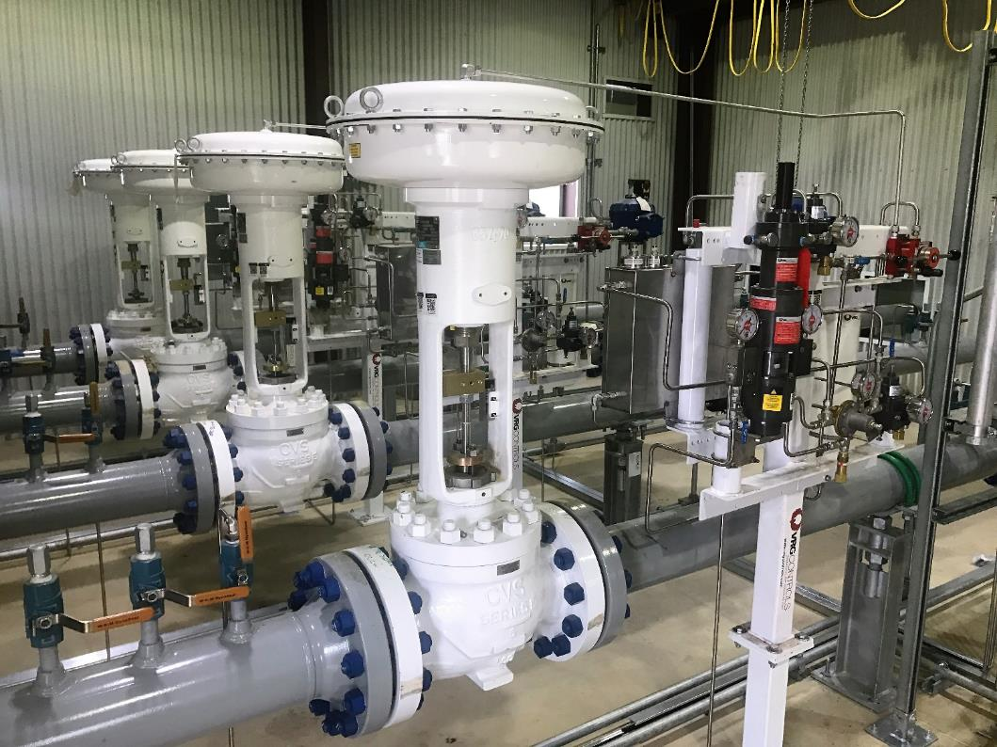
CV Series Linear Control Valves – Application 4
Louisville Gas & Electric (LG&E)
CVET Globe Control Valves with VPC Valve Pilot Controllers w/ VMO

Slide 33
CV Series Subassemblies Manufactured by CVS Controls
CVS Controls manufactures VRG’s CV Series Control Valves per design specifications jointly developed over 20 years.
The CV Series are specifically optimized by VRG for use in Natural Gas Transmission applications.
CVS is headquartered in Edmonton, Alberta CANADA
CVS US Operations is headquartered in Houston, Texas USA
CVS Controls Provides Joint Support for:
Secondary Parts Inventory
Secondary Spare Parts Dispatch
Secondary Field Services and Support

Slide 34
CV Series Subassemblies Manufactured by CVS Controls
IS0 9001:2015
CVS Controls Ltd. is an ISO registered 9000:2015 Canadian
manufacturing facility.
Registered Certificate Number SAI/QMI 0123989
HOUSTON USA Operations
Delta Valves and Controls
2843 Westside Drive Unit 17
Pasadena, TX 77502
ABSA
ABSA, the pressure equipment safety authority, is authorized by the Alberta Government for the administration and delivery of safety programs related to boilers, pressure vessels and pressure piping systems in Alberta.
EDMONTON CANADA Operations
CVS Controls
3900–101 Street
Edmonton, Alberta, Canada T6E 0A
24 HOUR
PARTS AVAILABILITY
CAPABLE

Slide 35
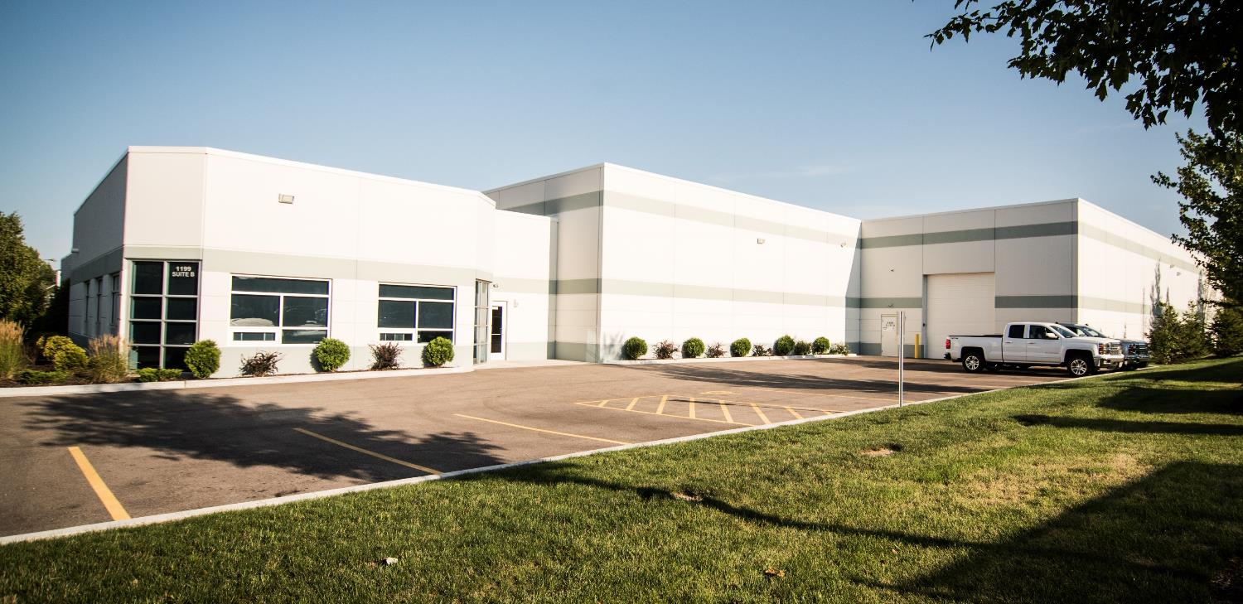
CV Series Control Valve Packages Provided by VRG Controls
VRG Controls Provides Complete CV Series Control Valve Solutions Paired with VRG Control Instrumentation and Accessories
The CV Series are specifically optimized by VRG for use in Natural Gas Transmission applications.
VRG is headquartered in Chicago, Illinois USA
VRG Sales Representatives Are Broadcast Across USA for Regional Support
VRG Houston, Texas USA Office Provides Engineering and Application Support
VRG Provides Primary Support for:
Primary Parts Inventory
Primary Spare Parts Dispatch
Primary Field Services and Support
24 HOUR
PARTS AVAILABILITY
CAPABLE

Slide 36
Notes

Slide 37
Notes

Slide 38
Our Contact Information
Contact VRG Controls
CHICAGO Headquarters
VRG Controls, LLC
1199 Flex Court, Unit B
Lake Zurich, Illinois 60047 USA
Toll-Free: +844-FLOW-VRG (USA & CANADA)
e-Mail: Sales@VRGControls.com
www.VRGControls.com
HOUSTON Regional Offices
VRG Controls, LLC
720 Rusk, Suite 304
Houston, Texas 77002 USA
Mobile: 713.440.9494
Office: 346.353.6802
Toll Free: 844-FLOW-VRG (USA & CANADA)
E-Mail: Aalvarado@VRGControls.com
IS0 9001:2015
VRG Controls Ltd. is an ISO registered 9000:2015 US
manufacturing facility.
Registered Certificate Number ABS QE 56549
Follow Us:

