Slide 1
VRG Controls
PRCV Pipeline Rotary Control Valves for Liquids Applications
Ver 032921

Slide 2
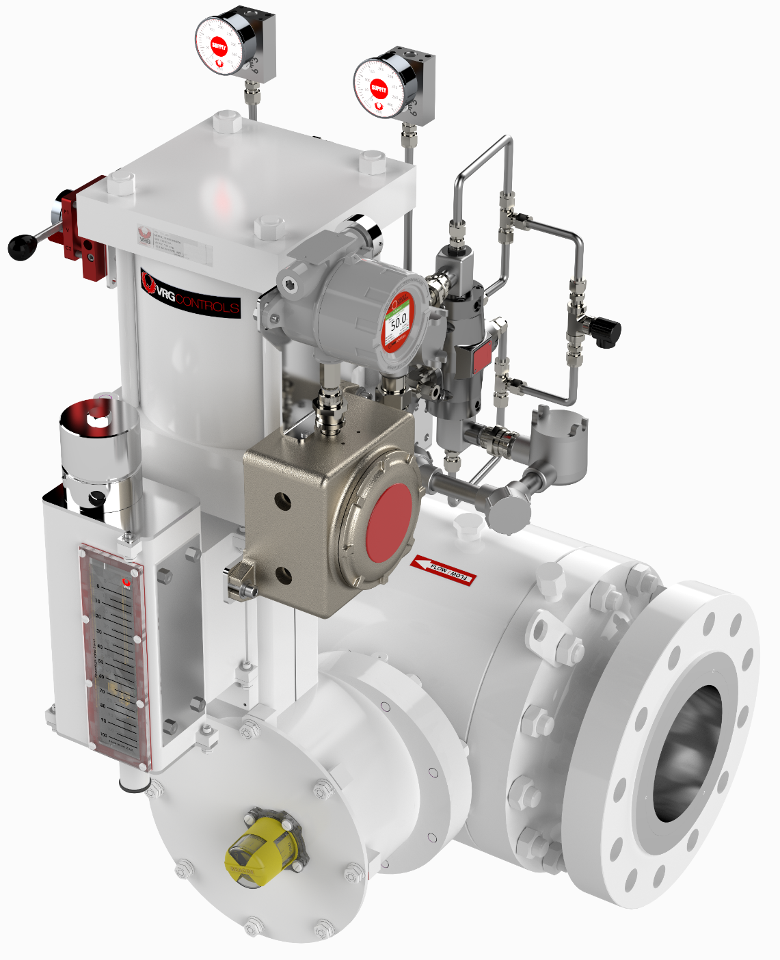
VRG Controls – Company Overview
Control Valves for Control of Natural Gas & Liquids Pipelines
Precision Control Instrumentation with Reduced Emissions (Natural Gas)
Complete Solutions Rather Than Commodity Products
Experience Application Support During Design Phase
Unparalleled Technical Support Day or Night
ISO 9001:2015 Registered
CRN Registered – All Provinces
CE / PED Compliant

Slide 3
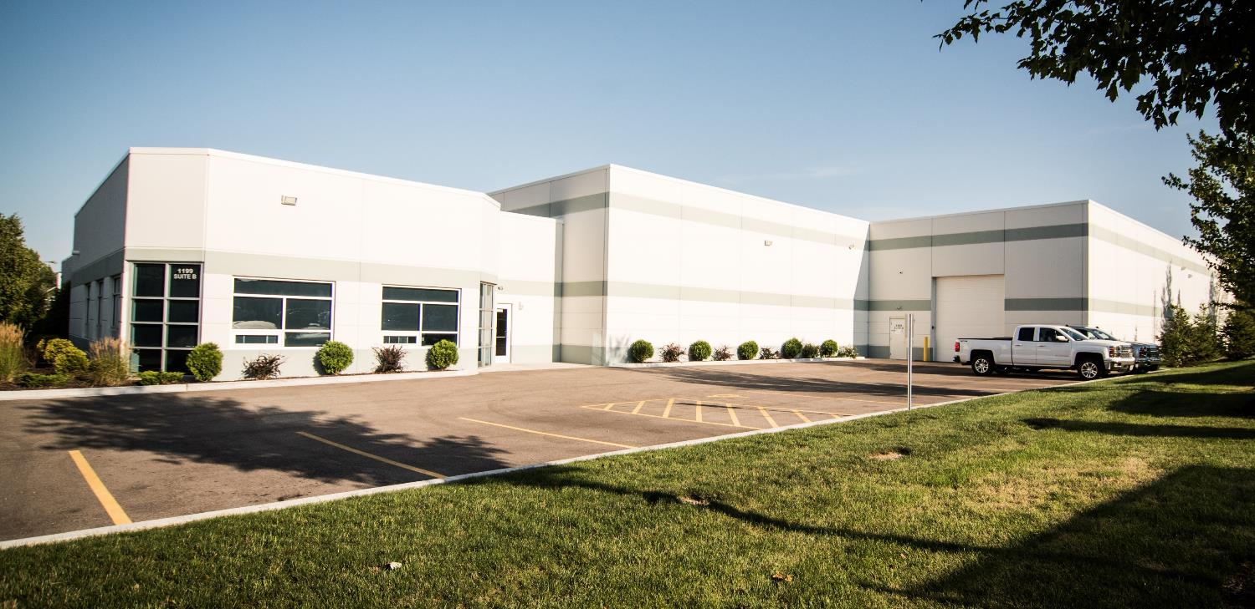
VRG Controls – Primary Facility
Lake Zurich, Illinois USA

Slide 4
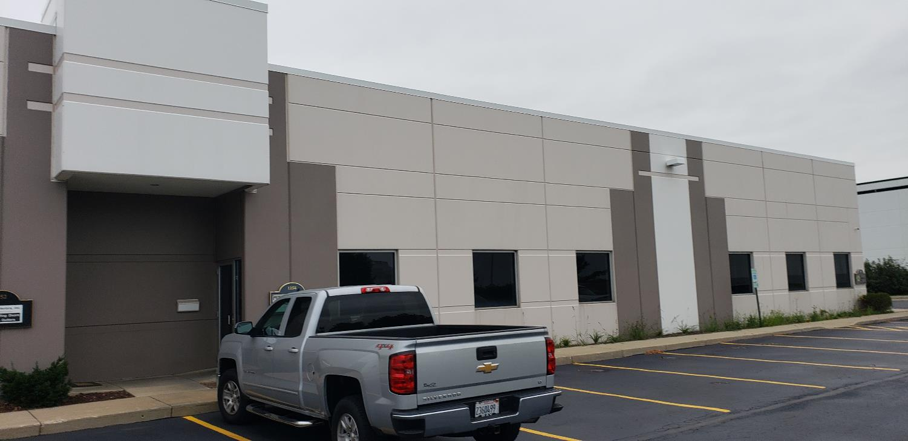
VRG Controls – Inventory & Staging Facility
Lake Zurich, Illinois USA

Slide 5
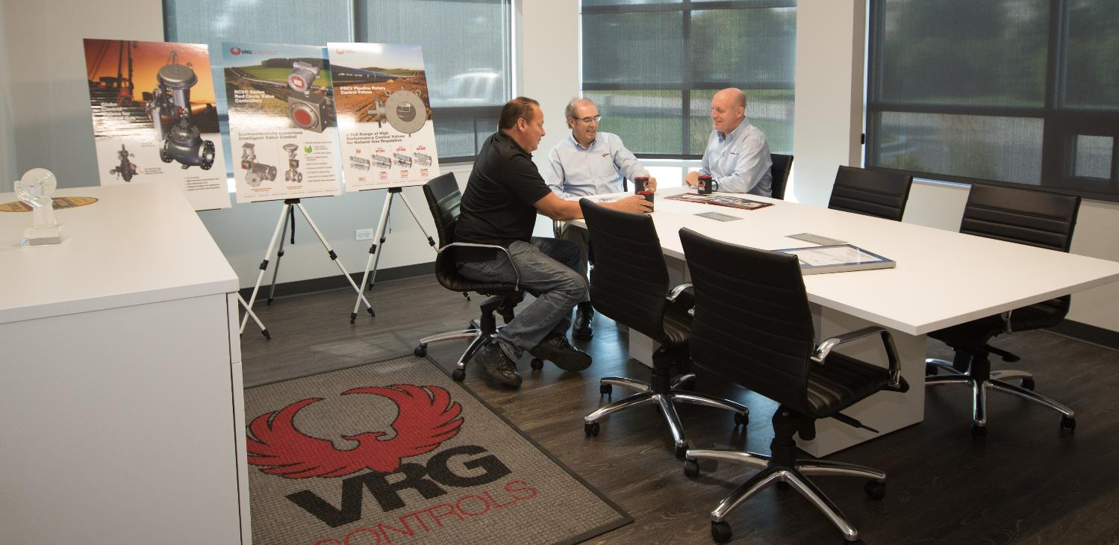
VRG Controls – Experienced Management Team
Lake Zurich, Illinois USA

Slide 6
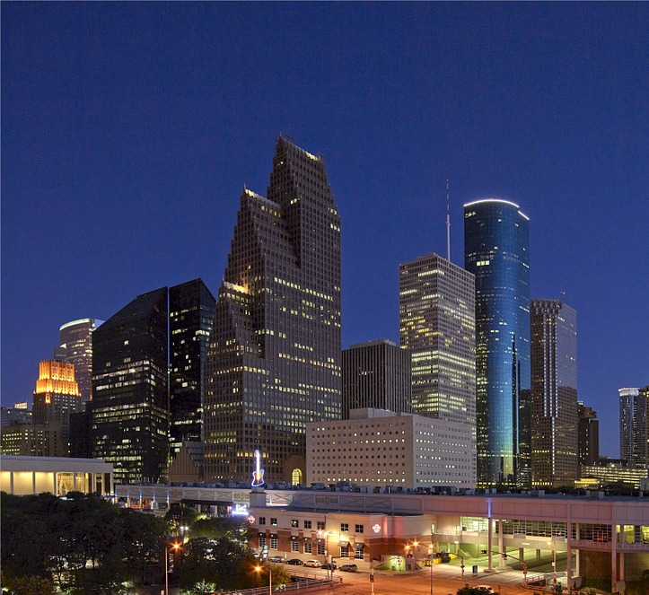
VRG Controls – Houston, Texas Support Offices
Houston, Texas USA

Slide 7
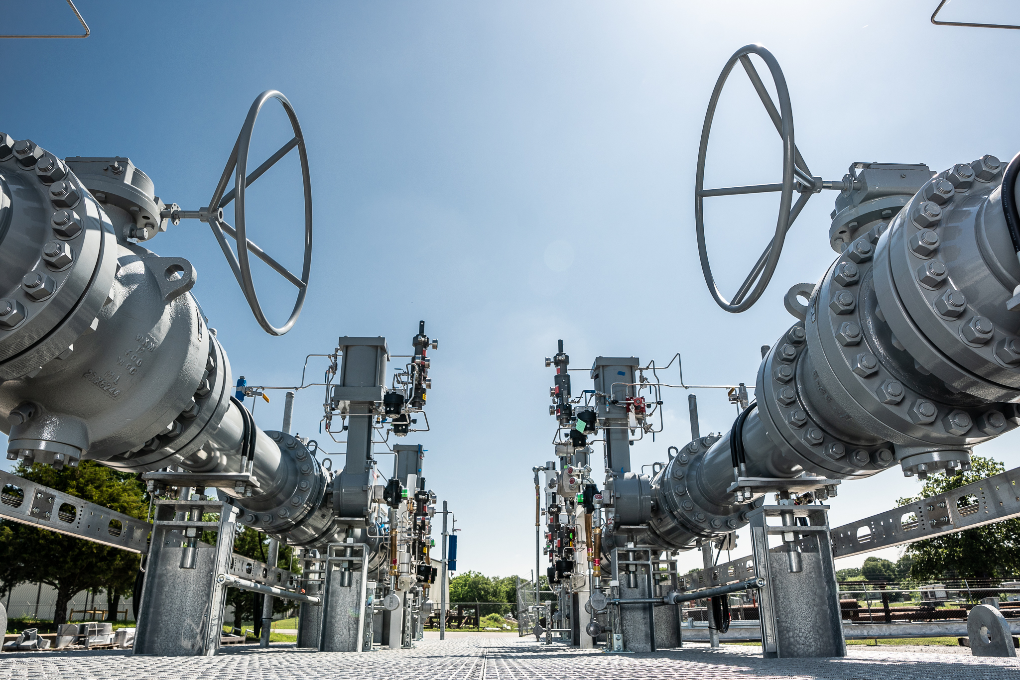
VRG Controls – We Control Pipelines

Slide 8
PRCV Pipeline Rotary Control Valves – Liquid Trim Overview – 1 of 3
PRCV Series | PRCV-VP0T | PRCV-STH1 | PRCV-VP1C
Bore Size | 2 in to 42 in | 2 in to 24 in | 2 in to 6 in
Trim Tech | Full Port | Upstream Var Diffuser Upstream Fixed Diffuser | Multi-Staged Drilled Ball
Bidirectional | YES | YES** | YES**
Relative Capacity | Maximum Capacity | High Capacity | High Capacity
Max Cavitation Index | 0.91 | 0.93 | 0.96
Cavitation Mitigation | Low | Moderate | High
Max Range-Ability | 75:1 | 300:1 | 300:1
Shutoff | Rate A (ISO 5208) Bubble Tight (soft seats) | FCI 70-2 Class V | FCI 70-2 Class V
Seats | 2X Soft Seats STD SR or DPE | 2X Soft Seats STD SR or DPE | 1X Upstream Metal Seats Std Double Piston Effect (DPE)
EU / USA CONTENT

Slide 9
PRCV Pipeline Rotary Control Valves – Liquid Trim Overview – 2 of 3
PRCV Series | PRCV-VP1AL | PRCV-VP1B | PRCV-VP2L
Bore Size | 6 in to 24 in | 6 in to 24 in | 6 in to 24 in
Trim Tech | Multi-Stage Convex Parallel Bent Plate Diffusers | Multi-Stage Parallel Plate Diffusers | Upstream Drilled Ball Diffuser Multi-Stage Convex Parallel Bent Plate Diffusers
Bidirectional | YES** | YES** | YES**
Relative Capacity | High Capacity | High Capacity | High Capacity
Max Cavitation Index | 0.96 | 0.93 | 0.96
Cavitation Mitigation | High | Moderate | High
Max Range-Ability | 200:1 | 200:1 | 400:1
Shutoff | FCI 70-2 Class V | FCI 70-2 Class V | FCI 70-2 Class V
Seats | 1X Upstream Metal Seats Std Double Piston Effect (DPE) | 2X Metal Seats Std Double Piston Effect (DPE) | 1X Upstream Metal Seats Std Double Piston Effect (DPE)
EU / USA CONTENT

Slide 10
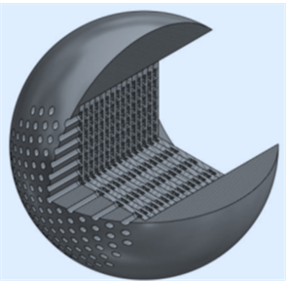
PRCV Pipeline Rotary Control Valves – Liquid Trim Overview – 3 of 3
PRCV Series | PRCV-VP2L+
Bore Size | 6 in to 24 in
Trim Tech | Upstream Drilled Ball Diffuser Multi-Stage Convex Parallel Bent Plate Diffusers Relieved Ball Body Labyrinth Multistage Diffuser**
Bidirectional | YES**
Relative Capacity | Medium Capacity
Max Cavitation Index | 0.99
Cavitation Mitigation | Maximum
Max Range-Ability | 350:1
Shutoff | FCI 70-2 Class V
Seats | 1X Upstream Metal Seats Std Double Piston Effect (DPE)
EU / USA CONTENT
Optional
Labyrinth Multistage
Diffuser

Slide 11
VRG Controls – Pipeline Rotary Control Valves – Liquid Trim

Slide 12
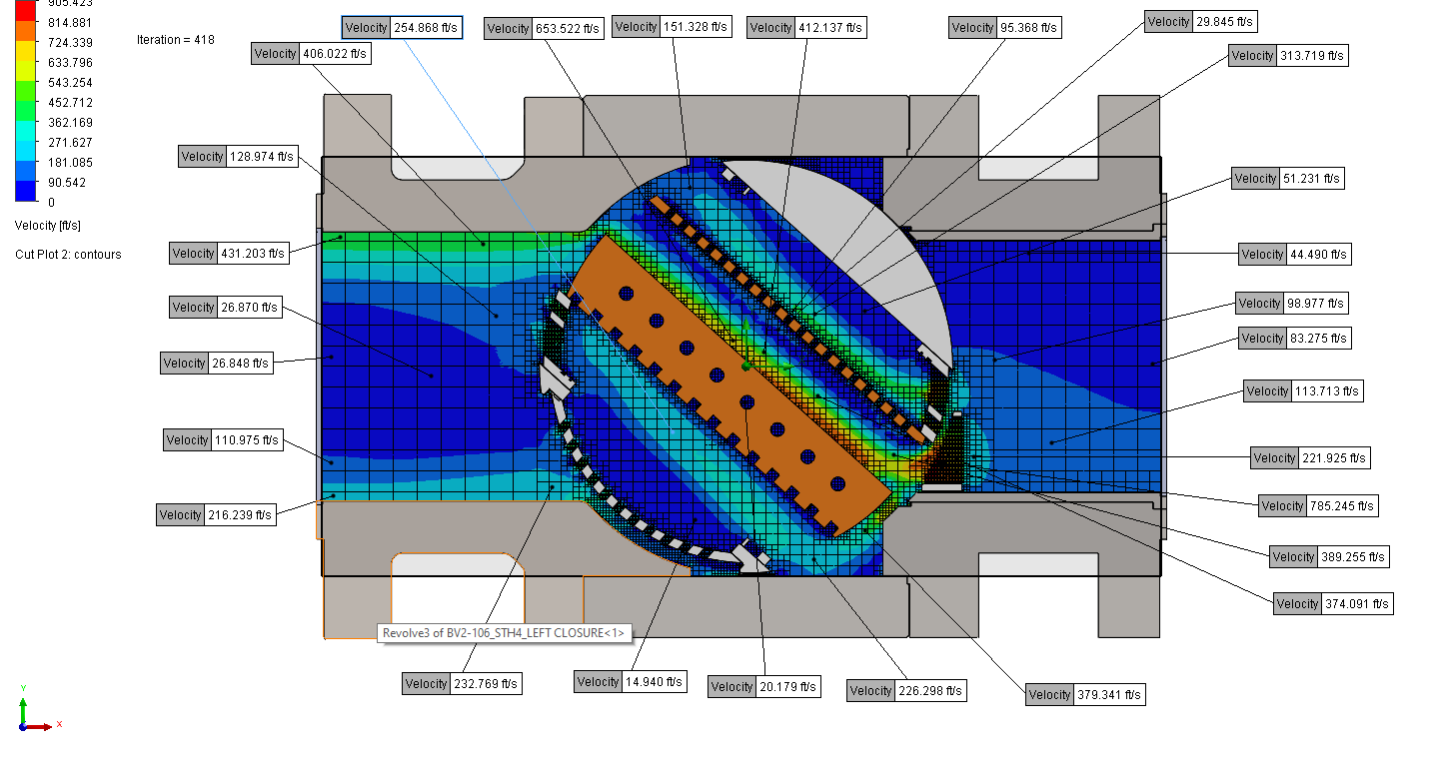
High Level CFD Predictive Analysis Capabilities
VELOSITY, FT/SEC

Slide 13
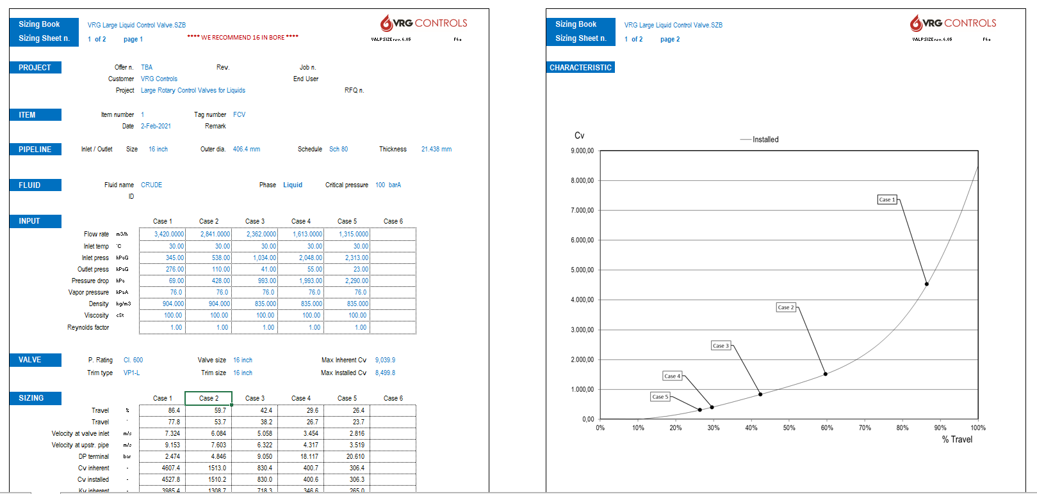
ValpSize PRCV Control Valve Sizing Program (Gas & Liquids)

Slide 14
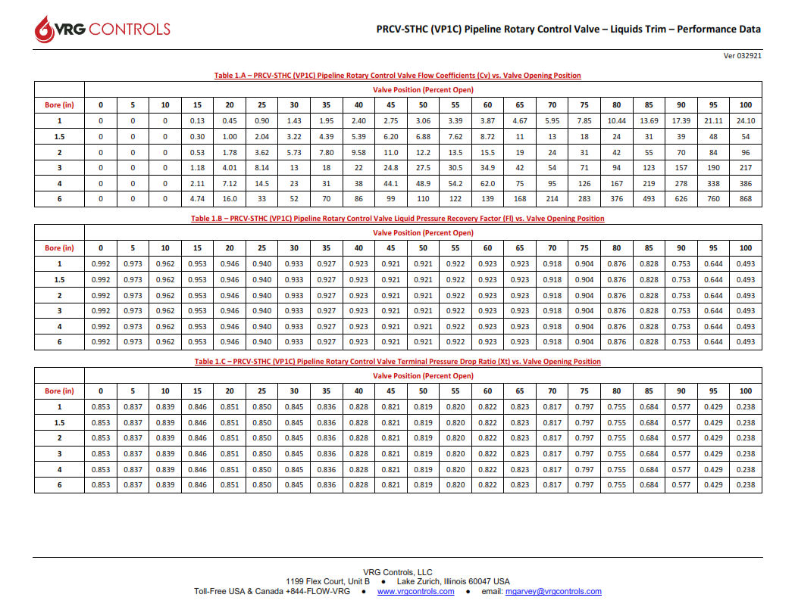
Complete Performance Data – Cv, Fl, Xt

Slide 15
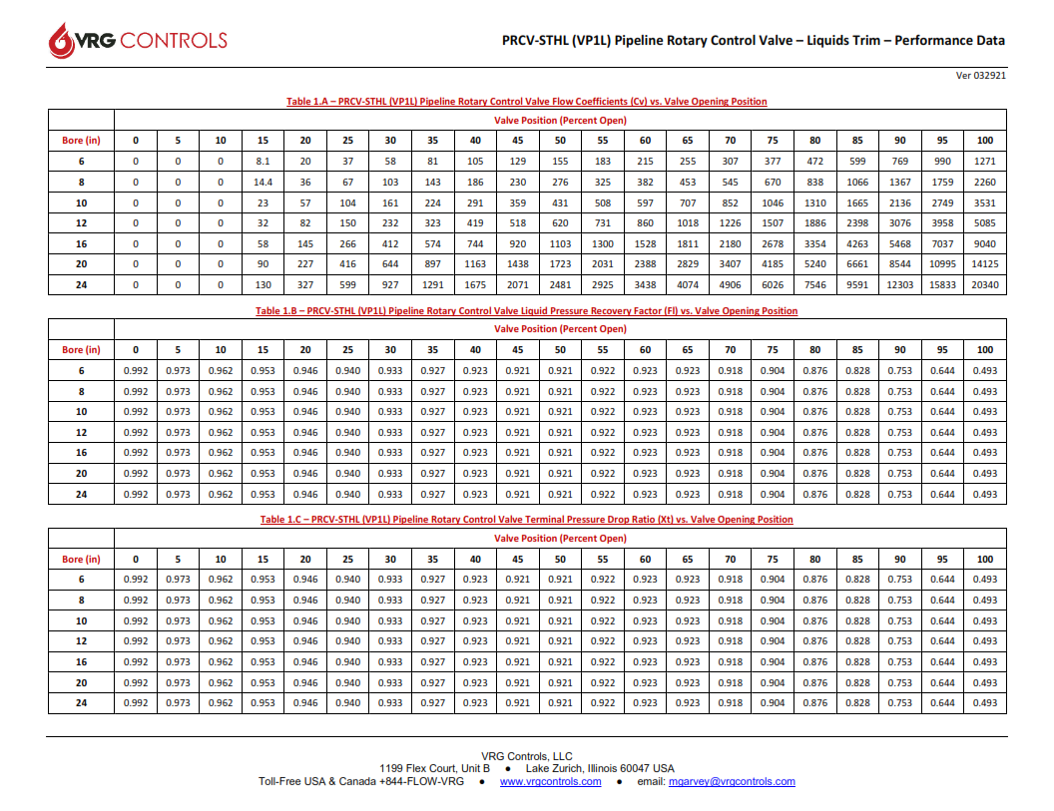
Complete Performance Data – Cv, Fl, Xt

Slide 16
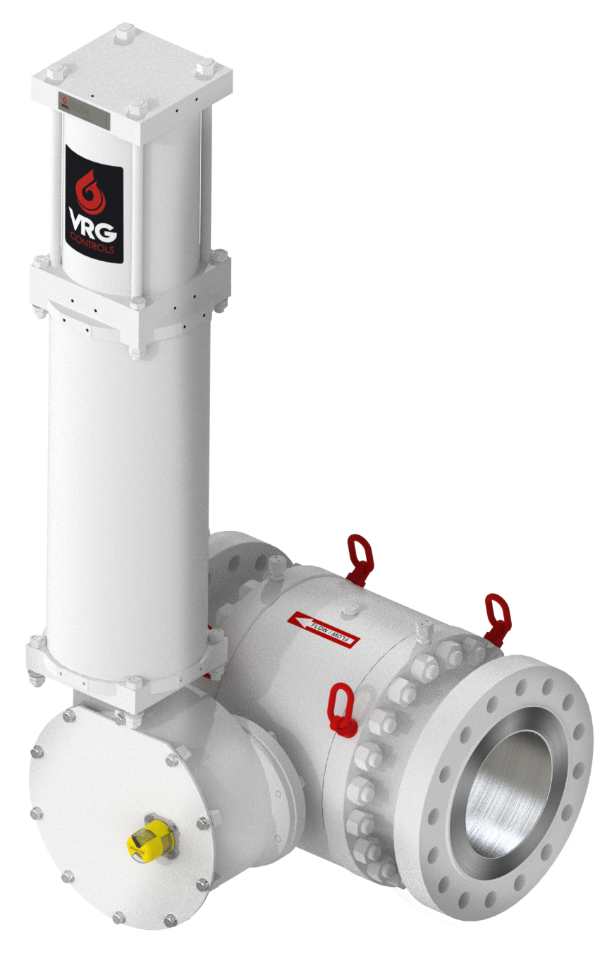
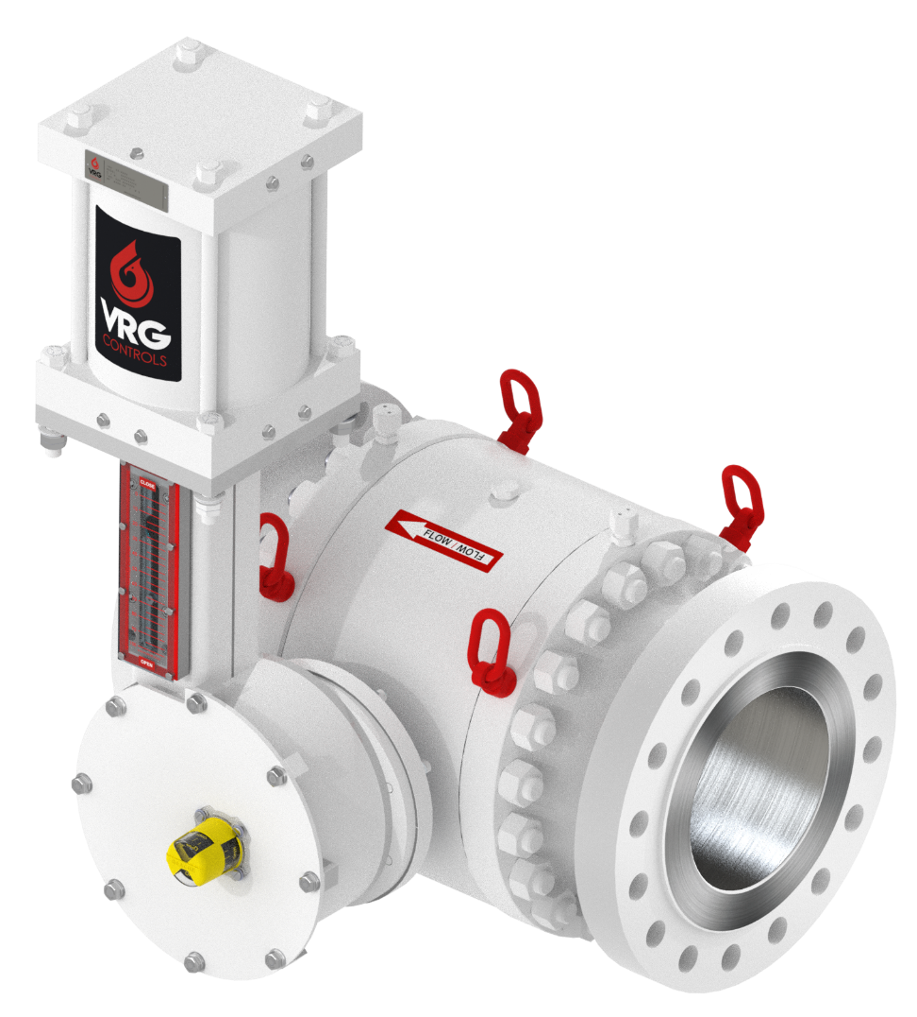
Actuators – Pneumatic Modulating – VRG Controls RHPA Range
RHPA-DA Double Acting Type
RHPA-SR Spring Return Type

Slide 17
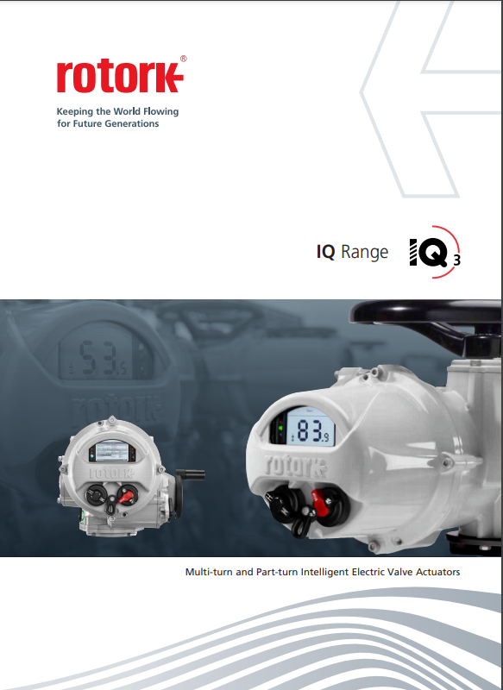
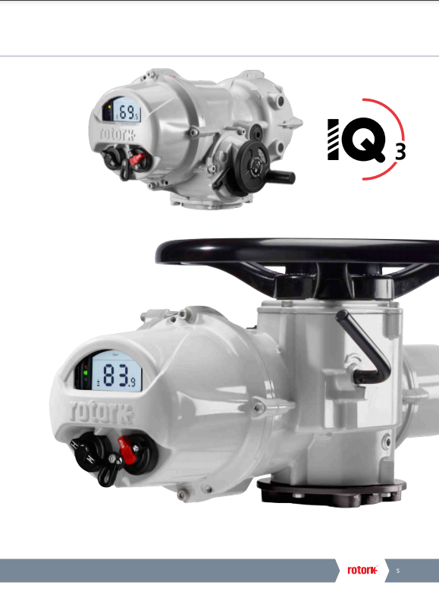
Actuators – Electric Modulating - Rotork IQM Range

Slide 18
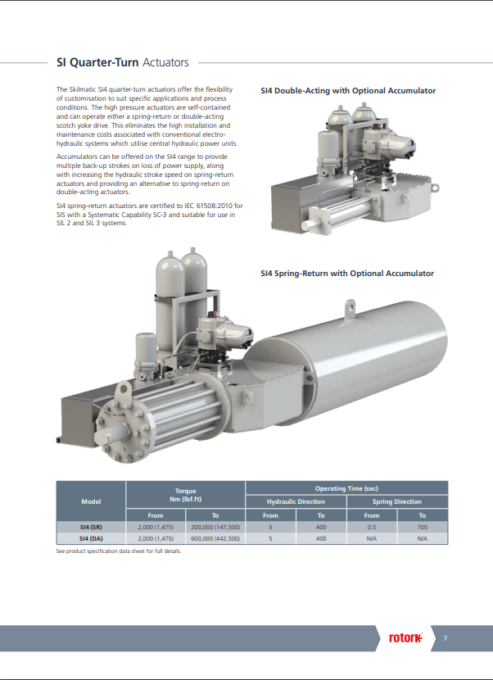
Actuators – Electro-Hydraulic Modulating – Rotork Skilmatic SI Range

Slide 19
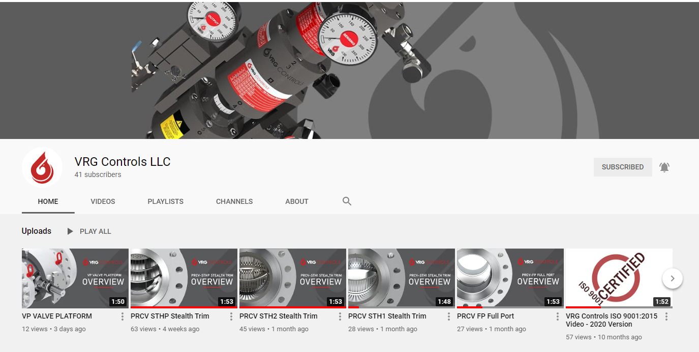
VRG Controls YouTube – PRCV Video Overview
https://www.youtube.com/channel/UCRUcSQBwek_Hlo4TXCXVxcw

Slide 20
Our Contact Information
VRG Controls, LLC
Toll-Free: +844-FLOW-VRG
e-Mail: Sales@VRGControls.com
www.VRGControls.com
VRG Controls, LLC
1199 Flex Court, Unit B
Lake Zurich, Illinois 60047 USA
VRG Controls, LLC
Solutions for Natural Gas!
Follow Us:

