Slide 1
VRG Controls
Emissions Reduction
Solutions
05/24/22

Slide 2
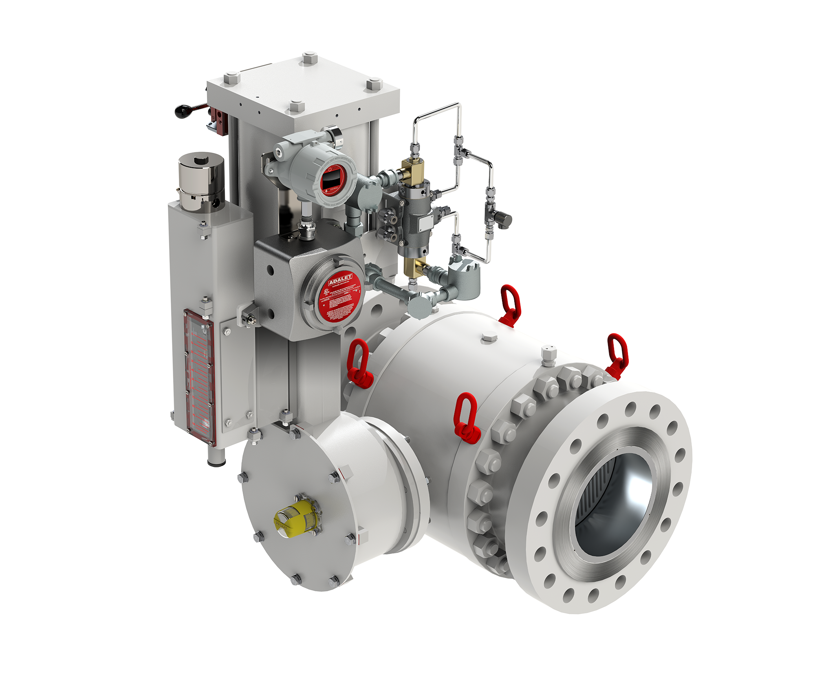
High Capacity Control Valves For Natural Gas Pipelines
PRCV Pipeline Rotary Control Valve
Typ. Double Acting Configuration

Slide 3
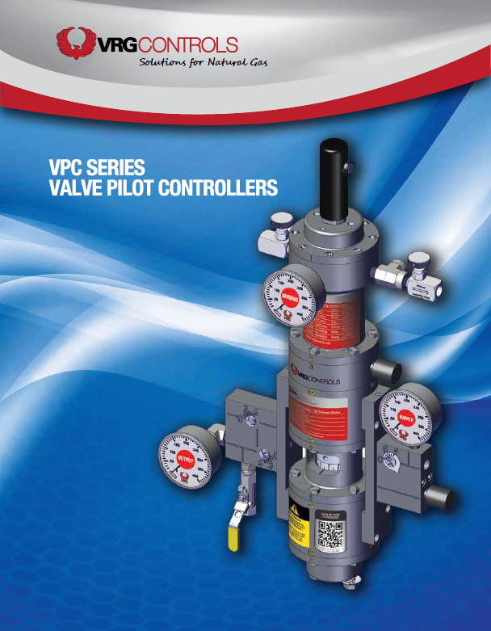
VPC Series Valve Regulator Pilots
Pneumatic Pressure Control Instrumentation for Use with Natural Gas Control Valves
Can Replace Venting Pressure Controllers to Reduce Emissions
Can Replace Becker VRP Pilots for Improved Performance and Reliability
Major Technological Advancements as Compared to Our Competition

Slide 4
Next Generation of Valve Pilot Controllers
SIX (6) Common Control Springs Across All Models
High Strength Setpoint Screw Design Includes Protective Cover
Setpoints Available From 3.0 psig to 1500 psig
All STAINLESS STEEL Internal Components
Environmentally Friendly Design Can Exhibit ZERO Steady State Emissions
Bleed to Pressure System Features Eliminates all Atmospheric Emissions
Larger Diameter Diaphragms Provide Greater Sensitivity (20% Increase in Area vs. Competition)
Patented* Manifold Design Provides Modular Format and Improved Dynamic Performance

Slide 5
Compatible To Retrofit / Replace Existing Pneumatic Pressure Controllers

Slide 6
VPC’s Better Than EPA Emissions Performance Mandate

Slide 7
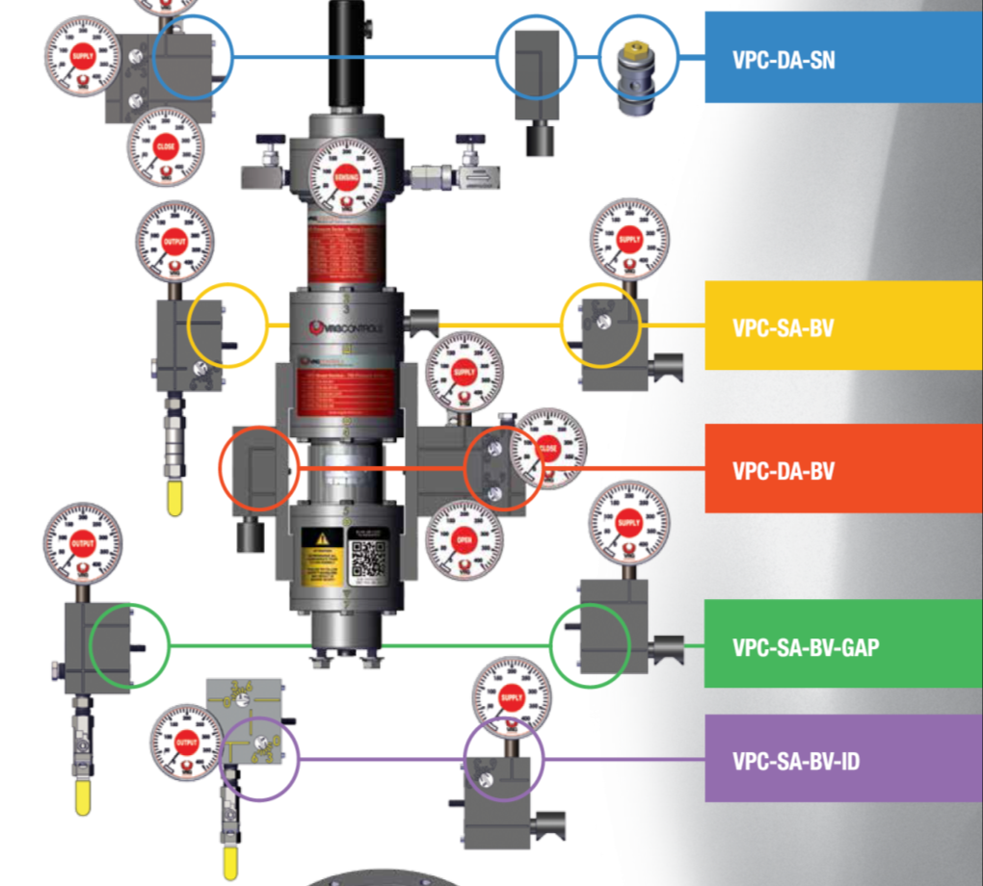
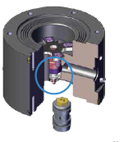
VPC Valve Pilot Controllers – 5 Plug & Play Configurations
Logic XChange

Slide 8
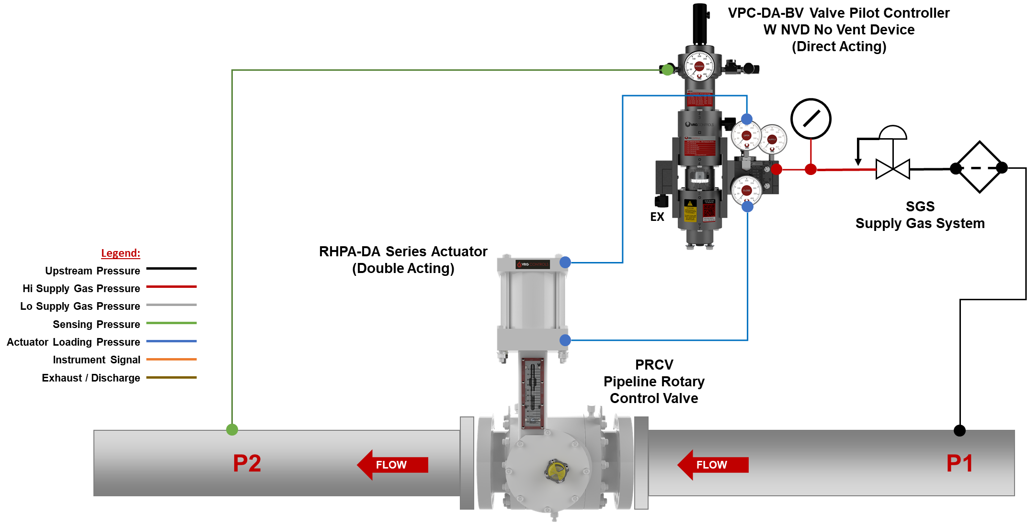
VPC Schematic #1 – VPC-DA-BV + NVD + ATM Ex – RHPA-DA

Slide 9
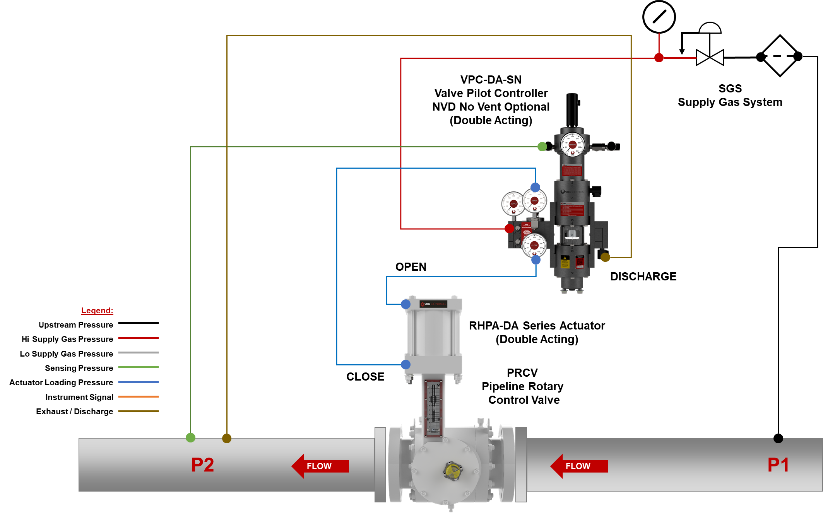
VPC Schematic #2 – VPC-DA-SN + NVD + Discharge Pressure + RHPA-DA

Slide 10
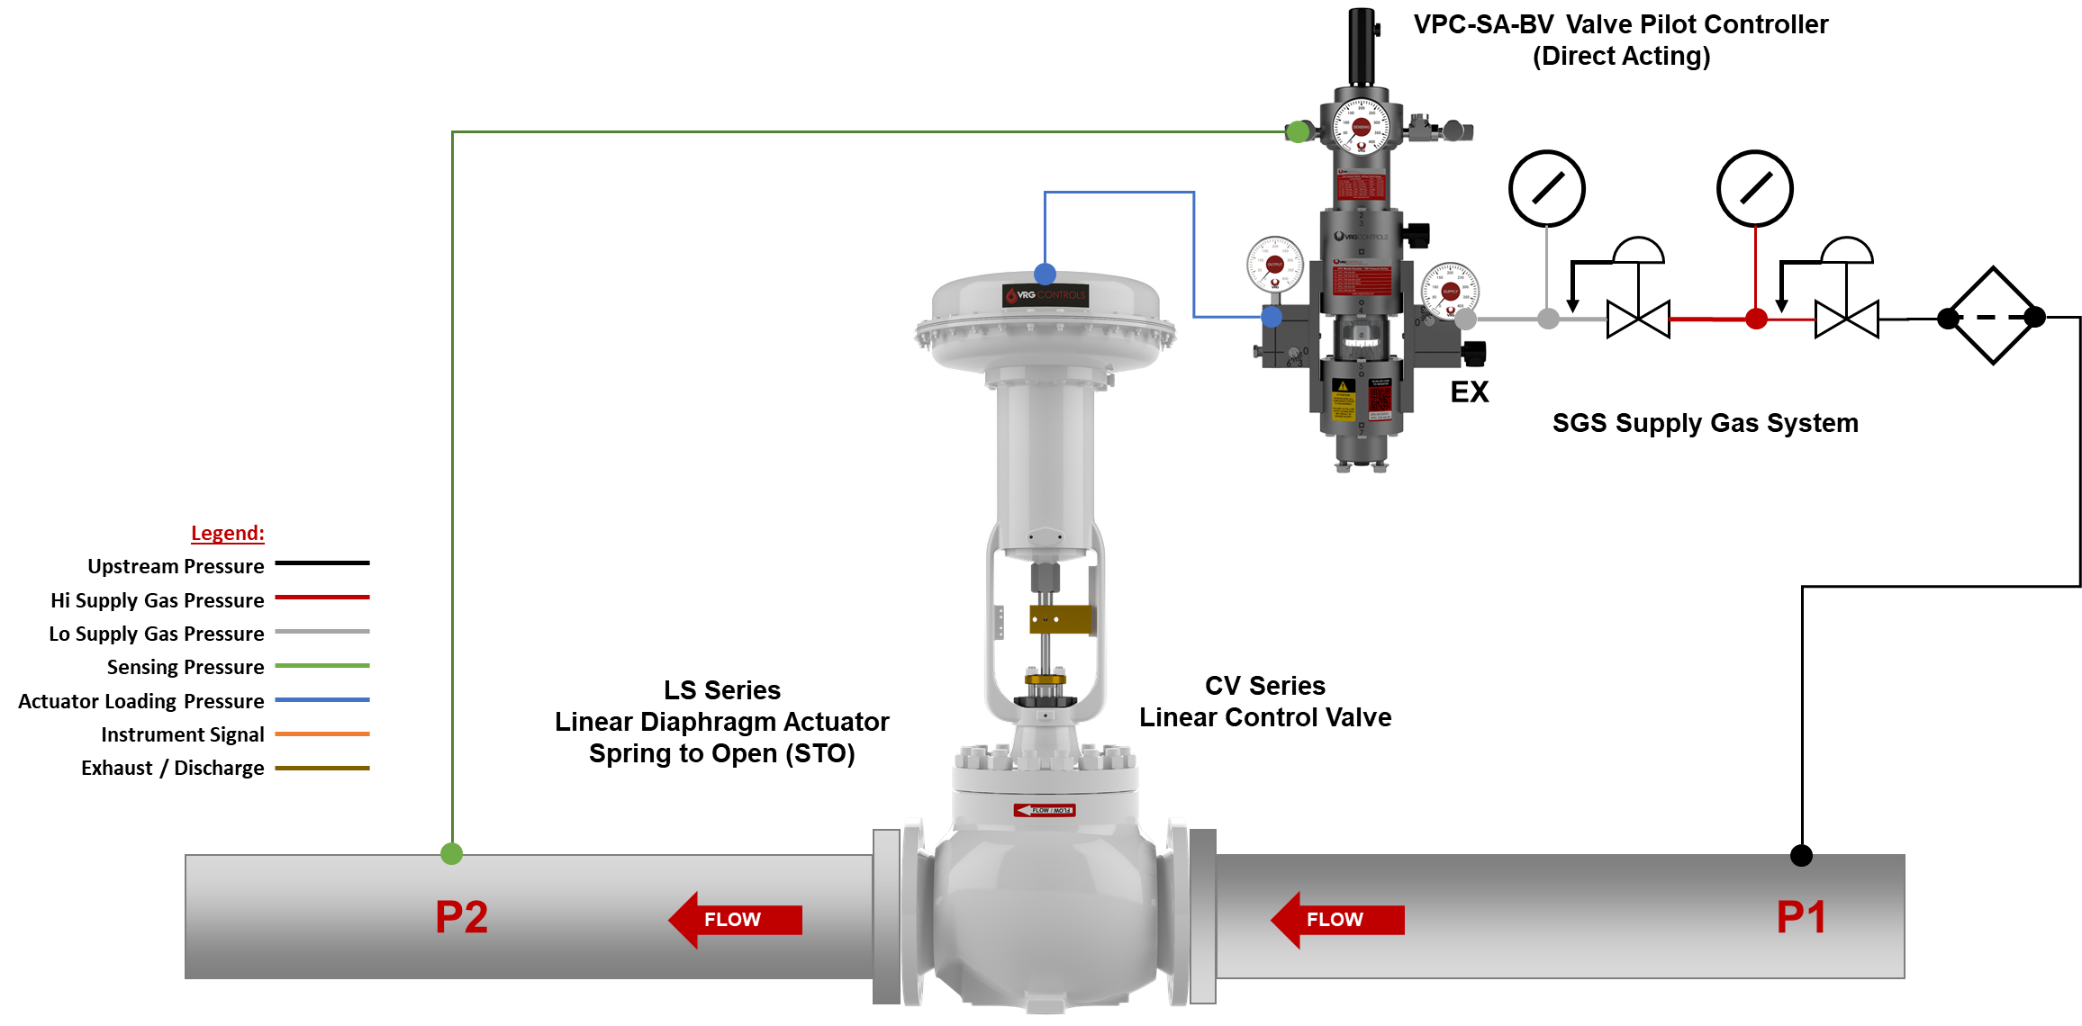
VPC Schematic #3 – VPC-SA-BV + ATM Ex + LD Actuator

Slide 11
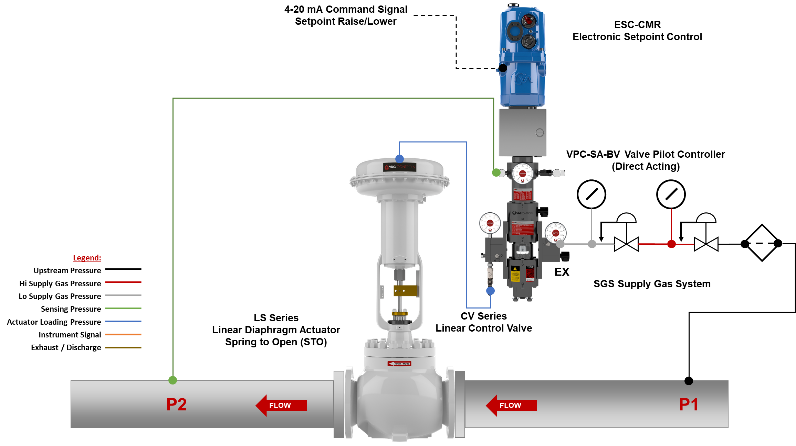
VPC Schematic #4 – VPC-SA-BV + ATM Ex + LD Actuator + Remote Set

Slide 12
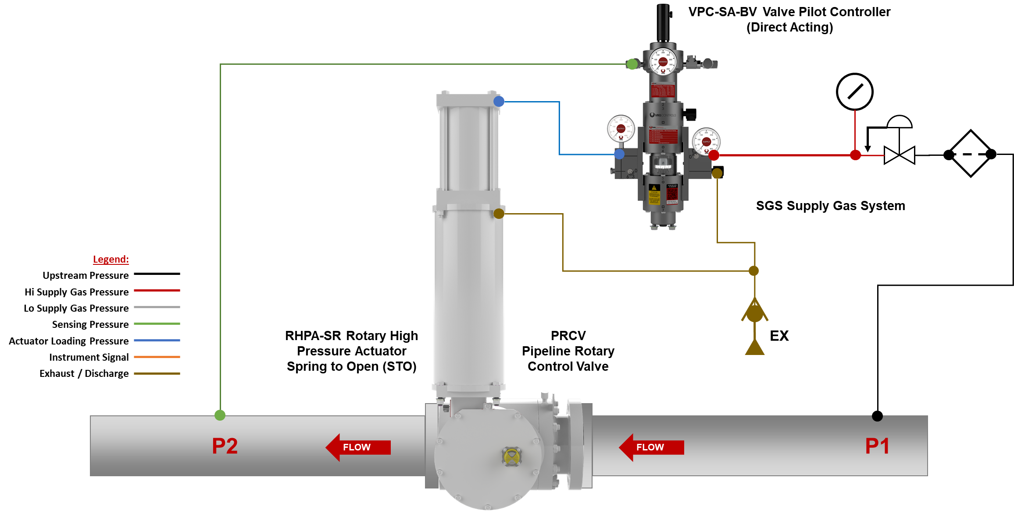
VPC Schematic #5 – VPC-SA-BV + ATM Ex – RHPA-SR

Slide 13
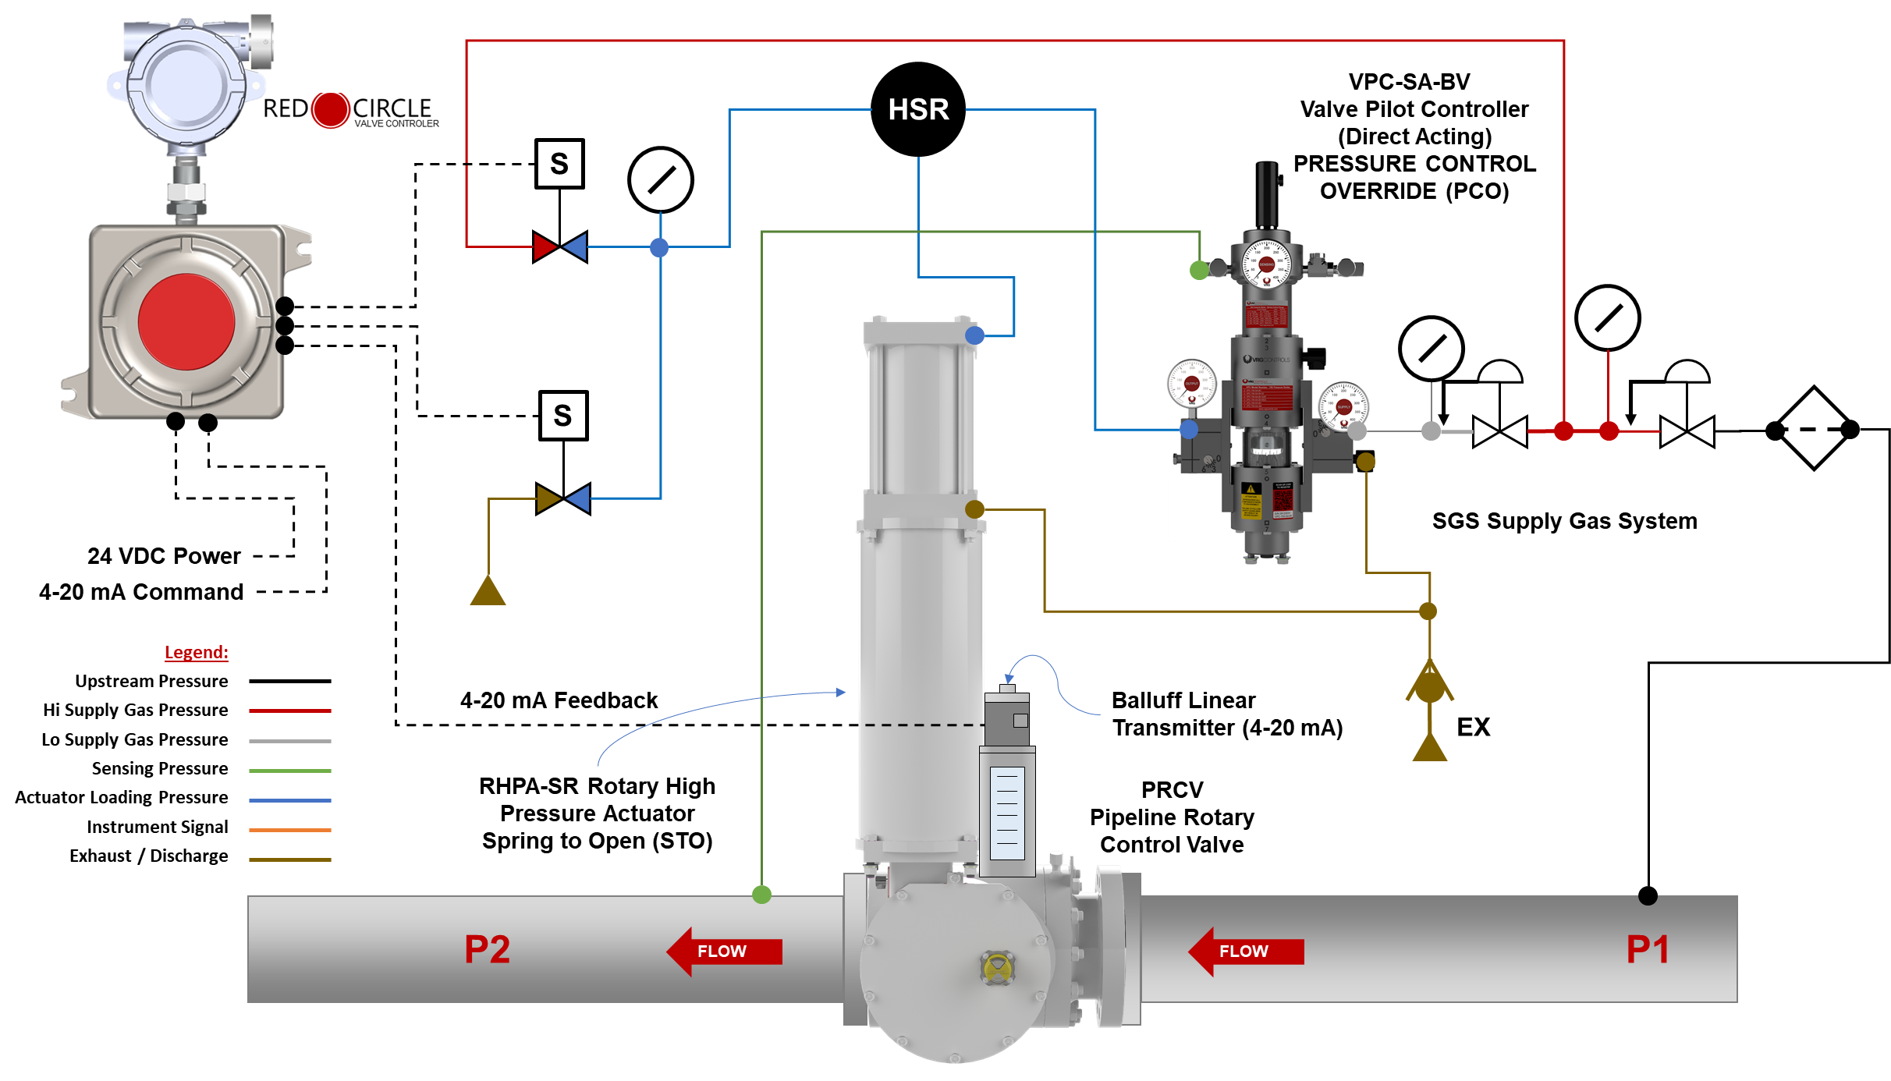
VPC Schematic #6 – VPC-SA-BV + ATM Ex – RHPA-SR

Slide 14
RCVC Red Circle Valve Controller
Hi Resolution Color TFT Programmable Display with Intuitive and Easy Read Menu
Rotary Control Switch Provides Non-Invasive Menu Navigation and Setup
PLUG & PLAY REPLACEMENT FOR BECKER/GE DNGP POSITIONER
4-20 mA Analog Command Signal Input OR ±24 VDC Discrete Pulse Positioning
HART Protocol Communication Standard. Wireless Bluetooth Capable for Easy Configuration and Evaluation. Bluetooth May Be Disabled as Desired.
ZERO Steady State Emissions with Ability to Discharge to Pressure System for Complete Atmospheric Emissions.
Class 1, Div. 1 Ex Proof Terminal Strip Housing Provides Generous Room for Easy Wire Termination
RCVC Electrical Ports and Mounting Brackets Provide Flexible Configuration. 100% Compatible with Existing Becker/GE DNGP & EFP Enclosures for Easy Retrofit
RCVC May be Installed Directly on Control Valve or Remotely in Control Cabinet or RTU Building
RED
CIRCLE
VALVE CONTROLER

Slide 15
RCVC Red Circle Valve Controller – Typical RHPA-DA Schematic
Line Pressure
RED
CIRCLE
Supply Regulator
RED CIRCLE
VALVE CONTROLLER
Class 1, Div 1
VALVE CONTROLER
RHPA-DA
Rotary High Pressure Actuator
OPEN
Signal
Adjust Orifices
(Optional)
Micropulse Linear Position Sensor
EX
4-20 mA Command Signal
CLOSE
Signal
24 VDC Power
4-20 mA Feedback Signal
HART Handheld Communicator
PRCV Pipeline Rotary Control Valve

Slide 16
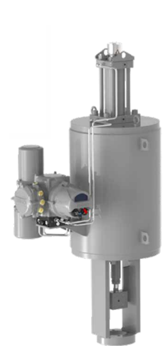
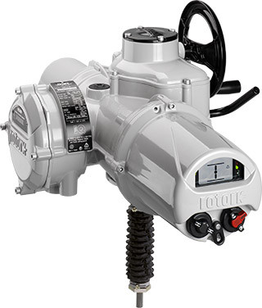
Interchangeable Linear Power Modules Crank Arm Actuators - AG
ELECTRO-HYDRAULIC ACTUATOR POWER MODULE (LINEAR OUTPUT) | ELECTRIC ACTUATOR POWER MODULE (LINEAR OUTPUT) | PNEUMATIC ACTUATOR POWER MODULE (LINEAR OUTPUT)
This Photo by Unknown Author is licensed under CC BY
Above Ground Installation
VRG Controls RHPA Actuator
OR
Becker RPDA/RPSR Actuator

Slide 17
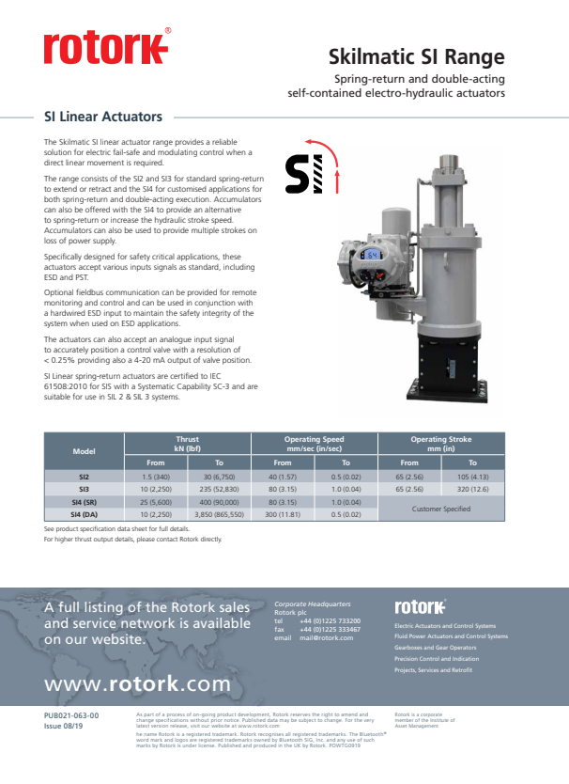
Skilmatic SI (Linear) Range – Electro Hydraulic Actuators
Notes:
1-Phase AC OR 24 VDC Power Required to Obtain Modulating Duty Infinite STARTS/HR
Direct Replace VRG RHPA Linear Piston
Can Retrofit to Existing VRG Below Ground Control Valves
Standard adaptations for VRG or Becker Existing Installations
Has Failsafe Options

Slide 18
Skilmatic SI (Rotary) Range – Electro Hydraulic Actuators
Notes:
1-Phase AC OR 24 VDC Power Required to Obtain Modulating Duty Infinite STARTS/HR
Direct Drive w Control Valve Stem
Pair w Rotork Quarter Turn Gear Assembly
Can Retrofit to Exist Quarter Turn Control Valves
Cannot Retrofit to Existing VRG Below Ground Control Valves (Need Linear)
Has Failsafe Options

Slide 19
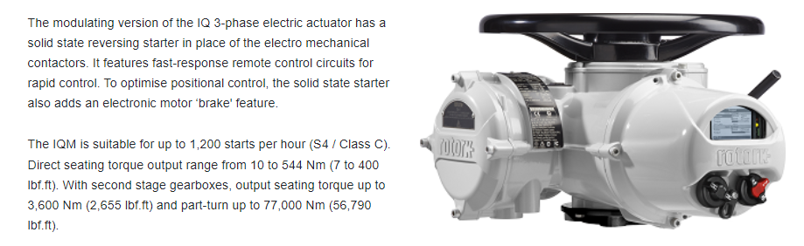
Rotork IQM – Quarter Turn Modulating Service
Notes:
3-Phase AC Power Required to Obtain Modulating Duty > 1200 STARTS / HR
Direct Drive w Control Valve Stem
Pair w Rotork Quarter Turn Gear Assembly
Can Retrofit to Exist Quarter Turn Control Valves
Cannot Retrofit to Existing VRG Below Ground Control Valves (Need Linear)
Has Failsafe Options

Slide 20
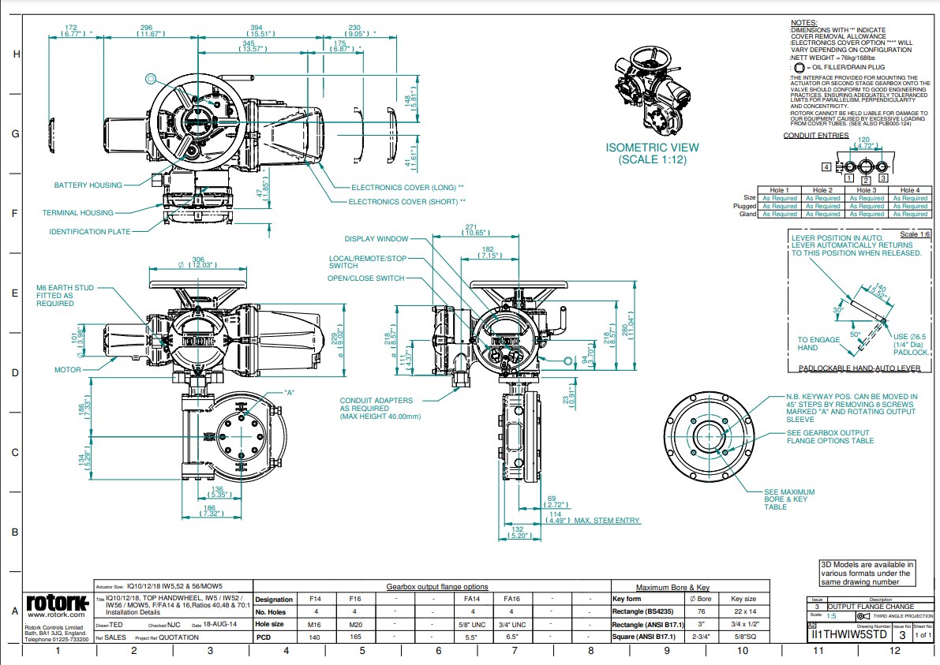
Rotork IQM – Quarter Turn Modulating Service

Slide 21
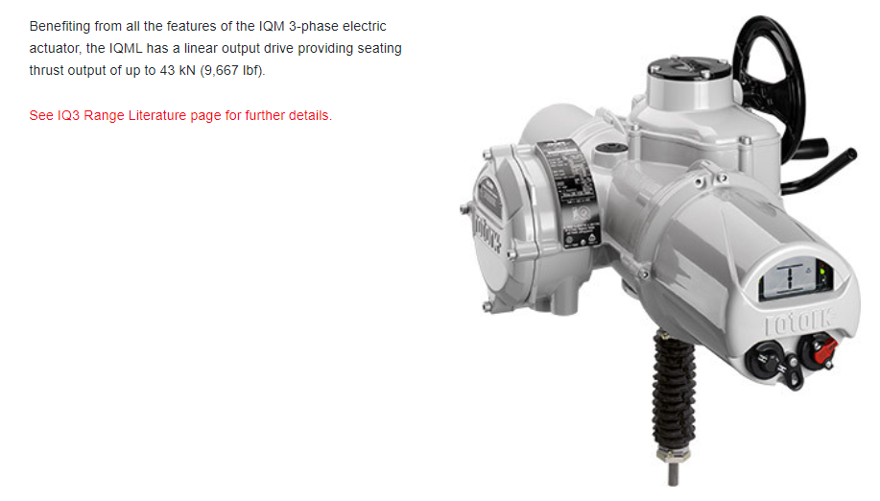
IQML – Linear Modulating
Notes:
3-Phase AC Power Required to Obtain Modulating Duty > 1200 STARTS / HR
Direct Replace VRG RHPA Linear Piston
Can Retrofit to Existing VRG Below Ground Control Valves
Standard adaptations for VRG or Becker Existing Installations
Has Failsafe Options

Slide 22
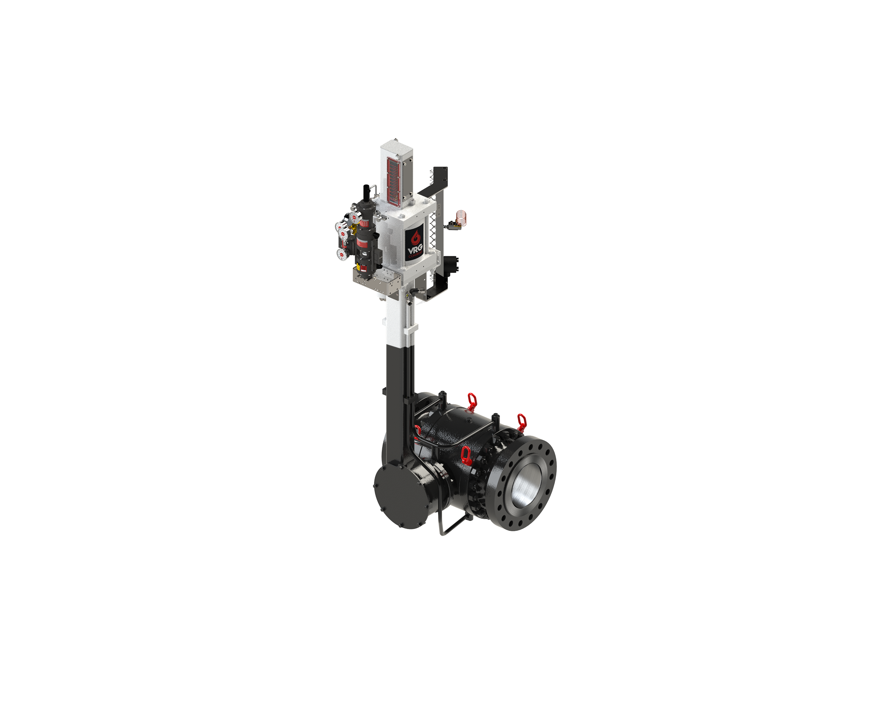
Below Ground Option - Key Design Considerations
Tail-rod Instrument Mounting System Standard
PRCV Seat Seals Extended Above Ground
Coal Tar Epoxy Coating on Below Ground Portion
Vented Actuator Housing
Stem Lubrication / Test Extended
Fully Welded Bracket Supports on All Lines
All Port Extension Lines ASME Code Welded and Hydro-tested
Drain Line / Blowdown Extended

Slide 23
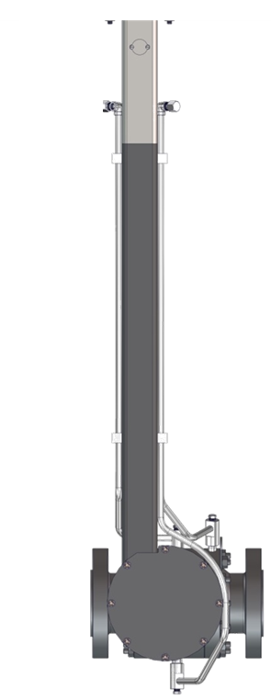
Interchangeable Linear Power Modules Crank Arm Actuators - BG
ELECTRO-HYDRAULIC ACTUATOR POWER MODULE (LINEAR OUTPUT) | ELECTRIC ACTUATOR POWER MODULE (LINEAR OUTPUT) | PNEUMATIC ACTUATOR POWER MODULE (LINEAR OUTPUT)
Below Ground Installation
VRG Controls RHPA Actuator
OR
Becker RPDA/RPSR Actuator

Slide 24
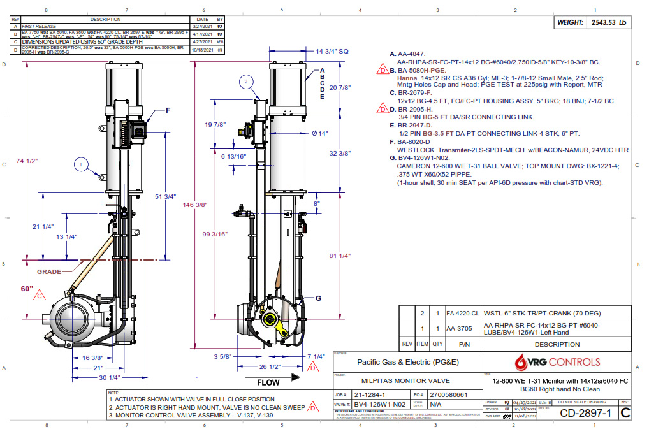
Example – Below Ground Pneumatic Monitor Control Valve

Slide 25
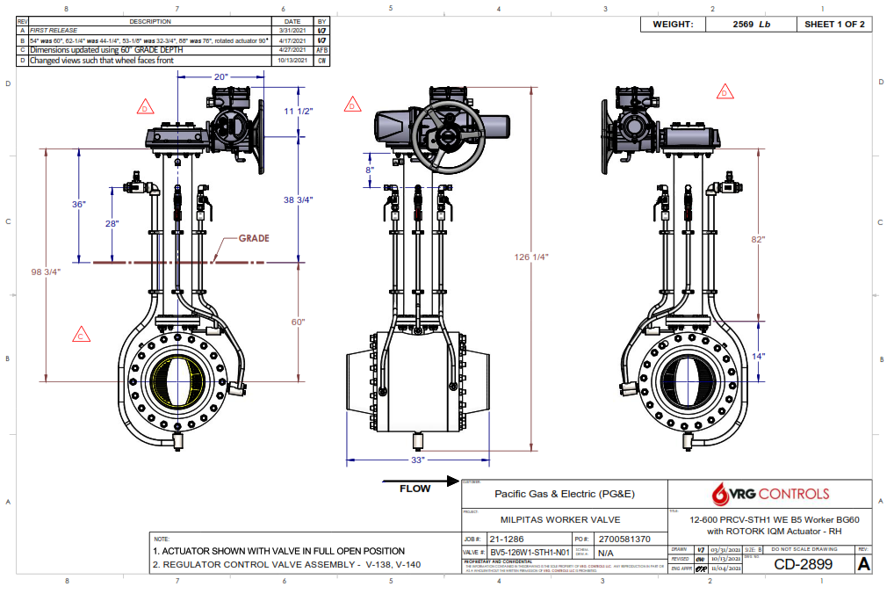
Example – Below Ground Electric Actuator Worker Control Valve
NON STANDARD DESIGN W
VERTICAL STEM EXTENSION

Slide 26
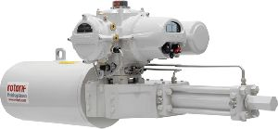
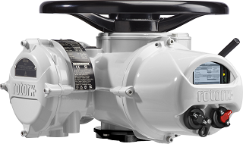
Variety of Controls / Actuation Options to Reduce Emissions
 | RHPA Actuator | RHPA Actuator | RHPA Actuator | IS Series | IQM Series
Power | Pneumatic | Pneumatic | Pneumatic | VDC 1-Phase AC | 3-Phase AC
Concept | Ex ATM | Discharge to Pressure | Capture by Combustion | Electro Hydraulic | Electric
Available Failsafe | Lock Last Fail Open Fail Closed | Lock Last Fail Open Fail Closed | Lock Last Fail Open Fail Closed | Lock Last Fail Open Fail Closed | Lock Last
Quarter Turn | YES | YES | YES | YES | YES
Interchangeable Linear | YES | YES | YES | YES | YES
End of Travel Emissions | ZERO | ZERO | ZERO | ZERO | ZERO
Steady State Control Emissions | ZERO | ZERO | ZERO | ZERO | ZERO
Transient Emissions | YES | ZERO | ZERO | ZERO | ZERO

Slide 27
Configuration 1 – Emissions Reduction
VMO-150
VALVE
MANUAL
OVERRIDE
VMO-150
VALVE
MANUAL
OVERRIDE
VPC
VALVE
PILOT
CONTROLLER
VPC
VALVE
PILOT
CONTROLLER
SGS
SUPPLY
GAS
SYSTEM
EX
SGS
SUPPLY
GAS
SYSTEM
EX
P1
P2
FLOW
MONITOR
CONTROL
VALVE
(STANDBY)
WORKER
CONTROL
VALVE
(ACTIVE)
CONFIGURATION: 1 - ALL PNEUMATIC PRESSURE CONTROL ATM DISCH
NOTES:
PRESSURE CONTROL APPLICATIONS ONLY
ALL PNEUMATIC – NO ELECTRICAL POWER REQUIRED
SELF-CONTAINED AND RELIABLE
LOW COST
ELIMINATES MOST ATMOSPHERIC EMISSIONS
 | MONITOR | WORKER
CONTROL | VPC SERIES | VPC SERIES
ACTUATOR | RHPA SERIES | RHPA SERIES
ENERGY | PNEUMATIC | PNEUMATIC
SIGNAL | PNEUMATIC | PNEUMATIC
STEADY EMISSIONS | ZERO | ZERO
TRANSIENT EMISSIONS | **ACTUATOR DISPLACE | **ACTUATOR DISCPLACE
**REFERENCE VRG CONTROL TRANSIENT EMISSONS CALCULATOR FOR DETAILS
Date | 03/23/22 | Title | EMISSIONS REDUX – CONFIGURAITON 1
Rev. | 0 | Customer | VRG CONTROLS

Slide 28
Configuration 2 – Emissions Reduction
VMO-150
VALVE
MANUAL
OVERRIDE
VMO-150
VALVE
MANUAL
OVERRIDE
VPC
VALVE
PILOT
CONTROLLER
VPC
VALVE
PILOT
CONTROLLER
SGS
SUPPLY
GAS
SYSTEM
SGS
SUPPLY
GAS
SYSTEM
EX
EX
P1
P2
FLOW
MONITOR
CONTROL
VALVE
(STANDBY)
WORKER
CONTROL
VALVE
(ACTIVE)
NOTES:
PRESSURE CONTROL APPLICATIONS ONLY
ALL PNEUMATIC – NO ELECTRICAL POWER REQUIRED
SELF-CONTAINED AND RELIABLE
LOW COST
ZERO ATMOSPHERIC EMISSIONS – WORKER
MONITOR ONLY EMISSIONS IF “AOC” OPP OCCURENCE
PNEUMATIC MONITOR GUARANTEED OPP PROTECTION
REQURIES SUITABLE DP BETWEEN SUPPLY & DISCHARGE
CONFIGURATION: 2 - ALL PNEUMATIC PRESSURE CONTROL CAPTURED EMISSIONS
 | MONITOR | WORKER
CONTROL | VPC SERIES | VPC SERIES
ACTUATOR | RHPA SERIES | RHPA SERIES
ENERGY | PNEUMATIC | PNEUMATIC
SIGNAL | PNEUMATIC | PNEUMATIC
STEADY EMISSIONS | ZERO | CAPTURED
TRANSIENT EMISSIONS | **ACT DISPLACE | CAPTURED
**REFERENCE VRG CONTROL TRANSIENT EMISSONS CALCULATOR FOR DETAILS
Date | 03/23/22 | Title | EMISSIONS REDUX – CONFIGURAITON 2
Rev. | 0 | Customer | VRG CONTROLS

Slide 29
Configuration 3 – Emissions Reduction
VMO-150
VALVE
MANUAL
OVERRIDE
VMO-150
VALVE
MANUAL
OVERRIDE
VPC
VALVE
PILOT
CONTROLLER
VPC
VALVE
PILOT
CONTROLLER
DEDICATED CATALYTIC
HEATER OR PIPELINE HEATER
SGS
SUPPLY
GAS
SYSTEM
SGS
SUPPLY
GAS
SYSTEM
EX
EX
P1
P2
FLOW
MONITOR
CONTROL
VALVE
(STANDBY)
WORKER
CONTROL
VALVE
(ACTIVE)
NOTES:
PRESSURE CONTROL APPLICATIONS ONLY
ALL PNEUMATIC – NO ELECTRICAL POWER REQUIRED
SELF-CONTAINED AND RELIABLE
LOW COST
ZERO ATMOSPHERIC EMISSIONS – WORKER
MONITOR ONLY EMISSIONS IF “AOC” OPP OCCURENCE
PNEUMATIC MONITOR GUARANTEED OPP PROTECTION
REQURIES SUITABLE DP BETWEEN SUPPLY & DISCHARGE
CAN DISCHARGE TO NEARBY PIPELINE HEATER OR DEDICATED CATALYTIC
CONFIGURATION: 3 - ALL PNEUMATIC PRESSURE CONTROL CAPTURED BY COMBUSTION EMISSIONS
 | MONITOR | WORKER
CONTROL | VPC SERIES | VPC SERIES
ACTUATOR | RHPA SERIES | RHPA SERIES
ENERGY | PNEUMATIC | PNEUMATIC
SIGNAL | PNEUMATIC | PNEUMATIC
STEADY EMISSIONS | ZERO | CAPTURED
TRANSIENT EMISSIONS | **ACT DISPLACE | CAPTURED
**REFERENCE VRG CONTROL TRANSIENT EMISSONS CALCULATOR FOR DETAILS
Date | 03/23/22 | Title | EMISSIONS REDUX – CONFIGURAITON 3
Rev. | 0 | Customer | VRG CONTROLS

Slide 30
Configuration 4 – Emissions Reduction
4-20 MA COMMAND SIGNAL
4-20 MA FEEDBACK SIGNAL
VMO-150
VALVE
MANUAL
OVERRIDE
VMO-150
VALVE
MANUAL
OVERRIDE
VPC
VALVE
PILOT
CONTROLLER
EX
RCVC
RED CIRCLE
VALVE
CONTROLLER
SGS
SUPPLY
GAS
SYSTEM
EX
SGS
SUPPLY
GAS
SYSTEM
XT
P1
P2
FLOW
MONITOR
CONTROL
VALVE
(STANDBY)
WORKER
CONTROL
VALVE
(ACTIVE)
CONFIGURATION: 4 – ELECTRO-PNEUM WORKER W PNEUMATIC MONITOR – ATM DISCHARGE
 | MONITOR | WORKER
CONTROL | VPC SERIES | RCVC SERIES
ACTUATOR | RHPA SERIES | RHPA SERIES
ENERGY | PNEUMATIC | PNEUMATIC
SIGNAL | PNEUMATIC | 4-20 MA ELECTRIC
STEADY EMISSIONS | ZERO | ZERO
TRANSIENT EMISSIONS | ACT DISPLACE | ACT DISCPLACE
NOTES:
VOLUMETRIC OR PRESSURE CONTROL APPLICATIONS
ELECTRO PNEUMAITC WORKER REQUIRES POWER AND LOGIC
MONITOR ONLY EMISSIONS IF “AOC” OPP OCCURENCE
PNEUMATIC MONITOR GUARANTEED OPP PROTECTION
Date | 03/23/22 | Title | EMISSIONS REDUX – CONFIGURAITON 4
Rev. | 0 | Customer | VRG CONTROLS

Slide 31
Configuration 5 – Emissions Reduction
4-20 MA COMMAND SIGNAL
4-20 MA FEEDBACK SIGNAL
VMO-150
VALVE
MANUAL
OVERRIDE
VPC
VALVE
PILOT
CONTROLLER
VMO-150
VALVE
MANUAL
OVERRIDE
EX
RCVC
RED CIRCLE
VALVE
CONTROLLER
SGS
SUPPLY
GAS
SYSTEM
EX
SGS
SUPPLY
GAS
SYSTEM
XT
P1
P2
FLOW
MONITOR
CONTROL
VALVE
(STANDBY)
WORKER
CONTROL
VALVE
(ACTIVE)
CONFIGURATION: 5 – ELECTRO-PNEUM WORKER W PNEUMATIC MONITOR – CAPTURED EMISSIONS
NOTES:
VOLUMETRIC OR PRESSURE CONTROL APPLICATIONS
ELECTRO PNEUMAITC WORKER REQUIRES POWER AND LOGIC
MONITOR ONLY EMISSIONS IF “AOC” OPP OCCURENCE
PNEUMATIC MONITOR GUARANTEED OPP PROTECTION
ZERO ATMOSPHERIC EMISSIONS – WORKER
MONITOR ONLY EMISSIONS IF “AOC” OPP OCCURENCE
PNEUMATIC MONITOR GUARANTEED OPP PROTECTION
REQURIES SUITABLE DP BETWEEN SUPPLY & DISCHARGE
 | MONITOR | WORKER
CONTROL | VPC SERIES | RCVC SERIES
ACTUATOR | RHPA SERIES | RHPA SERIES
ENERGY | PNEUMATIC | PNEUMATIC
SIGNAL | PNEUMATIC | 4-20 MA ELECTRIC
STEADY EMISSIONS | ZERO | CAPTURED
TRANSIENT EMISSIONS | ACT DISPLACE | CAPTURED
Date | 03/23/22 | Title | EMISSIONS REDUX – CONFIGURAITON 5
Rev. | 0 | Customer | VRG CONTROLS

Slide 32
Configuration 6 – Emissions Reduction
4-20 MA COMMAND SIGNAL
4-20 MA FEEDBACK SIGNAL
VMO-150
VALVE
MANUAL
OVERRIDE
VMO-150
VALVE
MANUAL
OVERRIDE
VPC
VALVE
PILOT
CONTROLLER
EX
DEDICATED CATALYTIC
HEATER OR PIPELINE HEATER
RCVC
RED CIRCLE
VALVE
CONTROLLER
SGS
SUPPLY
GAS
SYSTEM
EX
SGS
SUPPLY
GAS
SYSTEM
XT
P1
P2
FLOW
MONITOR
CONTROL
VALVE
(STANDBY)
WORKER
CONTROL
VALVE
(ACTIVE)
CONFIGURATION: 6 – ELECTRO-PNEUM WORKER W PNEUMATIC MONITOR – CAPTURED BY COMBUSTION EMISSIONS
NOTES:
VOLUMETRIC OR PRESSURE CONTROL APPLICATIONS
ELECTRO PNEUMAITC WORKER REQUIRES POWER AND LOGIC
MONITOR ONLY EMISSIONS IF “AOC” OPP OCCURENCE
PNEUMATIC MONITOR GUARANTEED OPP PROTECTION
ZERO ATMOSPHERIC EMISSIONS – WORKER
MONITOR ONLY EMISSIONS IF “AOC” OPP OCCURENCE
PNEUMATIC MONITOR GUARANTEED OPP PROTECTION
REQURIES SUITABLE DP BETWEEN SUPPLY & DISCHARGE
CAN DISCHARGE TO NEARBY PIPELINE HEATER OR DEDICATED CATALYTIC
 | MONITOR | WORKER
CONTROL | VPC SERIES | RCVC SERIES
ACTUATOR | RHPA SERIES | RHPA SERIES
ENERGY | PNEUMATIC | PNEUMATIC
SIGNAL | PNEUMATIC | 4-20 MA ELECTRIC
STEADY EMISSIONS | ZERO | CAPTURED COMBUSTION
TRANSIENT EMISSIONS | ACT DISPLACE | CAPTURED COMBUSTION
Date | 03/23/22 | Title | EMISSIONS REDUX – CONFIGURAITON 6
Rev. | 0 | Customer | VRG CONTROLS

Slide 33
Configuration 7 – Emissions Reduction
VMO-150
VALVE
MANUAL
OVERRIDE
VPC
VALVE
PILOT
CONTROLLER
4-20 MA COMMAND SIGNAL
4-20 MA FEEDBACK SIGNAL
ELECTRICAL POWER OPTIONS:
3-PHASE AC
1-PHASE AC
24 VDC
SGS
SUPPLY
GAS
SYSTEM
SGS
SUPPLY
GAS
SYSTEM
ELECTRIC OR
ELECTRO-HYDRAULIC
ACTUATOR
EX
M
P1
P2
FLOW
MONITOR
CONTROL
VALVE
(STANDBY)
WORKER
CONTROL
VALVE
(ACTIVE)
CONFIGURATION: 7 – ELECTRO-PNEUM WORKER W PNEUMATIC MONITOR – CAPTURED BY COMBUSTION EMISSIONS
NOTES:
VOLUMETRIC OR PRESSURE CONTROL APPLICATIONS
ELECTRIC WORKER REQUIRES POWER AND LOGIC
MONITOR ONLY EMISSIONS IF “AOC” OPP OCCURENCE
PNEUMATIC MONITOR GUARANTEED OPP PROTECTION
ZERO ATMOSPHERIC EMISSIONS – WORKER
MONITOR ONLY EMISSIONS IF “AOC” OPP OCCURENCE
PNEUMATIC MONITOR GUARANTEED OPP PROTECTION
 | MONITOR | WORKER
CONTROL | VPC SERIES | RCVC SERIES
ACTUATOR | RHPA SERIES | RHPA SERIES
ENERGY | PNEUMATIC | PNEUMATIC
SIGNAL | PNEUMATIC | 4-20 MA ELECTRIC
STEADY EMISSIONS | ZERO | CAPTURED COMBUSTION
TRANSIENT EMISSIONS | ACT DISPLACE | CAPTURED COMBUSTION
Date | 03/23/22 | Title | EMISSIONS REDUX – CONFIGURAITON 7
Rev. | 0 | Customer | VRG CONTROLS

Slide 34
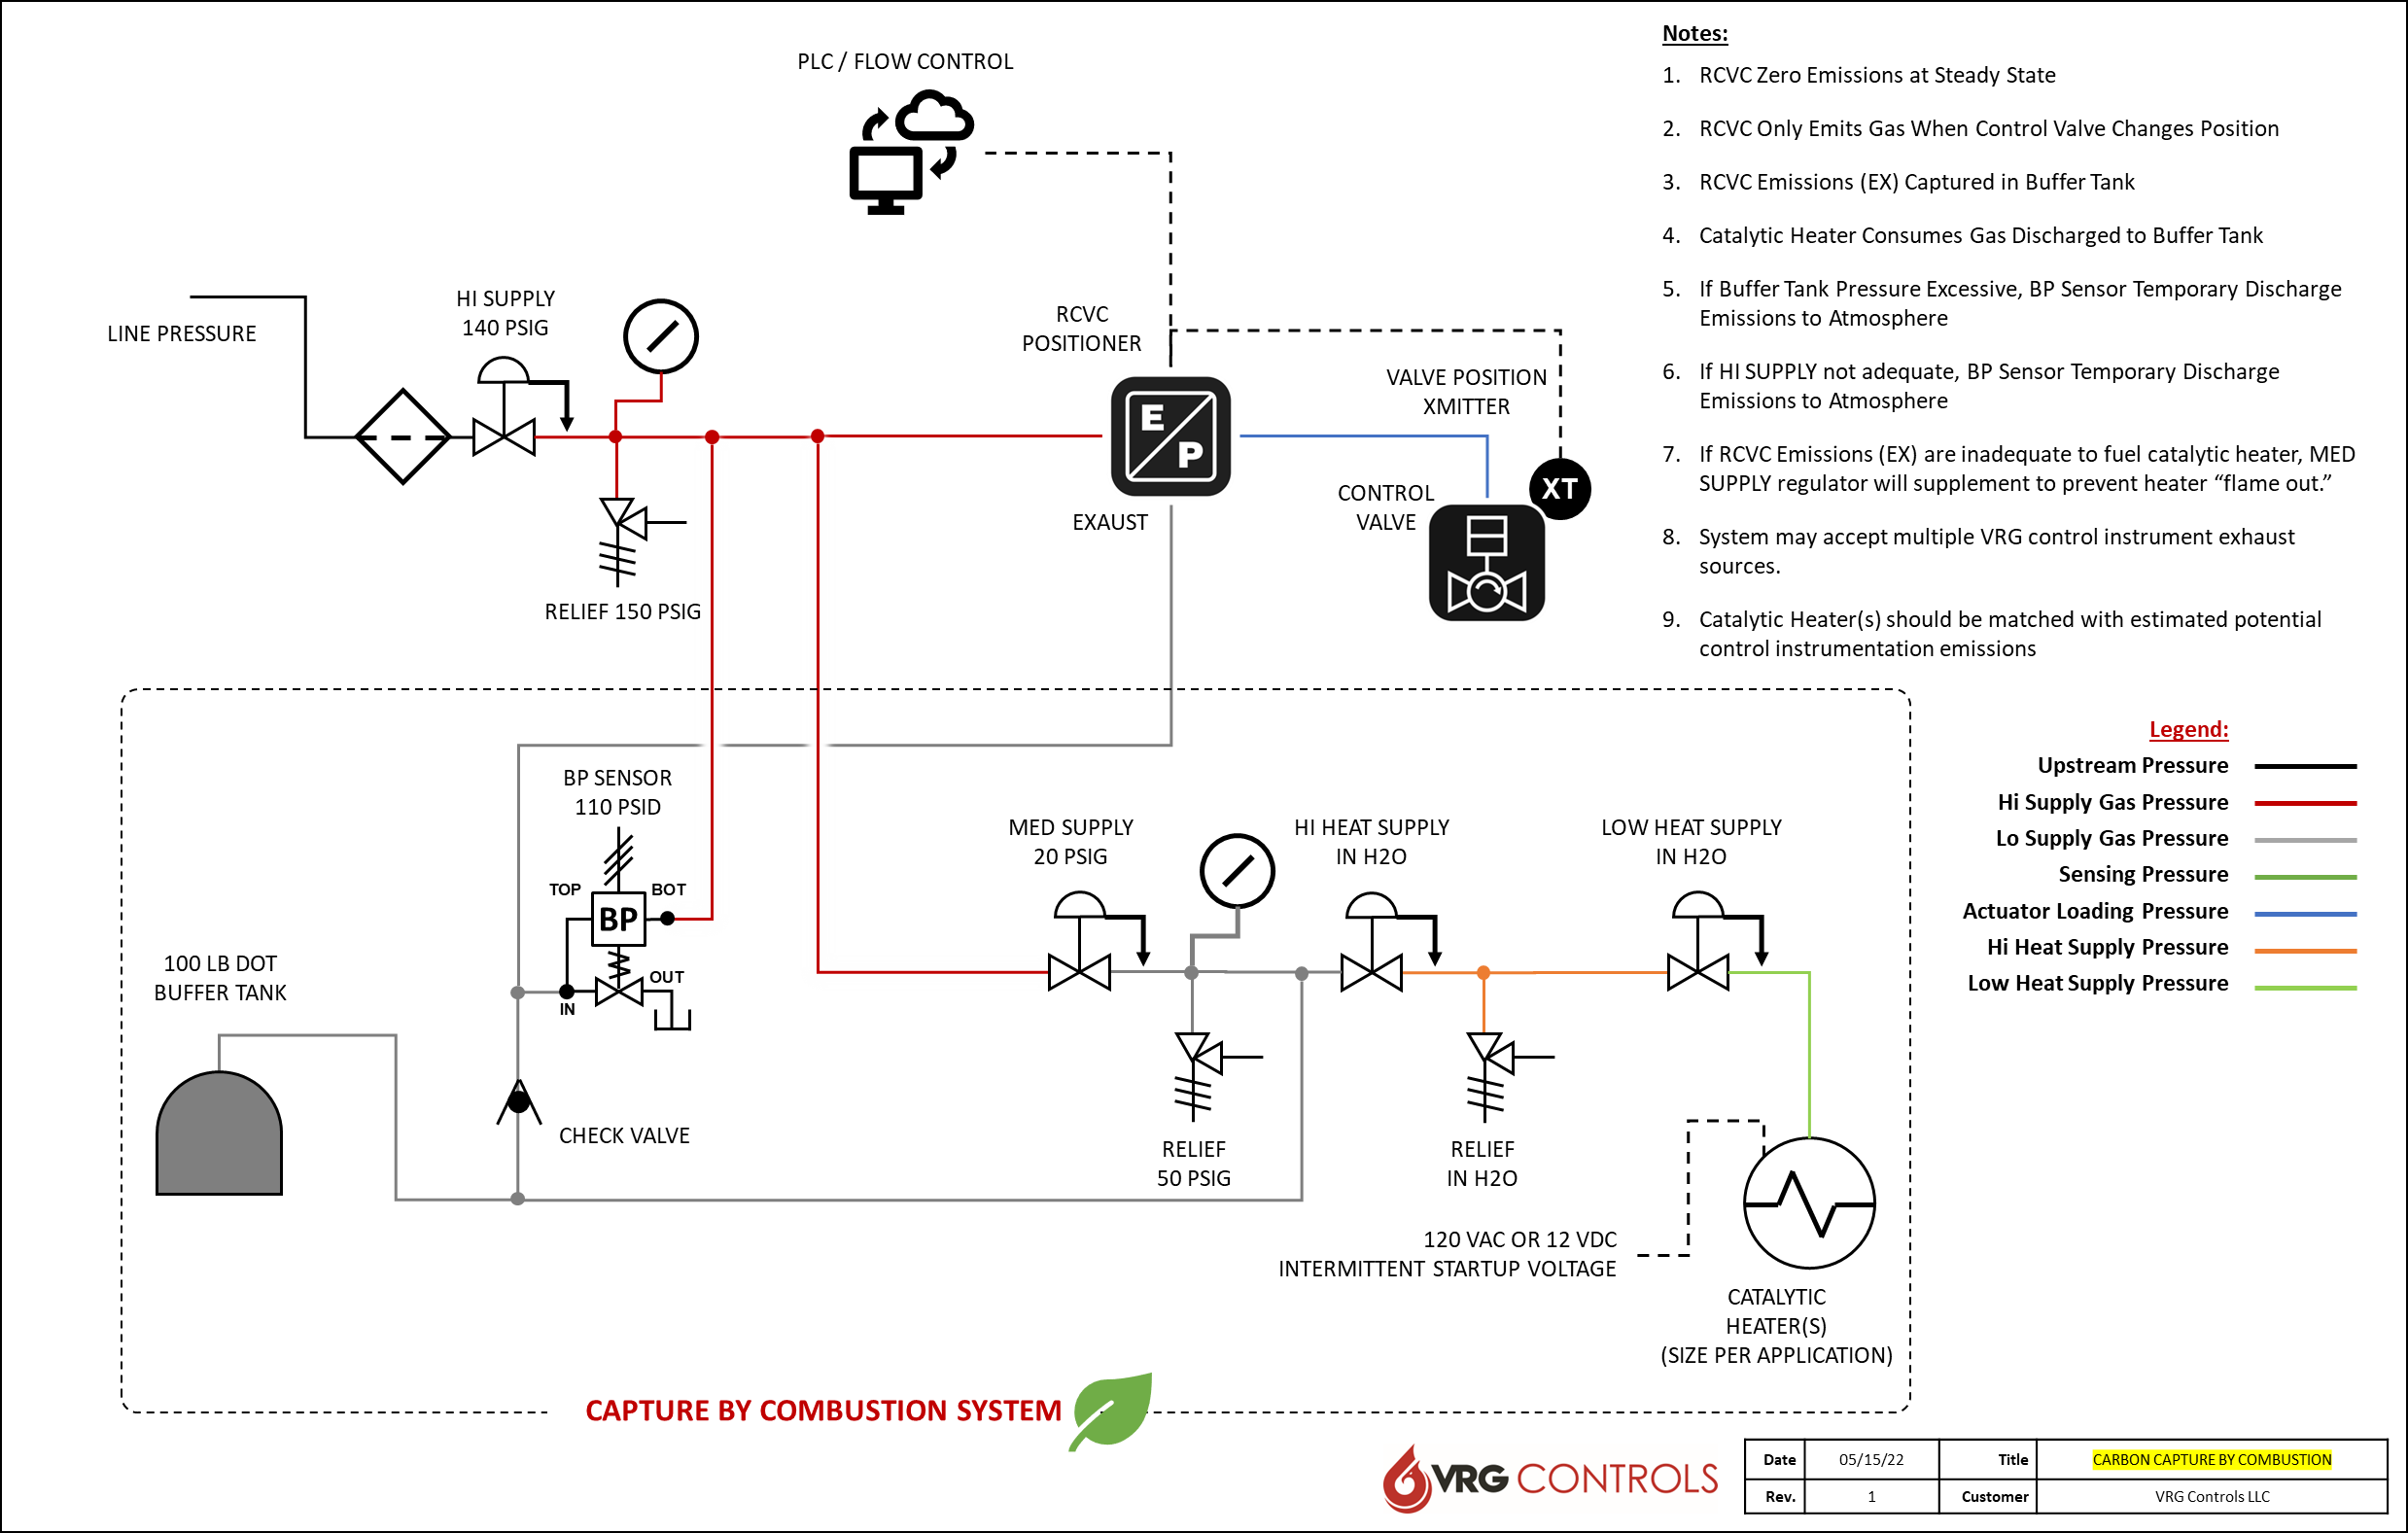
Carbon Capture by Combustion Solution

Slide 35
Oxford Flow
Control
Regulator
Technologies
03/23/22

Slide 36
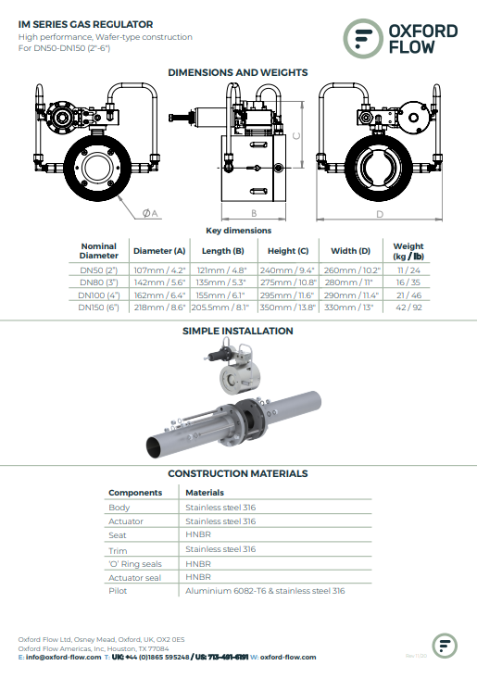
Title Here

Slide 37
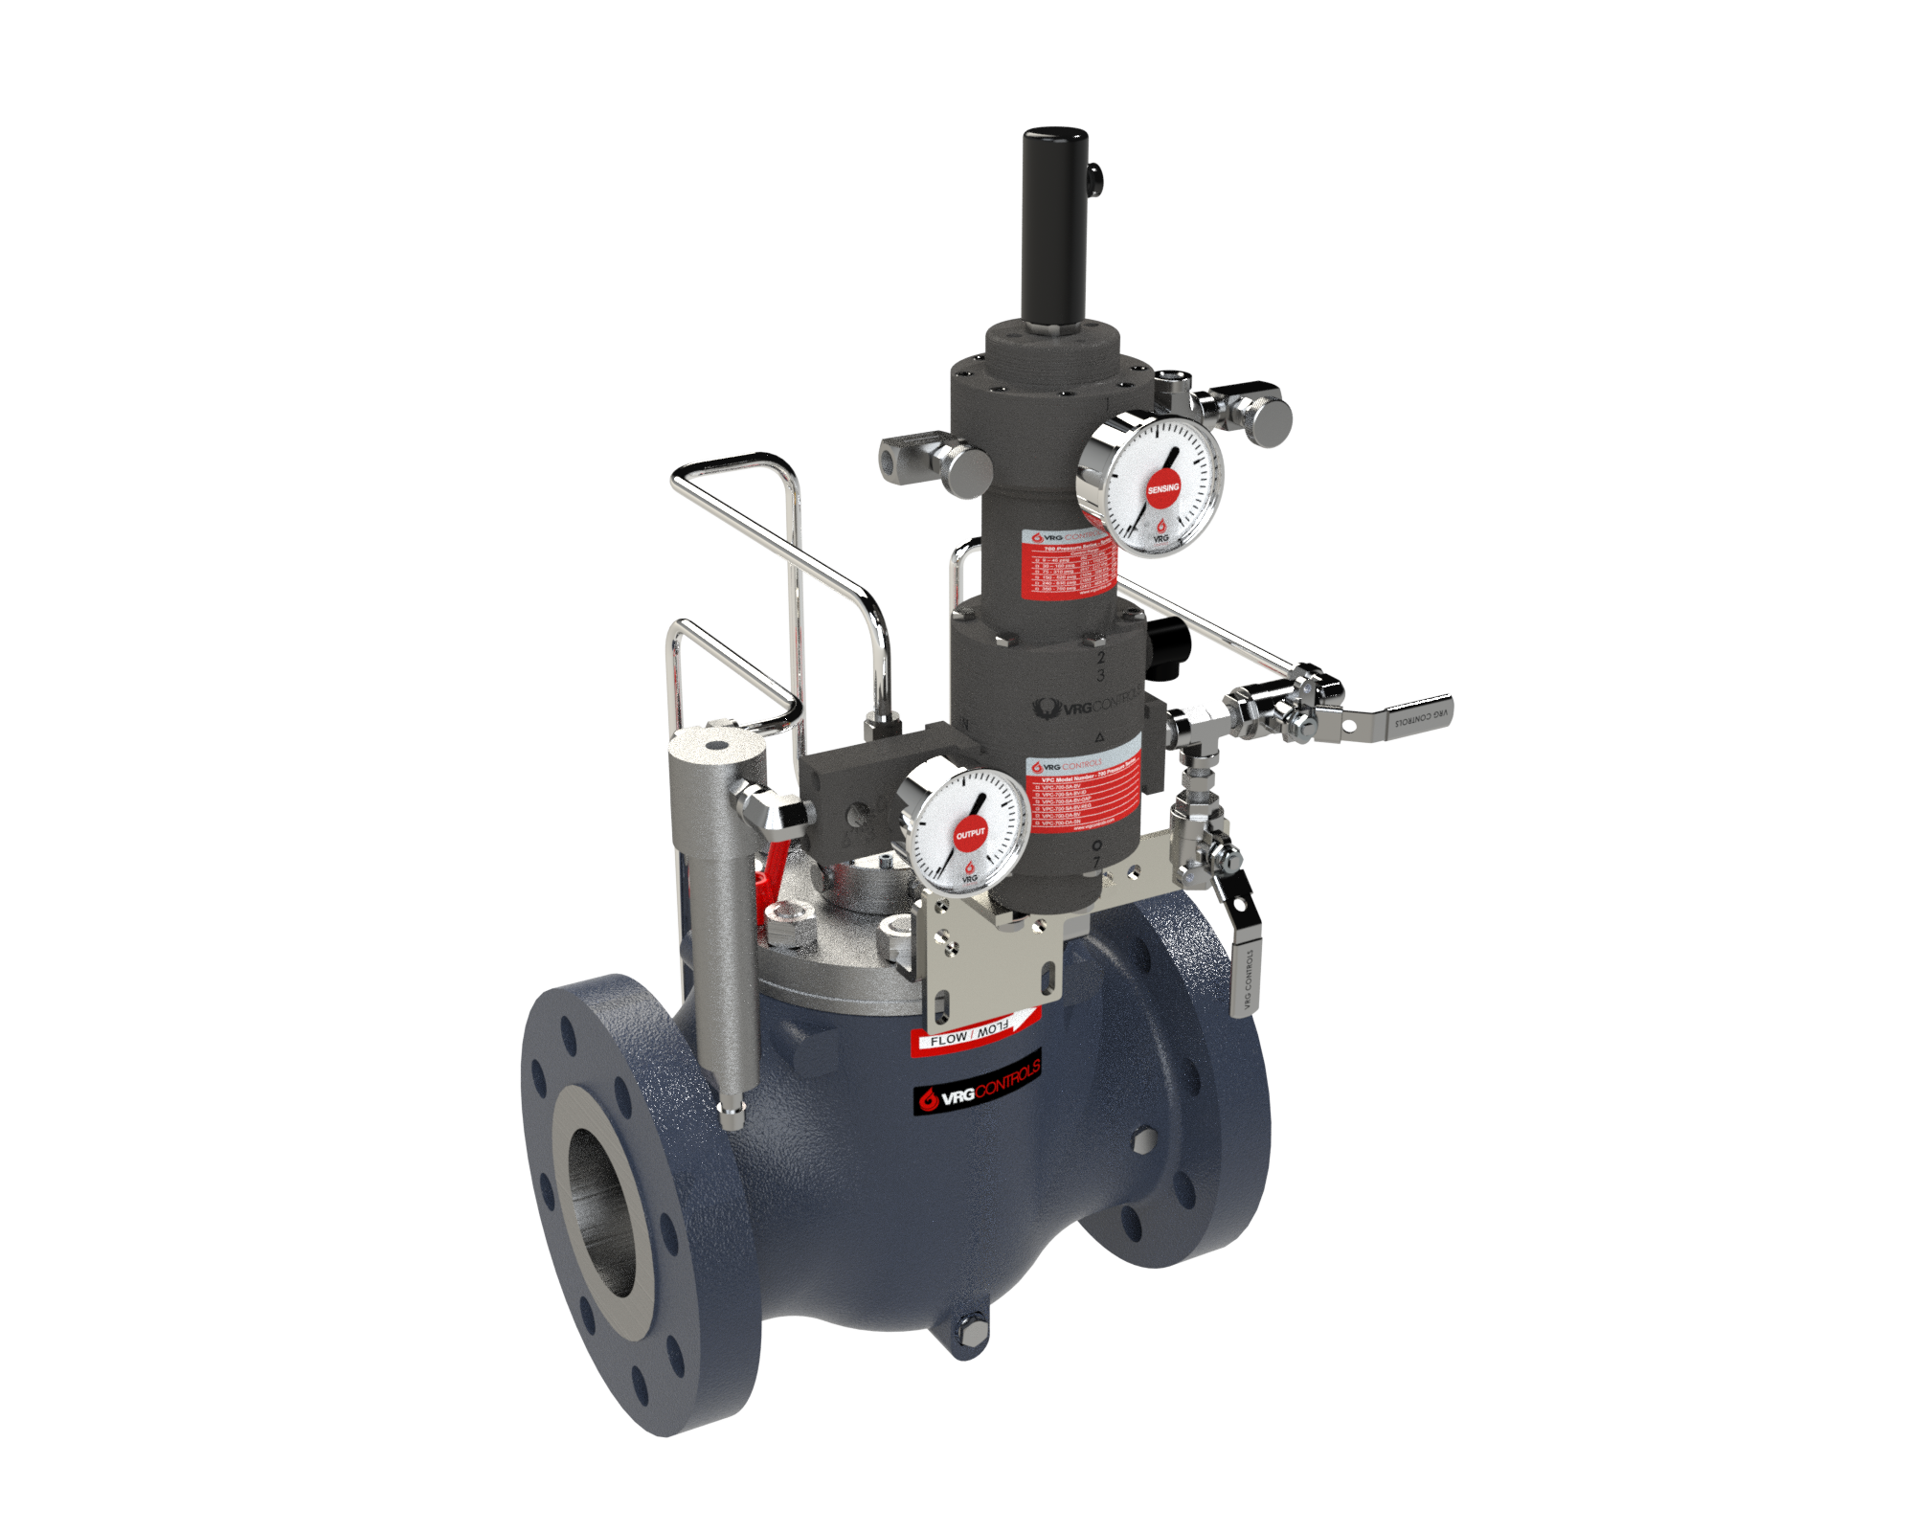
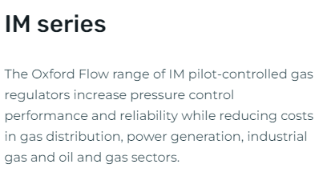
IM Series Wafer Style Regulators

Slide 38
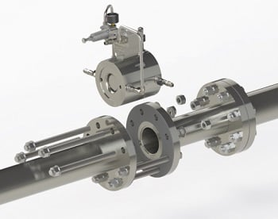
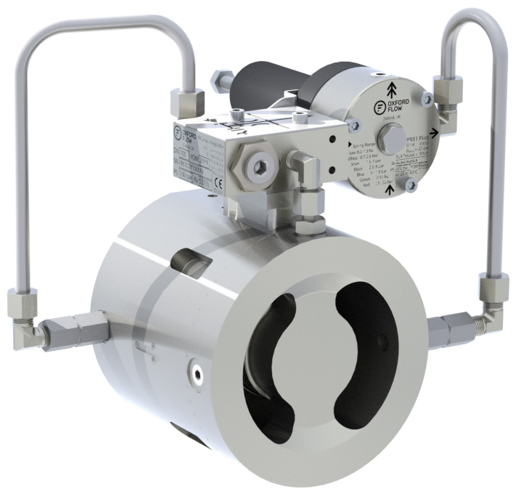
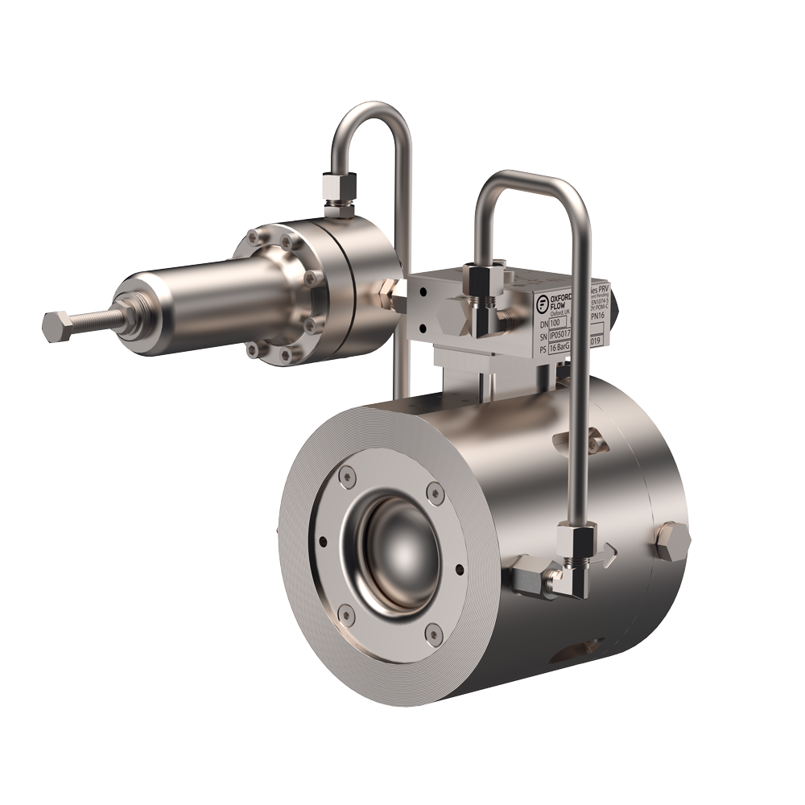
IM Series Wafer Style Regulators

Slide 39
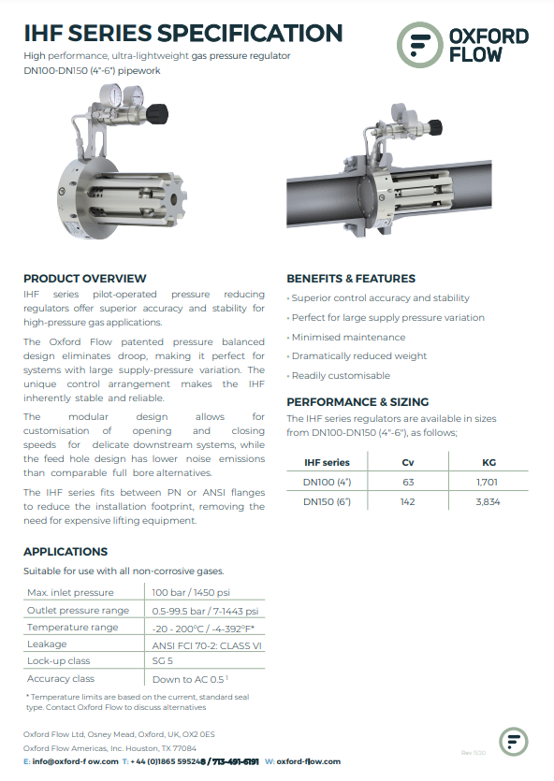
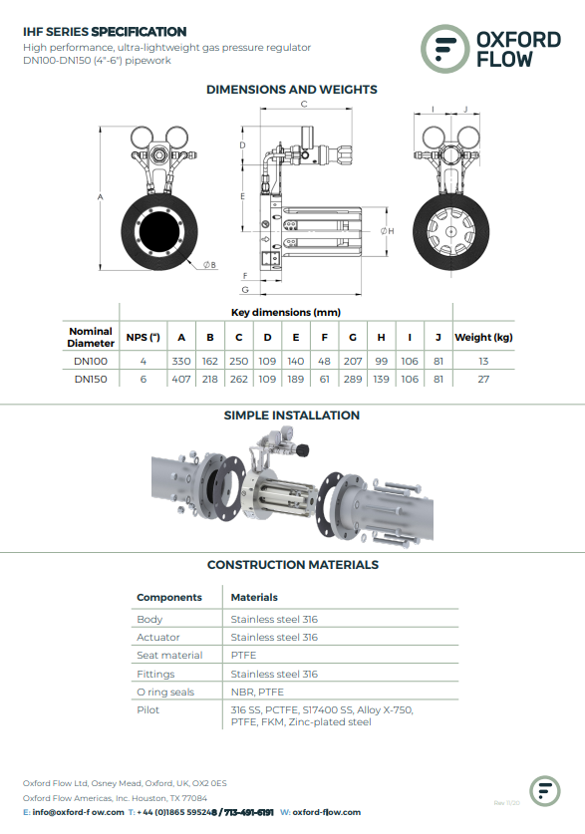
IHF Series Cartridge Style Regulators

Slide 40
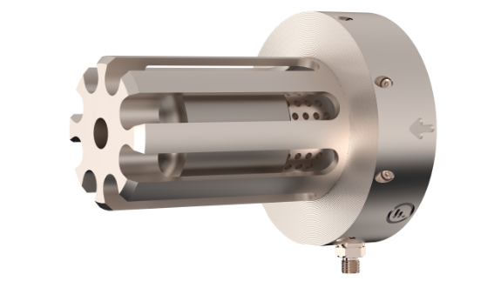
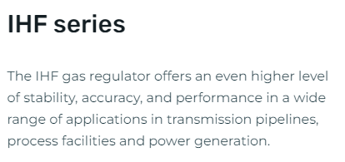
IHF Series Cartridge Style Regulators

Slide 41
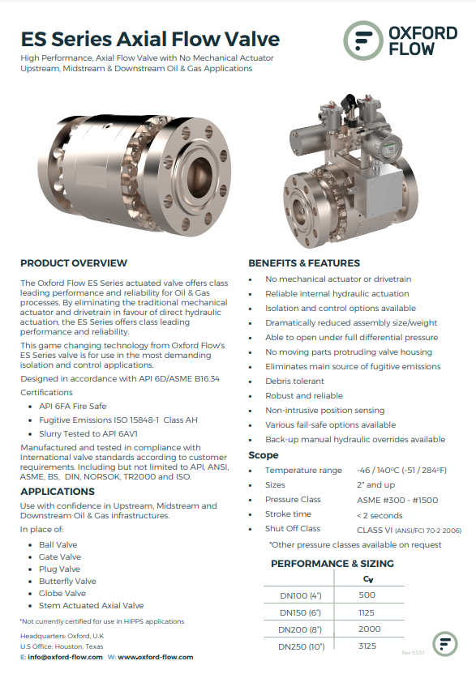
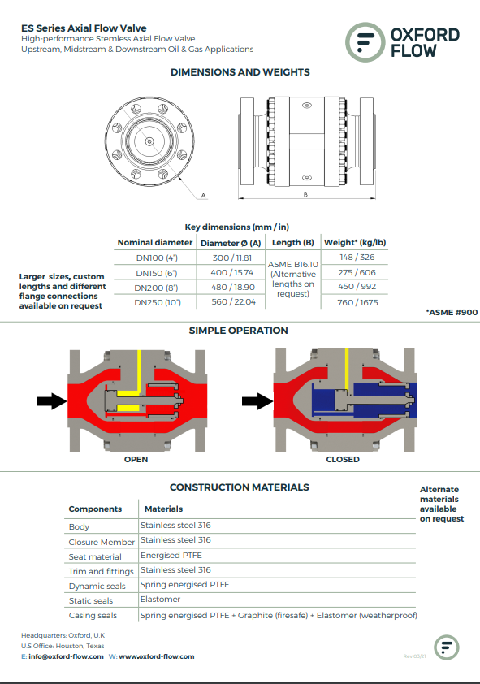
ES Axial Control Valve

Slide 42
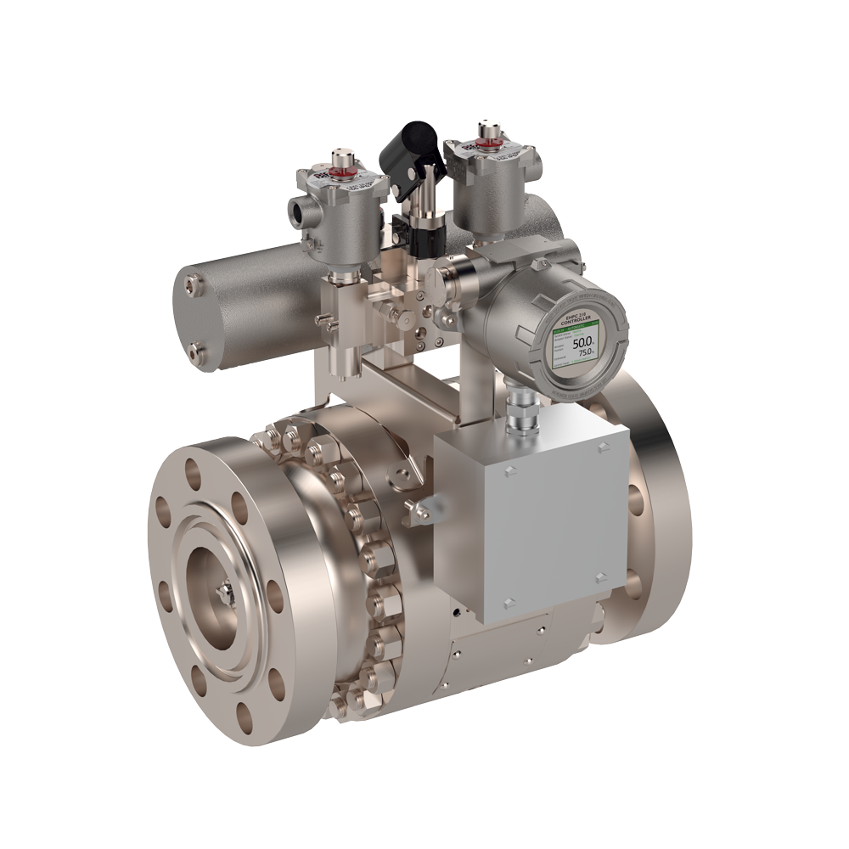
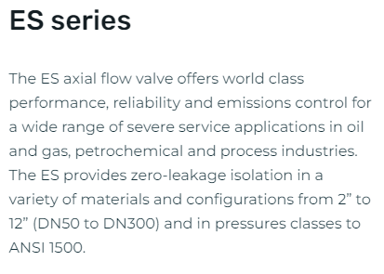
ES Axial Control Valve
RED
CIRCLE
VALVE CONTROLER

Slide 43
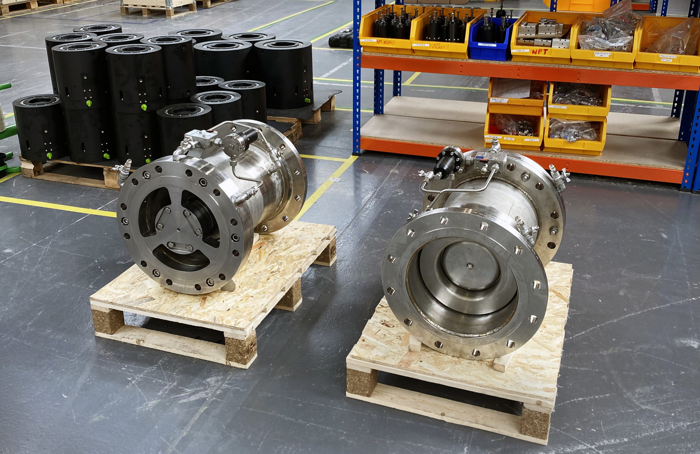
14 IN Axial Type Liquid Surge Reliever

Slide 44
Our Contact Information
VRG Controls, LLC
Toll-Free: +844-FLOW-VRG (USA & CANADA)
e-Mail: Sales@VRGControls.com
www.VRGControls.com
VRG Controls, LLC
1199 Flex Court, Unit B
Lake Zurich, Illinois 60047 USA
VRG Controls, LLC
Solutions for Natural Gas!
Follow Us:

