Slide 1
VRG Controls
Product
Overview
10/19/2021

Slide 2
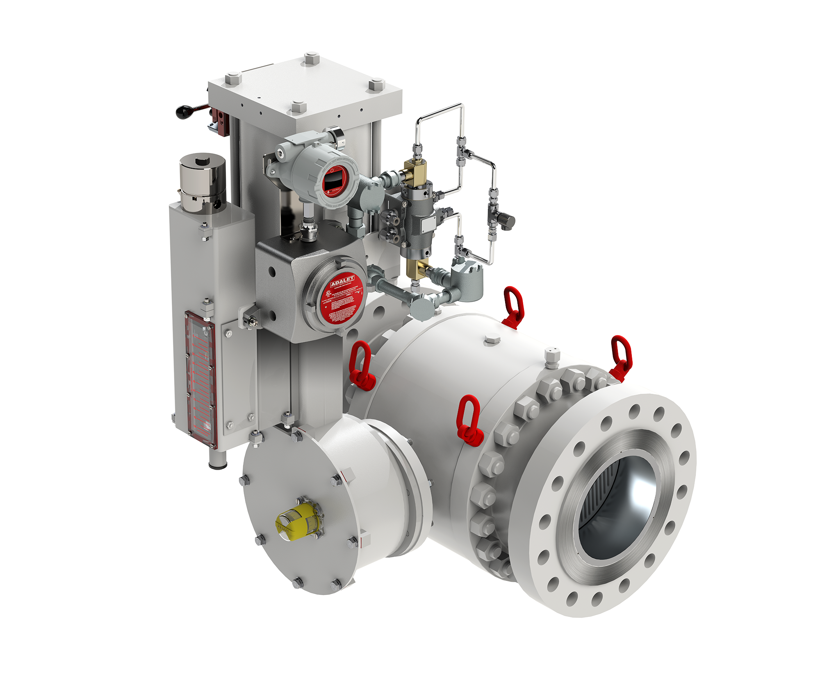
High Capacity Control Valves For Natural Gas Pipelines
PRCV Pipeline Rotary Control Valve
Typ. Double Acting Configuration
PRCV Pipeline Rotary Control Valves

Slide 3
Control Valve Solutions Designed Specifically for Natural Gas Applications
Variety of Options Such as VMO Valve Manual Override
High Pressure, High Performance Actuator Pistons Provide high Torque Output and Allow “Bleed to Pressure” Feature
An Array of Environmentally Friendly High Performance Control Instrumentation
Family of High Performance PRCV Pipeline Rotary Control Valves to Address Your Operating Conditions
Multiple Supply Gas System (SGS) Options Available
Limit Switches, Position Transmitters and Valve Positioners Available to Provide Valve Status and Control Options

Slide 4
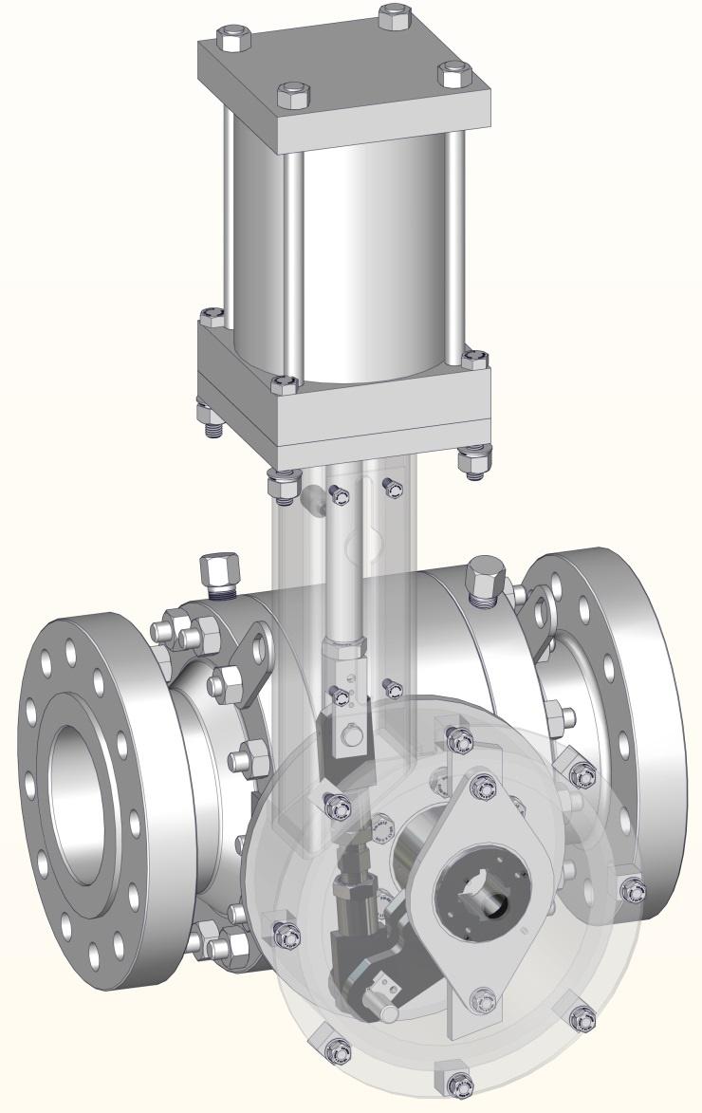
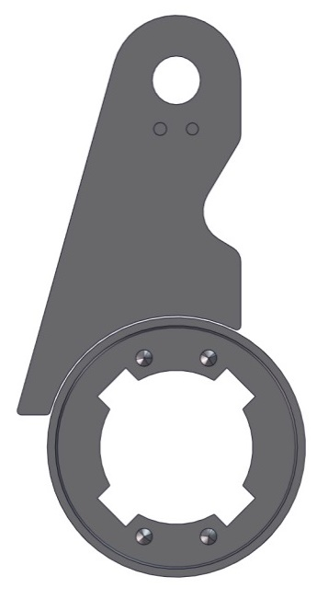
RHPA Actuator Crank Arm Design for Demanding Pipeline Applications
Torque Arm Actuator Mechanism Provides Optimum Torque Performance w/ ZERO Lost Motion
High Pressure / High Performance Actuator Pistons Standard
Dual High Tolerance Torque Arm Bearings Prevent Valve Stem Side Load
4-Position Stem Keyway for Maximum Installation Flexibility
Tight Tolerance Clevis Pin w/ Spherical Bearing
Tight Tolerance Torque Arm Pin w/ Spherical Bearing and Retainer System

Slide 5
RHPA-SR Spring Return Actuator for Guaranteed Failure Mode
RHPA-SR Spring Return Actuators Provide Guaranteed “Default Position” on Loss of Supply Gas Pressure
Fully Welded Actuator Spring Cartridge Ensures Safest Operation
Highly Engineered, Permanently Lubricated Actuator Springs Designed for Heavy Cycling and “Infinite-Life”
Available “Spring-to-Open” OR “Spring to Close”

Slide 6
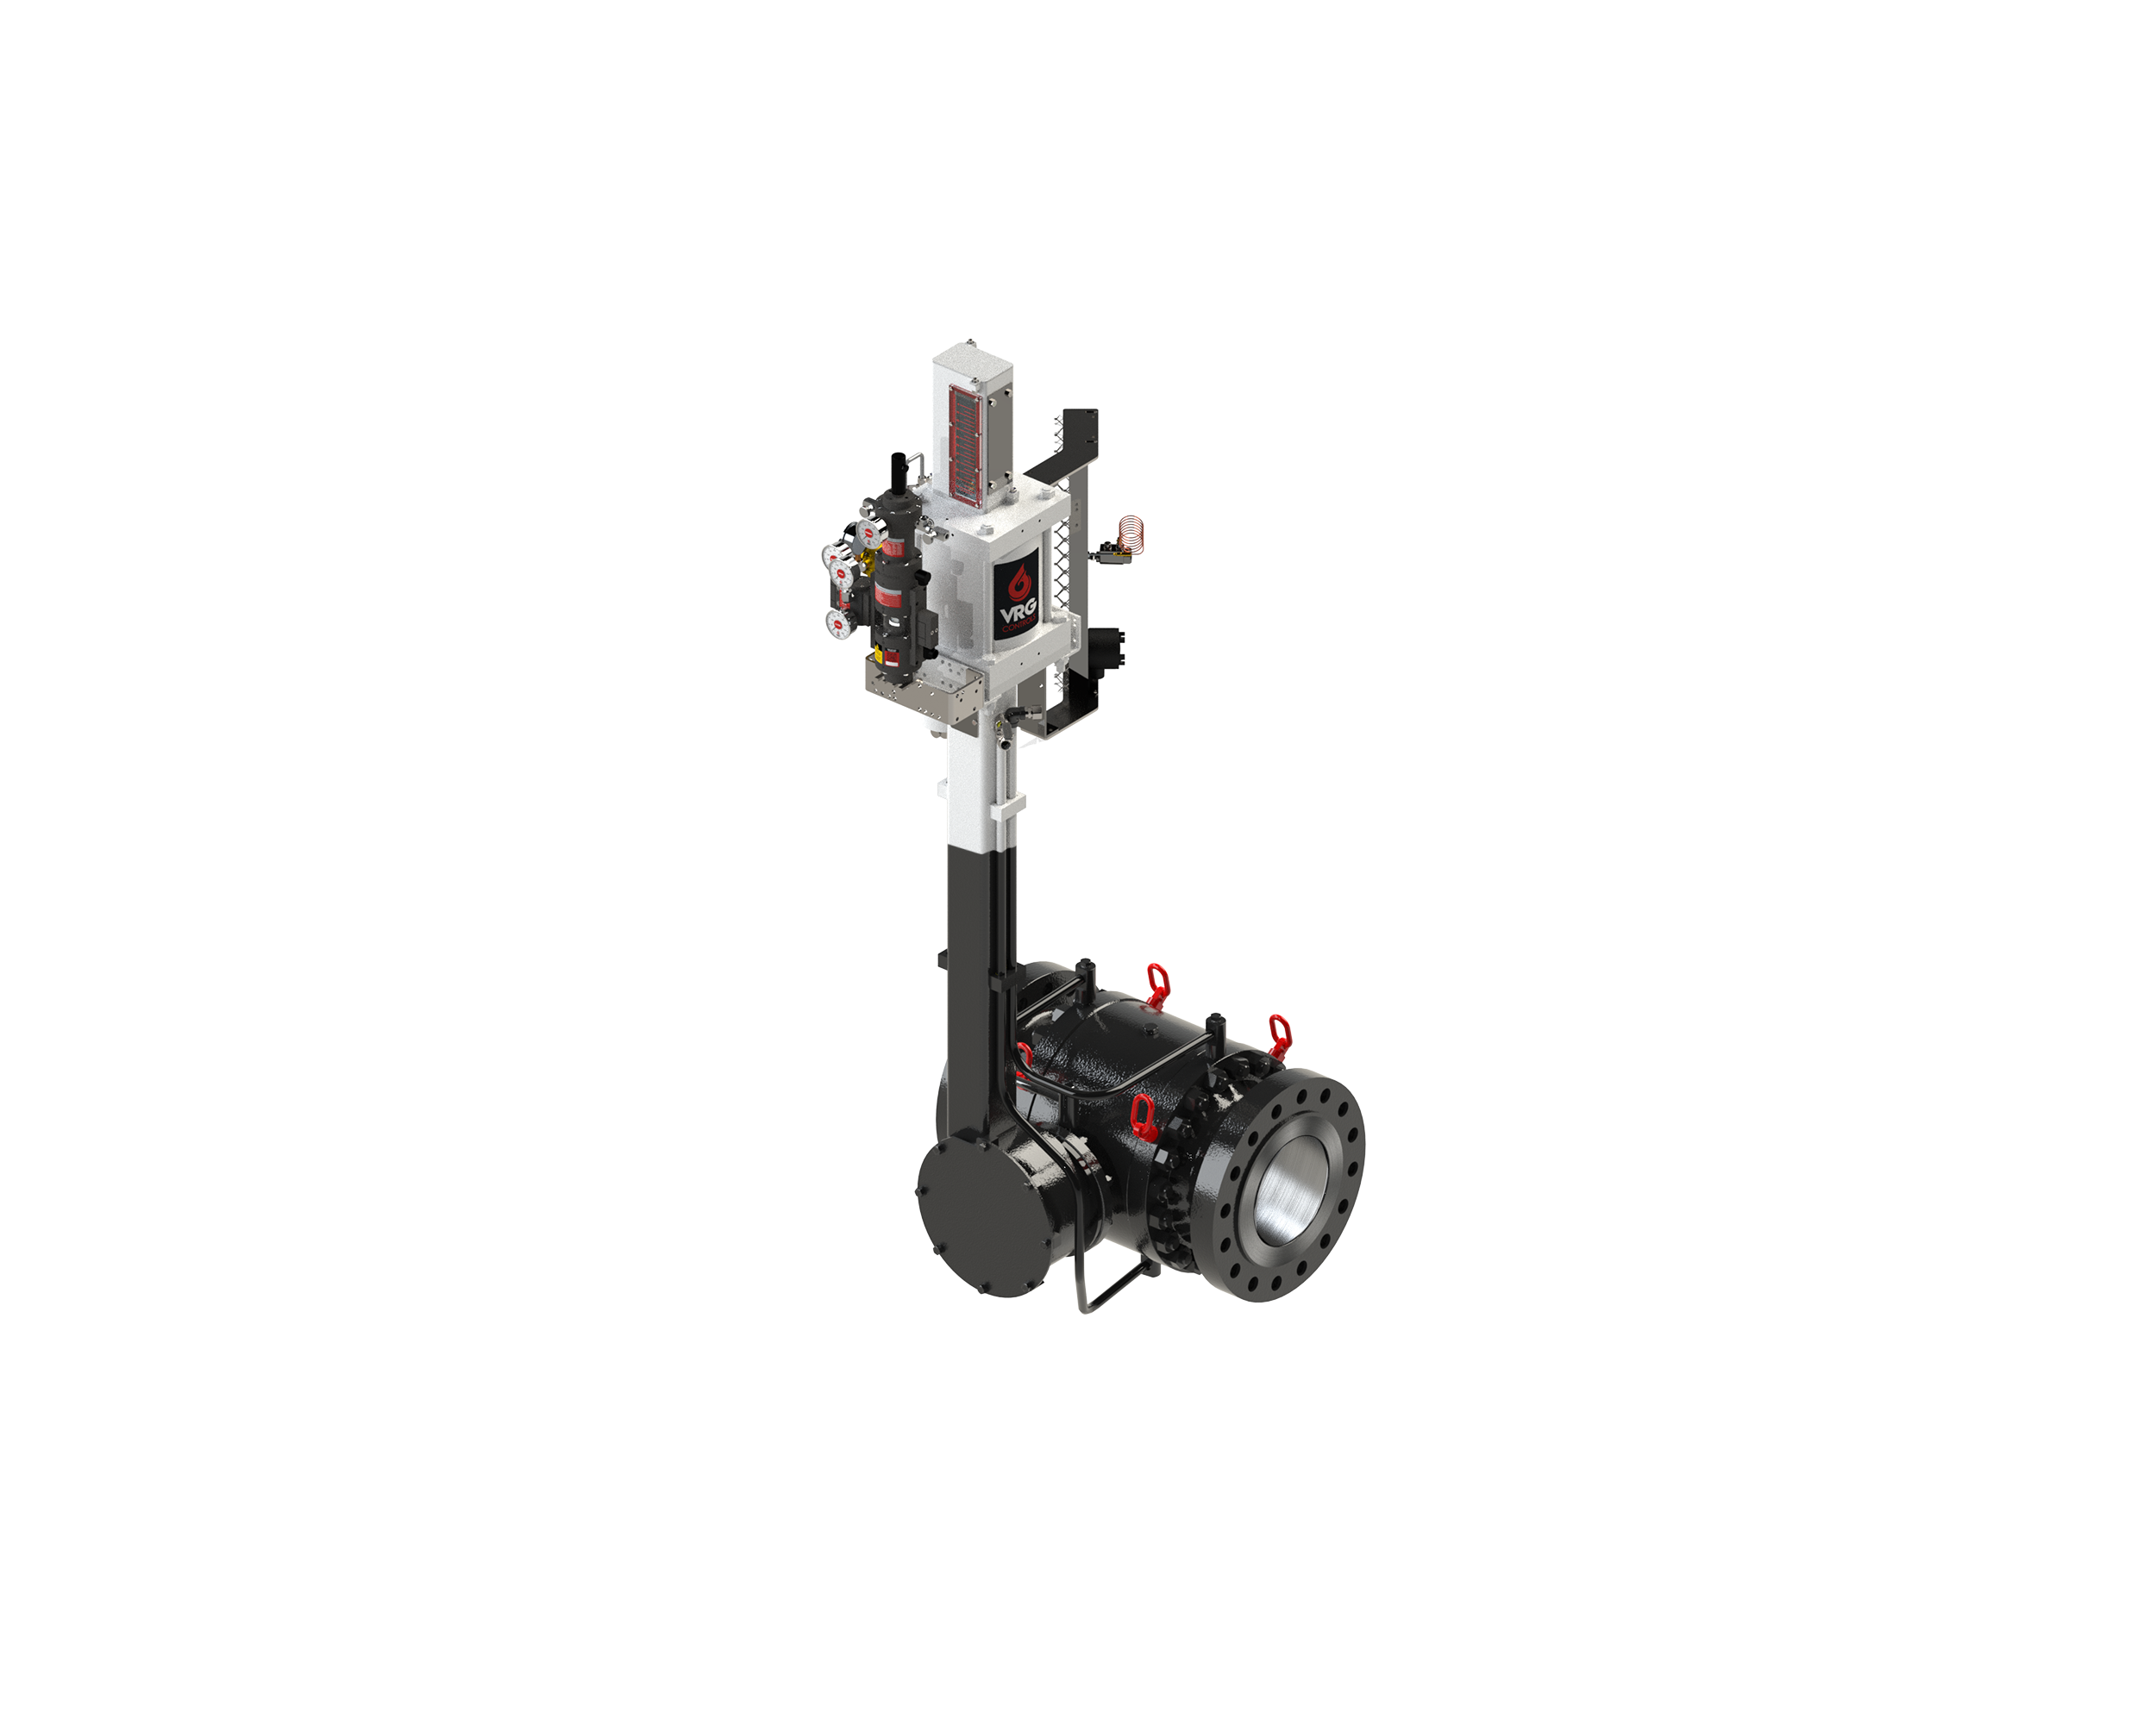
Below Ground Option Provides Maximum Performance
Most Cost Effective Noise Attenuation Available
Crank Arm Design Provides Only Truly Viable Control for Below Ground Station
Ideal Solution for High Pressure, High Volume Pipeline Station Design
Minimize Heat Loss via Burial
Lubrication and Drain Lines Extended Above Ground for Ease of Maintenance.
No Need For Excavation to Perform Preventative Maintenance and Performance Evaluation
Smaller Station Footprint and Lower Project Costs
Smaller Diameter Upstream & Downstream Piping / Isolation Valves
25 dBA Noise Attenuation Minimum (3 ft. Depth)
Replace Existing Becker Below Grade Control Valves
Grade Level

Slide 7
Below Ground Option - Key Design Considerations
Tail-rod Instrument Mounting System Standard
PRCV Seat Seals Extended Above Ground
Coal Tar Epoxy Coating on Below Ground Portion
Vented Actuator Housing
Stem Lubrication / Test Extended
Fully Welded Bracket Supports on All Lines
All Port Extension Lines ASME Code Welded and Hydro-tested
Drain Line / Blowdown Extended

Slide 8
Station Design Considerations - Below Ground
Worker Regulator
Monitor Regulator
Optimize Station M&R Station Design with Less Overall Costs
25 dBA Noise
Attenuation (3 Ft.)
BURIED DEPTH

Slide 9
Station Design Considerations - Below Ground

Slide 10
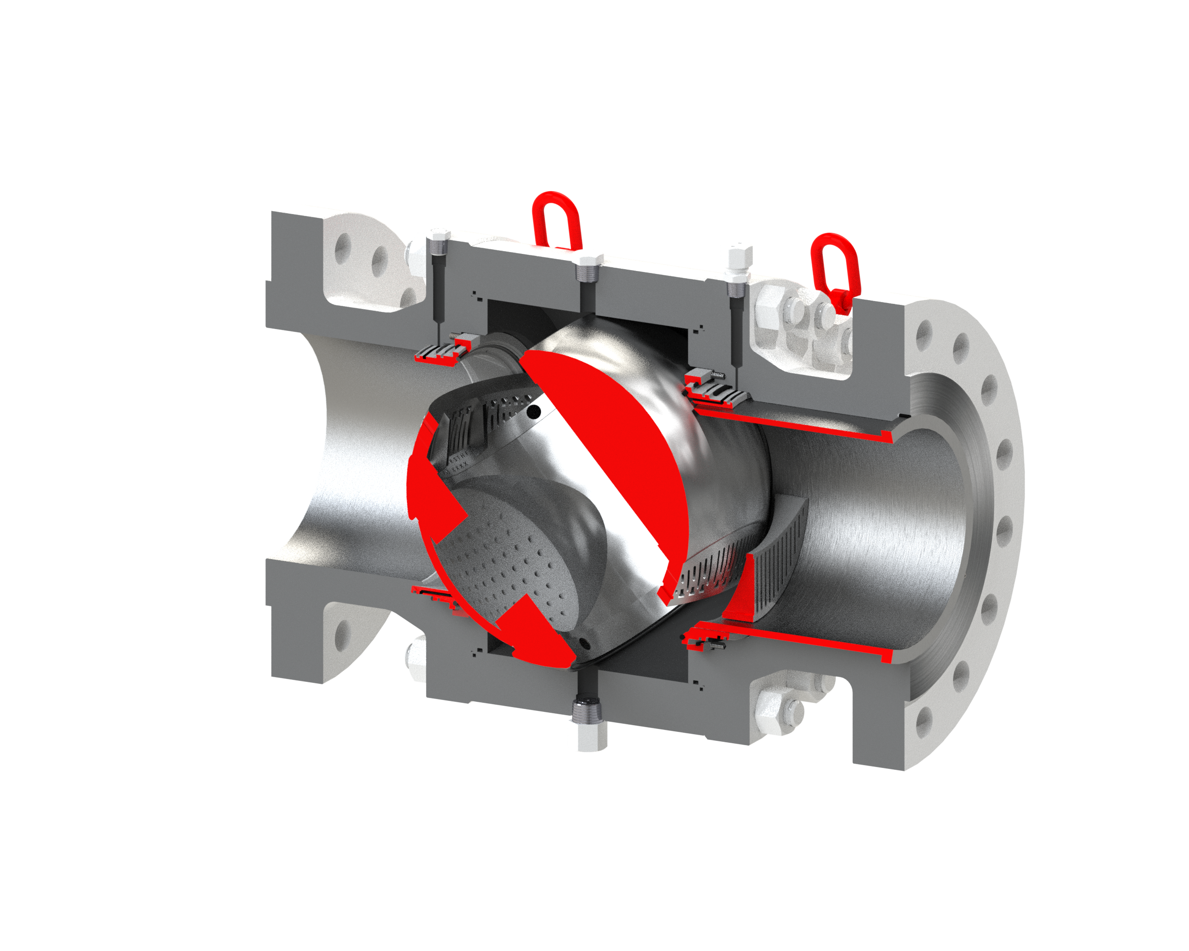
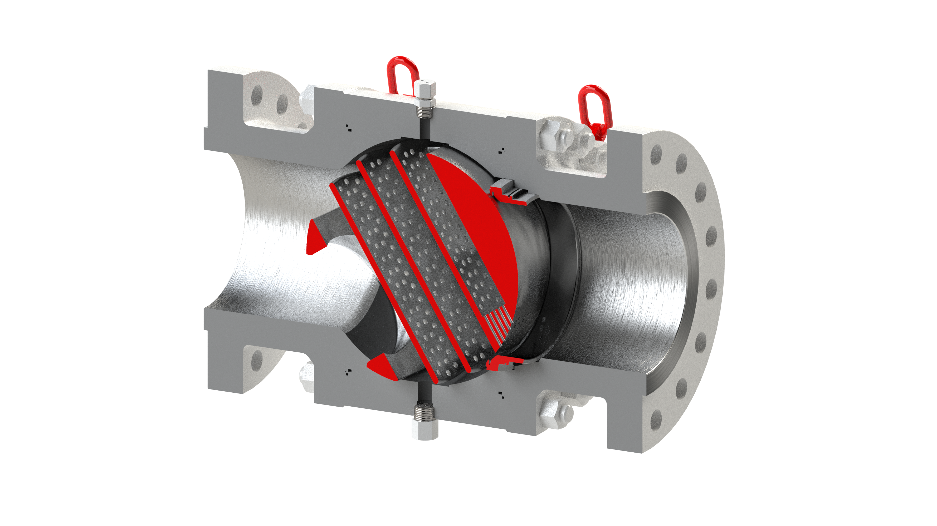
PRCV Pipeline Rotary Control Valve – Product Overview
PRCV Performance Summary
PRCV Series | PRCV-FP | PRCV-STH1 | PRCV-STH2 | PRCV-STHP
Size Range | 2 in to 42 in | 6 in to 24 in | 6 in to 24 in | 6 in to 24 in
ANSI Range | 150 – 1500 ANSI | 150 – 1500 ANSI | 150 – 1500 ANSI | 150 – 1500 ANSI
End Connections | RFFE, Weld, RTJ, Combo | RFFE, Weld, RTJ, Combo | RFFE, Weld, RTJ, Combo | RFFE, Weld, RTJ, Combo
Trim Type | Full Port | Stealth Trim Level 1 | Stealth Trim Level 2 | Stealth Trim High Performance
Performance Trim Technology | N/A | Upstream Var Diffuser Upstream Fixed Diffuser | Upstream Var Diffuser Downstream Var Diffuser Upstream Fixed Diffuser Drilled Hole Ball Side Exit | Upstream Var Diffuser Ball Diffuser Plates Ball Side Exit
Relative Capacity | Maximum Capacity | Very High Capacity | Very High Capacity | High Capacity
Max Noise Attenuation | N/A | 7 dBA | 15 dBA | 25 dBA
Max Range-Ability | 100:1 | 300:1 | 300:1 | 200:1
Shutoff | API 6D Bubble Tight | Class VI | Class V | Class V

Slide 11
PRCV-STH1 Stealth Trim – Upstream Bore View and Cutaway
STH1
DESIGN
Stem Injection Port
High Strength Stem Design
Seat Lubrication Ports
Body Drain
Upstream Variable Diffuser
https://www.youtube.com/watch?v=Be1-YxPOpIU

Slide 12
PRCV-STH2 Stealth Trim – Upstream Bore View and Cutaway
STH2
DESIGN
Stem Injection Port
High Strength Stem Design
Seat Lubrication Ports
Body Drain
Upstream Variable Diffuser
Upstream Fixed Diffuser
Downstream Variable Diffuser
https://www.youtube.com/watch?v=p1oGn2P_7F0

Slide 13
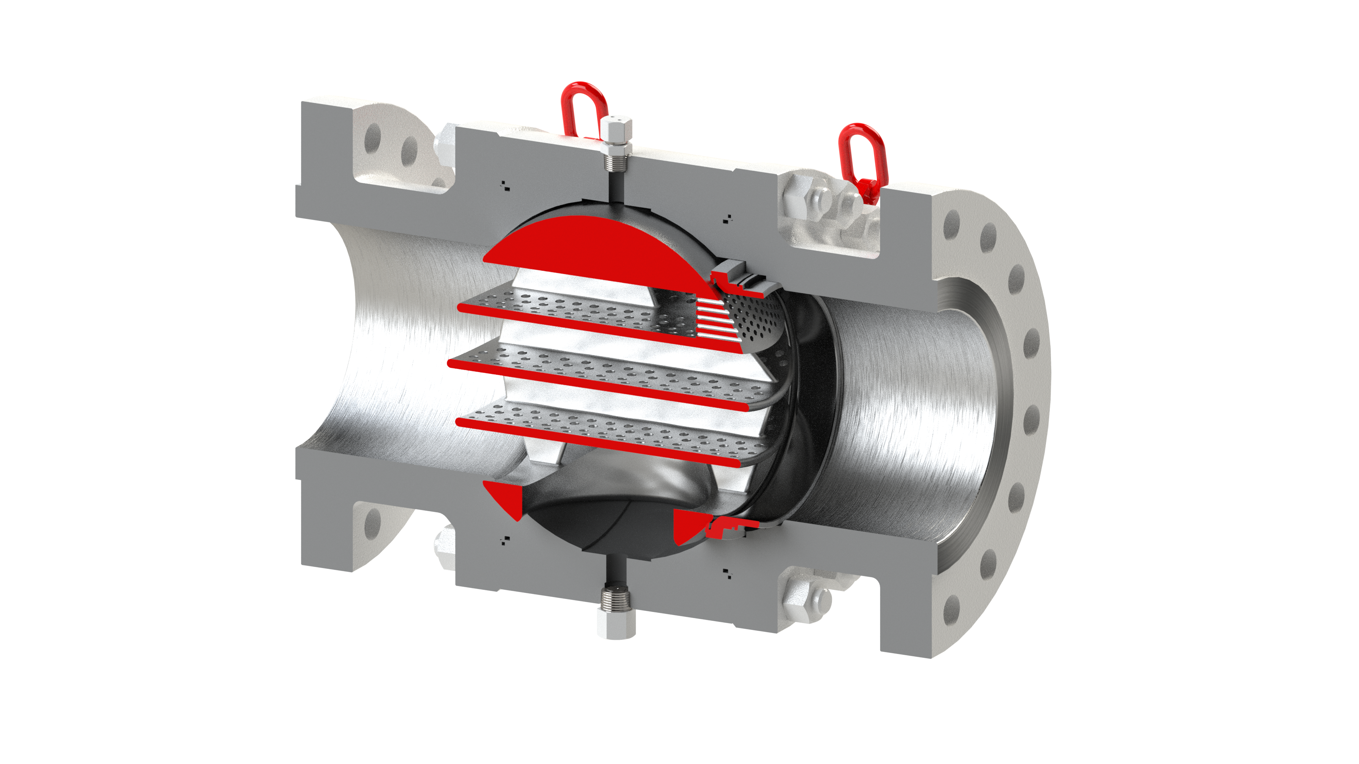
PRCV-STHP Stealth Trim – Upstream Bore View and Cutaway
STHP
DESIGN
Lifting Lugs
Stem Injection Port
High Strength Stem Design
Seat Lubrication Port
Body Drain
Ball Diffuser Plates

Slide 14
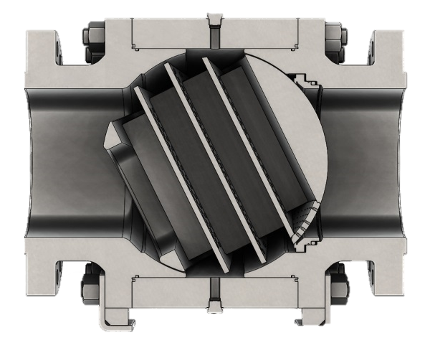
PRCV-STHP Stealth Trim – Upstream Bore View and Cutaway
STHP
DESIGN
Swivel Lift Eyes
Ball Exit Hole
Stem Injection Port
V-Pack Steam Seals
Upstream Variable Diffuser
Variable Ball
Diffuser Plates
Body Drain
https://www.youtube.com/watch?v=WhtVl1fsYSU
https://www.youtube.com/watch?v=KCA3Nx41Pck

Slide 15
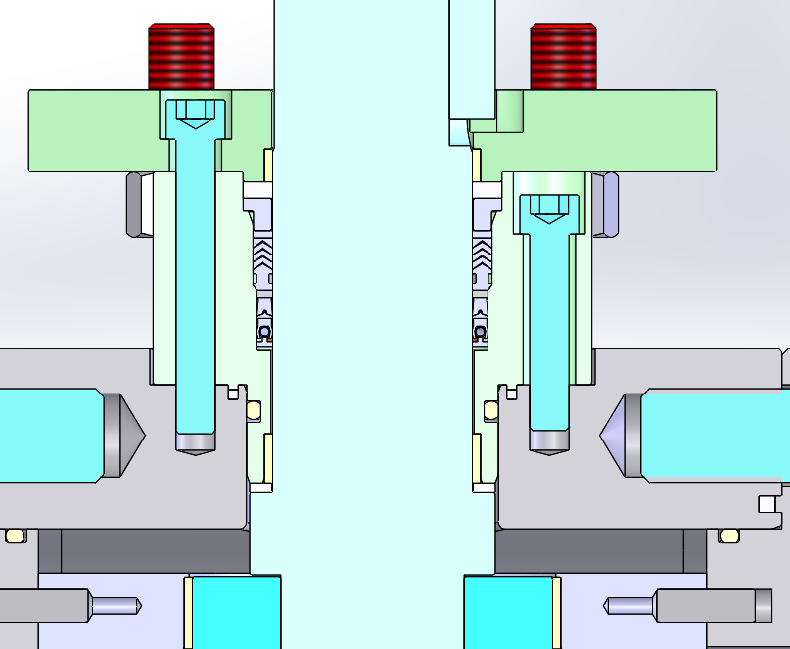
PRCV-STHP High Performance Stem Seal Design
PRCV-STH2 Stealth Trim – Upstream Bore View and Cutaway
STHP
DESIGN
Lip Seal
PTFE V-Pack
Graphite Gasket
High Performance V-Pack
Stem Seal Configuration
High Performance V-Pack
Stem Seal Assembly

Slide 16
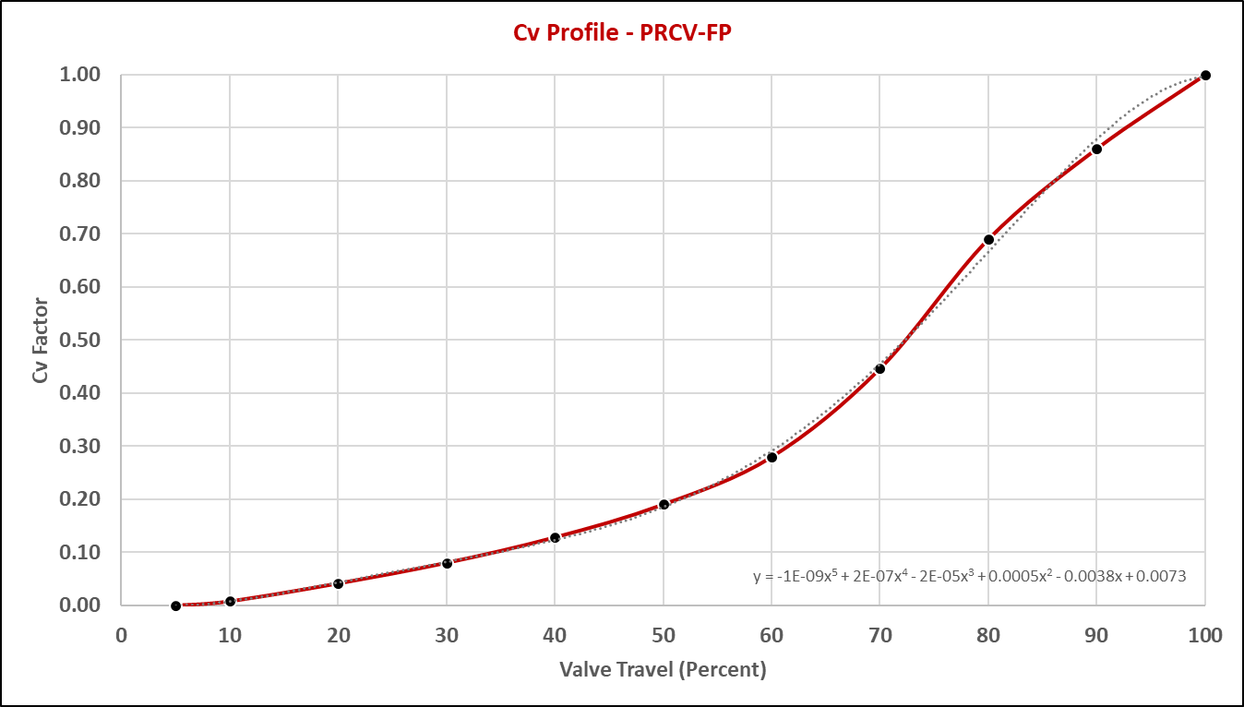
PRCV-FP Flow Profile – Modified Equal Percentage
FP
DESIGN

Slide 17
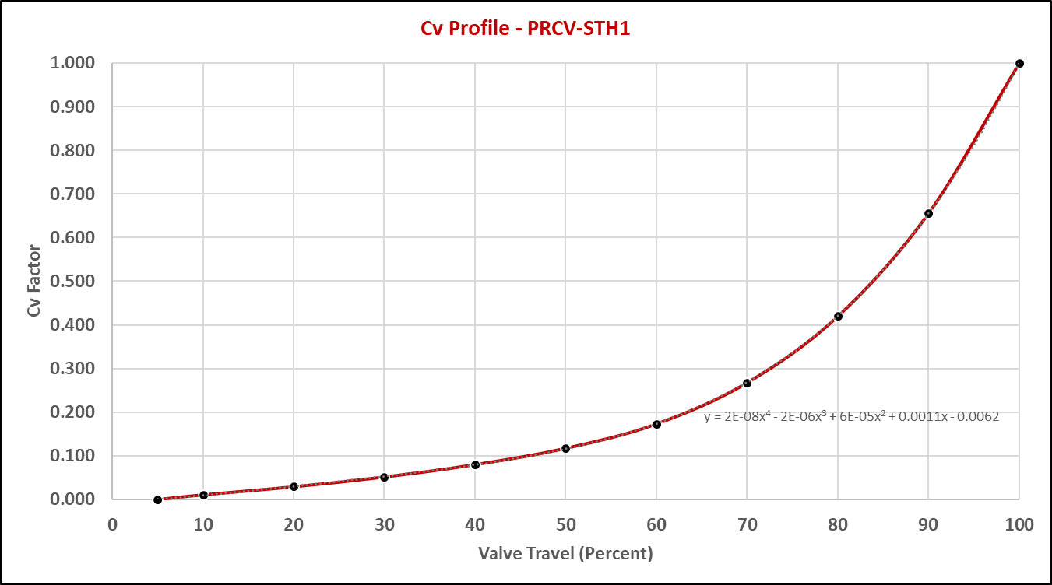
PRCV-STH1 Flow Profile – Modified Equal Percentage
STH1
DESIGN
FP
DESIGN

Slide 18
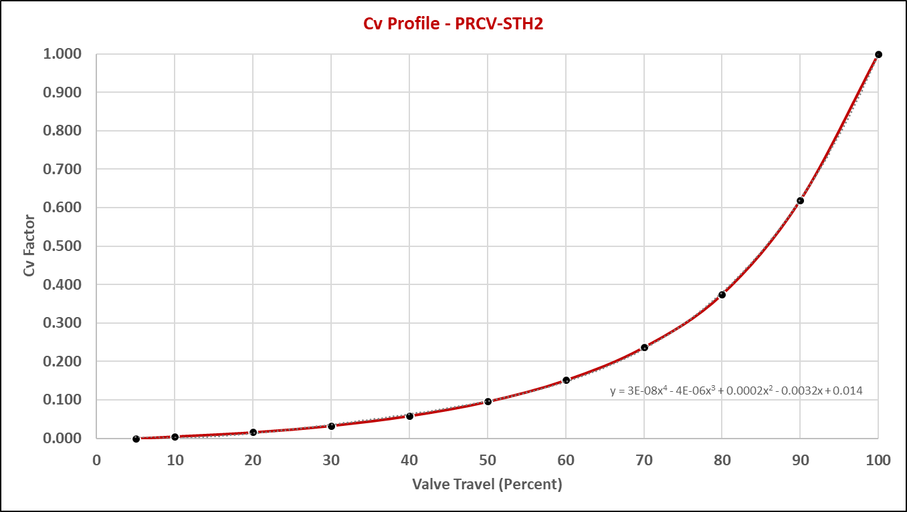
PRCV-STH2 Flow Profile – Modified Equal Percentage
STH2
DESIGN

Slide 19
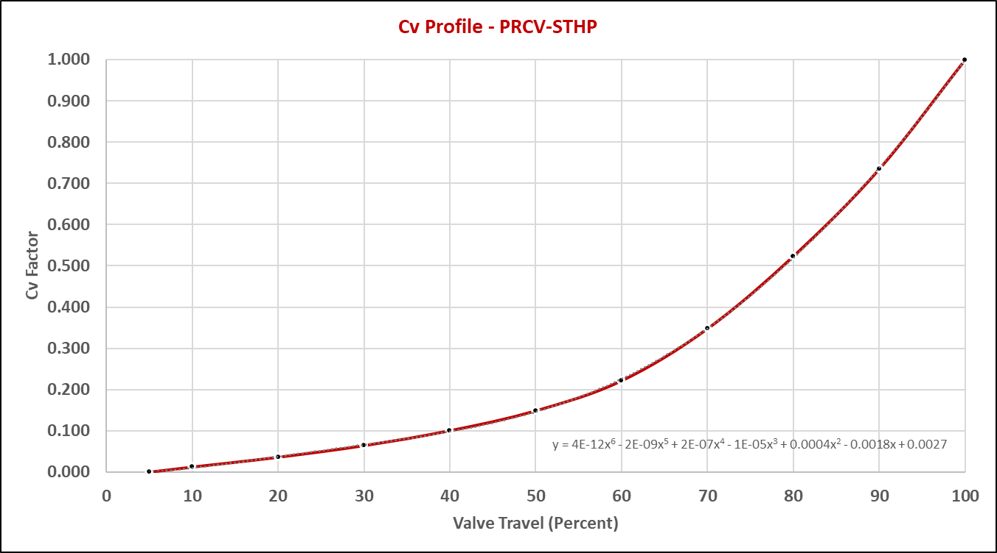
PRCV-STHP Flow Profile – Modified Equal Percentage
STHP
DESIGN

Slide 20
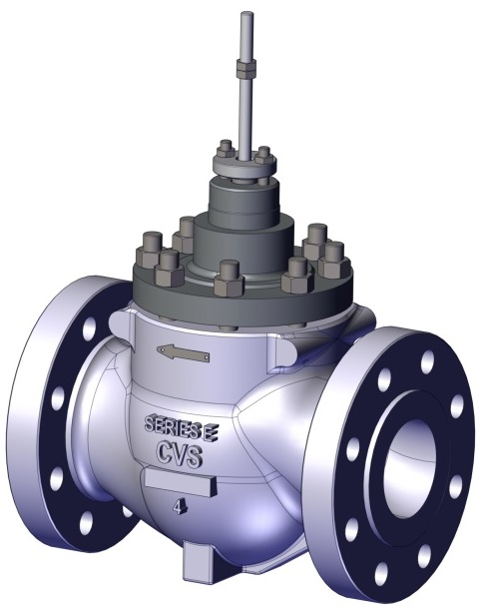
CVET Linear Control Valve – Product Overview
CV Trim | CVEZ | CVET | CVET – LEVEL I | CVET – LEVEL II | CVET – LEVEL III
Size Range | 1 in to 4 in | 2 in to 16 in | 2 in to 16 in | 2 in to 16 in | 2 in to 16 in
Design Standard | API-6D / ASME B16.5 API 6FA | API-6D / ASME B16.5 API 6FA | API-6D / ASME B16.5 API 6FA | API-6D / ASME B16.5 API 6FA | API-6D / ASME B16.5 API 6FA
ANSI Range | 150 – 900 ANSI | 150 – 900 ANSI | 150 – 900 ANSI | 150 – 900 ANSI | 150 – 900 ANSI
End Connections | RFFE, RTJ | RFFE, RTJ | RFFE, RTJ | RFFE, RTJ | RFFE, RTJ
Trim Type | Unbalanced | Balanced | Balanced | Balanced | Balanced
Performance Trim Technology | Plug Linear Equal Percent | Linear Equal Percent | Drilled Hole Noise Trim Linear Equal Percent | Drilled Hole Noise Trim Linear Equal Percent | Drilled Hole Noise Trim Linear Equal Percent
Relative Capacity | Moderate | Moderate | Moderate | Restricted | Restricted
Max Noise Attenuation | N/A | N/A | 10-15 dBA | 15-20 dBA | 25 dBA
Compatible Buried Applications | NO | NO | NO | NO | NO
Max Range-Ability | 50:1 | 30:1 | 30:1 | 30:1 | 30:1
Shutoff | Class V Class VI – Standard | Class V Class VI | Class V Class VI | Class V Class VI | Class V Class VI
Seats | Metal Seats Optional Soft Seats – Standard | Metal Seats Optional Soft Seats – Standard | Metal Seats Optional Soft Seats – Standard | Metal Seats Optional Soft Seats – Standard | Metal Seats Optional Soft Seats – Standard

Slide 21
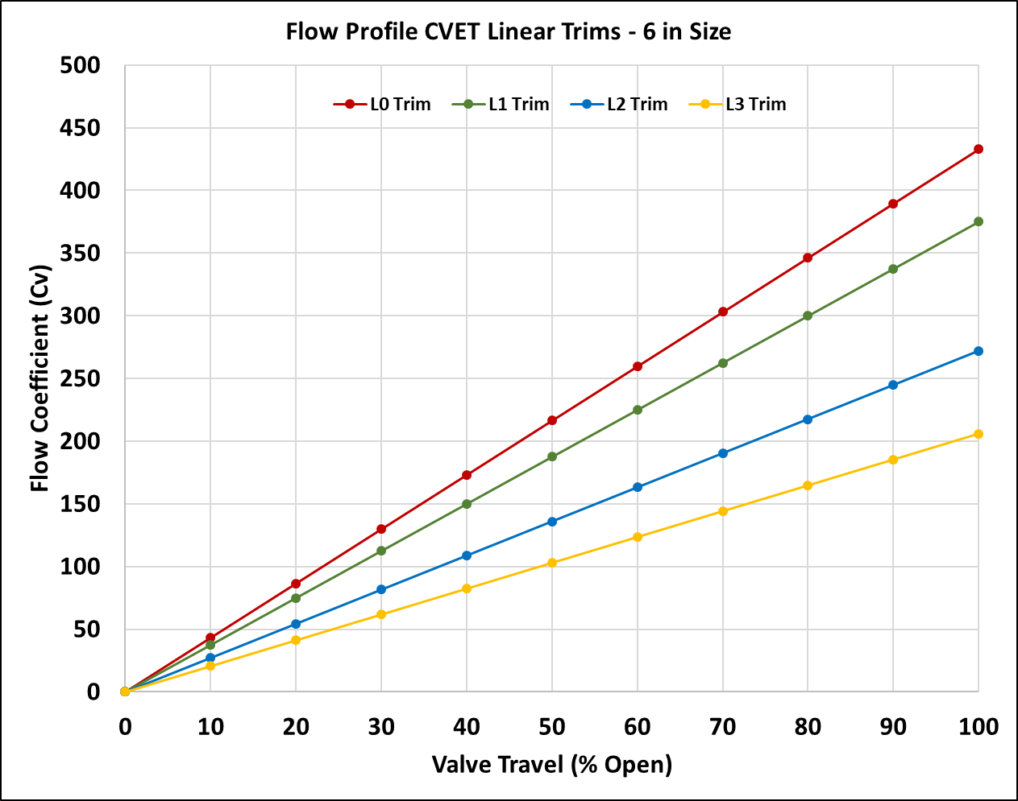
CV-ET Flow Profile – Linear Characteristic

Slide 22
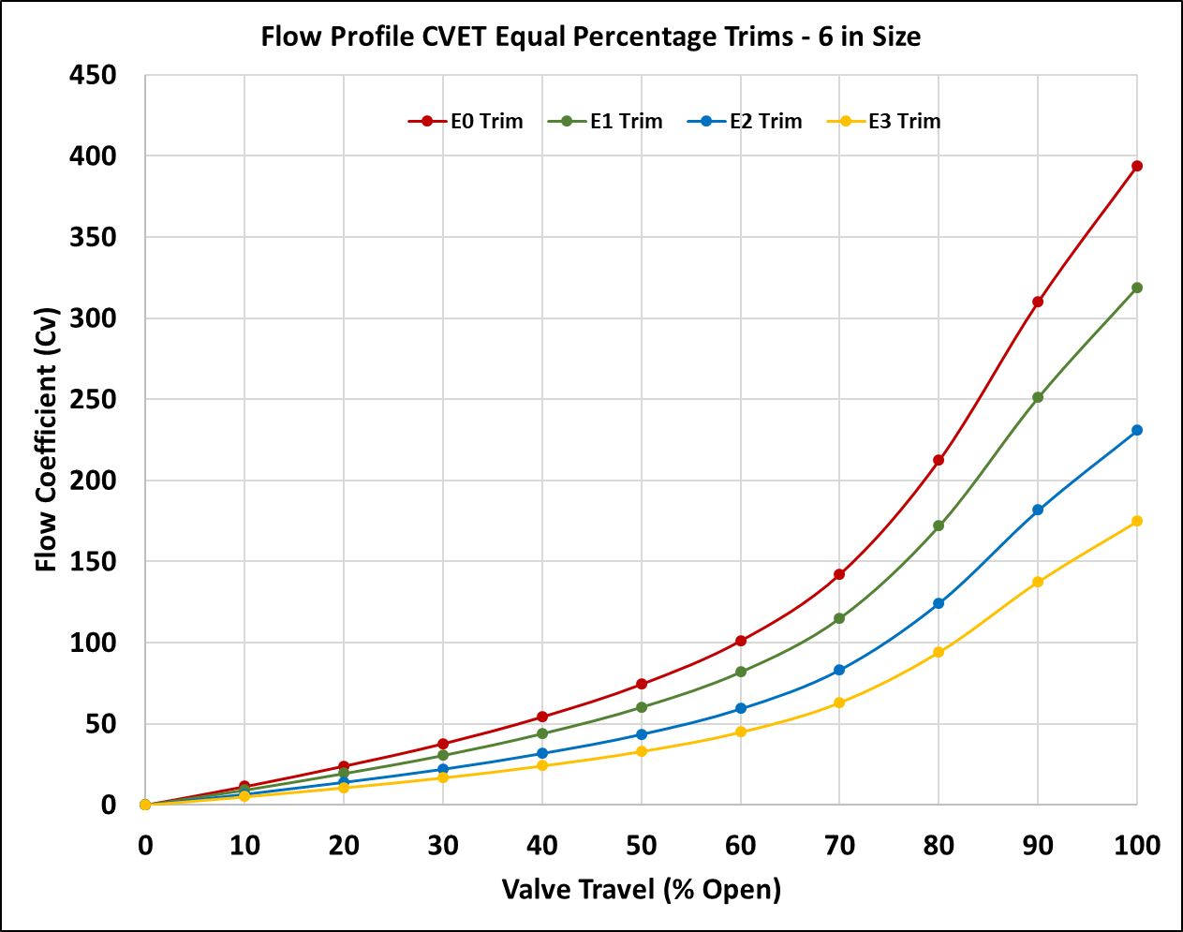
CV-ET Flow Profile – Equal Percentage

Slide 23
CVET Series – Linear Control Valves
LD Linear Diaphragm Actuators for High Thrust at Low Supply Pressure
Stainless Steel Mounting Brackets
Sizes from 1.0 in to 12 in Bore
150, 300, 600 and 900 ANSI Ratings
Full Range of Noise Attenuation Trims w
Equal Percent or Linear Flow Characterization
CVET Series
Linear Control Valves

Slide 24
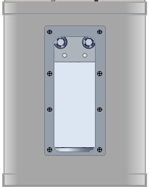
LD& LHPA-SR Linear Spring Return Actuators
High MAOP Allows
Bleed to Pressure
ZERO ATM Emissions
High Thrust
Low Pressure
LD Actuator
High Thrust for Large CVET Control Valves
High Thrust for Large CVET Control Valves
Compact
High Pressure
LHPA-SR Actuator
High MAOP Allows
Bleed to Pressure
ZERO ATM Emissions
Compact
High Pressure
LHPA-SR Actuator
Closed Yoke Design
Submersible
Ideal for Vaults
Open Yoke Design
CVET Series
Linear Control Valves
w LD Series Diaphragm Actuator
CVET Series
Linear Control Valves
w LHPA-SR Series
Linear High Pressure Actuator
(Spring Return, Open Yoke)
CVET Series
Linear Control Valves
w LHPA-SR Series
Linear High Pressure Actuator
(Spring Return, Closed Yoke)

Slide 25
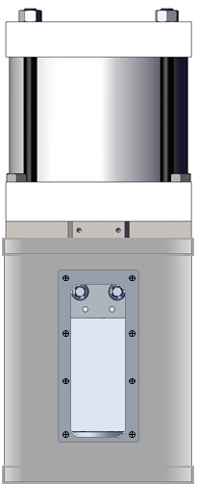
LHPA-DA Linear High Pressure Actuators (Double Acting)
High MAOP Allows
Bleed to Pressure
ZERO ATM Emissions
High MAOP Allows
Bleed to Pressure
ZERO ATM Emissions
High Thrust for Large CVET Control Valves
High Thrust for Large CVET Control Valves
Compact
High Pressure
LHPA-DA Actuator
Compact
High Pressure
LHPA-DA Actuator
Closed Yoke Design
Submersible
Ideal for Vaults
Open Yoke Design
CVET Series
Linear Control Valves
w LHPA-DA Series
Linear High Pressure Actuator
(Double Acting, Open Yoke)
CVET Series
Linear Control Valves
w LHPA-DA Series
Linear High Pressure Actuator
(Double Acting, Closed Yoke)

Slide 26
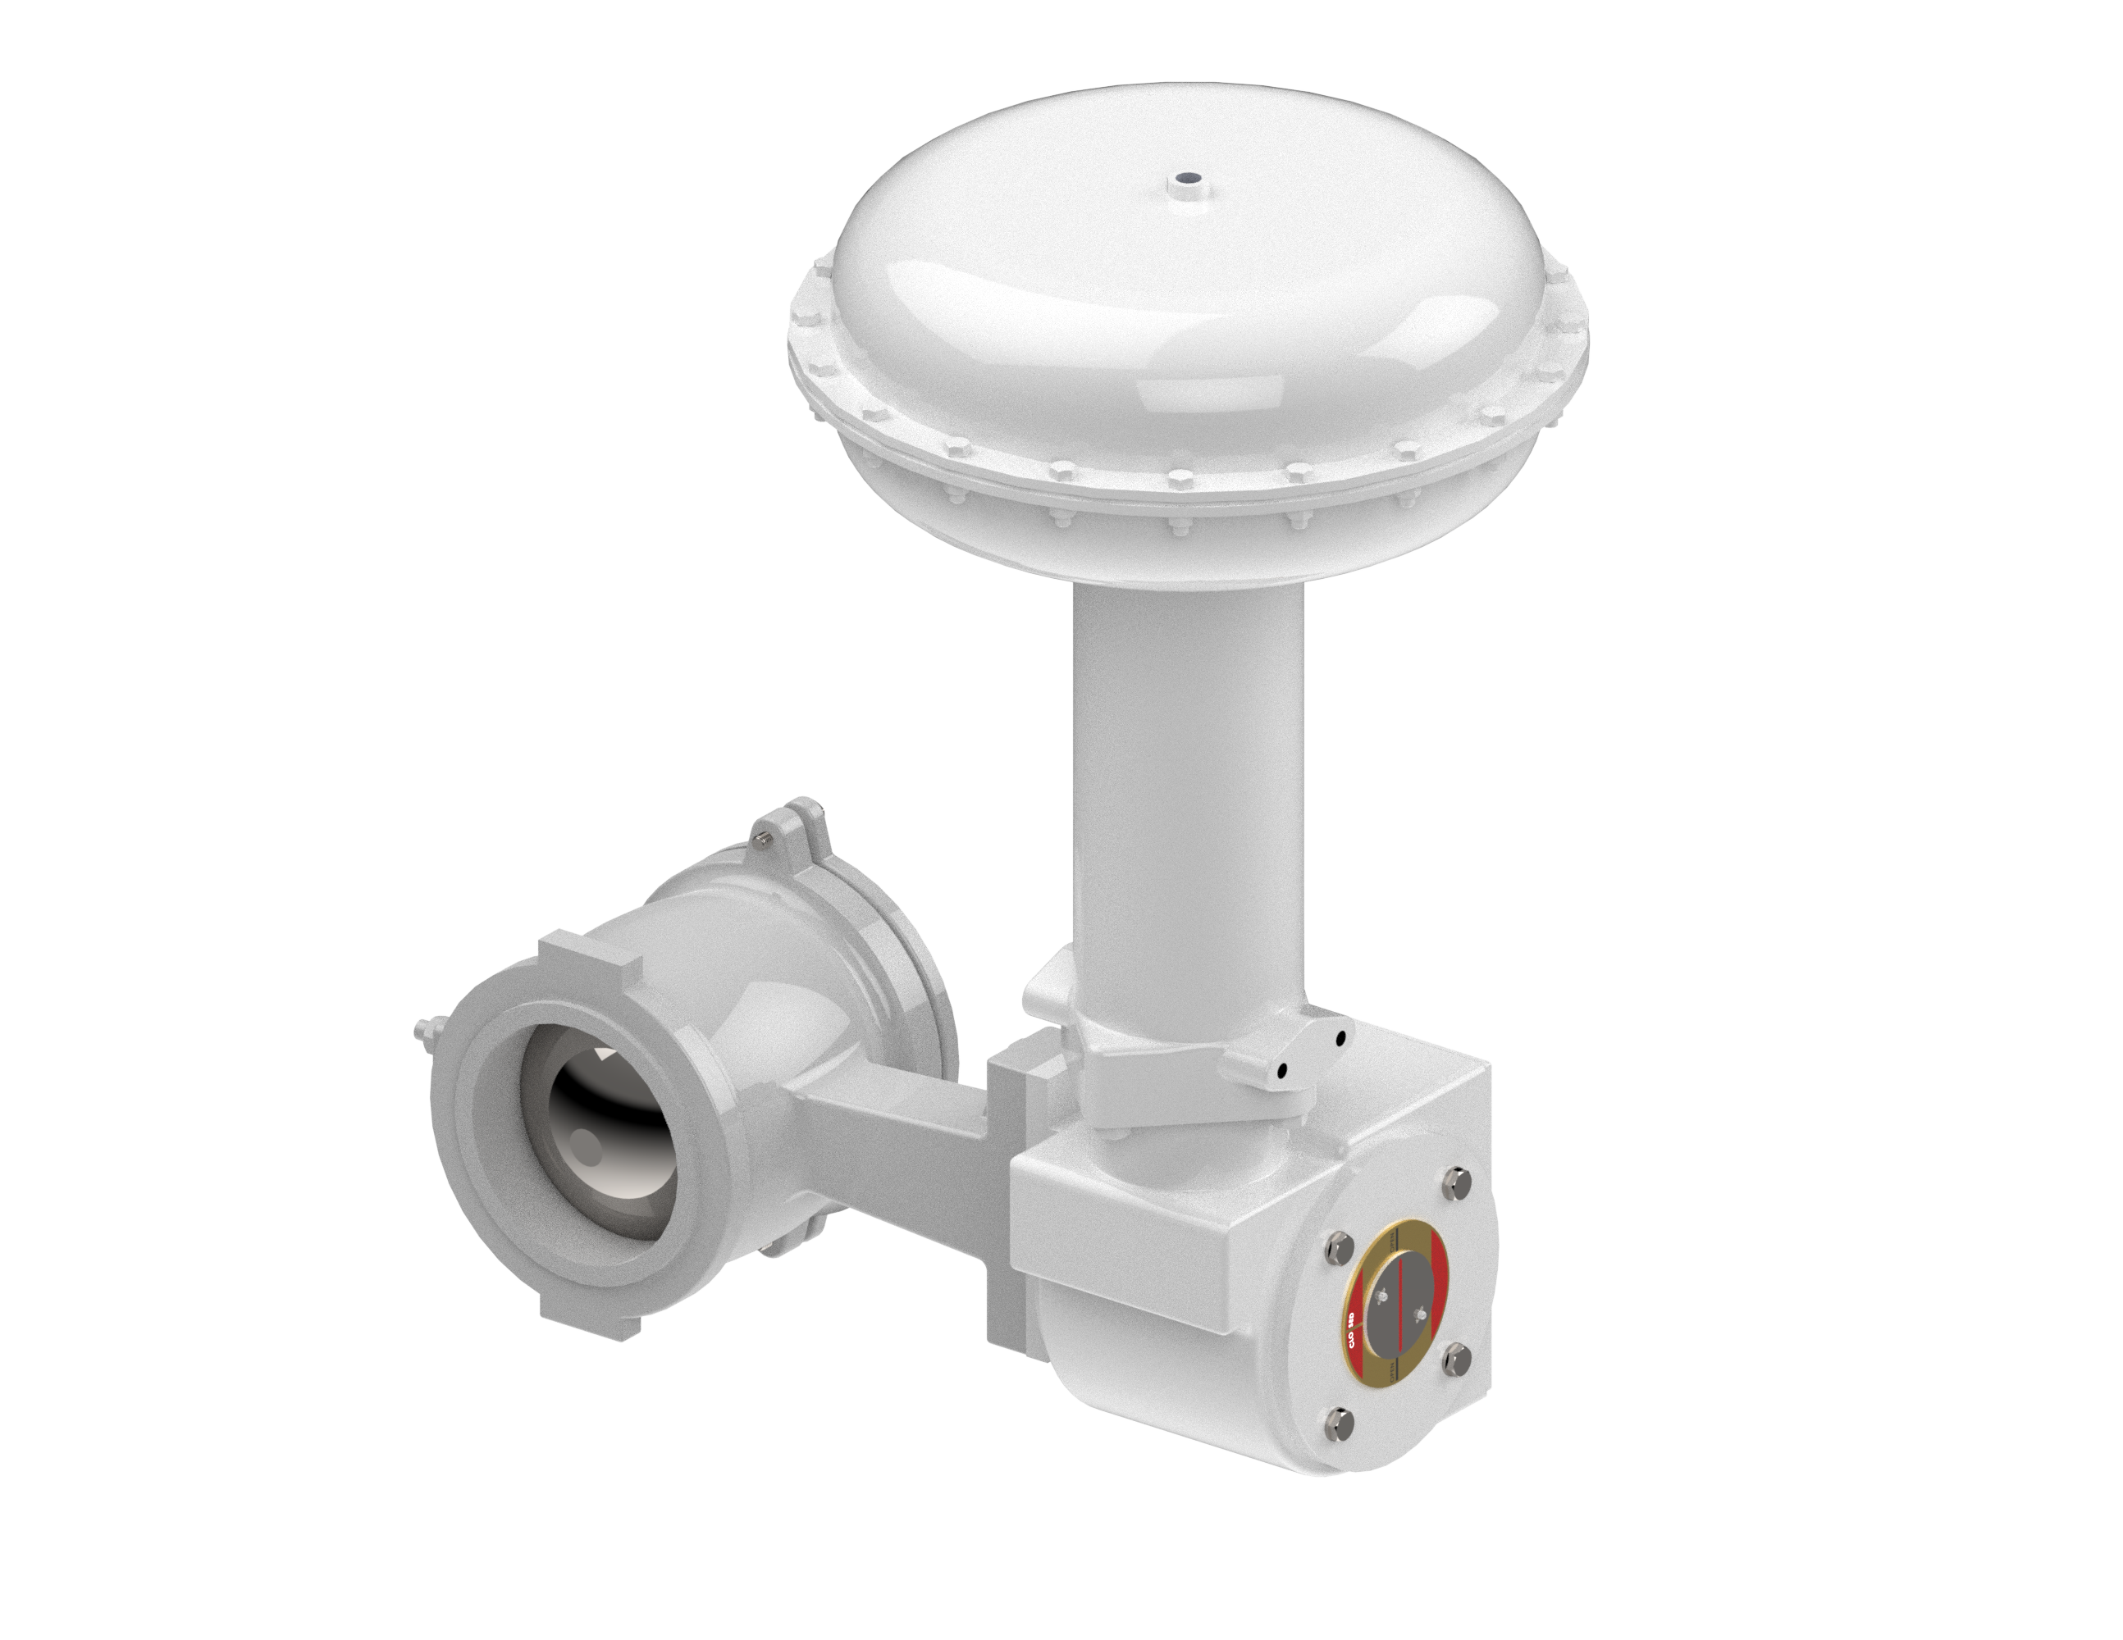
V100 Series Rotary Control Valves (Flangeless)
LD Linear Diaphragm Actuators for High Thrust at Low Supply Pressure
Flangeless Segmented Rotary Design
Low Pressure Drop, Light Duty
Ideal for Gas Distribution Applications
Sizes from 1.0 in to 12 in Bore
150, 300, 600 ANSI Ratings
V100 Series
Flangeless Rotary Control Valves

Slide 27
PRCV Pipeline Rotary Control Valves –Available Size Range
Valve Size | PRCV-FP | PRCV-STH1 | PRCV-STH2 | PRCV-STHP
2 in | STANDARD | NA | NA | NA
3 in | STANDARD | NA | NA | NA
4 in | STANDARD | NA | NA | STANDARD
6 in | STANDARD | STANDARD | STANDARD | STANDARD
8 in | STANDARD | STANDARD | STANDARD | STANDARD
10 in | STANDARD | STANDARD | STANDARD | STANDARD
12 in | STANDARD | STANDARD | STANDARD | STANDARD
14 in | AVAILABLE | AVAILABLE | AVAILABLE | AVAILABLE
16 in | STANDARD | STANDARD | STANDARD | STANDARD
18 in | AVAILABLE | AVAILABLE | AVAILABLE | AVAILABLE
20 in | STANDARD | STANDARD | STANDARD | STANDARD
22 in | AVAILABLE | AVAILABLE | AVAILABLE | AVAILABLE
24 in | STANDARD | STANDARD | STANDARD | STANDARD
26 in | AVAILABLE | NA | NA | NA
30 in | STANDARD | STANDARD | STANDARD | NA
36 in | STANDARD | STANDARD | STANDARD | NA
42 in | STANDARD | NA | NA | NA
*Standard ANSI Pressure Ratings: 300, 600 ANSI, 900 ANSI Other ANSI RATINGS AVAILABLE

Slide 28
CVET Linear Control Valve – Available Size Range
Valve Size | CVEZ | CVET E0 & L0 | CVET E1 & L1 | CVET E2 & L2 | CVET E3 & L3
1 in | STANDARD | NA | NA | NA | NA
1.5 in | STANDARD | NA | NA | NA | NA
2 in | STANDARD | STANDARD | STANDARD | STANDARD | STANDARD
3 in | STANDARD | STANDARD | STANDARD | STANDARD | STANDARD
4 in | STANDARD | STANDARD | STANDARD | STANDARD | STANDARD
6 in | NA | STANDARD | STANDARD | STANDARD | STANDARD
8 in | NA | STANDARD | STANDARD | STANDARD | STANDARD
10 in | NA | STANDARD | STANDARD | STANDARD | STANDARD
12 in | NA | STANDARD | STANDARD | STANDARD | STANDARD
16 in | NA | STANDARD | STANDARD | STANDARD | STANDARD
*Standard ANSI Pressure Ratings: 300, 600, 900 ANSI, Other ANSI RATINGS AVAILABLE

Slide 29
V100 Rotary Control Valve – Available Size Range
Valve Size | V100
1 in | STANDARD
1.5 in | STANDARD
2 in | STANDARD
3 in | STANDARD
4 in | STANDARD
6 in | STANDARD
8 in | STANDARD
10 in | STANDARD
12 in | STANDARD
*Standard ANSI Pressure Ratings: 150, 300, and 600 ANSI RATINGS AVAILABLE

Slide 30
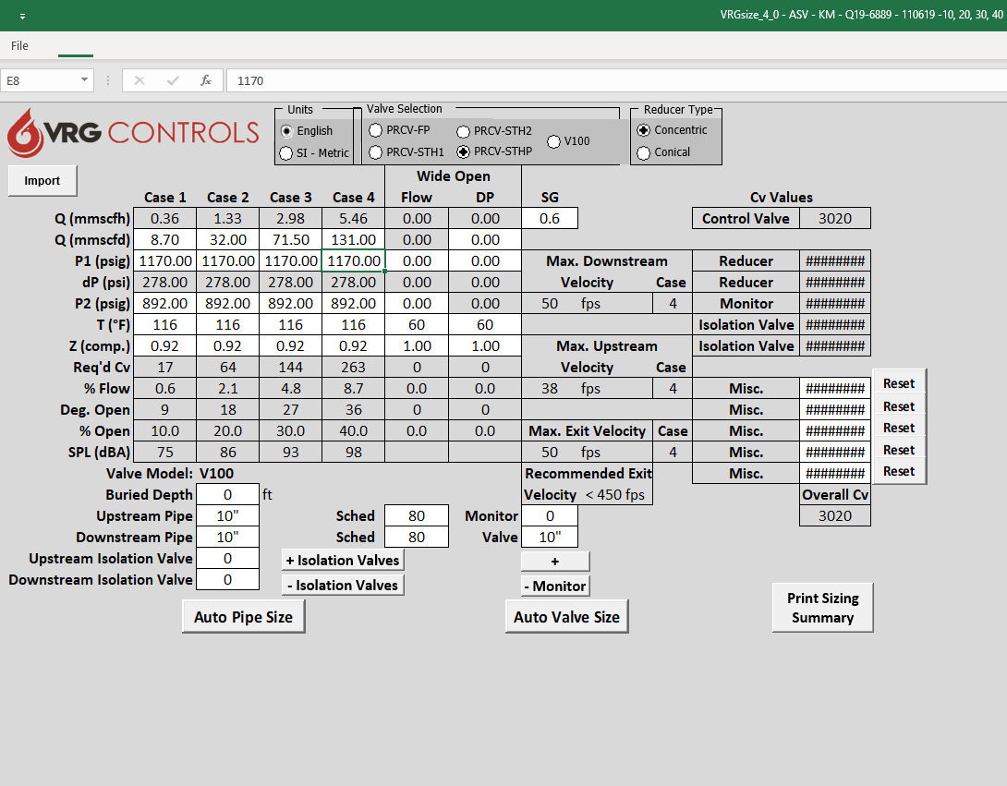
VRGSize Station Design and Control Valve Sizing Program
FREE Download at www.vrgcontrols.com
Size PRCV Pipeline Rotary Control Valves
Size CVET Globe Valves
Design ABOVE and BELOW GROUND Stations, including piping and monitors
Analyze Control Valve Performance
Calculate Predicted Noise
Analyze “Split Range” Parallel Runs
Save as DATA file or print to PDF

Slide 31
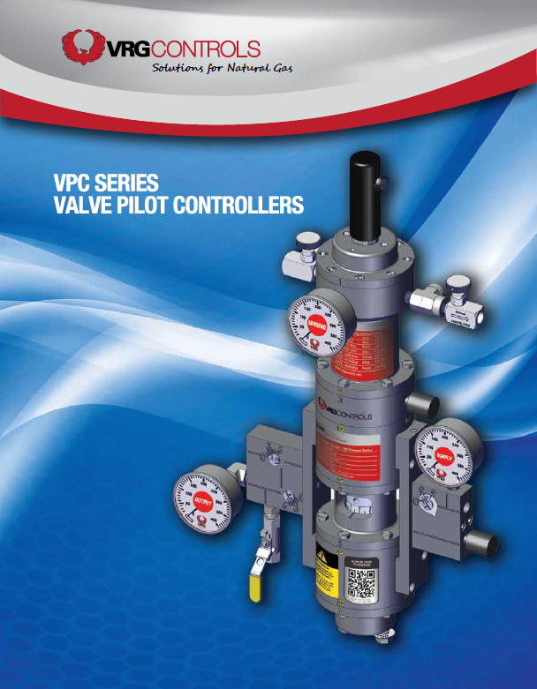
VPC Series Valve Regulator Pilots
Pneumatic Pressure Control Instrumentation for Use with Natural Gas Control Valves
Can Replace Venting Pressure Controllers to Reduce Emissions
Can Replace Becker VRP Pilots for Improved Performance and Reliability
Major Technological Advancements as Compared to Our Competition

Slide 32
Next Generation of Valve Pilot Controllers
SIX (6) Common Control Springs Across All Models
High Strength Setpoint Screw Design Includes Protective Cover
Setpoints Available From 3.0 psig to 1500 psig
All STAINLESS STEEL Internal Components
Environmentally Friendly Design Can Exhibit ZERO Steady State Emissions
Bleed to Pressure System Features Eliminates all Atmospheric Emissions
Larger Diameter Diaphragms Provide Greater Sensitivity (20% Increase in Area vs. Competition)
Patented* Manifold Design Provides Modular Format and Improved Dynamic Performance

Slide 33
Compatible To Retrofit / Replace Existing Pneumatic Pressure Controllers

Slide 34
VPC’s Better Than EPA Emissions Performance Mandate

Slide 35
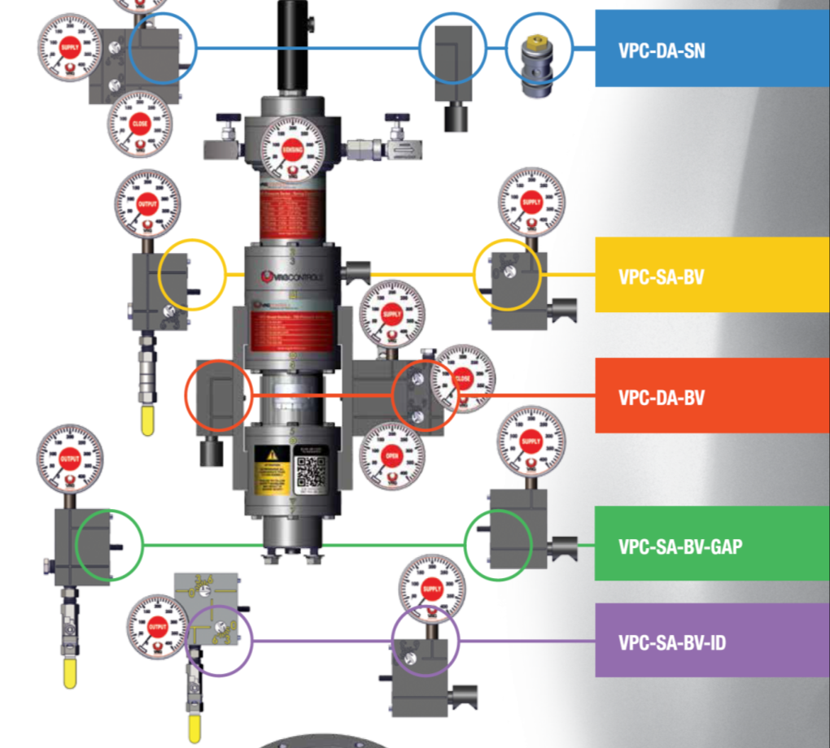
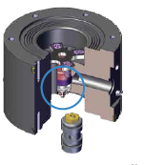
VPC Valve Pilot Controllers – 5 Plug & Play Configurations
Logic XChange

Slide 36
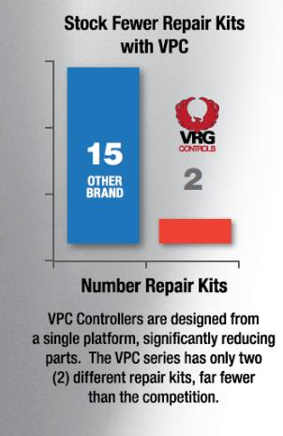
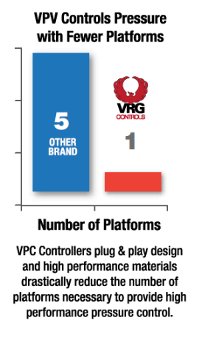
VPC Valve Pilot Controllers - Improved Features Compared to the Competition

Slide 37
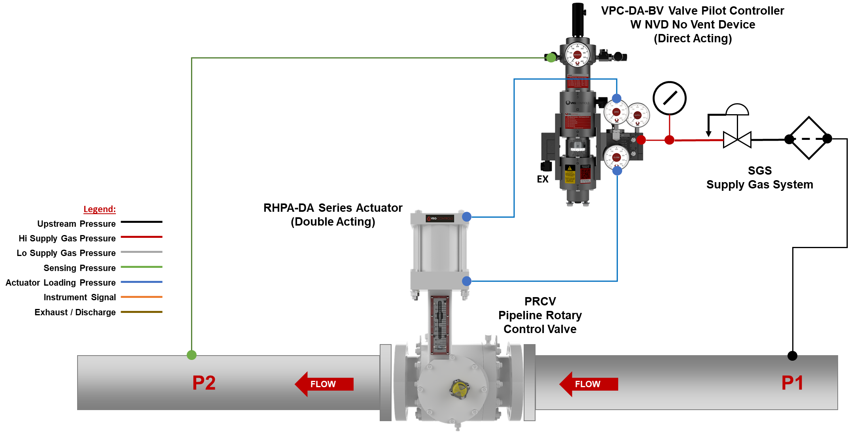
VPC Schematic #1 – VPC-DA-BV + NVD + ATM Ex – RHPA-DA

Slide 38
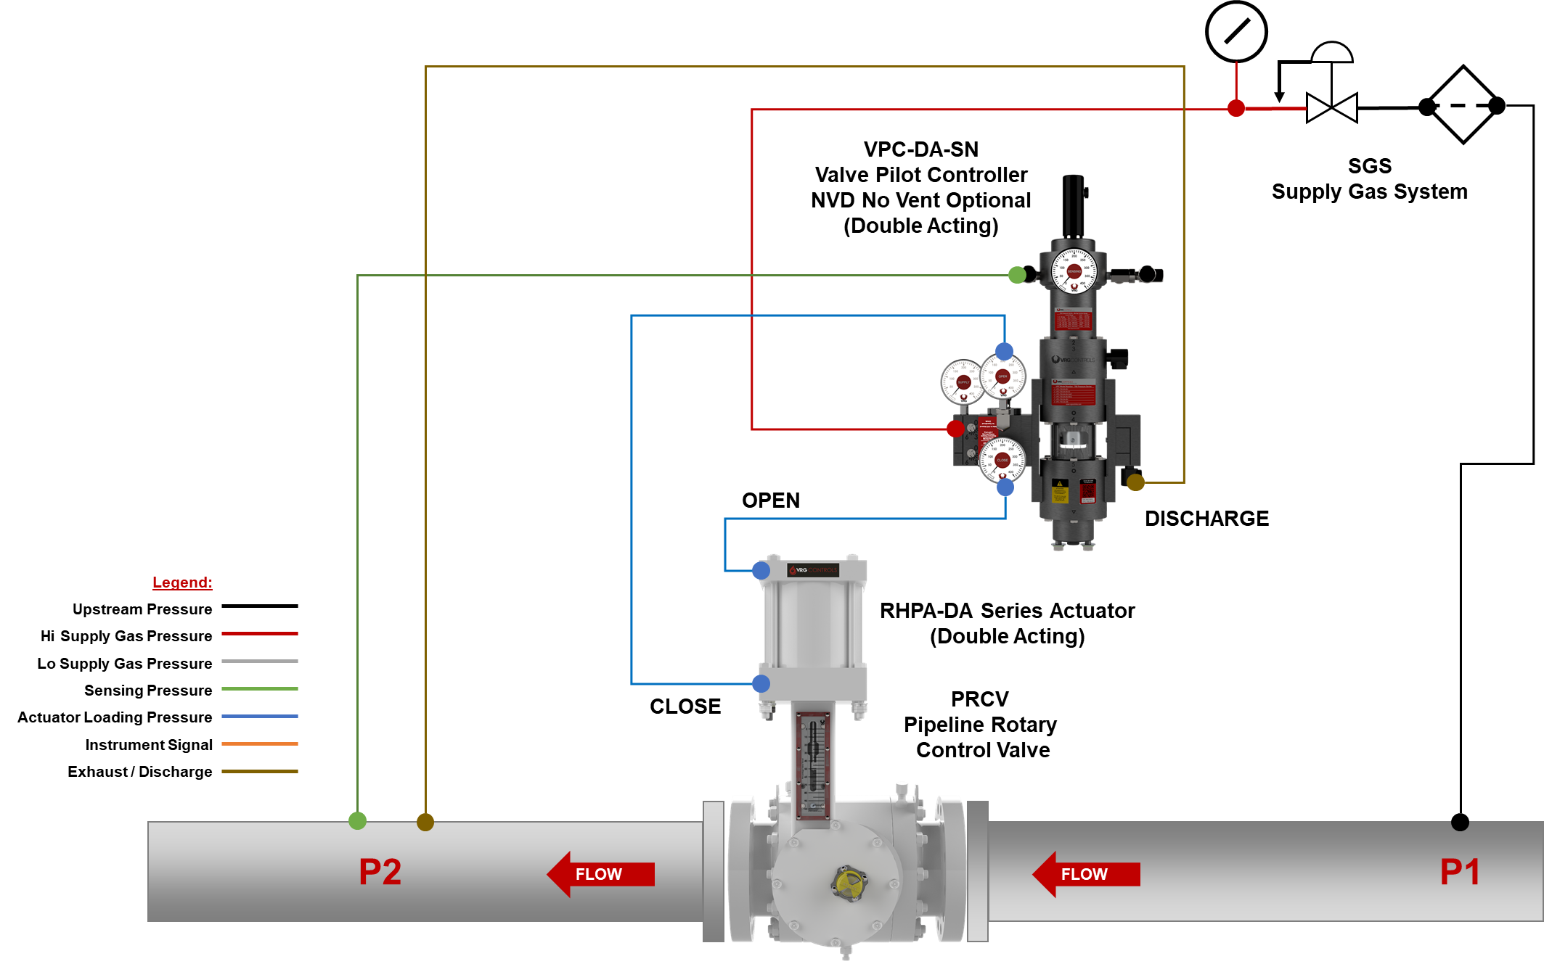
VPC Schematic #2 – VPC-DA-SN + NVD + Discharge Pressure + RHPA-DA

Slide 39
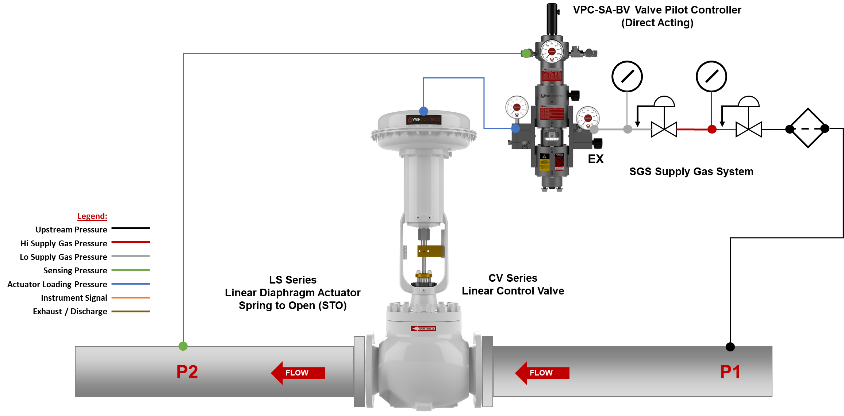
VPC Schematic #3 – VPC-SA-BV + ATM Ex + LD Actuator

Slide 40
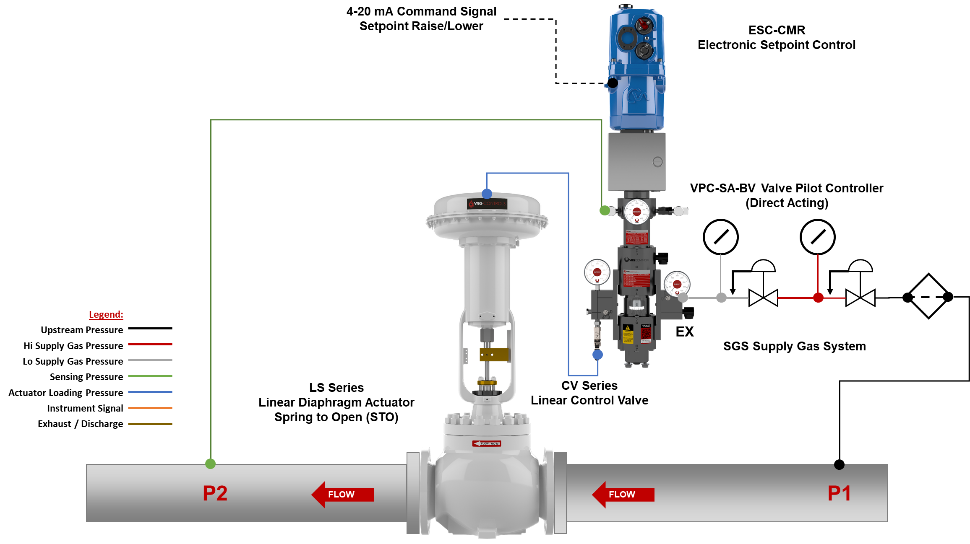
VPC Schematic #4 – VPC-SA-BV + ATM Ex + LD Actuator + Remote Set

Slide 41
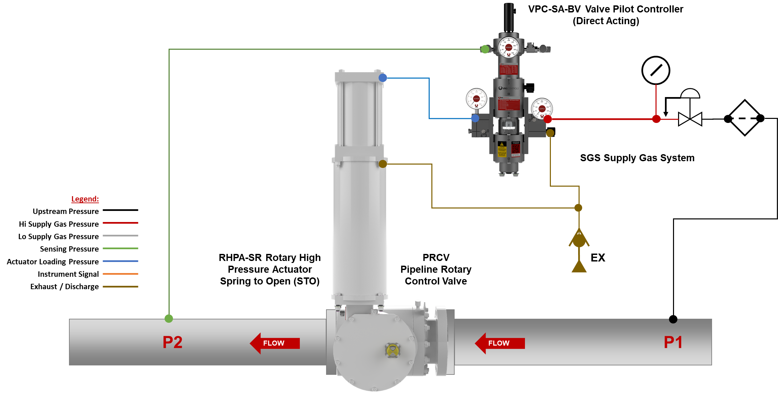
VPC Schematic #5 – VPC-SA-BV + ATM Ex – RHPA-SR

Slide 42
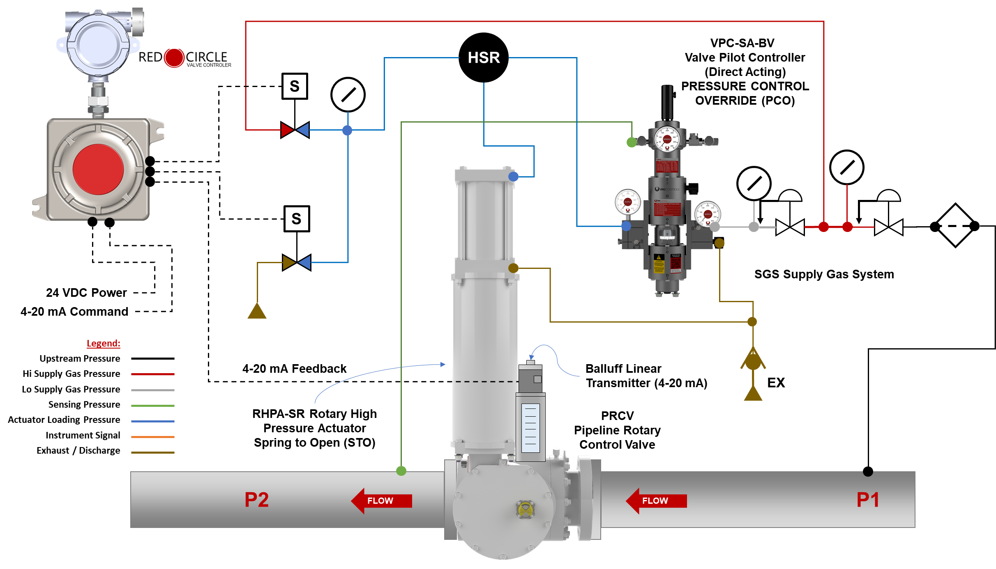
VPC Schematic #6 – VPC-SA-BV + ATM Ex – RHPA-SR

Slide 43
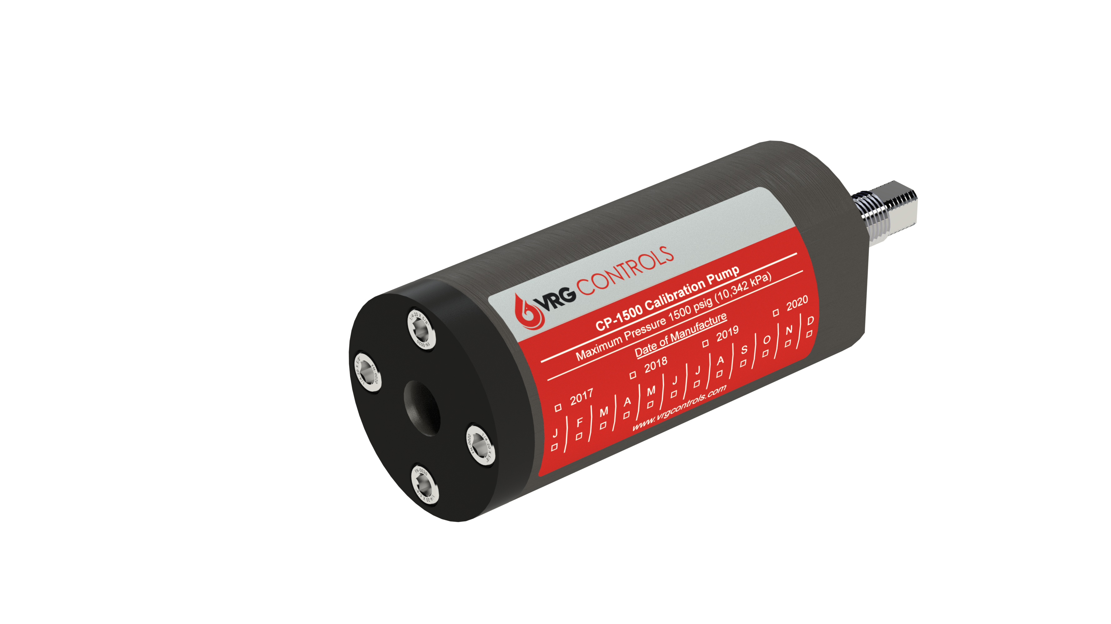
CP-1500 Calibration Pump
Features:
Maximum Pressure – 1500 psig
¼ NPT Port allows technicians to build custom test rigs
Compatible with all VRG control instrumentation
Multiple units may be installed in parallel for greater compression
No outside pressure source required to operate
Extras & Options
Custom configurations with gages, fittings and valves
Multiple unit configurations for greater compression
Models:
CP-1500

Slide 44
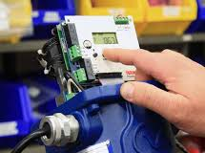
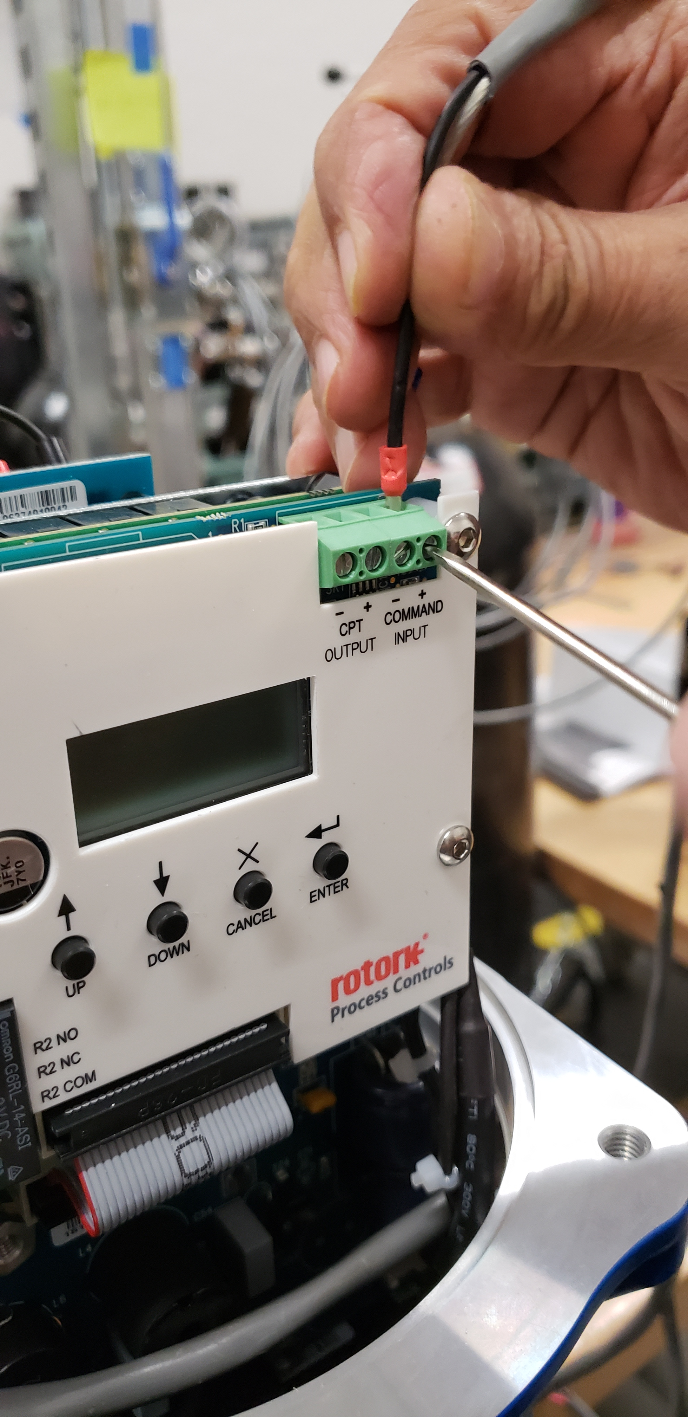
ESC-CMR Electronic Setpoint Control
Features:
Remote Variation of Pressure Setpoint via Electronic Signal
Lock Last Pressure Setpoint Upon Loss Control Signal
Pushbutton Programming Interface
Replaces ESC-1100 and ESC-1000 (Now Obsolete)
Rated for installation in natural gas applications (Explosion Proof)
Analog Command or Discrete Pulese Signal control input options
Failsafe configuration options to lock last or max/min on loss of signal
Compatible with VRG VPC’s and RP’s
Compatible with Becker VRP’s/FEP’s and Mooney Series 20 Pilots
Extras & Options
MNTESC - Mounting Bracket for ESC Module w/ Mooney-20L/20S
Configured for Mooney Series 20/20S/20L Pilots
Configured for Becker FEP’s and VRP’s
Locking Option for Secure Interface Module
Models:
ESC-CMR Analog and Discrete Pulse

Slide 45
ESC-CMR Electronic Setpoint Control
Models:
ESC-CMR Analog and Discrete Pulse

Slide 46
RCVC Red Circle Valve Controller
Hi Resolution Color TFT Programmable Display with Intuitive and Easy Read Menu
Rotary Control Switch Provides Non-Invasive Menu Navigation and Setup
PLUG & PLAY REPLACEMENT FOR BECKER/GE DNGP POSITIONER
4-20 mA Analog Command Signal Input OR ±24 VDC Discrete Pulse Positioning
HART Protocol Communication Standard. Wireless Bluetooth Capable for Easy Configuration and Evaluation. Bluetooth May Be Disabled as Desired.
ZERO Steady State Emissions with Ability to Discharge to Pressure System for Complete Atmospheric Emissions.
Class 1, Div. 1 Ex Proof Terminal Strip Housing Provides Generous Room for Easy Wire Termination
RCVC Electrical Ports and Mounting Brackets Provide Flexible Configuration. 100% Compatible with Existing Becker/GE DNGP & EFP Enclosures for Easy Retrofit
RCVC May be Installed Directly on Control Valve or Remotely in Control Cabinet or RTU Building
RED
CIRCLE
VALVE CONTROLER

Slide 47
RCVC Red Circle Valve Controller – Typical RHPA-DA Schematic
Line Pressure
RED
CIRCLE
Supply Regulator
RED CIRCLE
VALVE CONTROLLER
Class 1, Div 1
VALVE CONTROLER
RHPA-DA
Rotary High Pressure Actuator
OPEN
Signal
Adjust Orifices
(Optional)
Micropulse Linear Position Sensor
EX
4-20 mA Command Signal
CLOSE
Signal
24 VDC Power
4-20 mA Feedback Signal
HART Handheld Communicator
PRCV Pipeline Rotary Control Valve

Slide 48
VGP Valve Gas Positioner – Pneumatic Input
Features:
Compatible with many pneumatic valve actuators
3-15 psig, 6-30 psig or Split Range Signal Loading
Supply Pressure to 400 psig
Addition of NVD ensures ZERO emissions at full open and full closed valve positions for DA versions
SA versions feature ZERO emissions at steady state, full open full closed
Field reversible without changing tubing or hardware
Extras & Options
Reverse or Direct Acting
Split Range Control
SS Construction
NVD No Vent Device
BTP Bleed to Pressure System
MNTVGPLD – Mounting and Feedback (LD Actuators)
MNTVGPLHPA – Mounting and Feedback (LHPA Actuators)
MNTVRGCUST – Mounting and Feedback (Custom)
Models:
VGP-SA-BV
VGP-DA-BV
VGP-DA-SN

Slide 49
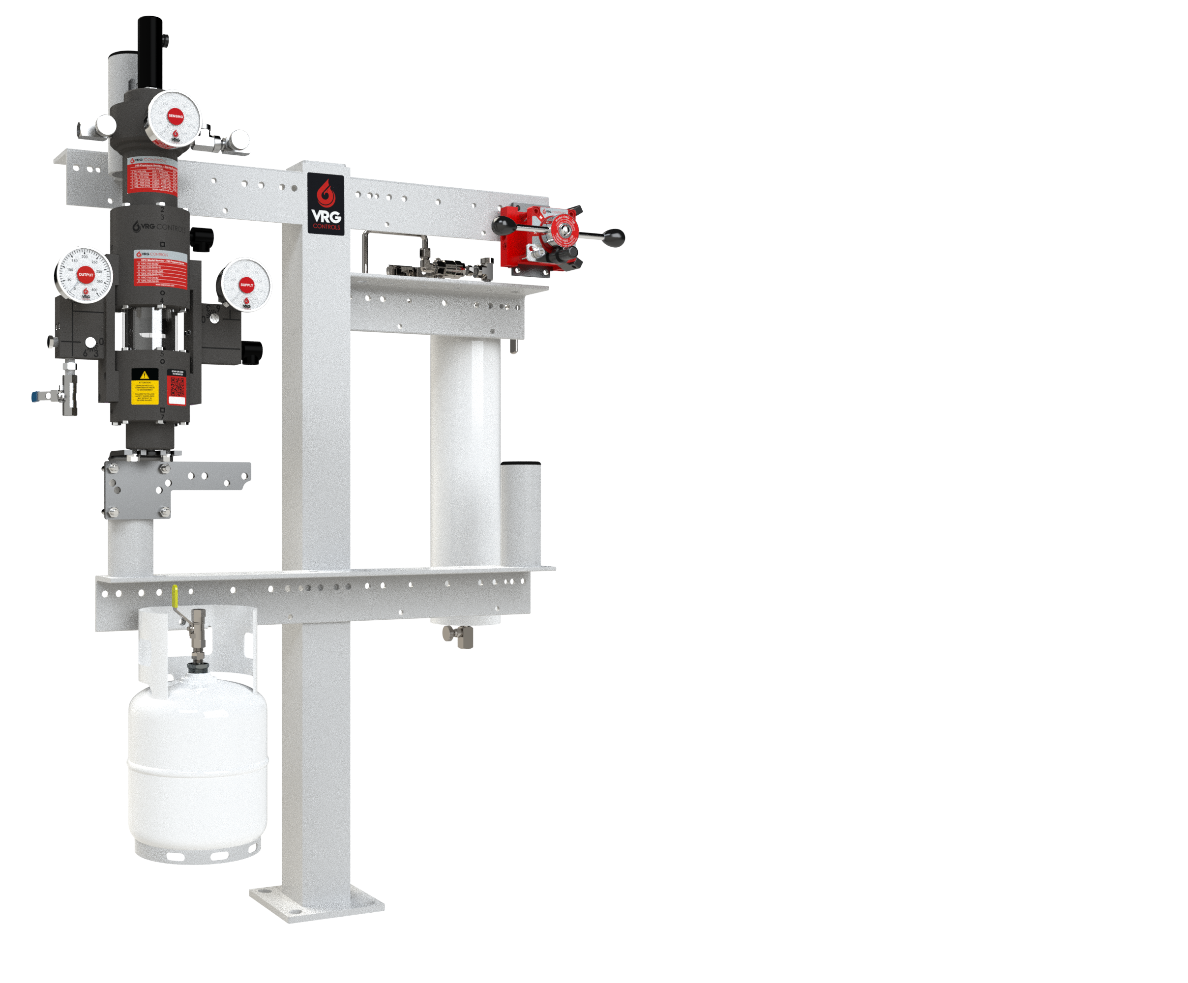
Mounting Stand Control Instrumentation Mounting System
Features:
Floor mount model easily bolted to concrete floors or footings
Pre-packaged design customized to your application
“Work Height” brackets ergonomically designed
Can accept virtually any control instrumentation and/or supply gas systems
6” Square Slotted Square Base
CS Carbon Steel-Sandblast, Zinc Primer, White Top Coat Epoxy
Extras & Options
“Versa” Type Valves
IH Instrument Heaters
Limitless Options
SGS Supply Gas Systems
VMO Valve Manual Override
VPC Valve Regulator Pilots
Models:
POST

Slide 50
SGC Supply Gas Column
Description
The VRG Controls SGC Series Pressure Instrumentation Column provides regulated and conditioned supply pressures for control valves and instrumentation utilized in natural gas pipeline applications.
Features:
Standard square flange base mounts and bolts easily to concrete pad or floor
Pre-packaged design customized to your application
“Work Height” brackets ergonomically designed
Can accept virtually any control instrumentation and/or supply gas systems
6” Square Slotted Square Base
Fully welded design eliminates threaded body for safety and durability
Rated to full ANSI pressures (600 ANSI and 900 ANSI)
SGCs are hydrostatically tested to 1.5X ANSI rating
Single appliance provides complete supply gas system
Fully tested and engineered packaging minimizes field work
Non-threaded design
Fully welded construction, X-Ray to API-1104 available
LOW
Pressure
MEDIUM
Pressure
PIPELINE
Pressure
Models:
SGC

Slide 51
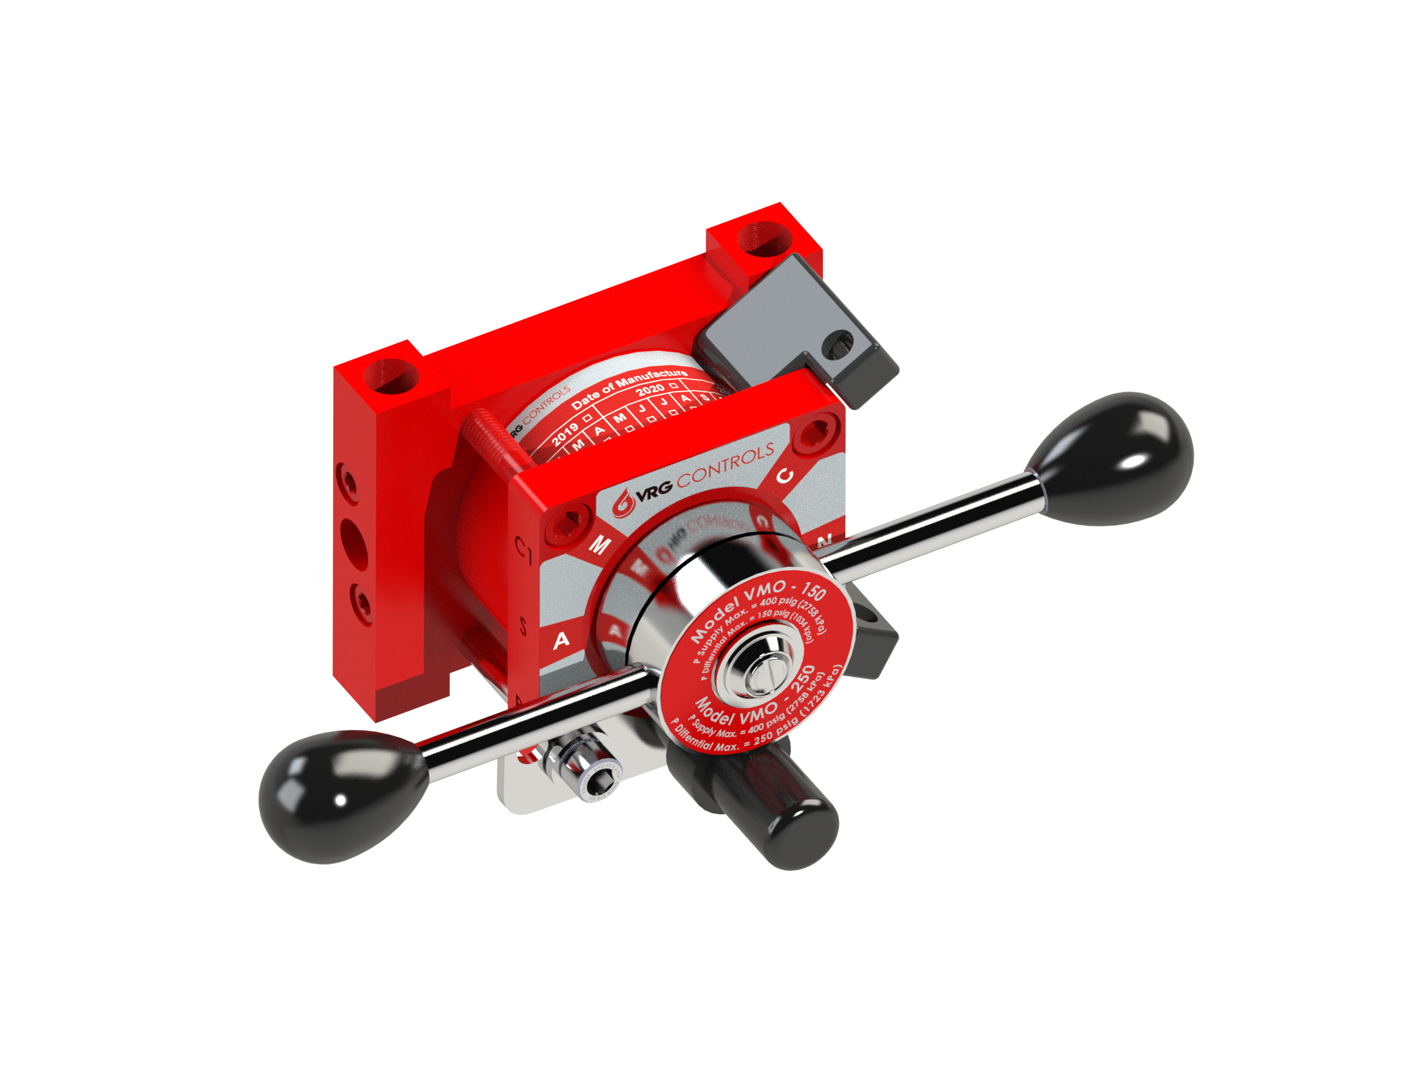
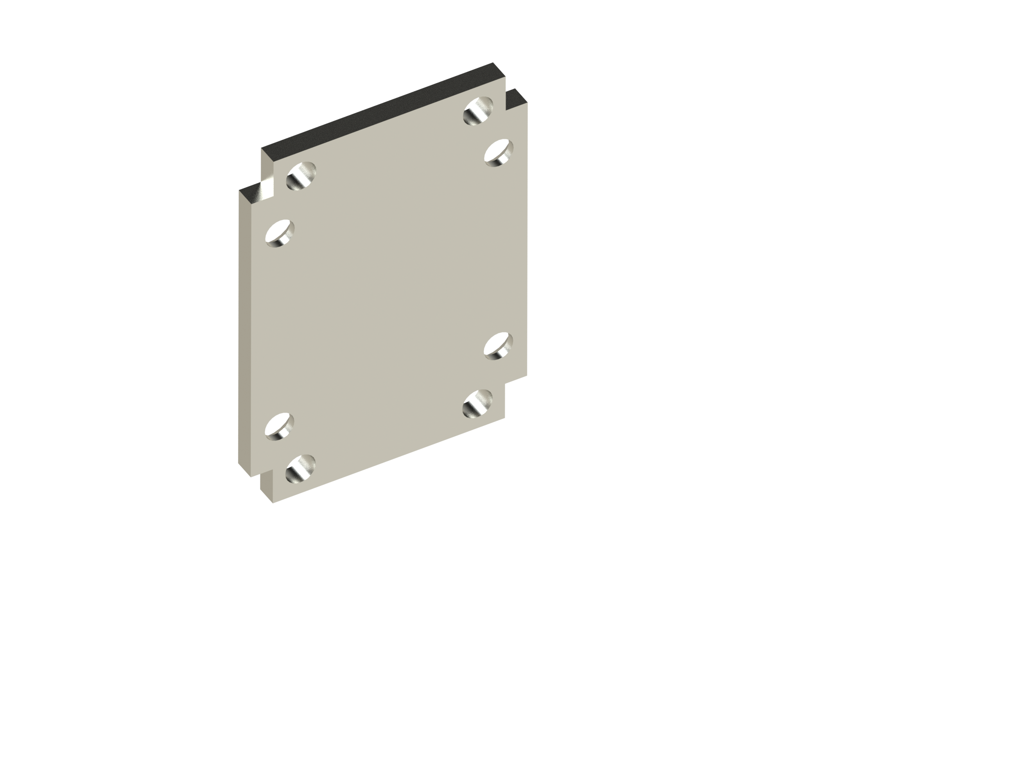
VMO Valve Manual Override
Features:
Compatible with almost all pneumatic actuators
Utilized with regulating or on-off applications
Compact, manifold system easily installed
Safety button prevents accidental operation
Detachable SS Mounting Backplate ensures easy installation
Auto/Manual Locking device prevents unauthorized operation
Position Handle Locking device prevents provides Lock Out Tag Out Capability - STANDARD
Applications
VMO-150 (P_{D} ≤ 150 psid)
VMO-250 (150 psig < P_{D} >150 psid)
P_{D} = P_{DIFFERENTIAL} = _{PSUPPLY} - P_{DISCHARGE}
Extras & Options
VMO Activation Limit Switches
Models:
VMO-150
VMO-250

Slide 52
Our Contact Information
VRG Controls, LLC
Toll-Free: +844-FLOW-VRG (USA & CANADA)
e-Mail: Sales@VRGControls.com
www.VRGControls.com
VRG Controls, LLC
1199 Flex Court, Unit B
Lake Zurich, Illinois 60047 USA
VRG Controls, LLC
Solutions for Natural Gas!
Follow Us:

